Slide 1
Project: IEEE P802.15 Working Group for Wireless Personal Area Networks (WPANs)
Submission Title: [Proposal of LDPC (Low Density Parity Check) Code for LPWA]
Date Submitted: [6 July, 2018]
Source: [Seiji Kobayashi] Company [Sony Semiconductor Solutions Corporation]
Address [Astugi Tec. No2, 4-16-1 Okata, Atsugi-shi Kanagawa, 243-0021 Japan]
Voice:[+81 80 9976 0007], FAX: [+81 50 3809 1781], E-Mail:[Seiji.Kobayashi@sony.com]
Re: [IEEE P802.15.4w Low Power Wide Area Call for Proposals, 12 March 2018]
Abstract: [LDPC (Low Density Parity Code) as a Forward Error Correction.]
Purpose: [Contribution to IEEE 802.15.4w.]
Notice: This document has been prepared to assist the IEEE P802.15. It is offered as a basis for discussion and is not binding on the contributing individual(s) or organization(s). The material in this document is subject to change in form and content after further study. The contributor(s) reserve(s) the right to add, amend or withdraw material contained herein.
Release: The contributor acknowledges and accepts that this contribution becomes the property of IEEE and may be made publicly available by P802.15.

Slide 2
Proposal of LDPC (Low Density Parity Check) Code for LPWA
-- new results
Seiji Kobayashi (Sony Semiconductor Solutions Corporation), Nabil Loghin (Sony European Technology Center, Stuttgart, Germany) and Ryoji Ikegaya (Sony Semiconductor Solutions Corporation)

Slide 3
802.15.4k Forward Error Correction
Current FEC scheme
0
+
+
+
+
a_{k}
u_{k}
u_{k-1}
u_{k-2}
u_{k-3}
u_{k-4}
u_{k-5}
u_{k-6}
1
+
+
+
+
a_{k}
Rate ½ convolutional coding with constraint length K = 7 has been specified in 802.15.4k.
In a practical implimentation, additional 6 bits are needed as a purpose of “termination”, which increases redundancy. 6bits of redundant information is not negligible for a system with small-size payload.

Slide 4
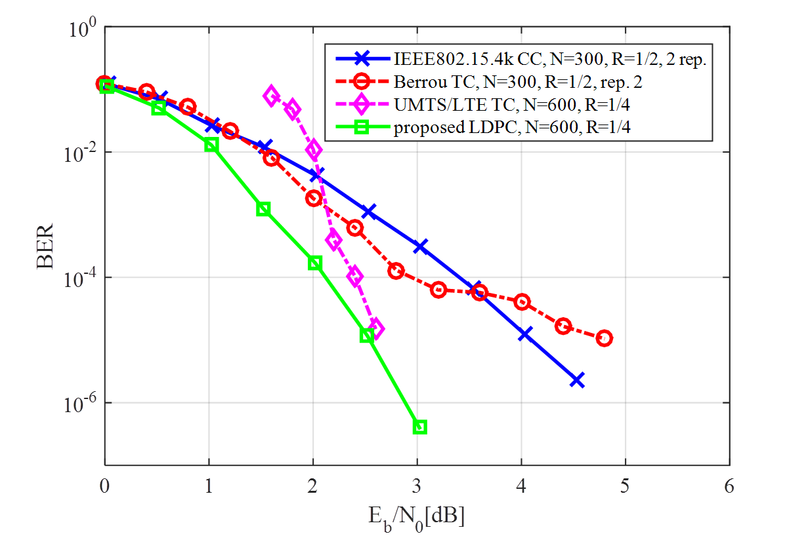
LDPC (Rate ¼) performance comparison
Reference: “A GPS Synchronized, Long-Range Uplink-Only Radio Designed for IoT,“ ICC2018 (SAC-IoT 01)
1.2dB
In an example shown above, the LDPC (Rate ¼) outperforms 1.2dB (at BER=10⁻⁴ ) against Rate ½ convolutional code.

Slide 5
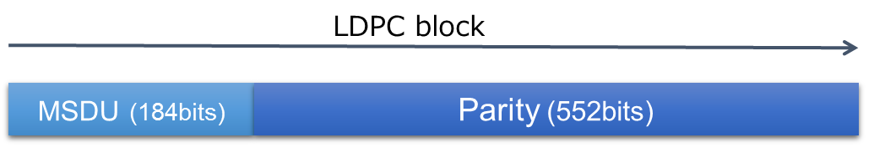

LDPC Rate (1/4) for 802.15.4w
Proposal
The table
Row and col index | 1 | 2 | 3 | 4 | 5 | 6 | 7 | 8 | 9 | 10
1 | 1 | 7 | 90 | 172 | 209 | 359 | 401 | 420 | 483 | 487
2 | 57 | 164 | 192 | 197 | 284 | 307 | 174 | 356 | 408 | 425
3 | 22 | 50 | 191 | 379 | 385 | 396 | 427 | 445 | 480 | 543
4 | 32 | 49 | 71 | 234 | 255 | 286 | 297 | 312 | 537 | 550
5 | 30 | 70 | 88 | 111 | 176 | 201 | 283 | 322 | 419 | 499
6 | 86 | 94 | 177 | 193 | 266 | 368 | 373 | 389 | 475 | 529
7 | 134 | 223 | 242 | 254 | 285 | 319 | 403 | 496 | 503 | 534
8 | 18 | 84 | 106 | 165 | 170 | 199 | 321 | 355 | 386 | 410
9 | 129 | 158 | 226 | 269 | 288 | 316 | 397 | 413 | 444 | 549
10 | 33 | 113 | 133 | 194 | 256 | 305 | 318 | 380 | 507
11 | 317 | 354 | 402
12 | 53 | 64 | 374
13 | 83 | 314 | 378
14 | 162 | 259 | 280
15 | 166 | 281 | 486
16 | 185 | 439 | 489
17 | 119 | 156 | 224
18 | 26 | 62 | 244
19 | 8 | 246 | 482
20 | 15 | 72 | 91
21 | 43 | 69 | 390
22 | 127 | 186 | 506
23 | 55 | 81 | 412

Slide 6
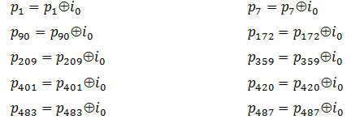
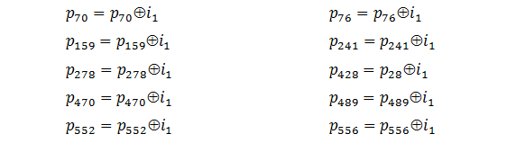
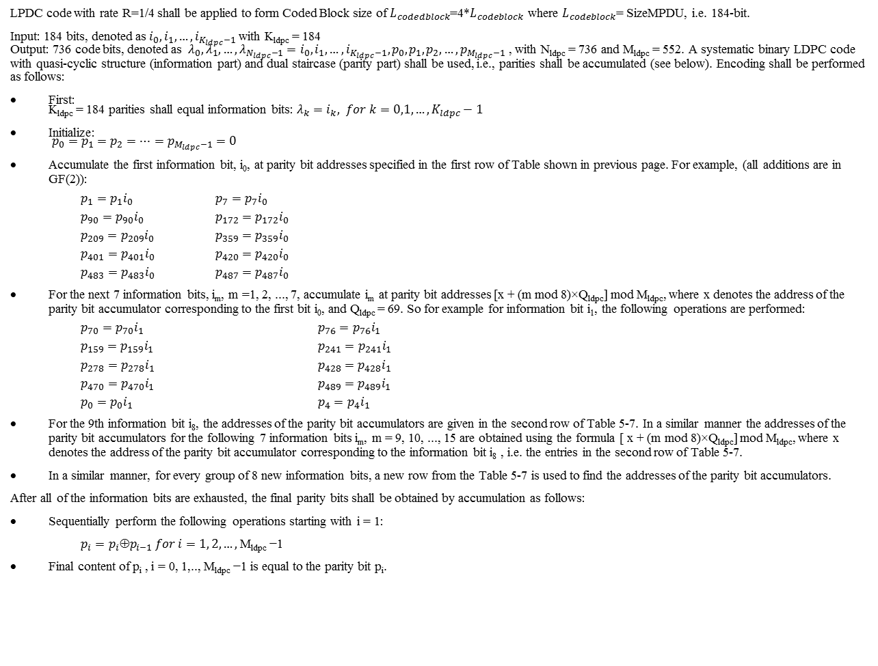
LPDC code with rate R=1/4 shall be applied to form Coded Block size of $L_{codedblock}$=4*$L_{codeblock}$ where $L_{codeblock}$= SizeMPDU, i.e. 184-bit.
Input: 184 bits, denoted as $i_{0}, i_{1}, …,i_{K_{ldpc}−1}$with K_{ldpc} = 184
Output: 736 code bits, denoted as $λ_{0},λ_{1},…, λ_{N_{ldpc}−1}=i_{0}, i_{1}, …,i_{K_{ldpc}−1}, p_{0},p_{1},p_{2},…,p_{M_{ldpc}−1}$ , with N_{ldpc} = 736 and M_{ldpc} = 552. A systematic binary LDPC code with quasi-cyclic structure (information part) and dual staircase (parity part) shall be used, i.e., parities shall be accumulated (see below). Encoding shall be performed as follows:
First:
K_{ldpc} = 184 parities shall equal information bits: $λ_{k}=i_{k}, for k=0,1,…,K_{ldpc}−1$
Initialize:
$p_{0}=p_{1}=p_{2}=…=p_{M_{ldpc}−1}=0$
Accumulate the first information bit, i₀, at parity bit addresses specified in the first row of Table shown in previous page. For example, (all additions are in GF(2)):
$p_{1}=p_{1}i_{0}$ $p_{7}=p_{7}i_{0}$
$p_{90}=p_{90}i_{0}$ $p_{172}=p_{172}i_{0}$
$p_{209}=p_{209}i_{0}$ $p_{359}=p_{359}i_{0}$
$p_{401}=p_{401}i_{0}$ $p_{420}=p_{420}i_{0}$
$p_{483}=p_{483}i_{0}$ $p_{487}=p_{487}i_{0}$
For the next 7 information bits, i_{m}, m =1, 2, ..., 7, accumulate i_{m} at parity bit addresses [x + (m mod 8)×Q_{ldpc}] mod M_{ldpc}, where x denotes the address of the parity bit accumulator corresponding to the first bit i₀, and Q_{ldpc} = 69. So for example for information bit i₁, the following operations are performed:
$p_{70}=p_{70}i_{1}$ $p_{76}=p_{76}i_{1}$
$p_{159}=p_{159}i_{1}$ $p_{241}=p_{241}i_{1}$
$p_{278}=p_{278}i_{1}$ $p_{428}=p_{428}i_{1}$
$p_{470}=p_{470}i_{1}$ $p_{489}=p_{489}i_{1}$
$p_{0}=p_{0}i_{1}$ $p_{4}=p_{4}i_{1}$
For the 9th information bit i₈, the addresses of the parity bit accumulators are given in the second row of Table 5‑7. In a similar manner the addresses of the parity bit accumulators for the following 7 information bits i_{m}, m = 9, 10, ..., 15 are obtained using the formula [ x + (m mod 8)×Q_{ldpc}] mod M_{ldpc}, where x denotes the address of the parity bit accumulator corresponding to the information bit i₈ , i.e. the entries in the second row of Table 5‑7.
In a similar manner, for every group of 8 new information bits, a new row from the Table 5‑7 is used to find the addresses of the parity bit accumulators.
After all of the information bits are exhausted, the final parity bits shall be obtained by accumulation as follows:
Sequentially perform the following operations starting with i = 1:
$p_{i}=p_{i}{p}_{i−1} for i=1, 2,…,$M_{ldpc} −1
Final content of p_{i} , i = 0, 1,.., M_{ldpc} −1 is equal to the parity bit p_{i}.

Slide 7
Encoder Complexity (corrected)
Reference: Convolutional Code of memory 6 (133,171)
  184 info bits, 5 elements in mod-2 addition per code bit:
    (184+6)*(5-1 + 5-1) = 1.5k metrics
Conv. Code, CR 1/4 of memory 6 (117 127 155 133)
  184 info bits, 5 elements in mod-2 addition per code bit:
    (184+6)*(5-1)*4 = 3.4k metrics
LDPC, CR 1/4
  552 parities, average check node degree 3 4
  (→ 3 4 elements in mod-2 additions)
  552*(3 4 -1) = 1.1k 1.7k metrics

Slide 8
Erasure Performance: Conditions
assuming telegram splitting with 24 telegrams
  lost frames result in complete erasure
  if interleaving is applied, resulting frame has iid erasures with erasure rates = n/24, integer n
simulated AWGN, followed by iid erasure channel

Slide 9
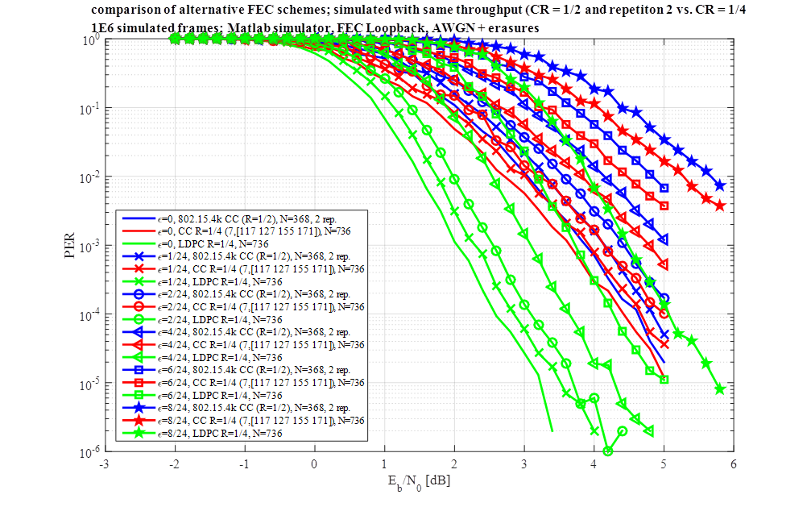
Erasure Performance: Results

Slide 10
Erasure Performance: Summary
erasure rates
LDPC gain at 1% PER | ε = 0 | ε = 1/24 | ε = 2/24 | ε = 4/24 | ε = 6/24 | ε = 8/24
vs. baseline FEC [dB] | 1.54 | 1.56 | 1.58 | 1.60 | 1.66 | 1.75
vs. best CC of rate 1/4 [dB] | 1.21 | 1.27 | 1.23 | 1.27 | 1.29 | 1.36
gains even slightly increasing with larger erasure rates

Slide 11
Mobile Performance: Conditions
TU6 channel has very short delay spread of 5µs << symbol duration
consider only 1-tap Rayleigh fading with Jakes’ psd @ f_{D,max} = 25Hz (900MHz, 30km/h)
12kbaud, corresponding to 3kbps data rate
genie-aided equalization (of each tap)
assumed idealalized random interleaver
Maximum ratio combining for CR=1/2 baseline code with 2 frame repetitions

Slide 12
Mobile Performance: Results

Slide 13
Mobile Performance: Summary (1/2)
LDPC gain at 1% PER | without interleaver | without idealized random interleaver
vs. baseline FEC [dB] | > 5 | 2.75
vs. best CC of rate 1/4 [dB] | > 5 | -0.25
LDPC with large gains without specific interleaver
for fully random interleaver
  LDPC with large gain vs. baseline FEC
  minor degradation vs. best CR 1/4 conv. code

Slide 14
Mobile Performance: Summary (2/2)
For time-varying fading, interleaver is required
LDPC has intrinsic interleaving between variable node decoder and check node decoder
Using interleaver, CR 1/4 codes outperform CR 1/2 baseline code + 2 repetitions, since only repetition only increases temporal diversity, but offers no additional coding gain

Slide 15
Summary
Comparison of LDPC vs. baseline FEC vs. conv. code of rate 1/4
  LDPC encoding complexity
    13% larger than for baseline FEC
    100% smaller than conv. code of same rate 1/4
  AWGN + erasure: LDPC gains:
    1.54 … 1.75dB vs. baseline FEC
    1.21 … 1.36dB vs. conv. code of same rate 1/4
  mobile fading channel with ideal interleaver
    2.75dB gain vs. baseline FEC
    0.25dB loss vs. conv. code of same rate 1/4

