Slide 1
Project: IEEE P802.15 Working Group for Wireless Personal Area Networks (WPANs)
Submission Title: Evaluation of short PM PHY synchronization preamble
Date Submitted: 6 July 2018
Source: Malte Hinrichs, Volker Jungnickel [Fraunhofer HHI]
Address: Einsteinufer 37, 10587 Berlin, Germany
Voice:[+49-30-31002 284], E-Mail:[malte.hinrichs@hhi.fraunhofer.de]
and
Sang-Kyu Lim, Il Soon Jang, Jin-Doo Jeong, Tae-Gyu Kang [ETRI]
Address: 218 Gajeong-ro, Yuseong-gu, Daejeon, 34129, Korea
Voice:[+82-42-860-1573], FAX: [+82-42-860-5218], E-Mail:[sklim@etri.re.kr]
Re:
Abstract: This document provides the evaluation results on a shorter synchronization preamble for the PM PHY by Fraunhofer HHI and ETRI.
Purpose: Contribution to IEEE 802.15.13
Notice: This document has been prepared to assist the IEEE P802.15. It is offered as a basis for discussion and is not binding on the contributing individual(s) or organization(s). The material in this document is subject to change in form and content after further study. The contributor(s) reserve(s) the right to add, amend or withdraw material contained herein.
Release: The contributor acknowledges and accepts that this contribution becomes the property of IEEE and may be made publicly available by P802.15.

Slide 2
IEEE P802.15.13
Evaluation of short PM PHY synchronization preamble
Date: 2018-07-09 Place: San Diego, CA
Authors:

Slide 3
Background
Aim: Create unified structure for synchronization preamble
HHI and ETRI have investigated use of shorter preamble (48 samples) for use at high SNR with same structure as longer preambles
Sign pattern + + – + – –, 8 samples per sub-sequence
Replaces two-section preamble (64 samples) proposed by ETRI initially
HHI‘s and ETRI‘s results are presented

Slide 4
HHI‘s evaluation
Authors: Malte Hinrichs, Volker Jungnickel [Fraunhofer HHI]
Based on docs. 18-170/r2 and 18-190/r1, extended with evaluation of short preamble

Slide 5
Preamble structure
Sequence
  Enhanced Gold sequence A_{N}:
  (N-1)-bit Gold sequence appended with a 1-bit for balancing
  Sequence lengths for A_{N} : N = 8, 16, 32, 64
Repetition pattern: + + – + – –
  Optimized for use of Minn auto-correlator
  Good autocorrelation properties (low side peaks)
  Resulting preamble: [A_{N} A_{N} –A_{N} A_{N} –A_{N} –A_{N}]
  Overall length is 6*N

Slide 6
Simplified frame structure
Bit scaling
  Bipolar mapping around DC bias: 0/1 → -1/+1
  Modulation signal power = 1
Simulated frame:
  Zeros (L = 6*N bits)
  Preamble (L bits)
  Random data (L bits)
  → Emulates the beginning of the PHY frame
Zeros
Preamble
Random bits
48/96/192/384 bits each

Slide 7
Channel simulation
Apply Channel Impulse Response (CIR)
  Upsampling, convolution with CIR, downsampling
Add AWGN
  Test 10,000 noise realizations
Detector: Cross correlation with ideal preamble
  Selection of first value > threshold per frame
  Count positive detection rate
Detector
Zeros
Preamble
Random bits
n
X
n
+
CIR
AWGN

Slide 8
Detection threshold
Finding of threshold
  Generate frame with 100,000 noise samples
  SNR (relative to preamble power): -5 dB
  Perform cross-correlation of the preamble at all possible shifts
  100,000 random correlation values
  Random values are sorted (see CDF)
  Detection threshold is selected so that 0.1% of all random values lie above it
  → 0.1% false positive rate

Slide 9
Detection threshold
False Alarm Rate: 0.1%

Slide 10
Evaluation
Synchronization reliability according to IEEE 802.15.13 evaluation framework
  AWGN channel
  Scenario 3, Device 3 (S3/D3): little spreading
  Scenario 4, Device 7 (S4/D7): energy is spread over several peaks, frequency selective
  Optical Clock Rates 3.125..200 MHz
  Requirement: Detection rate 99.9% at false positive rate 0.1%
Notes:
Only showing 25/50 MHz

Slide 11
CIR Scenario 3, D3
Notes:
Insert Scenario overview

Slide 12
CIR Scenario 4, D7
Notes:
Insert Scenario overview

Slide 13
AWGN: Detection ratio for different preamble lengths
Notes:
Compare to slide 11 (AWGN): Barely a difference (but there is one)

Slide 14
S3/D3: Detection ratio for different preamble lengths @3.125 MHz
Notes:
Compare to slide 11 (AWGN): Barely a difference (but there is one)

Slide 15
S3/D3: Detection ratio for different preamble lengths @6.25 MHz
Notes:
Compare to slide 11 (AWGN): Barely a difference (but there is one)

Slide 16
S3/D3: Detection ratio for different preamble lengths @12.5 MHz
Notes:
Compare to slide 11 (AWGN): Barely a difference (but there is one)

Slide 17
S3/D3: Detection ratio for different preamble lengths @25 MHz
Notes:
Compare to slide 11 (AWGN): Barely a difference (but there is one)

Slide 18
S3/D3: Detection ratio for different preamble lengths @50 MHz
Notes:
Compare to slide 11 (AWGN): Barely a difference (but there is one)

Slide 19
S3/D3: Detection ratio for different preamble lengths @100 MHz
Notes:
Compare to slide 11 (AWGN): Barely a difference (but there is one)

Slide 20
S3/D3: Detection ratio for different preamble lengths @200 MHz
Notes:
Compare to slide 11 (AWGN): Barely a difference (but there is one)

Slide 21
S4/D7: Detection ratio for different preamble lengths @3.125 MHz

Slide 22
S4/D7: Detection ratio for different preamble lengths @6.25 MHz

Slide 23
S4/D7: Detection ratio for different preamble lengths @12.5 MHz

Slide 24
S4/D7: Detection ratio for different preamble lengths @25 MHz

Slide 25
S4/D7: Detection ratio for different preamble lengths @50 MHz

Slide 26
S4/D7: Detection ratio for different preamble lengths @100 MHz

Slide 27
S4/D7: Detection ratio for different preamble lengths @200 MHz

Slide 28
Impact on parametrization
Performance of synch., header, and payload over SNR
  Evaluation of Detection Rate for synch. preamble,
  Packet Error Rate (PER) for header and payload
  PER = (1 - BER)^{L}, L = packet length / bits. Here: 1 FEC codeword
  Spreading gain of HCM assumed to be equal eff. spreading factor:
  6 dB for HCM(1,4), 9 dB for HCM(1,8), 12 dB for HCM(1,16)
  Similar spreading gain through repetition assumed for header
Criteria¹:
  Sync preamble: Detection rate > 0.999
  Header: (1 - PER) > 0.99
  Payload: (1 - PER) > 0.9
¹ SNR values given for the criteria in the graphics are interpolated

Slide 29
PAM-2 modulation (AWGN)

Slide 30
PAM-2 with HCM(1,4) (AWGN)

Slide 31
PAM-2 with HCM(1,8) (AWGN)

Slide 32
PAM-2 with HCM(1,16) (AWGN)

Slide 33
ETRI‘s evaluation
Authors: Sang-Kyu Lim, Il Soon Jang, Jin-Doo Jeong, Tae-Gyu Kang [ETRI]

Slide 34
Evaluation Framework of PM PHY
Preamble : Detection probability (for false alarm rate = 0.1%) vs. SNR (cf. doc. 15-18-0106/r0) and required SNR where prob. of misdetection (timing error) < 0.1%
Header : BER vs. SNR for the header incl. 8B10B and RS(36,24) coding assuming random data for the header information
Payload : BER vs. SNR for the payload incl. 8B10B or HCM and RS(255,248) coding assuming random data for the payload
Results are expected for AWGN, D3 in scenario 3 and D7 in scenario 4 (Fig. 25) where LED1-6 are used together from https://mentor.ieee.org/802.15/dcn/15/15-15-0746-01-007a-tg7r1-channel-model-document-for-high-rate-pd-communications.pdf.
CIRs: https://mentor.ieee.org/802.15/dcn/15/15-15-0747-00-007a-tg7r1-cirs-channel-model-document-for-high-rate-pd-communications.zip a companion file.
In case of questions, please, use TG13 email reflector.

Slide 35
Background on 48-bits Preamble
62-bits Preamble
48-bits Preamble
(6 TDPs from the 31-bits Gold Sequences)
(5 TDPs from the 7-bits Gold Sequences)
P1
1 0 1 1 1 0 1 1 1 0 0 1 0 1 0 0 1 0 0 0 1 0 1 0 0 1 0 1 1 0 1
P1
1 0 0 1 0 1 1 0
P2
1 1 0 0 1 0 1 0 1 1 0 0 1 1 1 0 1 0 0 1 0 0 1 1 0 1 1 0 0 1 0
P2
1 0 0 1 1 1 0 0
P3
1 0 1 0 0 0 1 0 1 0 1 0 1 0 1 0 0 1 1 0 1 0 0 0 1 1 1 0 1 1 1
P3
1 1 0 1 1 0 0 0
P4
1 1 1 0 0 0 0 1 1 0 0 0 1 1 0 1 1 0 1 1 0 1 0 0 1 0 1 1 1 0 0
P4
1 1 1 0 0 0 1 0
P5
1 0 0 1 1 1 0 0 0 1 0 0 1 0 0 0 1 1 0 1 1 1 0 0 1 1 0 1 1 1 0
P5
1 0 1 0 1 1 0 0
P6
1 0 1 0 1 1 1 0 0 0 1 1 0 1 0 1 0 0 0 1 1 0 0 1 1 0 1 1 0 1 0
TDP
~TDP
TDP
TDP
~TDP
TDP
~TDP
~TDP
62 bits
48 bits

Slide 36
Selection of 5 TDPs for 48-bits Preamble
(5 TDPs for 48-bits Preamble)
7-bits PN Sequences
P1
1 0 0 1 0 1 1 0
P2
1 0 0 1 1 1 0 0
P3
1 1 0 1 1 0 0 0
1-bit for balancing
7-bits Gold Sequences extracted from PN Sequences
P4
1 1 1 0 0 0 1 0
P5
1 0 1 0 1 1 0 0
48-bits Preamble
TDP
TDP
~TDP
TDP
~TDP
~TDP
(+ + – + – –)
48 bits
Only 3 Gold sequences in which the difference between the number of 1 and 0 is one were extracted from 7-bits PN sequences.
A 1-bit for balancing was appended to each pattern.

Slide 37
Auto & Cross correlations for 48-bits Preambles using 5 TDPs

Slide 38
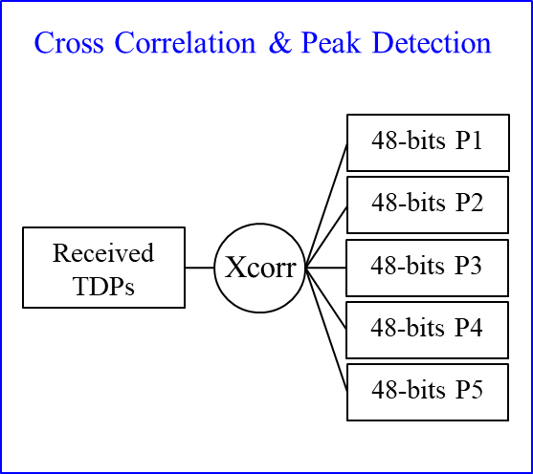
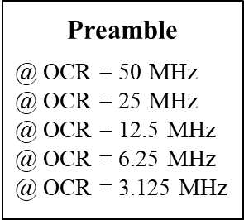
Simulation Set-up for Preamble (1)
(5 TDPs for 48-bits Preamble)
P1
1 0 0 1 0 1 1 0
P2
1 0 0 1 1 1 0 0
P3
1 1 0 1 1 0 0 0
P4
1 1 1 0 0 0 1 0
P5
1 0 1 0 1 1 0 0
(1) AWGN only Model
AWGN
48 bits / 100,000 times
Modulation
CIR
Channels
Preamble
Detector
=
48-bits Preambles
+
Detection
Probability
@ 0.1% FA

Slide 39
Simulation Set-up for Preamble (2)
(2) CIR Channel Model
AWGN
48 bits / 100,000 times
Modulation
CIR
Channels
Preamble
Detector
=
48-bits Preambles
+
Detection
Probability
@ 0.1% FA

Slide 40
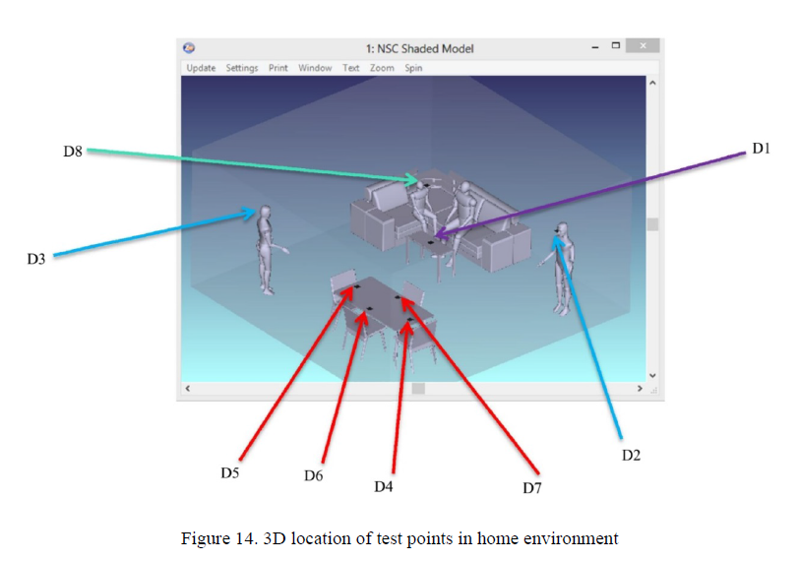
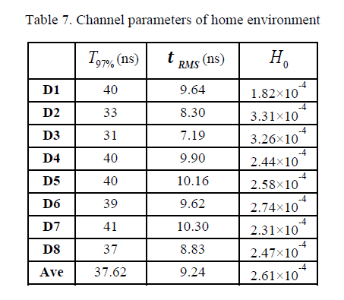
D3 in Scenario 3 (Home)

Slide 41
D7 in Scenario 4 (Manufacturing Cell)

Slide 42
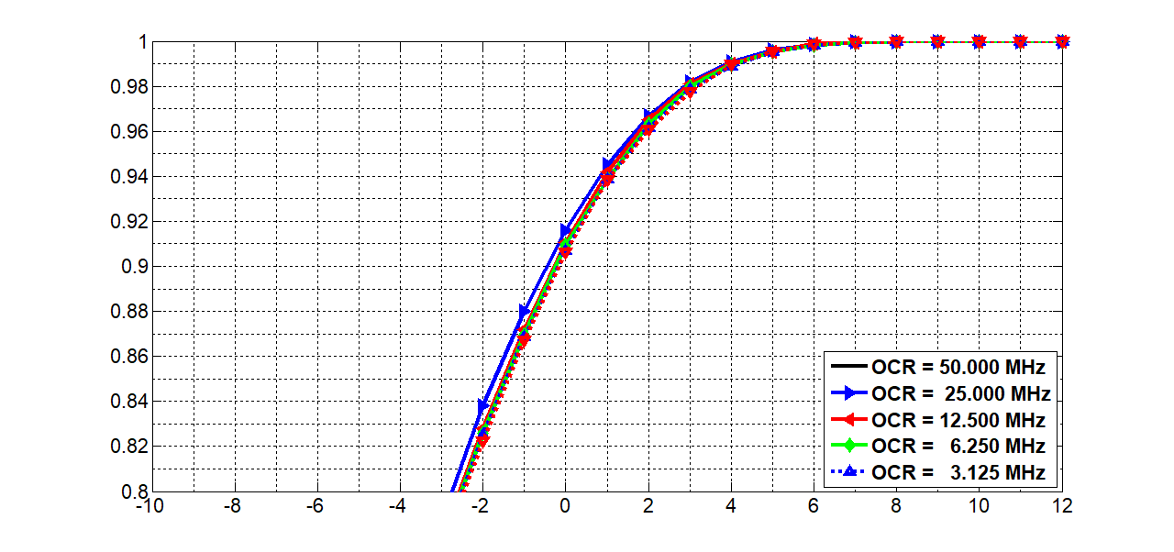
Results for P1 TDP @ AWGN only
False Alarm = 0.1 %
Detection Probability
Eb/No (dB)

Slide 43
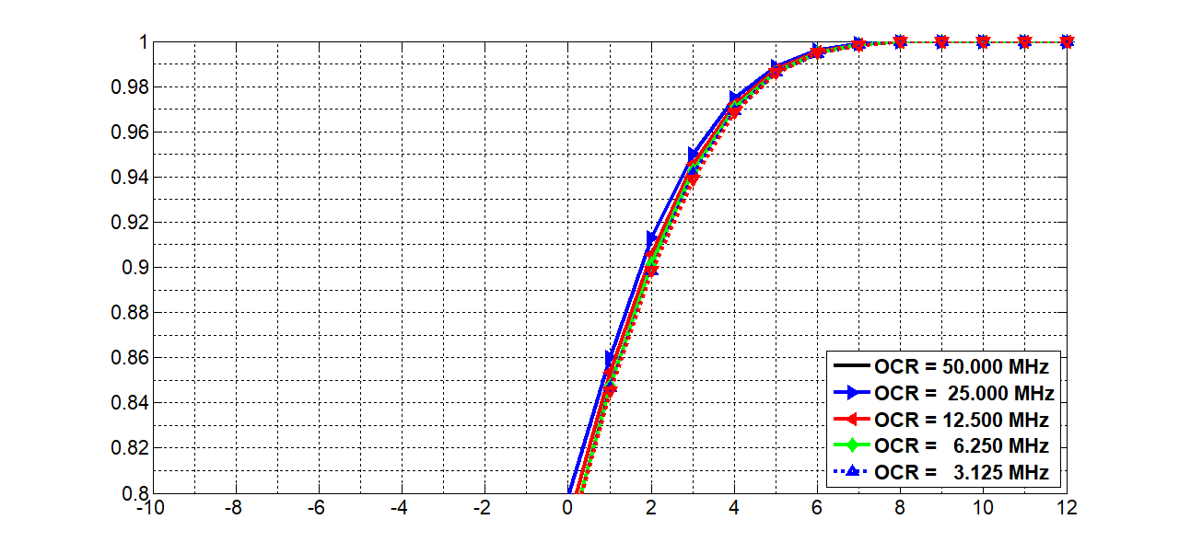
Results for P2 TDP @ AWGN only
False Alarm = 0.1 %
Detection Probability
Eb/No (dB)

Slide 44
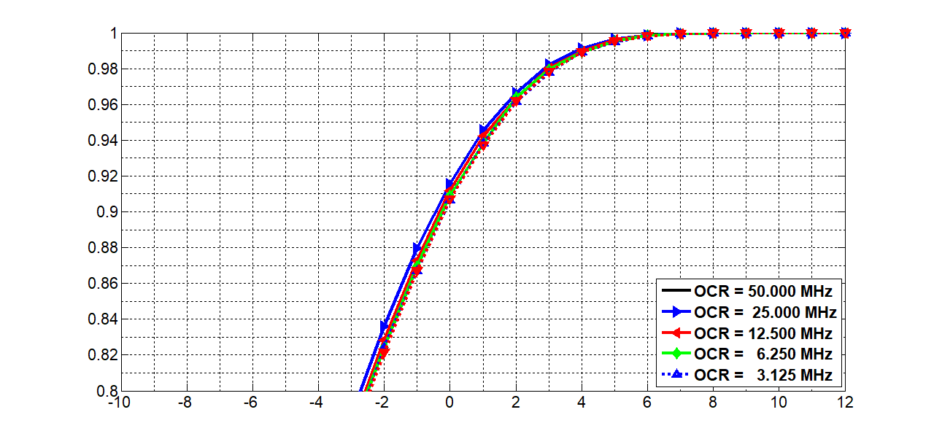
Results for P3 TDP @ AWGN only
False Alarm = 0.1 %
Detection Probability
Eb/No (dB)

Slide 45
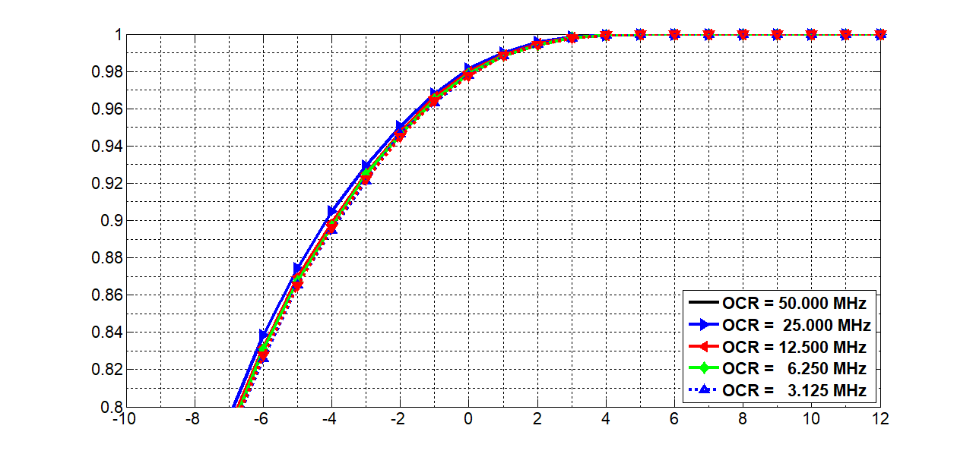
Results for P4 TDP @ AWGN only
False Alarm = 0.1 %
Detection Probability
Eb/No (dB)

Slide 46
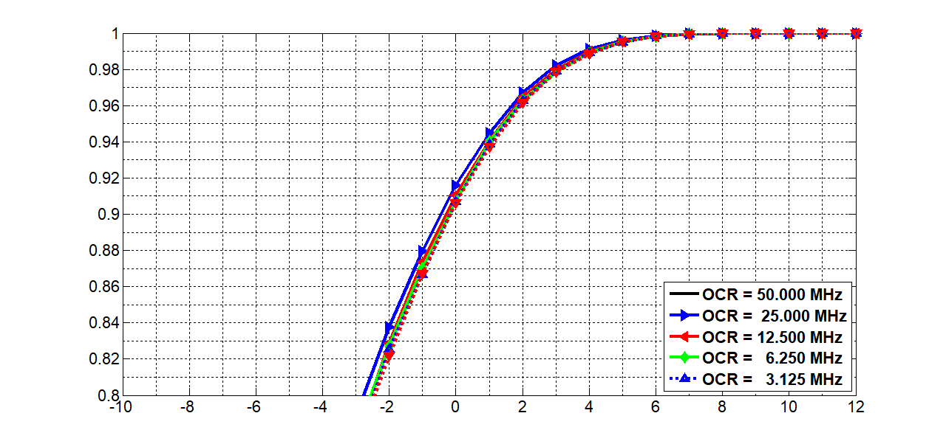
Results for P5 TDP @ AWGN only
False Alarm = 0.1 %
Detection Probability
Eb/No (dB)

Slide 47
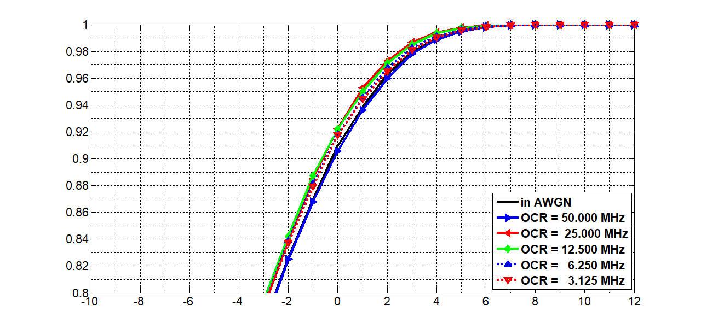
Results for P1 TDP @ D3 in S3
False Alarm = 0.1 %
Detection Probability
Eb/No (dB)

Slide 48
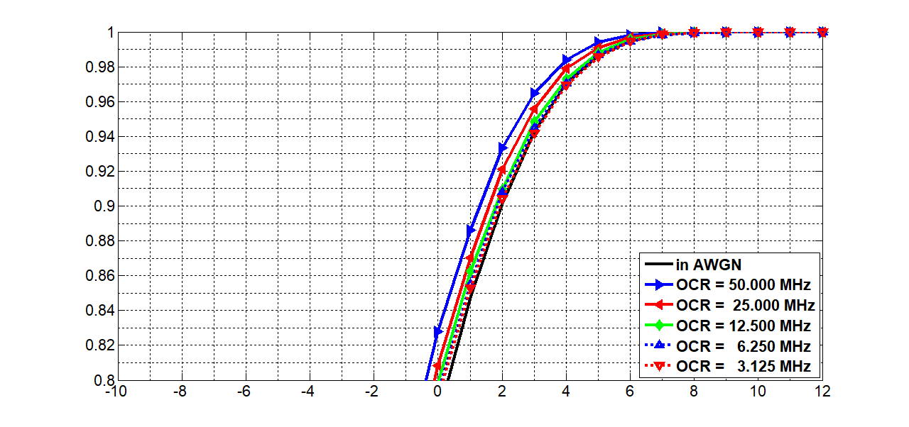
Results for P2 TDP @ D3 in S3
False Alarm = 0.1 %
Detection Probability
Eb/No (dB)

Slide 49
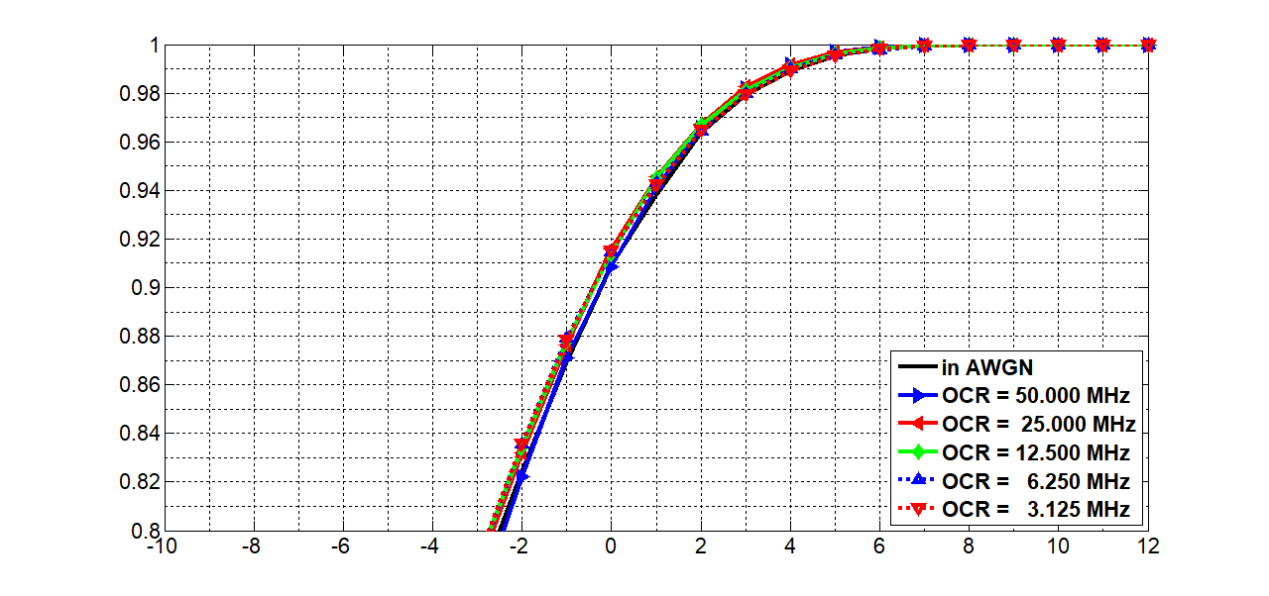
Results for P3 TDP @ D3 in S3
False Alarm = 0.1 %
Detection Probability
Eb/No (dB)

Slide 50
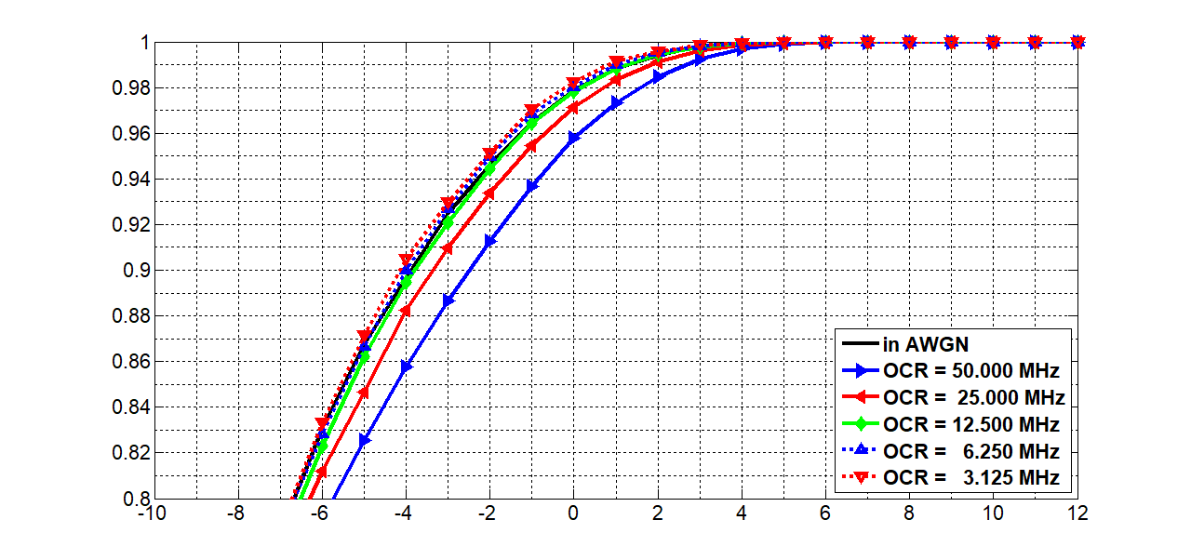
Results for P4 TDP @ D3 in S3
False Alarm = 0.1 %
Detection Probability
Eb/No (dB)

Slide 51
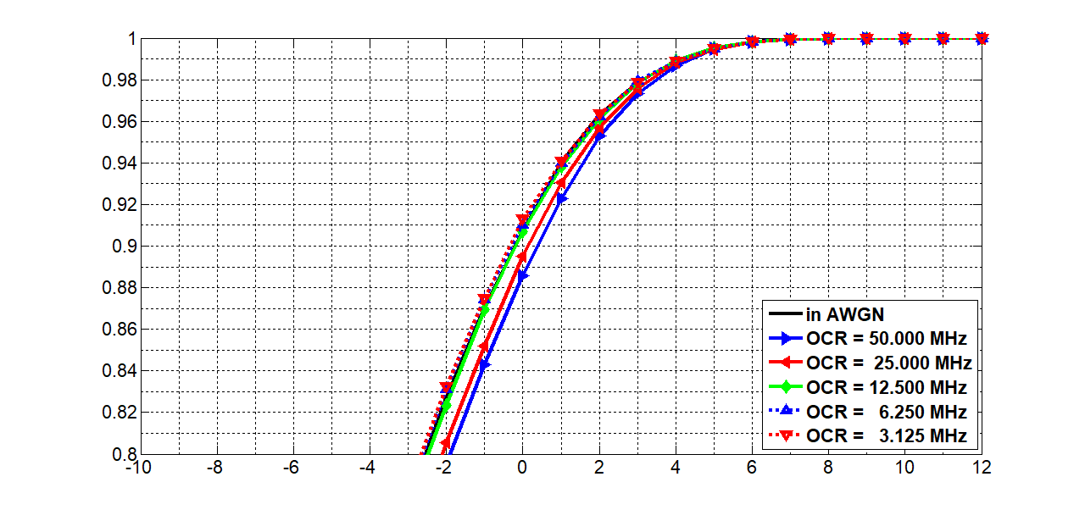
Results for P5 TDP @ D3 in S3
False Alarm = 0.1 %
Detection Probability
Eb/No (dB)

Slide 52
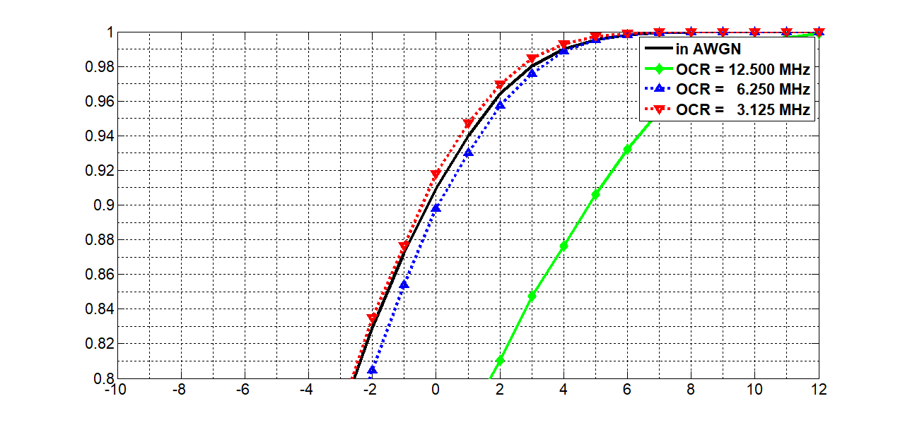
Results for P1 TDP @ D7 in S4
False Alarm = 0.1 %
Detection Probability
Eb/No (dB)

Slide 53
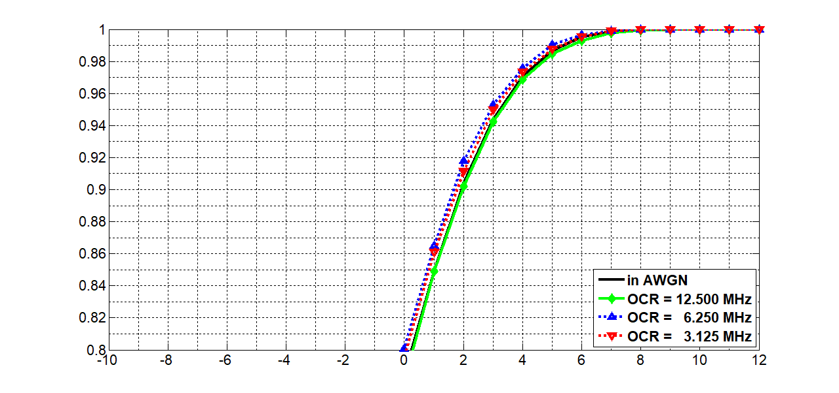
Results for P2 TDP @ D7 in S4
False Alarm = 0.1 %
Detection Probability
Eb/No (dB)

Slide 54
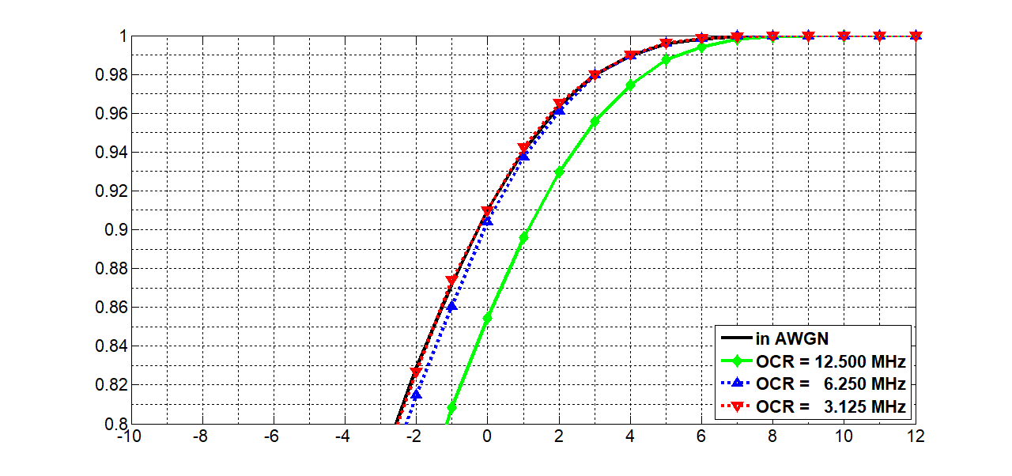
Results for P3 TDP @ D7 in S4
False Alarm = 0.1 %
Detection Probability
Eb/No (dB)

Slide 55
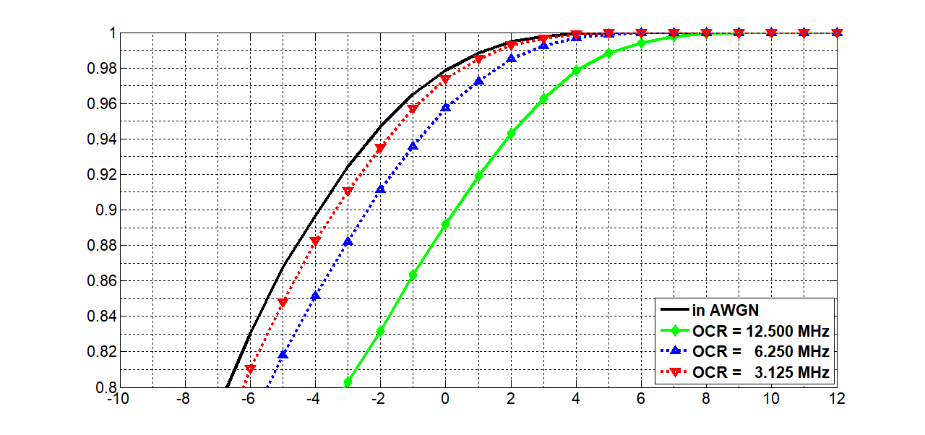
Results for P4 TDP @ D7 in S4
False Alarm = 0.1 %
Detection Probability
Eb/No (dB)

Slide 56
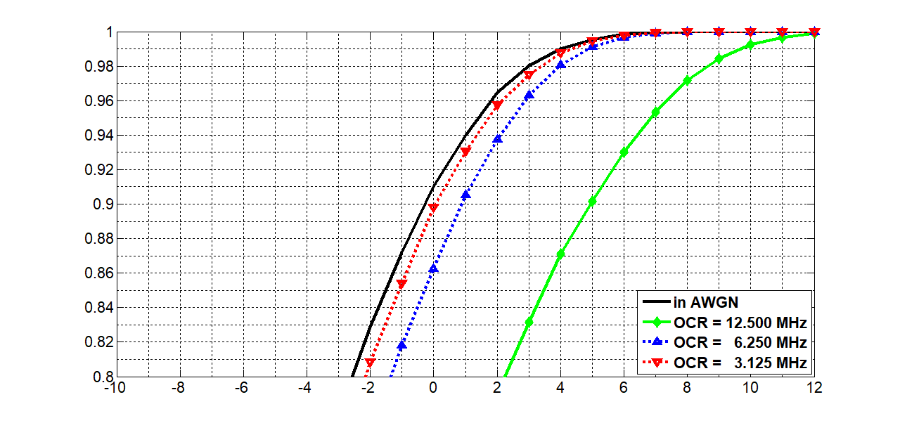
Results for P5 TDP @ D7 in S4
False Alarm = 0.1 %
Detection Probability
Eb/No (dB)

Slide 57
Conclusions
(from both evaluations)
Both HHI‘s and ETRI‘s results indicate that the short preamble fulfills the requirements for synchronization
Differences in simulation setups:
  HHI: Pseudo-frame start, down-sampling by decimation
  ETRI: Unpadded preamble, down-sampling by averaging
Preamble sub-sequences under evaluation
  HHI: Gold sequence A₈
  ETRI: PN/Gold sequences P1-P5
To be discussed: Which base sequence shall be used?

