Slide 1
Project: IEEE P802.15 Working Group for Wireless Personal Area Networks (WPANs)
Submission Title: Roadway Pre-Order Solution using LiFiCamCom Technology
Date Submitted: May 2018
Source: Jaesang Cha(SNUST), Miseon Kim(SNUST), Chiwook Kim(SNUST), Sangwoon Lee(Namseoul Univ.), Sooyoung Chang(SYCA), Vinayagam Mariappan(SNUST)
Address: Contact Information: +82-2-970-6431, FAX: +82-2-970-6123, E-Mail: chajs@seoultech.ac.kr
Re:
Abstract: This documents introduce the V2V LiFi/CamCom Link design consideration for VAT. This proposed LiFi/CamCom technology for roadway pre-order solution using vehicle lights. This VAT to operate on the application services like ITS, ADAS, IoT/IoL, etc. on road condition. Also this can be used for LED IT, Digital Signage with connected information services etc.
Purpose: To provided concept models of Light Communication based LiFi/CamCom solution for Vehicular Assistant Technology (VAT) Interest Group
Notice: This document has been prepared to assist the IEEE P802.15. It is offered as a basis for discussion and is not binding on the contributing individual(s) or organization(s). The material in this document is subject to change in form and content after further study. The contributor(s) reserve(s) the right to add, amend or withdraw material contained herein.
Release: The contributor acknowledges and accepts that this contribution becomes the property of IEEE and may be made publicly available by P802.15.
Slide 1

Slide 2
Contents
Need for Roadway Pre-Order Solution
Vehicle Light based LiFi/CamCom Link
Conclusion
Slide 2

Slide 3
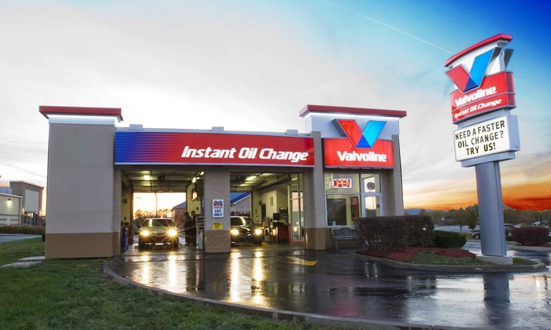
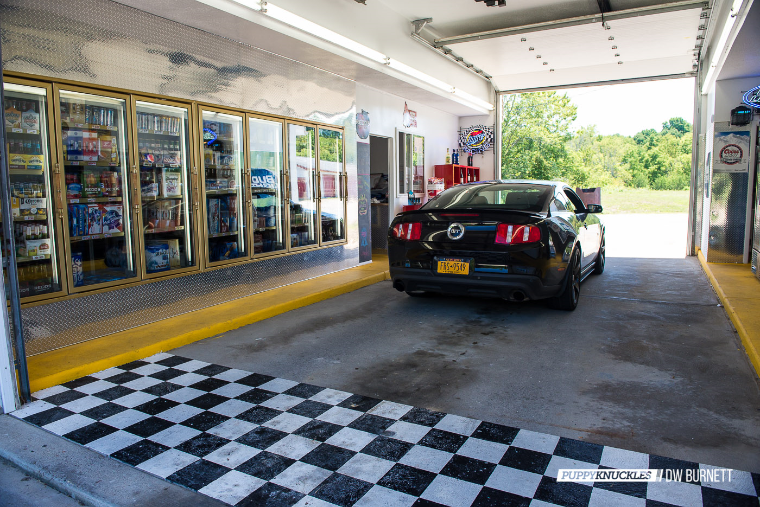
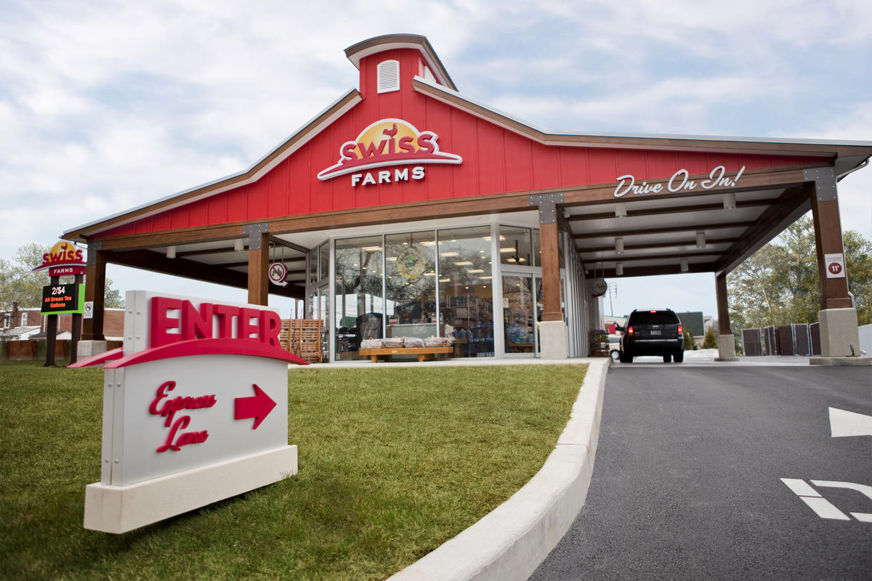

Need for Roadway Pre-Order Solution
Needs
  Many want buy the things fast in roadways due to time, emergency, and on the way traffic conditions, etc.
  Make the order in advance to save time
  Important to introduce the simple and fast ordering system on moving.
Basic Concept
  Uses the existing roadway stores installed CCTV infrastructure and Vehicle front light to implement pre-order solution
  Provides a simple interface to pre-order solution for shopping goods without additional interaction with roadway shops service man.
  < Roadway Shopping Scenario >
GOOGLE
Slide 3

Slide 4
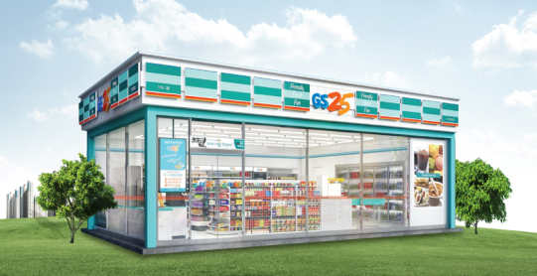

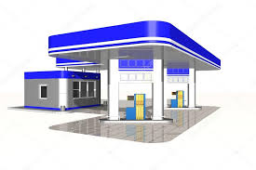
Vehicle Light based LiFi/CamCom Link
Receiver
Vehicle Light based LiFi/CamCom Link
  Tx : Vehicle Front Light
  Rx : Roadway Shops CCTV Camera
  Day-Night Communication Mode
  Modulations : OOK, VPPM, Offset-VPWM, PPM, DSSS SIK, etc.
  Data Rate : 1K ~ 1Mb/s
  Supported LoS (Line of Sight)
  Available Distance : 2m ~ 50m
I need water
I need 10 liters
  < Vehicle Front Light based LiFi/CamCom Link >
Uses the vehicle lighting system based on car and the CCTV Camera on the roadway shops to enable pre-order services using LiFi/CamCom technology.
Slide 3

Slide 5
Conclusion
Proposed the Roadway Pre-Order Solution using LiFi/CamCom Technology
Uses the vehicle lighting system and the CCTV camera installed in roadway shops to have LiFi/CamCom connectivity between roadway shops and vehicle.
Pre-order solution can be used in gas station, roadway stores, roadway restaurant, tollgates, etc.
Slide 5

