Slide 1
Project: IEEE P802.15 Working Group for Wireless Personal Area Networks (WPANs)
Submission Title: Automatic Docking Solution using LiFiCamCom Technology
Date Submitted: May 2018
Source: Jaesang Cha(SNUST), Miseon Kim(SNUST), Chiwook Kim(SNUST), Sangwoon Lee(Namseoul Univ.), Sooyoung Chang(SYCA), Vinayagam Mariappan(SNUST)
Address: Contact Information: +82-2-970-6431, FAX: +82-2-970-6123, E-Mail: chajs@seoultech.ac.kr
Re:
Abstract: This documents introduce the V2V LiFi/CamCom Link design consideration for VAT. This proposed solution for automatic spaceship docking using LiFi/CamCom technology. This VAT to operate on the application services like ITS, ADAS, IoT/IoL, etc. on road condition. Also this can be used for LED IT, Digital Signage with connected information services etc.
Purpose: To provided concept models of Light Communication based LiFi/CamCom solution for Vehicular Assistant Technology (VAT) Interest Group
Notice: This document has been prepared to assist the IEEE P802.15. It is offered as a basis for discussion and is not binding on the contributing individual(s) or organization(s). The material in this document is subject to change in form and content after further study. The contributor(s) reserve(s) the right to add, amend or withdraw material contained herein.
Release: The contributor acknowledges and accepts that this contribution becomes the property of IEEE and may be made publicly available by P802.15.
Slide 1

Slide 2
Contents
Need for Automatic Spaceship Docking Solution
Spaceships Docking LiFi/CamCom Link
Conclusion
Slide 2

Slide 3
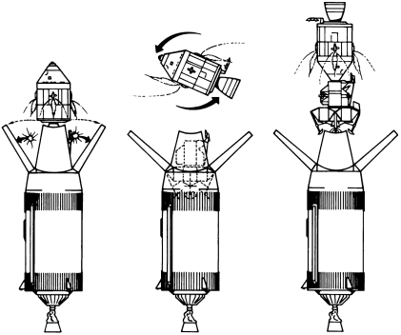
Need for Automatic Spaceship Docking Solution
Needs
Spacecraft docking capability depends on space rendezvous, the ability of two spacecraft to find each other and station-keep in the same orbit
Spacecraft first initiates a soft dock by making contact and latching its docking connector with that of the target vehicle
Once the soft connection is secured, if both spacecraft are pressurized, they may proceed to a hard dock where the docking mechanisms form an airtight seal, enabling interior hatches to be safely opened so that crew and cargo can be transferred.
Takes long time align with orbit to position it on orbit
Basic Concept
Use the light communication orbit alignment to position the spaceships for docking
Every spaceships have the light communication transceiver and Operate on both LiFi/CamCom Technology to communicate each other when it needs the docking
Make effective docking with less time
GOOGLE
< Spaceship Docking Orbital Mechanics S>
Slide 3

Slide 4
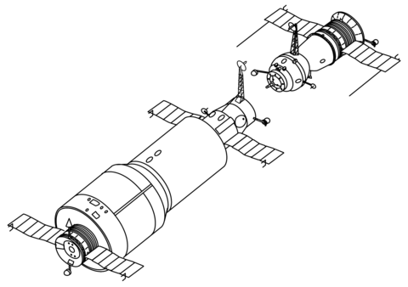
Spaceships Docking LiFi/CamCom Link
Vehicle Front Light based LiFi/CamCom Link
Tx : Vehicle Front Light
Rx : Roadway Shops CCTV Camera
Day-Night Communication Mode
Modulations : OOK, VPPM, Offset-VPWM, PPM, DSSS SIK, etc.
Data Rate : 1K ~ 1Mb/s
Supported LoS (Line of Sight)
Available Distance : 2m ~ 50m
VLC Transceiver
VLC Transceiver
< Spaceships Docking LiFi/CamCom Link >
Uses the vehicle lighting system based on car and the CCTV Camera on the roadway shops to enable pre-order services using LiFi/CamCom technology.
Slide 3

Slide 5
Conclusion
Proposed the Automatic Docking Solution using LiFi/CamCom Technology
Uses the LiFi/CamCom connectivity between spaceships vehicle using lighting system and the camera communication technology for effectively interact to position the spaceships on orbit
Reduce the time of docking and position the spaceships on required orbit more precisely
Slide 5

