Slide 1
Project: IEEE P802.15 Working Group for Wireless Personal Area Networks (WPANs)
Submission Title: Polarization Analysis for Vehicle Navigation using IoTIoL Technology
Date Submitted: May 2018
Source: Jaesang Cha(SNUST), Beomhee Lee(SNUST), Chiwook Kim(SNUST), Jaekwon Shin(Fivetek Co., Ltd.), Jintae Kim(Fivetek Co., Ltd.), Kirak Jung(Namuga Co. Ltd.), Jonghyeok Lee(SNUST), Sooyoung Chang(SYCA), Vinayagam Mariappan(SNUST)
Address: Contact Information: +82-2-970-6431, FAX: +82-2-970-6123, E-Mail: chajs@seoultech.ac.kr
Re:
Abstract: This documents introduce the V2I IoT/IoL Link design consideration for VAT. This proposed polarization analysis integrated image sensor based IoT/IoL solution for ITS to support light communication supported ADAS design. This VAT to operate on the application services like ITS, ADAS, IoT/IoL, etc. on road condition. Also this can be used for LEDIT, Digital Signage with connected information services etc.
Purpose: To provided concept models of Light Communication based IoT/IoL solution for Vehicular Assistant Technology (VAT) Interest Group
Notice: This document has been prepared to assist the IEEE P802.15. It is offered as a basis for discussion and is not binding on the contributing individual(s) or organization(s). The material in this document is subject to change in form and content after further study. The contributor(s) reserve(s) the right to add, amend or withdraw material contained herein.
Release: The contributor acknowledges and accepts that this contribution becomes the property of IEEE and may be made publicly available by P802.15.
Slide 1

Slide 2
Contents
Need of Polarization Analysis on Image Sensor
Polarization Analysis for IoT/IoL Technology
Conclusion
Slide 2

Slide 3
Need of Polarization Analysis on Image Sensor
Needs
At low temperature, water and snow drops on the road/ traffic signal / roadway signage freezes
Makes the surface slippery and unclear visible information on traffic signals / roadway signage
This increases the risk of accidents and affect visible light communication links on roadways.
The image sensor needs the capability to detect the frozen layer on traffic signals, roadway signage, etc.
Basic Concept
Temperature detection, the reflected light of a stationary laser are basic freezing detection methods and have issues on detecting a wide area of freezing while the vehicle is moving
Polarization based detection gives precise visibility
Gives effective light communication connectivity on fog and snowing conditions
GOOGLE
GOOGLE
Slide 3

Slide 4
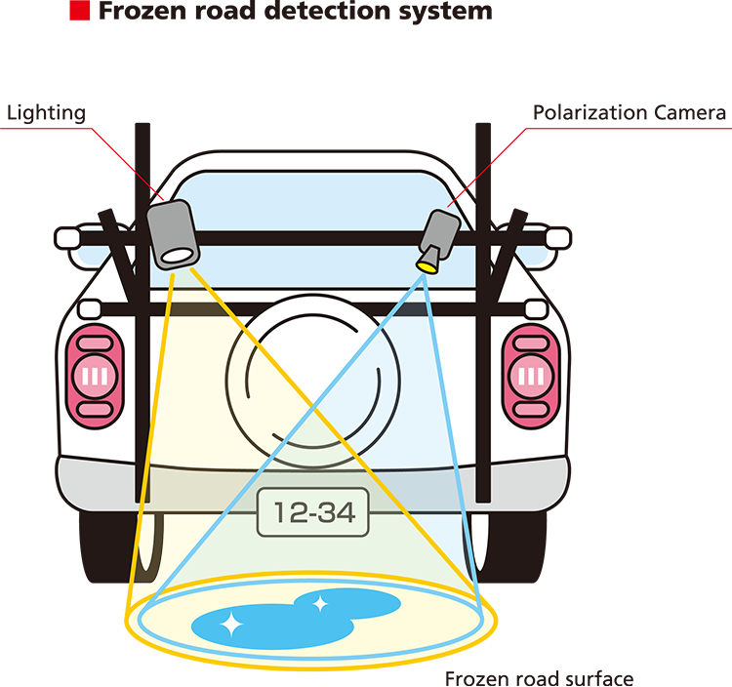
Polarization Analysis for IoT/IoL Technology
Polarization Analysis Integrated Image Sensor based IoT/IoL Link
Rx : Polarization Camera for Receiver
Tx : Traffic Lights, Roadway Signage
Day-Night Communication Mode
Modulations : VTASC, SS2DC, QR-Code, Color Code, OOK, VPPM, Offset-VPWM, PPM, DSSS SIK, etc.
Data Rate : 1K ~ 1Mb/s
Supported LoS (Line of Sight)
Available Distance : 2m ~ 20m
< Polarization Integrated Image Sensor Concept Model >
Uses polarization camera based IoT/IoL Technology to vehicle due to difficult driving conditions such as frozen condition will highly reduce the number of car accident
Allows the vehicle to precise connection with light communication device on frozen condition and helps to drive on the frozen area
Slide 4

Slide 5
Conclusion
Proposed the Polarization Analysis for Vehicle Navigation using IoT/IoL Technology
Improves the onroad IoT/IoL connectivity to vehicle using light communication with roadway infrastructure
Provides and aids the drivers to avoid car accidents and provides more secure driving on the frozen surface/road
Slide 5

