Slide 1
Project: IEEE P802.15 Working Group for Wireless Personal Area Networks (WPANs)
Submission Title: Frozen ICE Detection based IoT/IoL Technology for ITS Services
Date Submitted: May 2018
Source: Jaesang Cha(SNUST), Beomhee Lee(SNUST), Chiwook Kim(SNUST), Jaekwon Shin(Fivetek Co., Ltd.), Jintae Kim(Fivetek Co., Ltd.), Kirak Jung(Namuga Co. Ltd.), Jonghyeok Lee(SNUST), Sooyoung Chang(SYCA), Vinayagam Mariappan(SNUST)
Address: Contact Information: +82-2-970-6431, FAX: +82-2-970-6123, E-Mail: chajs@seoultech.ac.kr
Re:
Abstract: This documents introduce the V2I IoT/IoL Link design consideration for VAT. This proposed frozen ICE detection based IoT/IoL solution for ITS to support light communication supported ADAS design. This VAT to operate on the application services like ITS, ADAS, etc. on road condition. Also this can be used for LED IT, Digital Signage with connected information services etc.
Purpose: To Provided Concept models of light communication based IoT/IoL solution for Vehicular Assistant Technology (VAT) Interest Group
Notice: This document has been prepared to assist the IEEE P802.15. It is offered as a basis for discussion and is not binding on the contributing individual(s) or organization(s). The material in this document is subject to change in form and content after further study. The contributor(s) reserve(s) the right to add, amend or withdraw material contained herein.
Release: The contributor acknowledges and accepts that this contribution becomes the property of IEEE and may be made publicly available by P802.15.
Slide 1

Slide 2
Contents
Need of Frozen ICE Detection on Vehicle
Frozen ICE Detection based IoT/IoL Link
Conclusion
Slide 2

Slide 3
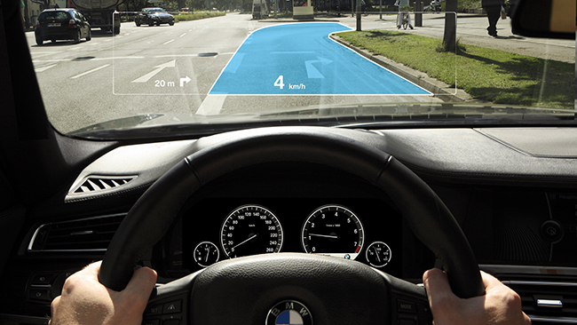
Need of Frozen ICE Detection on Vehicle
Needs
Fog reduces visibility, limits contrast, distorts perception and causes many car accidents each year
In essence, it limits ability to see other cars and objects on the road, so you must be very cautious when driving in it
In order to see the road and drive more safely in the fog, the car need to be equipped with a special anti fog camera
Basic Concept
Uses the Vehicle mirror or front lights as OWC Transmitter and the camera connected on vehicle decode the data from Traffic Lights , Roadway Signage etc.
Gives effective light communication connectivity on fog and snowing conditions
Technology easy to apply to growing infrastructure without adding additional infrastructure
< Image View from Anti Fog Camera >
GOOGLE
< Projected Roadway on the "transparent LCD” windshield of the car >
Slide 3

Slide 4
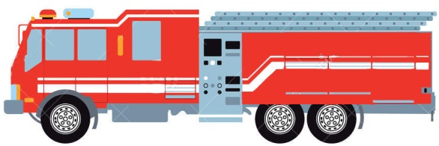
Frozen ICE Detection based IoT/IoL Link
IoT/IoL Link using anti fog function
Rx : Anti-fog camera used for Receiver
Tx : Traffic Lights, Roadway Signage
Day-Night Communication Mode
Modulations : VTASC, SS2DC, QR-Code, Color Code, OOK, VPPM, Offset-VPWM, PPM, DSSS SIK, etc.
Data Rate : 1K ~ 1Mb/s
Supported LoS (Line of Sight)
Available Distance : 2m ~ 20m
Distance - Fog density:
5dB/km – 4km;
15dB/km – 2km.
Transparent LCD windshield
Anti-fog
camera
< Camera Based IoT/IoL Link using anti fog camera >
Uses the IoT/IoL Technology to vehicle due to difficult driving conditions such as fog will highly reduce the number of car accident;
This Technology will allow the special services (Police, Ambulance, etc.) to get the place faster with poor visibility on the road
Slide 4

Slide 5
Conclusion
Proposed the Frozen ICE Detection based IoT/IoL Technology for ITS Services
Provides effective ITS service using light communication with roadway infrastructure on fog/snowing condition
Reduces car accidents and allow faster transportation in emergency cases in foggy surfaces / roads
Slide 5

