Slide 1
Project: IEEE P802.15 Working Group for Wireless Personal Area Networks (WPANs)
Submission Title: LED-ID Based Shop VR Signage detection on the road by using HMD Camera
Date Submitted: May 2018
Source: Jaesang Cha (SNUST), Minwoo Lee (SNUST), Byungjun Min (Head IT Co., Ltd.), Jungjin Ra (Head IT Co., Ltd.), Juphil Cho (Kunsan National Univ.), Vinayagam Mariappan(SNUST)
Address: Contact Information: +82-2-970-6431, FAX: +82-2-970-6123, E-Mail: chajs@seoultech.ac.kr
Re:
Abstract: This documents introduce the design consideration on V2I Shop Signage based location mapping using HMD Camera Communication Link for VAT. The proposed HMD Camera Communication Link with Shop Signage helps to design the navigation application for vehicle riders using OWC technology. This VAT solution helps to operate on the application services like ITS, ADAS, etc. on road condition safety AIDS using Lighting / Sign Boards / Signage Display based infrastructure.
Purpose: To provided concept models of LED-ID based location specific navigator solution using image sensor communication for Vehicular Assistant Technology (VAT) Interest Group
Notice: This document has been prepared to assist the IEEE P802.15. It is offered as a basis for discussion and is not binding on the contributing individual(s) or organization(s). The material in this document is subject to change in form and content after further study. The contributor(s) reserve(s) the right to add, amend or withdraw material contained herein.
Release: The contributor acknowledges and accepts that this contribution becomes the property of IEEE and may be made publicly available by P802.15.
Slide 1

Slide 2
Contents
Needs for LED-ID Based Location Navigator
Shop Signage - HMD Camera Link
Conclusion
Slide 2

Slide 3
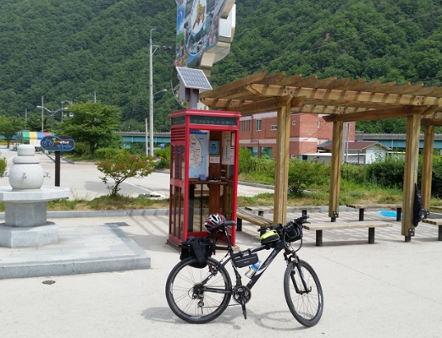
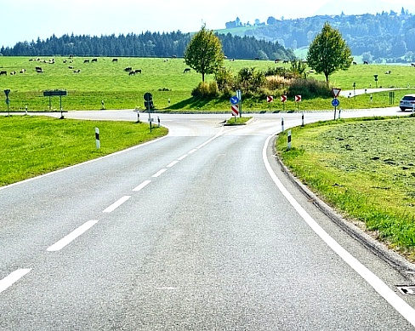
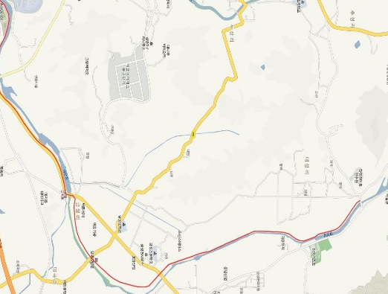

Needs for LED-ID Based Location Navigator
Needs
  Required interactive path navigation guidance service on smart device for Relax and safety vehicle Riding
  To provide live riding path condition and nearby available services for health and food
  Need to find the emergency situation spot as quick as possible for AIDs
Basic Idea
  To find the navigation information for particular shop service or location identification
  Navigation service designed using LED-ID on street and pathway shops signage and HMD Camera
  Provide nondestructive riding support for vehicle riders
GOOGLE
  < Bicycle Riding Usage Scenario >
Slide 3

Slide 4

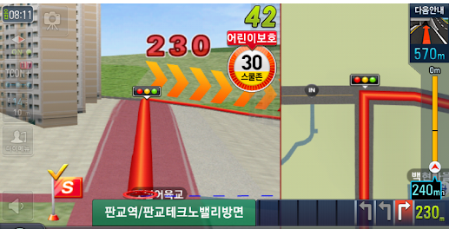







Shop Signage - HMD Camera Link
  Auto Navigation Function
Shop Signage - HMD Camera Link
  Tx : Street / Pathway Shop Signage
  Rx : CMOS Image Sensor in HMD
  Modulations :
    For Street Lights : OOK, VPPM, Offset-VPWM, Multilevel PPM, DSSS SIK
    For Signage : QR-Code, Color Code, VTASC, SS2DC
  Day-Night Communication Mode
  Data Rate : 1K ~ 1Mb/s
  Supported LoS(Line of Sight)
  Distance : 1m ~ 15m
  Various types of Signage
  HMD-AR
  < Shop Signage - HMD Camera Link>
※ To Get bicycle riding pathway information and safety information for smart bicycle riding guidance
Slide 4

Slide 5
Conclusion
Proposed the LED-ID Based Shop VR Signage detection on the road by using HMD Camera.
Uses the LED-ID technology on existing Street / Pathway signage as OWC Transmitter to provide location specific informations
HMD Camera Link on vehicle riding time, helps to design the smart navigation function to find the riding pathway , restaurants, coffee shops, movie theaters, etc informations without stopping the riding.
Slide 5

