Slide 1
Project: IEEE P802.15 Working Group for Wireless Personal Area Networks (WPANs)
Submission Title: HUD display and CamCom based Smart Driving Guidance Technology
Date Submitted: May 2018
Source: Jaesang Cha (SNUST), Minwoo Lee (SNUST), Byungjun Min (Head IT Co., Ltd.), Jungjin Ra (Head IT Co., Ltd.), Juphil Cho (Kunsan National Univ.), Vinayagam Mariappan(SNUST)
Address: Contact Information: +82-2-970-6431, FAX: +82-2-970-6123, E-Mail: chajs@seoultech.ac.kr
Re:
Abstract: This documents introduce the design consideration on V2I Street Lights and Signage based location mapping using HUD Camera Communication Link for VAT. The proposed HUD CamCom Link with Street lights and Signage helps to design the navigation application for bicycle riders using OWC technology. This VAT solution helps to operate on the application services like ITS, ADAS, etc. on road condition safety AIDS using Lighting / Sign Boards / Signage Display based infrastructure.
Purpose: To Provided Concept models of See-Through Display based Vehicle CamCom for Vehicular Assistant Technology (VAT) Interest Group
Notice: This document has been prepared to assist the IEEE P802.15. It is offered as a basis for discussion and is not binding on the contributing individual(s) or organization(s). The material in this document is subject to change in form and content after further study. The contributor(s) reserve(s) the right to add, amend or withdraw material contained herein.
Release: The contributor acknowledges and accepts that this contribution becomes the property of IEEE and may be made publicly available by P802.15.
Slide 1

Slide 2
Contents
Needs for Smart Driving Guidance
Roadway lights - HUD CamCom Link
Conclusion
Slide 2

Slide 3
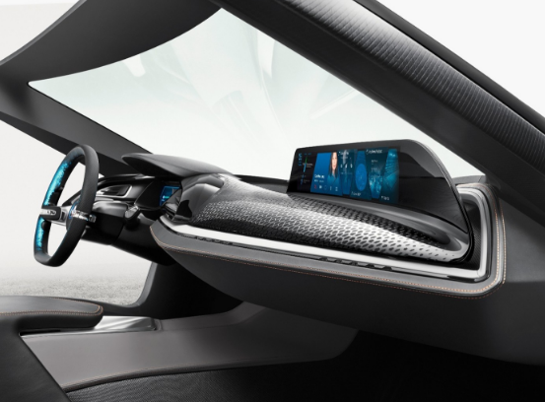
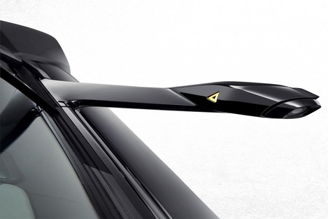
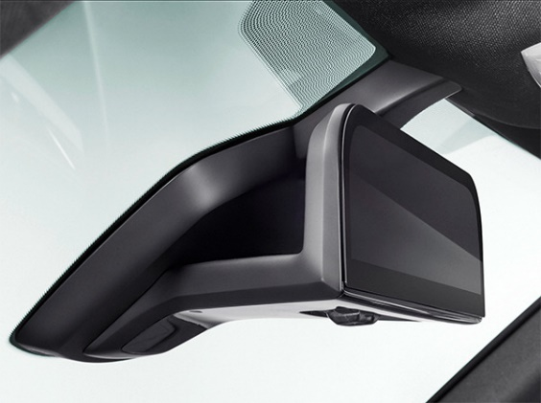
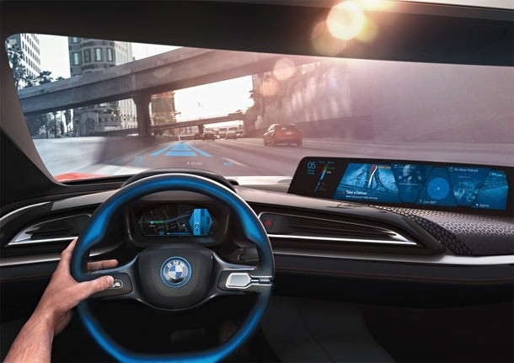
Needs for Smart Driving Guidance
Needs
Relax and safety Onroad Driving
Required interactive driving guidance service with a driver in the vehicle
To provide live Onroad condition
Difficult to set built-in cameras to focus on roadway lights
Conceptual Idea
HUD Camera can be used to implement Camera communication link between driver and roadway lights
Live various Onroad condition information can be obtained through the Need to be in emergency situation spot as quick as possible for AIDs installed on the road
< In-Vehicle Driving Assistive Infrastructures on New Generation Vehicle >
Slide 3

Slide 4
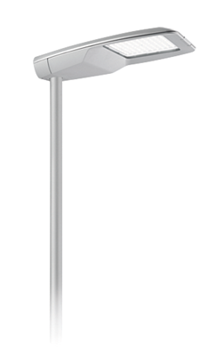
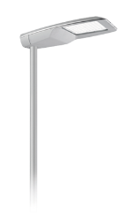
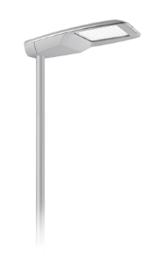
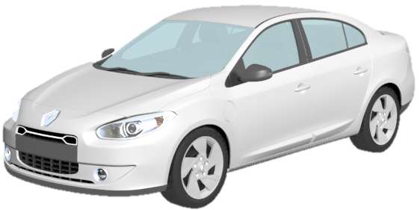
Roadway lights - HUD CamCom Link
HUD CamCom Link Using Roadway Lights
Tx : LED based Roadway Lights
Rx : CMOS Image Sensor in HUD
Modulations : OOK, VPPM, Offset-VPWM, Multilevel PPM, DSSS SIK
Day-Night Communication Mode
Data Rate : 1K ~ 1Mb/s
Supported LoS (Line of Sight)
Distance : 1m ~ 15m
< Roadway lights - HUD CamCom Link >
※To Get live roadway condition and safety information for smart driving guidance
Slide 4

Slide 5
Conclusion
Proposed the HUD display and CamCom based Smart Driving Guidance Technology
In recent years, smart driving guidance and vehicle assistive technology research has been actively conducted, and HUD can be applied to general automobiles to enable smart driving guidance
This proposed approach provides automatic navigation and live Onroad traffic information while moving on roads through roadway lights
Slide 5

