Slide 1
Project: IEEE P802.15 Working Group for Wireless Personal Area Networks (WPANs)
Submission Title: Reply to the Comment on Simulation Results from ETRI
Date Submitted: 09 May 2018
Source: Sang-Kyu Lim, Jin-Doo Jeong, Il Soon Jang, Tae-Gyu Kang [ETRI]
Address: 218 Gajeong-ro, Yuseong-gu, Daejeon, 34129, Korea
Voice:[+82-42-860-1573], FAX: [+82-42-860-5218], E-Mail:[sklim@etri.re.kr]
Re:
Abstract: This document provides the answer to the comment on the simulation results from ETRI.
Purpose: Contribution to IEEE 802.15.13
Notice: This document has been prepared to assist the IEEE P802.15. It is offered as a basis for discussion and is not binding on the contributing individual(s) or organization(s). The material in this document is subject to change in form and content after further study. The contributor(s) reserve(s) the right to add, amend or withdraw material contained herein.
Release: The contributor acknowledges and accepts that this contribution becomes the property of IEEE and may be made publicly available by P802.15.

Slide 2
Reply to the Comment
on Simulation Results from ETRI
Sang-Kyu Lim, Jin-Doo Jeong, Il Soon Jang, Tae-Gyu Kang [ETRI]

Slide 3
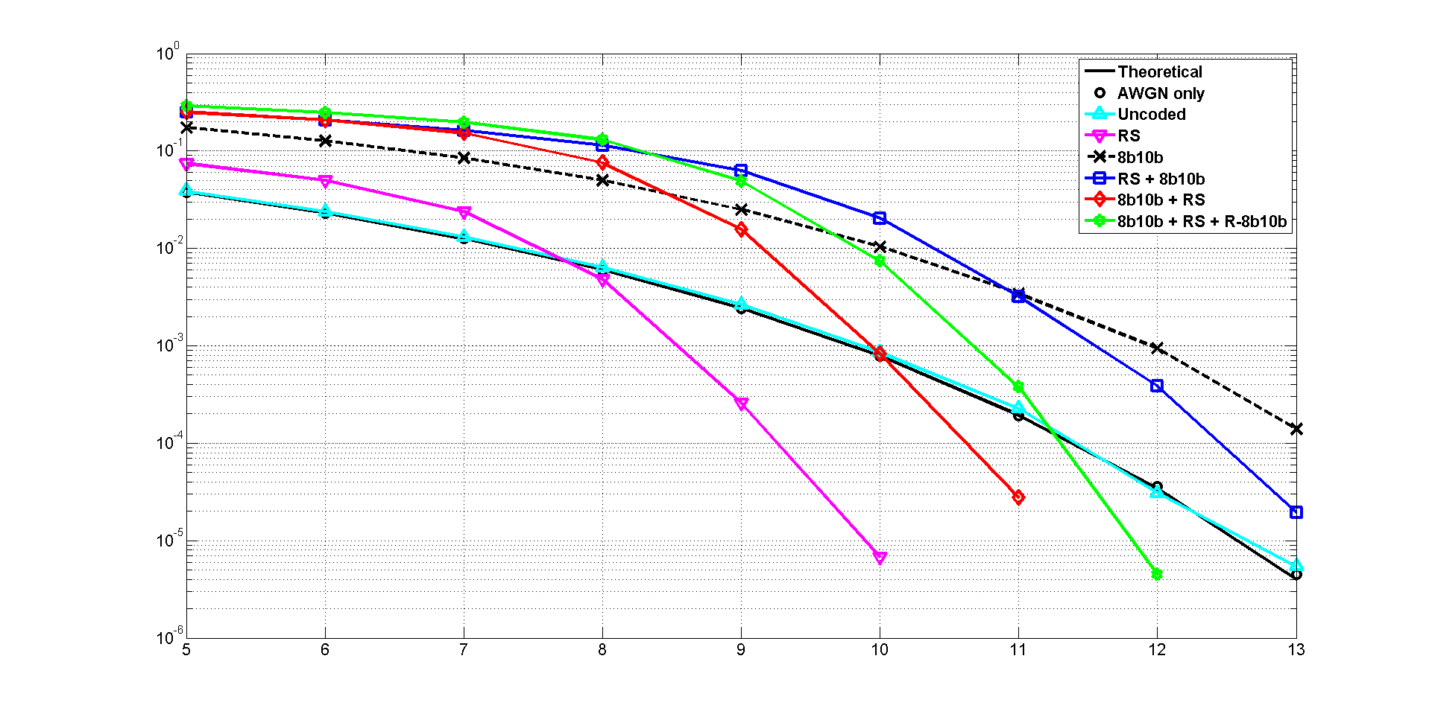
Results for D3 in S3 @ OCR = 3.125 MHz
Number of bits = 2,447,360
BER
SNR (dB)

Slide 4
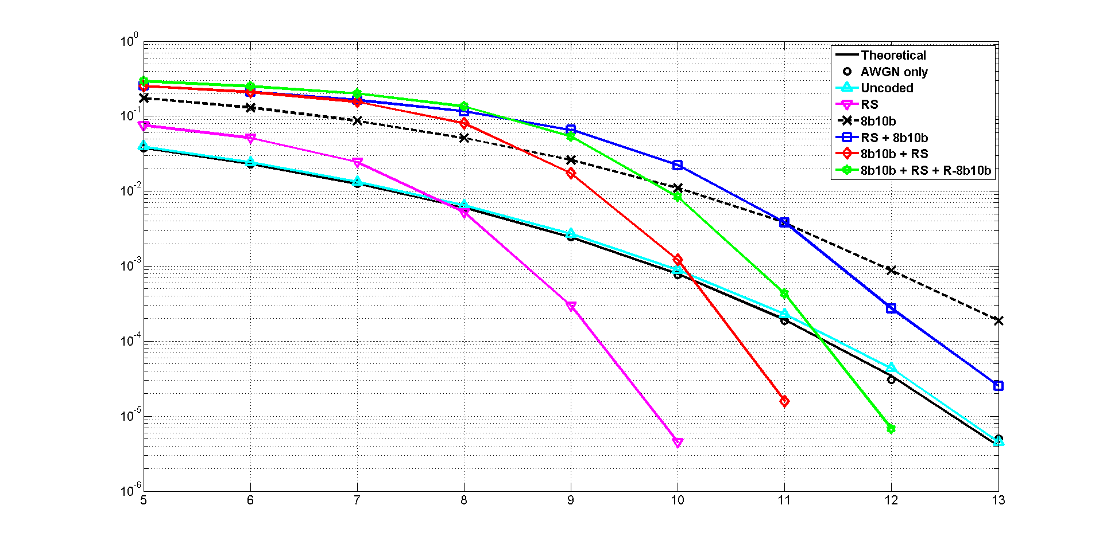
Results for D3 in S3 @ OCR = 6.25 MHz
Number of bits = 2,447,360
BER
SNR (dB)

Slide 5
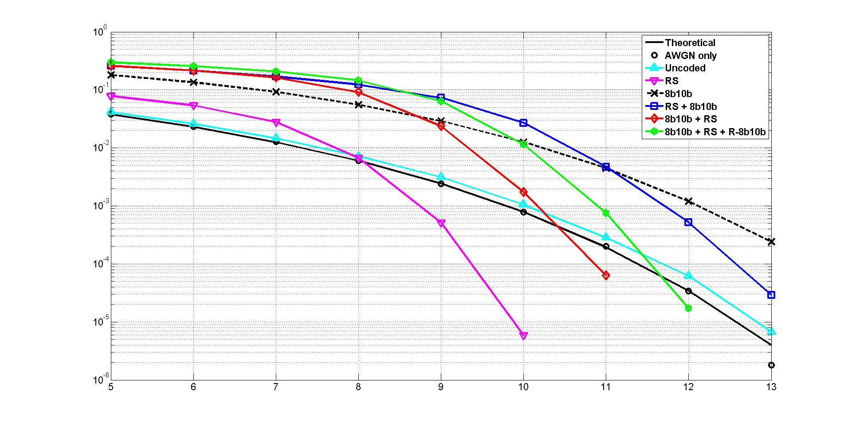
Results for D3 in S3 @ OCR = 12.5 MHz
Number of bits = 2,447,360
BER
SNR (dB)

Slide 6
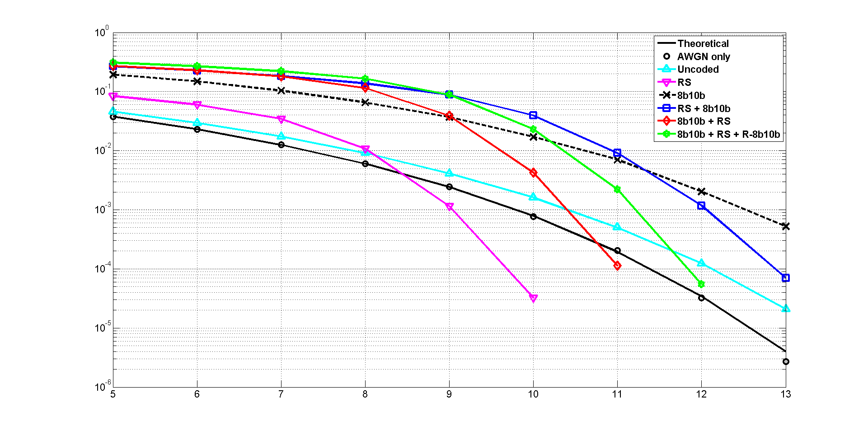
Results for D3 in S3 @ OCR = 25 MHz
Number of bits = 2,447,360
BER
SNR (dB)

Slide 7
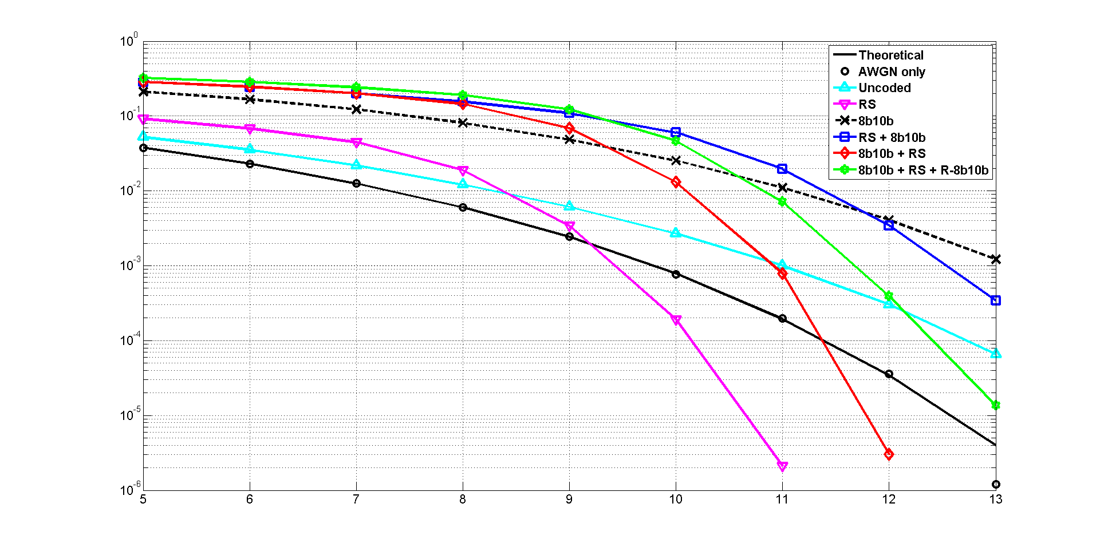
Results for D3 in S3 @ OCR = 50 MHz
Number of bits = 3,317,760
BER
SNR (dB)

Slide 8
Comment on the Simulation Results
How un-coded transmission shows better performance than when encoded?
No clear explanation, need to double check the evaluation assumptions.

Slide 9
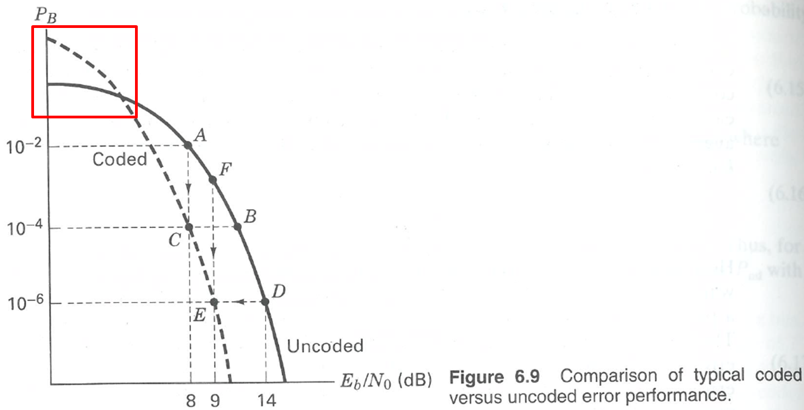
Answer to the Comment
Reference: Bernard Sklar, “Digital Communications: Fundamentals and Applications,” Prentice Hall PTR, 2nd Edition, New Jersey, 2001.

Slide 10
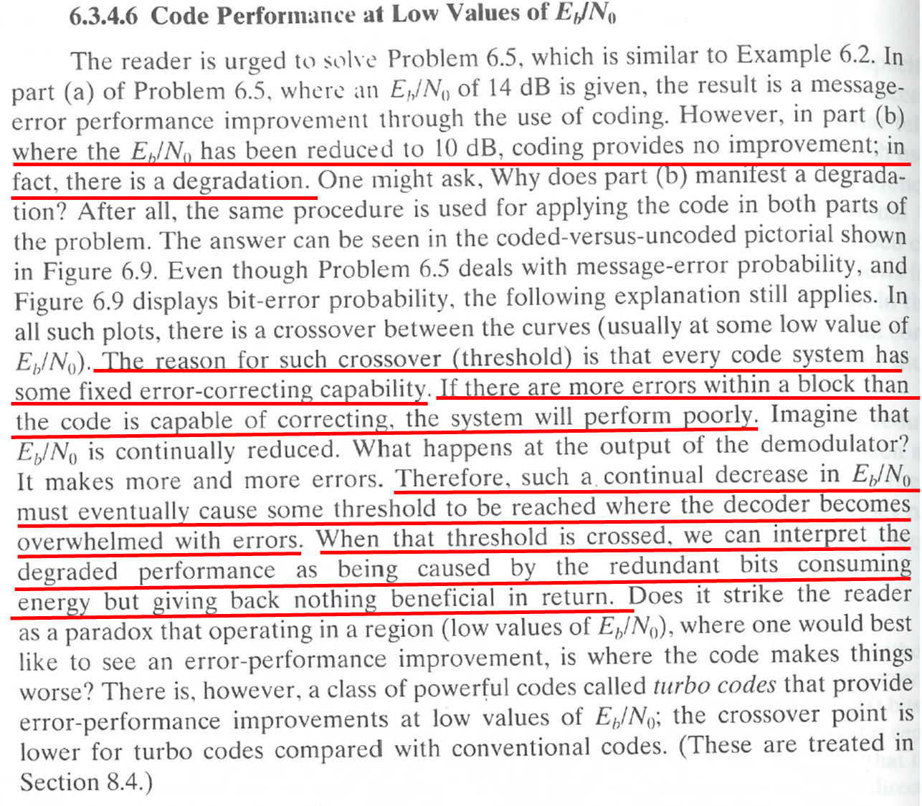
Answer to the Comment
Reference: Bernard Sklar, “Digital Communications: Fundamentals and Applications,” Prentice Hall PTR, 2nd Edition, New Jersey, 2001.

