Slide 1
Project: IEEE P802.15 Working Group for Wireless Personal Area Networks (WPANs)
Submission Title: Transparent HUD Vehicle Windows linked with OCC information
Date Submitted: May 2018
Source: Jaesang Cha (SNUST), Jinyong Choi (Shinhan Bank), Jonghyeok Lee (SNUST), Hyoungkyu Song (Sejong Univ.), Younkwan Kim (The Catholic University of Korea), Hyeongho Lee (Korea Univ.), Vinayagam Mariappan (SNUST)
Address: Contact Information: +82-2-970-6431, FAX: +82-2-970-6123, E-Mail: chajs@seoultech.ac.kr
Re:
Abstract: This documents introduce the V2I optical camera communication (OCC) Link design consideration to use vehicle HUD windows for VAT. The proposed vehicle transparent windows based optical camera communication (OCC) for vehicles pathway observation services. This VAT to operate on the application services like ITS, ADAS, etc. on road condition, Bio-Plant / Manufacturing Industry Safety AIDS using Sign boards / Lighting / Display based infrastructure. Also this can be used for IoT/IoL, LEDIT, Digital Signage with Advertisement Information etc.
Purpose: To provided concept models of vehicle transparent window based OCC for Vehicular Assistant Technology (VAT) Interest Group
Notice: This document has been prepared to assist the IEEE P802.15. It is offered as a basis for discussion and is not binding on the contributing individual(s) or organization(s). The material in this document is subject to change in form and content after further study. The contributor(s) reserve(s) the right to add, amend or withdraw material contained herein.
Release: The contributor acknowledges and accepts that this contribution becomes the property of IEEE and may be made publicly available by P802.15.
Slide 1

Slide 2
Contents
Needs for Vehicle Pathway Observation Services
Vehicle Transparent HUD Windows based OCC Solution
Conclusion
Slide 2

Slide 3
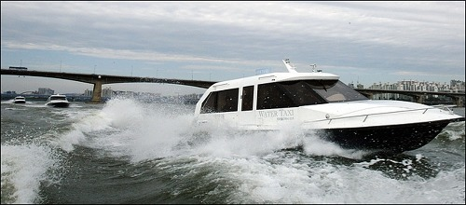
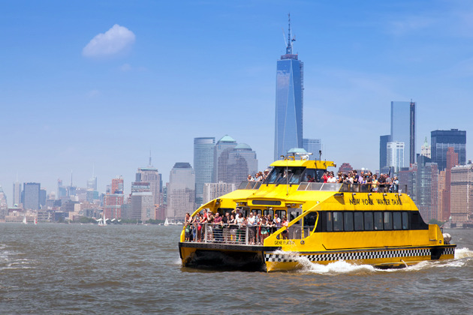
Needs for Vehicle Pathway Observation Services
Needs
Waterway always subject to change natural calamities
Waterway subject sudden water flow variation
Water Vehicle malfunctions subject to water taxi accidents and impacts human health & life
infrastructure is increasing
Need technology to be used to select the number of users and destination
Helps to prevent the waterway accidents
Basic Idea
Use the water vehicle window as a communication medium to interact with waterway infrastructure
Utilize the Waterway Monitoring CCTV Infrastructure to observe the waterway condition from water taxi
Enhance the waterway observation services to avoid waterway accidents
< Water Vehicle Usage >
GOOGLE
Slide 3

Slide 4
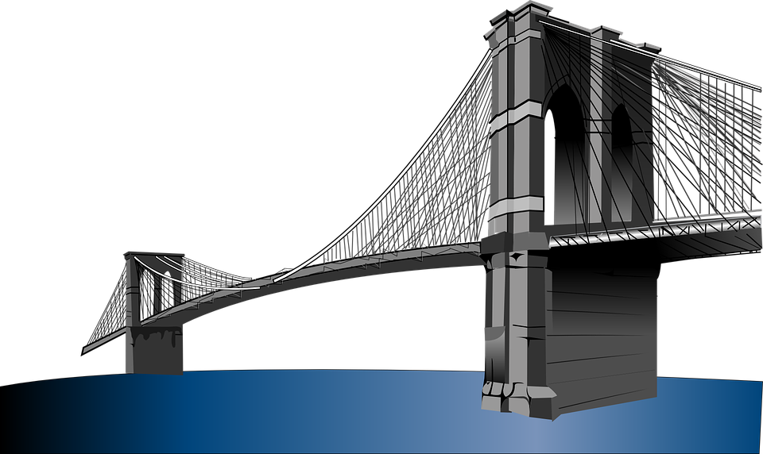
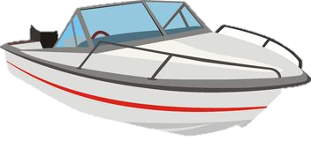
Vehicle Transparent HUD Windows based OCC Solution
Vehicle Transparent HUD Windows based OCC Link
Tx : Water Vehicle Transparent HUD Window
Rx : Waterway Mentoring CCTV Camera’s CMOS Image Sensor
Modulation : QR-Code, Color Code, VTASC, SS2DC
Day-Night Communication Mode
Data Rate : 1K ~ 1Mb/s
Supported LoS(Line of Sight)
Available Distance : 5m ~ 50m
User
Destination
Camera
< Water Vehicle Transparent HUD Windows based OCC Link >
※Gets waterway informations like Waterway flow speed , water depth, Water Taxi Type, Water Taxi Speed, No of Passengers in Taxi, Source and Destination point, etc.
Slide 4

Slide 5
Conclusion
Proposed the Transparent HUD Vehicle Windows linked with OCC information
Development on waterway monitoring infrastructure helps to easily build the OCC solution for enhanced waterway observation services without any additional infrastructure installations
Uses the Water vehicle transparent HUD Window display and Waterway Monitoring CCTV system to enable proposed service on waterway
Helps to avoid water way accidents and saves human life's
Slide 5

