Slide 1
Project: IEEE P802.15 Working Group for Wireless Personal Area Networks (WPANs)
Submission Title: Transparent HUD Built-in Safety Equipment Using Internet of Signage Network for ITS
Date Submitted: May 2018
Source: Jaesang Cha(SNUST), Jinyong Choi(Shinhan Bank), Jonghyeok Lee(SNUST), Hyoungkyu Song(Sejong Univ.), Younkwan Kim(The Catholic University of Korea), Hyeongho Lee(Korea Univ.), Vinayagam Mariappan(SNUST)
Address: Contact Information: +82-2-970-6431, FAX: +82-2-970-6123, E-Mail: chajs@seoultech.ac.kr
Re:
Abstract: This documents introduce the V2I light communication link supported HUD Built-in safety equipment design consideration for VAT. The proposed solution used for ITS service using Internet of Signage Network . This VAT solution helps to operate on the application services like ITS, ADAS, etc. on road condition safety AIDS using Lighting / Sign Boards / Signage Display based infrastructure. Also this can be used LED-ID based IoT/IoL, Digital Signage with Advertisement Information etc.
Purpose: To provided concept models of HUD based light communication method for Vehicular Assistant Technology (VAT) Interest Group
Notice: This document has been prepared to assist the IEEE P802.15. It is offered as a basis for discussion and is not binding on the contributing individual(s) or organization(s). The material in this document is subject to change in form and content after further study. The contributor(s) reserve(s) the right to add, amend or withdraw material contained herein.
Release: The contributor acknowledges and accepts that this contribution becomes the property of IEEE and may be made publicly available by P802.15.
Slide 1

Slide 2
Contents
Needs for HUD Built-in Safety Equipment
HUD based Internet of Signage Network for ITS Service
Conclusion
Slide 2

Slide 3
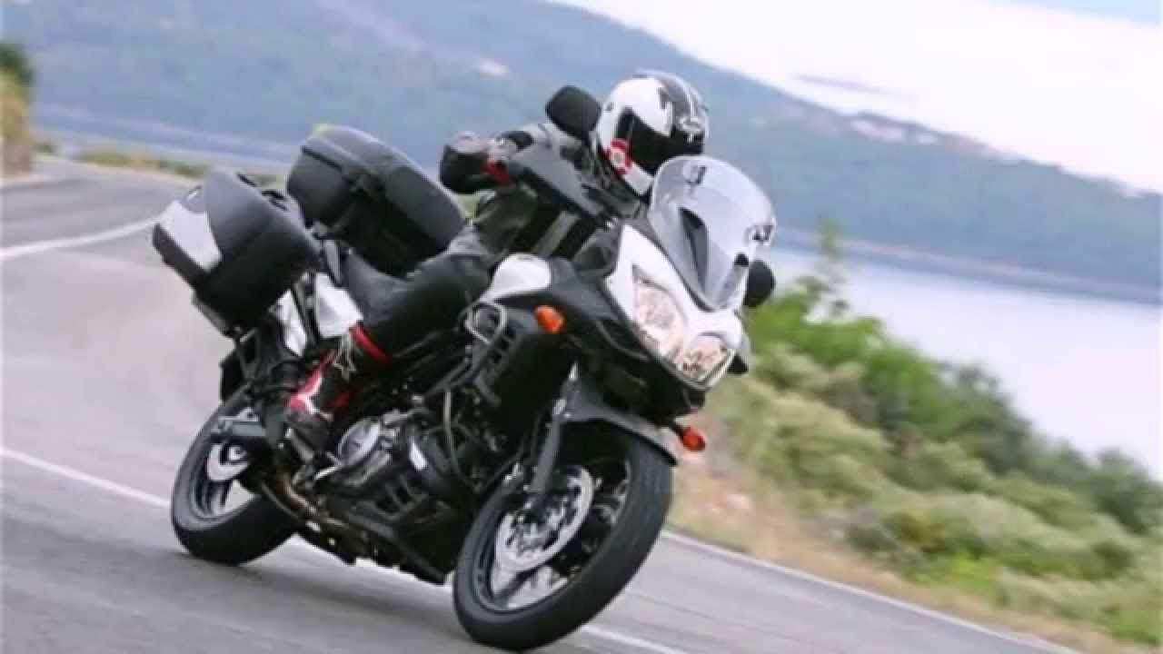
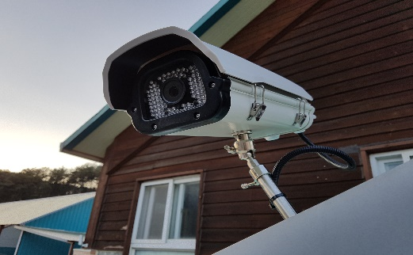
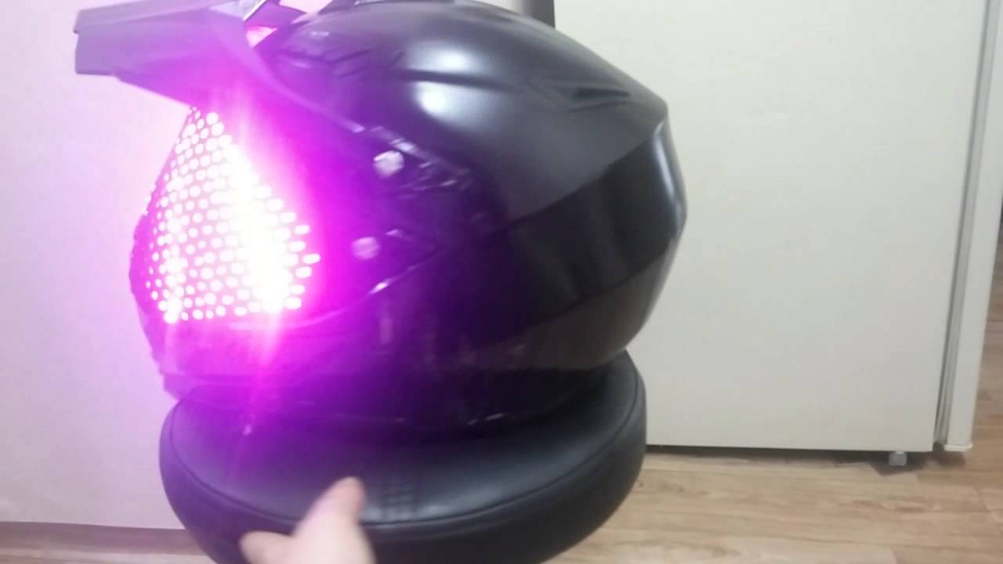
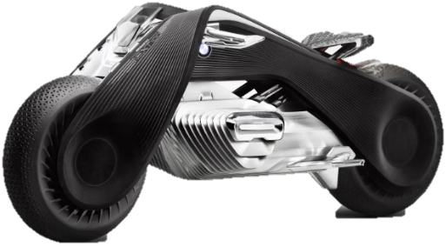
Needs for HUD Built-in Safety Equipment
Needs
Relax and safety motorcycle riding with required interactive driving guidance service with a rider
Exact Live Onroad condition update in addition to satellite imaging to provide high precise onroad conditions
Smart use of head safety equipment with next-generation display technology development such as HUD for navigation and automatic safe motorcycle riding in all climate and traffic conditions.
Concept Approach
Utilize the camera infrastructure installed on the road
Uses the next-generation display technology such as HUD for navigation as well as light communication.
Camera Built-in On HUD used for light communication receiver
Transparent HUD used for light communication transmitter
Easy to use with user interactive service technology on motorcycle helmet
< Motorcycle Riding Scenario >
GOOGLE
Slide 3

Slide 4
HUD based Internet of Signage Network for ITS Service
HUD based Internet of Signage Network Link for ITS Service
Tx : Helmet HUD Display Signage
Rx : CMOS Image Sensor in Built-in Helmet and CCTV on Roadways
Modulations :
For Street Lights : OOK, VPPM, Offset-VPWM, Multilevel PPM, DSSS SIK
For HUD / HMD / Signage : QR-Code, Color Code, VTASC, SS2DC
Day-Night Communication Mode
Data Rate : 1K ~ 1Mb/s
Supported LoS (Line of Sight)
Distance : 5m ~ 50m
To Get a Traffic Information from Motorcycle Rider
Live Traffic Information Update on ITS
< HUD Built-in Safety Equipments Light Communication Link >
※ To update live roadway condition and safety information on ITS
Slide 4

Slide 5
Conclusion
Proposed the Transparent HUD Built-in Safety Equipment Using Internet of Signage Network for ITS
In this approach, Safety Equipment built-in with HUD provides the Internet of Signage Network used for navigation guidance as well as to transfer the roadway condition on ITS to provide precise traffic or road conditions
Utilize the roadway side installed CCTV and head mounted camera built-in with helmets.
Slide 5

