Slide 1
Project: IEEE P802.15 Working Group for Wireless Personal Area Networks (WPANs)
Submission Title: Factory Location Guide Solution using Color based LED-ID Technology
Date Submitted: May 2018
Source: Jaesang Cha(SNUST, VTASK Co., Ltd.), Suhyung Cho(Hans ENS Co., Ltd.), Kirhyong Kim (Seil Technologies Co., Ltd.), Vinayagam Mariappan(SNUST)
Address: Contact Information: +82-2-970-6431, FAX: +82-2-970-6123, E-Mail: chajs@seoultech.ac.kr
Re:
Abstract: This documents introduce the V2X using color based LED-ID technology design consideration for VAT. This proposed solution for factory vehicles used to guide find the service location automatically using LED-ID. This VAT to operate on the application services like ITS, ADAS, etc. on indoor / outdoor road condition. Also this can be used for LED-ID based IoT/IoL, Digital Signage with connected information services etc.
Purpose: To provided concept models of LED-ID based OWC solution for Vehicular Assistant Technology (VAT) Interest Group
Notice: This document has been prepared to assist the IEEE P802.15. It is offered as a basis for discussion and is not binding on the contributing individual(s) or organization(s). The material in this document is subject to change in form and content after further study. The contributor(s) reserve(s) the right to add, amend or withdraw material contained herein.
Release: The contributor acknowledges and accepts that this contribution becomes the property of IEEE and may be made publicly available by P802.15.
Slide 1

Slide 2
Contents
Needs for Automatic Location Guide in Factory
LED-ID Technology for Factory Vehicles
Conclusion
Slide 2

Slide 3
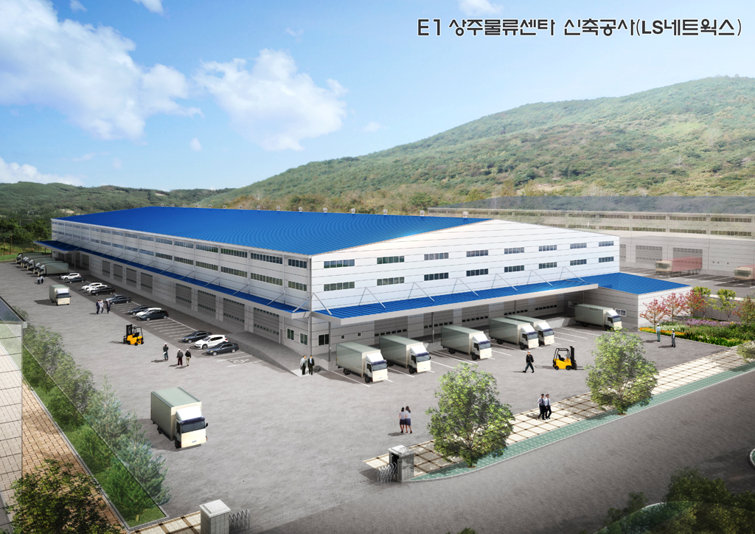
Needs for Automatic Location Guide in Factory
Needs
Vehicles needs to move specific department assigned cargo / department to transfer or deliver material
Cargo / Department assignment change randomly based on availability of material base and amount of material need to transfer or deliver
Factory cargo / department is not fixed systematic so confusion may occur where to collect or deliver materials
Simple solution for cargo / department transfer is required to avoid Confusions
Automatic Location Guide Concept
Utilize the already installed infrastructure in the factory like lighting devices, signage to assign location ID and CCTV to decode the vehicles specific Information
Vehicles Lights / Color LED-ID Tag used to transfer vehicle specific informations and camera on vehicle used to decode path specific information from LED-ID
Possible to systematically manage cargo in the factory.
GOOGLE
< Material Distribution Within the Factory >
Slide 3

Slide 4
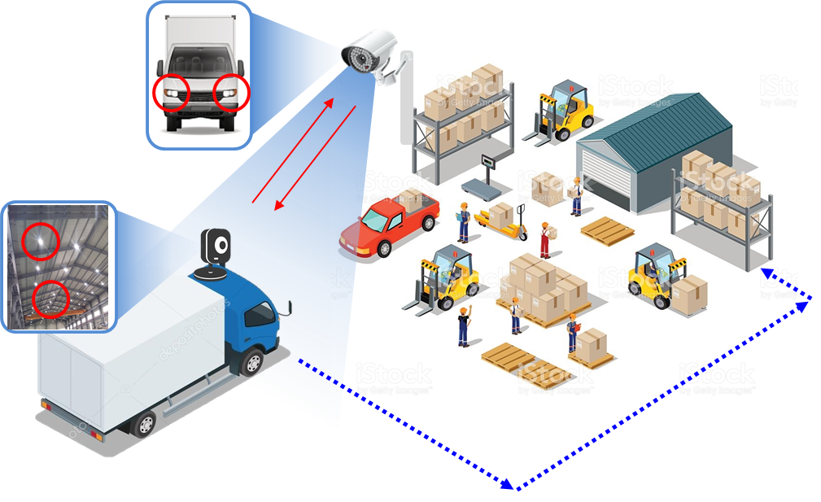
LED-ID Technology for Factory Vehicles
Bi-direction Light Communication
LED-ID Link for Factory Vehicles
Tx : Vehicle Lights and Factory Installed lights, Signage, Department Name Board
Rx : In-Vehicle Camera and Factory Installed CCTV Camera
Day-Night Communication Mode
Modulations :
OOK, VPPM, Offset-VPWM, Multilevel PPM, Inverted PPM, Subcarrier PPM, DSSS SIK etc.
Data Rate : 1K ~ 1Mb/s
Supported LoS (Line of Sight)
Available Distance : more than 500m with lens
Factory
Truck in Factory
Automatic Guidance
< OWC Link for Factory Vehicles >
Slide 4

Slide 5
Conclusion
Proposed the Factory Location Guide Solution using Color based LED-ID Technology
Utilize the factory installed infrastructure like lighting devices to assign LED-ID and CCTV to decode the vehicles specific Information
Provides systematically manage the logistics / department based on the optical camera communication linked with the truck using the camera and light installed in the factory.
Slide 5

