Slide 1
Project: IEEE P802.15 Working Group for Wireless Personal Area Networks (WPANs)
Submission Title: [Change Proposal for LRP UWB PHY]
Date Submitted: [8 May 2018]
Source: [David Barras] Company [3db Access AG]
Address [Uetlibergstrasse 137, 8035 Zurich, Switzerland]
Voice:[-], E-Mail:[david.barras (at) 3db-access.com]
Re: [Changes proposal for the LRP UWB PHY]
Abstract: [Contribute a proposal to the enhanced impulse radio group w.r.t. the LRP UWB PHY ]
Purpose: [Propose the modifications of the LRP UWB PHY for secure wireless access and location]
Notice: This document has been prepared to assist the IEEE P802.15. It is offered as a basis for discussion and is not binding on the contributing individual(s) or organization(s). The material in this document is subject to change in form and content after further study. The contributor(s) reserve(s) the right to add, amend or withdraw material contained herein.
Release: The contributor acknowledges and accepts that this contribution becomes the property of IEEE and may be made publicly available by P802.15.

Slide 2
ToC
Scope/Motivation
RTToF & Turnaround Time
LRP UWB PHY Modes

Slide 3
Scope - Why LRP UWB PHY ?
LRP UWB PHY has been identified as the closest to enable
“Secure wireless access and location of Things”
A true secure wireless access system is only achievable by a 1 pulse-per-bit scheme, for which energy associated with information is constrained on the shortest period of time.
LRP UWB PHY also offers “ultra-low power” by its simplicity of implementation and its ability of demodulation and decoding with zero latency (i.e. measurement is immediately available)

Slide 4
Scope - Why LRP UWB PHY ?
Strong market demand across all verticals for:
  Low cost of ownership
  (minimum size and BOM)
  Ultra-low power consumption
  (coin cell battery, several years of battery life)
  Low complexity and easy set-up
  (tolerance to different propagation environments)
  Provably secure
  (scientifically analyzed and proven)

Slide 5
Scope - Why LRP UWB PHY ?
LRP UWB perfectly fits the market demand with minor changes
LRP UWB enable ultra-low power consumption
(<<10 μJ per ranging):
  car/home/corporate/PC access, payment, location of “things”
  operated on small “things” such as keys, tags, wristwatches,…
  pave the way for “wake-up on UWB radio” devices
LRP UWB achieves optimally minimum silicon size
(< 3 mm²) with minimum BOM
LRP UWB achieves provable security under the strongest attacker model by means of classical challenge/response protocols

Slide 6
Scope - LRP UWB PHY Enhancements
Enhance the LRP UWB PHY to enable a new class of devices that will be used for secure wireless access and location of things with by adding two main features:
  round-trip time-of-flight for C/R protocol
  robust timing for distance bounding protocols

Slide 7
Fixed Rx-to-Tx Turnaround Time (1/5)
Purpose: enable a new class of devices capable of secure ranging with round-trip time-of-flight (RTToF) measurements
    RTToF in PHY crucial for implementing a “classical” challenge-response protocol;
    No timestamps exchanged, distance is measured in a secure way from the initiator only;
    LRP UWB PHY does not define Rx-to-Tx nor Rx-to-Tx turnaround times since LRP UWB PHY was not intended for RTToF (but rather for TDoA);
Initiator
Responder
t_{s}
Nv
Np
t_{p}
t_{r}
Secure distance measurement = (t_{r}-t_{s}-t_{p})*c/2

Slide 8
Fixed Rx-to-Tx Turnaround Time (2/5)
    PHY PIB attribute changes: add the attribute for round-trip time-of-flight that specifically use a fixed turnaround time
      A device supporting ranging measurement already has PHY PIB read-only attribute phyRanging (by default for LRP UWB PHY);
      A device able of answering in a fixed turnaround time will be defined by the new PHY PIB attribute in Table 11-2:
      For device supporting RTToF, the Rx-to-Tx turnaround time shall be defined with a fixed value (on the other hand, the Tx-to-Rx can re-use the definition in 10.2.1 with appropriate value in Table 11-1 ) …
Attribute | Type | Range | Description
phyRttof | Boolean | TRUE, FALSE | TRUE if Round-Trip Time-of-Flight with fixed Rx-to-Tx turnaround time is supported; FALSE otherwise.

Slide 9
Fixed Rx-to-Tx Turnaround Time (4/5)
A new PHY PIB attribute is proposed for devices supporting a fixed Rx-to-Tx turnaround time
Update of Table 11-1 – PHY PIB attributes:
Attribute | Description | Value
aTurnaroundTime | RX-to-TX or TX-to-RX turnaround time (in symbol periods), as defined in 10.2.1 and 10.2.2 | For the SUN, TVWS, and LECIM FSK PHYs, the value is 1 ms expressed in symbol periods, rounded up to the next integer number of symbol periods using the ceiling() function.ª For the LECIM DSSS PHY, the value is 1 ms expressed in modulation symbol periods, rounded up to the next integer number of symbol periods using the ceiling() function. The value is 12 for all other PHYs.
aFixedTurnaroundTime | RX-to-TX or TX-to-RX turnaround time (in pulse periods) | For the LRP UWB PHY supporting Round-Trip Time-of-flight with fixed Rx-to-Tx turnaround time, the value is 16 pulses periods for PRR=1 MHz and 32 pulses periods for PRR=2 MHz, i.e. 16 us. The Tx-to-Rx turnaround is less or equal than 16 us. If RTToF is not supported the value 0 is used.

Slide 10
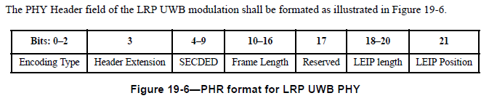
Fixed Rx-to-Tx Turnaround Time (5/5)
A device requiring a RTToF ranging measurement with fixed turnaround time response is notifying it directly in the PHR
This saves network traffic prior RTToF configuration
Only devices with attribute phyRttof=TRUE will interpret dedicated bit in PHR for immediate response with fixed Rx-to-Tx turnaround times
RTToF Notification : bit 17 in the PHY Header of LRP device:
  no longer “Reserved” for RTToF capable devices
  shall be set for RTToF measurements with fixed turnaround response

Slide 11
New Modes – Dual-frequency modes
Add [optional] PHY modes (“normal” and “extended”) that uses alternate OOK channels (similar to a 2-FSK)
Advantages:
  Timing: this mode always transmits a pulse in either one of the two used frequency bands
  → this avoid long series of pulse periods without energy (4f already implements some mechanisms)
  → increasing energy in each pulse period is optimum for pulse/bit synchronization (a key parameter for secure ranging!) but this should not
  be done at the cost of higher
  power spectral density !
OOK
1
0
1
0
1
2-FSK

Slide 12
New Modes – Dual-frequency modes
Advantages (cnt’d):
  PSD: using two distinct frequency band allows halving the BW of a pulse for the same overall Tx BW and peak PSD
  → reduce the constraint on the [full-band] peak power of the pulse (doubling the BW requires doubling the peak pulse RF voltage for keeping peak ESD constant)
  → better fits deep-submicron technologies

Slide 13
New Modes – Dual-frequency modes
To keep the packet as short as possible for reducing on-air transmission times (but without being impacted by IPI), the dual-frequency mode is proposed with a PRR of 2 MHz.
The dual-frequency modulation is proposed in two modes:
  dual-frequency mode with single pulse per bit, for secure ranging and efficient management of network of ranging devices and/or anchors;
  Extended dual-frequency with 4 pulses per bit encoding for improved [secure] ranging sensitivity and location of things;

Slide 14
New Modes – Mandatory/Optional Modes
Make the Extended and Long-Range PHY modes optional in UWB LRP PHY, keep only Base mode as mandatory mode
  Today’s statements: “All transmit modes are optional, but all modes shall be implemented in the receiver and operational concurrently”
  Proposed change : “Base mode shall be implemented in the receiver and the transmitter, other modes are optional.”

Slide 15
New Modes – Summary Table
To add in section 17.1:
In dual-frequency mode, LRP UWB PHY symbol consists of the presence of pulses at either one of the center frequencies defined in TBD, transmitted in 2 MHz PRF train.
In extended dual-frequency mode, LRP UWB PHY symbol consists of the presence of pulses at either one of the center frequencies defined in [TBD], transmitted in 2 MHz PRF train and generated by convolution with octal generators (5,7,7,7).

Slide 16
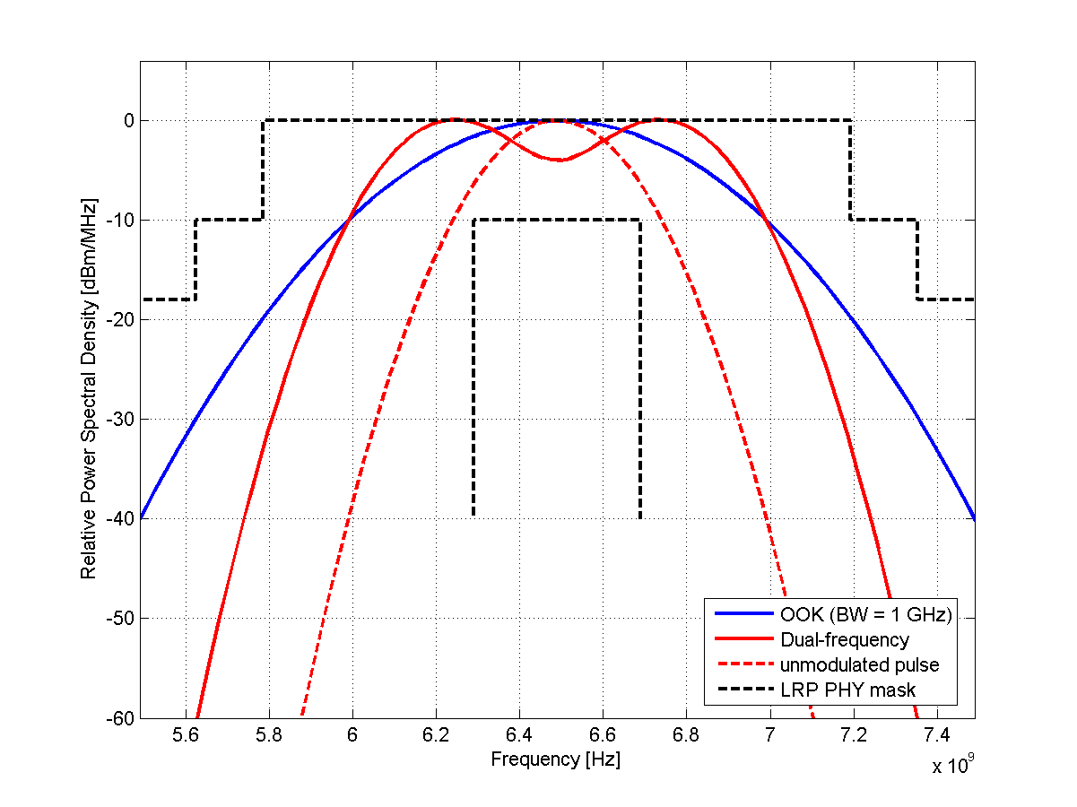
Modes – 4f PSD Mask Compliance
Add in Section 19.7.1
  “For both dual-frequency and extended dual-frequency modes, the un-modulated instantaneous frequency response (f_{dev}=0) as well as the modulated frequency response shall comply with the Transmit PSD mask defined in section 19.7.3.”

Slide 17
Q & A

