Slide 1
Project: IEEE P802.15 Working Group for Wireless Personal Area Networks (WPANs)
Submission Title: [IG LPWA Agenda November 2017 Plenary]
Date Submitted: [6 November, 2017]
Source: [Matthew Gillmore] Company [Itron]
Address[2111 N Molter Rd, Liberty Lake, WA 99019]
Voice[] E-Mail:[matthew.gillmore@itron.com]
Re: []
Abstract: [Contains the agenda of the IG FANE]
Purpose: [Agenda for March 2018 SG FANE]
Notice: This document has been prepared to assist the IEEE P802.15. It is offered as a basis for discussion and is not binding on the contributing individual(s) or organization(s). The material in this document is subject to change in form and content after further study. The contributor(s) reserve(s) the right to add, amend or withdraw material contained herein.
Release: The contributor acknowledges and accepts that this contribution becomes the property of IEEE and may be made publicly available by P802.15.

Slide 2
Instructions for the WG Chair
The IEEE-SA strongly recommends that at each WG meeting the chair or a designee:
  Show slides #1 through #4 of this presentation
  Advise the WG attendees that:
    The IEEE’s patent policy is described in Clause 6 of the IEEE-SA Standards Board Bylaws;
    Early identification of patent claims which may be essential for the use of standards under development is strongly encouraged;
    There may be Essential Patent Claims of which the IEEE is not aware. Additionally, neither the IEEE, the WG, nor the WG chair can ensure the accuracy or completeness of any assurance or whether any such assurance is, in fact, of a Patent Claim that is essential for the use of the standard under development.
  Instruct the WG Secretary to record in the minutes of the relevant WG meeting:
    That the foregoing information was provided and that slides 1 through 4 (and this slide 0, if applicable) were shown;
    That the chair or designee provided an opportunity for participants to identify patent claim(s)/patent application claim(s) and/or the holder of patent claim(s)/patent application claim(s) of which the participant is personally aware and that may be essential for the use of that standard
    Any responses that were given, specifically the patent claim(s)/patent application claim(s) and/or the holder of the patent claim(s)/patent application claim(s) that were identified (if any) and by whom.
  The WG Chair shall ensure that a request is made to any identified holders of potential essential patent claim(s) to complete and submit a Letter of Assurance.
  It is recommended that the WG chair review the guidance in IEEE-SA Standards Board Operations Manual 6.3.5 and in FAQs 14 and 15 on inclusion of potential Essential Patent Claims by incorporation or by reference.
  Note: WG includes Working Groups, Task Groups, and other standards-developing committees with a PAR approved by the IEEE-SA Standards Board.

Slide 3
Participants, Patents, and Duty to Inform
All participants in this meeting have certain obligations under the IEEE-SA Patent Policy.
  Participants [Note: Quoted text excerpted from IEEE-SA Standards Board Bylaws subclause 6.2]:
    “Shall inform the IEEE (or cause the IEEE to be informed)” of the identity of each “holder of any potential Essential Patent Claims of which they are personally aware” if the claims are owned or controlled by the participant or the entity the participant is from, employed by, or otherwise represents
    “Should inform the IEEE (or cause the IEEE to be informed)” of the identity of “any other holders of potential Essential Patent Claims” (that is, third parties that are not affiliated with the participant, with the participant’s employer, or with anyone else that the participant is from or otherwise represents)
  The above does not apply if the patent claim is already the subject of an Accepted Letter of Assurance that applies to the proposed standard(s) under consideration by this group
  Early identification of holders of potential Essential Patent Claims is strongly encouraged
  No duty to perform a patent search

Slide 4
Patent Related Links
  All participants should be familiar with their obligations under the IEEE-SA Policies & Procedures for standards development.
  Patent Policy is stated in these sources:
  IEEE-SA Standards Boards Bylaws
  http://standards.ieee.org/develop/policies/bylaws/sect6-7.html#6
  IEEE-SA Standards Board Operations Manual
  http://standards.ieee.org/develop/policies/opman/sect6.html#6.3
  Material about the patent policy is available at
  http://standards.ieee.org/about/sasb/patcom/materials.html
If you have questions, contact the IEEE-SA Standards Board Patent Committee Administrator at patcom@ieee.org or visit http://standards.ieee.org/about/sasb/patcom/index.html
This slide set is available at https://development.standards.ieee.org/myproject/Public/mytools/mob/slideset.ppt

Slide 5
Call for Potentially Essential Patents
If anyone in this meeting is personally aware of the holder of any patent claims that are potentially essential to implementation of the proposed standard(s) under consideration by this group and that are not already the subject of an Accepted Letter of Assurance:
  Either speak up now or
  Provide the chair of this group with the identity of the holder(s) of any and all such claims as soon as possible or
  Cause an LOA to be submitted

Slide 6
Other Guidelines for IEEE WG Meetings
All IEEE-SA standards meetings shall be conducted in compliance with all applicable laws, including antitrust and competition laws.
  Don’t discuss the interpretation, validity, or essentiality of patents/patent claims.
  Don’t discuss specific license rates, terms, or conditions.
    Relative costs, including licensing costs of essential patent claims, of different technical approaches may be discussed in standards development meetings.
      Technical considerations remain primary focus
  Don’t discuss or engage in the fixing of product prices, allocation of customers, or division of sales markets.
  Don’t discuss the status or substance of ongoing or threatened litigation.
  Don’t be silent if inappropriate topics are discussed … do formally object.
---------------------------------------------------------------
See IEEE-SA Standards Board Operations Manual, clause 5.3.10 and “Promoting Competition and Innovation: What You Need to Know about the IEEE Standards Association's Antitrust and Competition Policy” for more details.

Slide 7
802.15 SG FANE
Agenda May 2018 Interim
Matthew Gillmore
Itron

Slide 8
SG FAN Schedule for the Week
 | Monday | Tuesday | Wednesday | Thursday
AM 1 |  |  |  | SG FANE
AM 2 |  | TG FANE
PM 1 | TG FANE | TG FANE
PM 2

Slide 9
Main Agenda Items for the Week
Monday PM1
  Review Timeline, Goals, Plan for week
Tuesday AM2
  Review contributions
Tuesday PM1
  Created proposed amended text
Thursday AM1
  Finalize amended text and prepare for letter ballot

Slide 10
Timeline
Sept 2017 Interim (Waikoloa)
  Initial WNG presentation
November 2017 Plenary (Orlando)
  Develop IG report and draft PAR and CSD
January 2018
  Get SG/TG approval
March 2018
  Review PAR/CSD comments
  Develop amendment
May 2018
  Develop amendment
  Submit for ballot

Slide 11
TG Goals
Requirements derived from utility use cases
  51-17-0523.00
    Utilities want higher speeds
    Utilities want lower latency
    Utilities want longer range
    Utilities want to use existing hardware
    Utilities want less equipment

Slide 12
Requirements
Utilities are asking for higher data rates
  Require lower latency in mesh networks to support latency sensitive applications
  <10ms per hop required in some applications
  Applications with higher data volumes e.g. OTA updates.
Higher capacity of nodes in mesh networks
  Expanding trade-off space for balancing bandwidth, interference footprint, delivery reliability.
Performance: Higher Rates & Adaptive RF link optimization
  Mix of performance needs
  Minimize Latency, effective use of spectrum, backward compatibility
  Ability to adjust to changing RF conditions

Slide 13
Ways to improve
Points to increases in data rates
  Modest increases – still low Mb/sec
  Modest bandwidth usage/channel width
  Flexible channelization
Just Right balancing point
  OFDM 800 kbps, 1.2 Mbps, 2.4 Mbps
  Compliment to lower rate (bandwidth) OFDM, OQPSK and FSK
  Builds on what is working now

Slide 14
Longer Range Enhancements
MR-OQPSK rate modes 0-3 at 100 k/chips per second works well
  However, channel plan is not defined for most market regions including North America

Slide 15
PAR Scope
Create a WG to assess adding additional OFDM MCS modes
Clarify OQPSK channel plans for new markets (e.g. North America, etc)

Slide 16
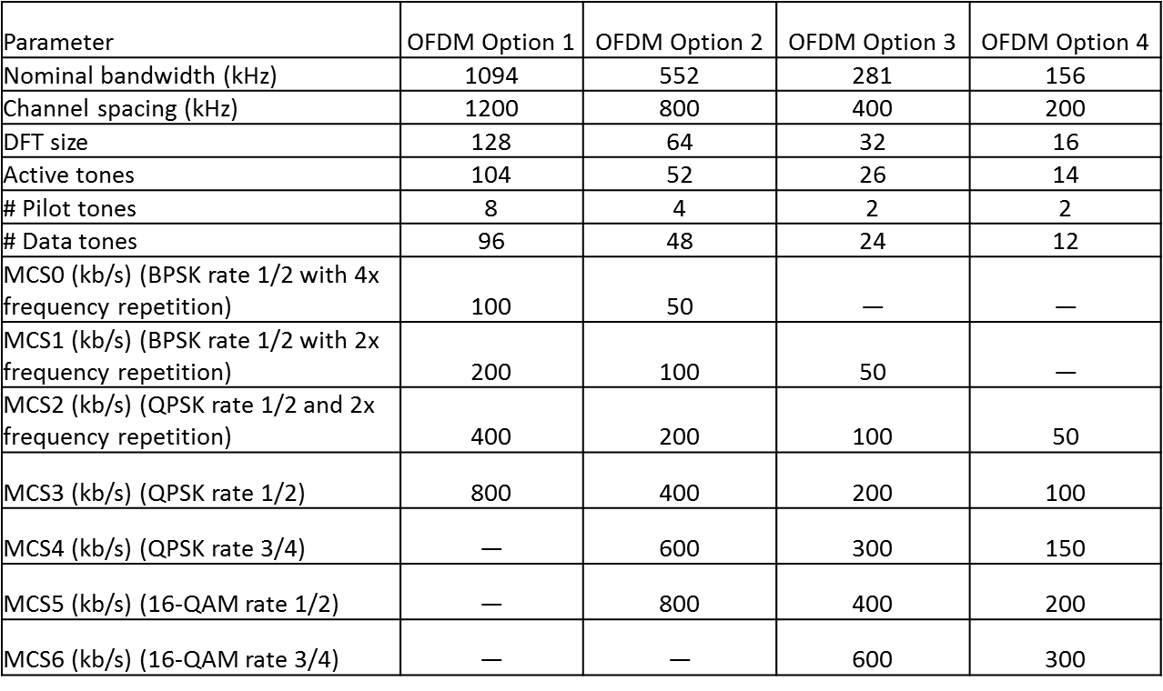
MR-OFDM Modes Existing

Slide 17
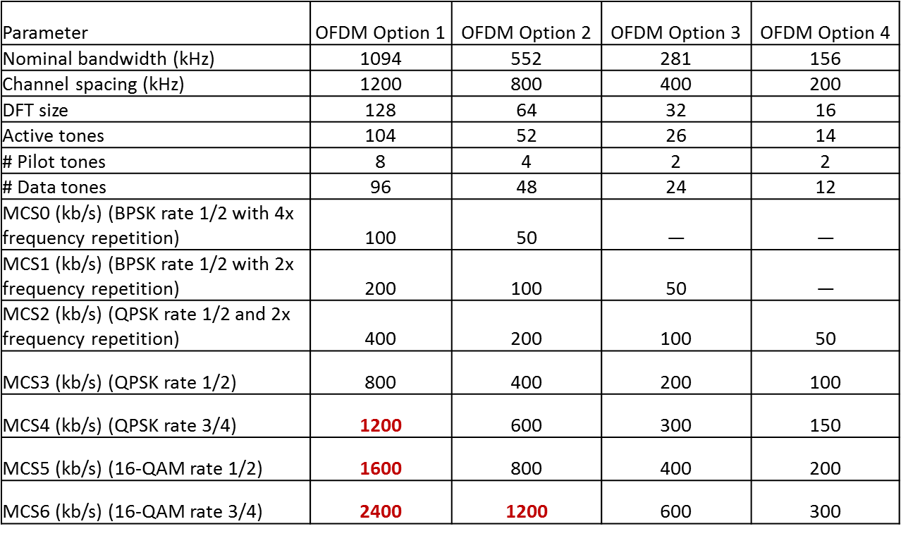
MR-OFDM Modes Proposed

Slide 18
Extension Justification
Multiple OFDM implementations commercially available
Existing implementations support MCS5 and MCS6 for all options already
Using modulation, coding, channelization already defined.

Slide 19
MR-OQPSK Channel Plans
Clarify where MR-OQPSK can be used in 200khz channel spacing in all markets

Slide 20
MR-OQPSK Examples
902 – 928 (U.S. ISM) Note (1) | MR-FSK mode #1 | 0.2 | 129 | 902.2
 | MR-FSK mode #2 & #3 | 0.4 | 64 | 902.4
 | OFDM Option 4 | 0.2 | 129 | 902.2
 | OFDM Option 3 | 0.4 | 64 | 902.4
 | OFDM Option 2 | 0.8 | 31 | 902.8
 | MR-O-QPSK 100 kchip/s | 0.2 | 129 | 902.2

Slide 21
PAR & CSD
PAR 15-17-0624-06
CSD 15-17-0622-04

