Slide 1
Project: IEEE P802.15 Working Group for Wireless Personal Area Networks (WPANs)
Submission Title: TG13 MAC considerations for distributed MIMO
Date Submitted: 08 May 2018
Source: Kai Lennert Bober, Volker Jungnickel [Fraunhofer HHI]
Address: Einsteinufer 37, 10587 Berlin, Germany
Voice:[+49-30-31002 284], E-Mail:[kai.lennert.bober@hhi.fraunhofer.de]
Re:
Abstract: This document provides MAC considerations for distributed MIMO in TG13
Purpose: Contribution to IEEE 802.15.13
Notice: This document has been prepared to assist the IEEE P802.15. It is offered as a basis for discussion and is not binding on the contributing individual(s) or organization(s). The material in this document is subject to change in form and content after further study. The contributor(s) reserve(s) the right to add, amend or withdraw material contained herein.
Release: The contributor acknowledges and accepts that this contribution becomes the property of IEEE and may be made publicly available by P802.15.

Slide 2
IEEE P802.15.13
MAC considerations of Fraunhofer HHI
Date: 2018-05-08 Place: Warsaw, Poland
Authors:

Slide 3
Introduction
Scope and goals
  Industrial applications → high reliability and low latencies
  Deterministic MAC, no CSMA for data transmission
  Spatial diversity through joint transmission / macro diversity

Slide 4
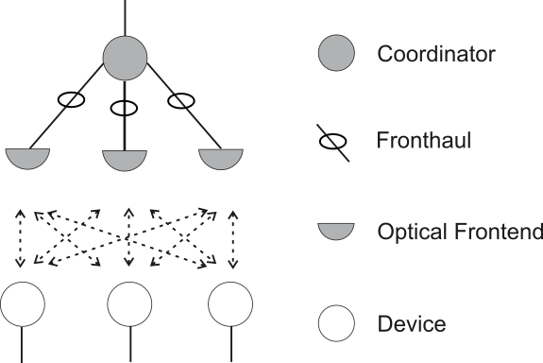
Introduction
What topology
  Area-wide distributed MIMO
  Single coordinator, multiple optical frontends connected via fronthaul
  All MIMO MAC performed in coordinator
  Logical topology is „star“, not „coordinated topology“

Slide 5
Distributed MIMO approach
Essential PHY & MAC capabilities:
  PHY supports MIMO reference symbols
  PHY transmits data from set of “TX-ports” (indicated through
  PHY-SAP) to intended devices
  Devices provide CSI feedback
  MAC defines GTS allocations and spatial precoder
Fronthaul
  Details out of scope
  But: must fulfill certain requirements (i.e. delay bounds)

Slide 6
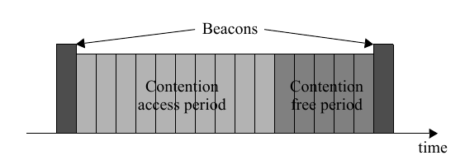
Superframe structure
Based on IEEE 802.15.4:
  Joint transmission of Beacon by all optical frontends
  CAP for random access by devices, e.g. (re-)association, …
  CFP for data transmission
  Spatial reuse of resources in CFP

Slide 7
Polling vs. 802.15.4-like MAC
802.15.4:
  Superframe specification broadcasted for the whole superframe in advance
  Synchronized devices transmit in allocated GTS
  Can tolerate fronthaul delays
Polling:
  GTS allocation is transmitted to device ad-hoc (downlink transmission per GTS needed)
  Skipping unused GTS
  Devices must always listen
  Small fronthaul delay required

Slide 8
MAC frame formats and types
General MAC header fields
  Addressing, sequence no., frame type, security indication, traffic class (i.e. ack. / no ack., …)
Frame types (differ in MAC payload)
  Control (e.g. Beacon, feedback, GTS specification)
    Contains descriptors for each control information type
  Management (e.g. Dis-/Association, key management, …)
    Contains management payload (Coordinator ←→ Device)
  Data
    Contains user data in payload

Slide 9
Example superframe showing regular control frame exchange
Beacon
CAP
Channel est.
CFP
Coordinator
Beacon
Feedback
Superframe / GTS
Specification
…
…
Device
Superframe
Channel est.
Optional TDD boundary

Slide 10
Summary
Li-Fi should be handled as large distributed MIMO.
PHY layers support measurements.
MAC layer defines feedback + GTS Specification incl. the required support for large distributed MIMO.
Industrial transmission schemes will focus on spatial diversity rather than on spatial multiplexing.
In this way, the requirements of for industrial applications are addressed:
  Moderate throughput (> 100 Mbit/s)
  High reliability
  Low latency

