Slide 1
IEEE 802.15 TG13
Partial Evaluation of PM-PHY using TG7r1 Channels
Date: 2018-05-09
Author:

Slide 2
Background
May 2018
In the IEEE 802.15 TG13 March 2018 meeting (15-18-0084-01-0013), TG13 requested full or partial evaluation results using PM-PHY through either simplified or TG7r1 channel models [1] [2].
This presentation will show the setup and results of a simulation of the Pulse Modulation through the specified channel environment.
  2-PAM (OOK) modulation
  Quantify Bit Error Rate using the TG7r1 channel models
Quantify costs and benefits of Pulse Shaping
  The current draft standard does not specify any pulse shaping.
  What are the consequences of that?
  Different pulse shapes will be used:
    Square
    Root-Raised Cosine

Slide 3
2-PAM PHY
May 2018
As defined in the draft 15-18-0003-03-0013 Text Proposal for Pulsed Modulation PHY
Data Rates from 4.7 Mbit/s to 150 Mbit/s
Channel estimation sequences from 32 bits to 1024 bits
Optional HCM
  For this analysis, HCM(1,1) is used
Pulse shaping is not defined

Slide 4
Simulation
May 2018
This presentation will cover 4 out of 8 of the test points in scenario 3 from TG7r1.
The simulation is agnostic to sample rate
  The data is transmitted at different oversample rates (OSR)
  This allows the results to be relative to the sample rate of the channel data in TG7r1.
A lower OSR would relate to a higher data rate
  If the sample rate were 1 GSPS, and the OSR were 5, then the data rate for 2-PAM would be 1 Mbit/s.
The simulation will run over a range of oversample rates.

Slide 5
Simulation
May 2018
The simulation is as hardware agnostic as possible.
  The simulation will run of a range of E_{b}/N₀, not SNR or transmit power.
  E_{b}/N₀ does not take propagation into account. Converting transmit power to received SNR to E_{b}/N₀ is specific to the hardware.
All signals will be real and positive valued
  There will be no negative values through the channel.
The simulation will not cover clipping at maximum amplitudes.
  Saturation at the LED is a function of that particular LED.

Slide 6
The Receiver
May 2018
Matched Filter
Symbol Timing and Decimation
Equalizer
Hard Decision
*
Channel

Slide 7
Synchronization
May 2018
Barker code used to confirm sampling phase.
Samples

Slide 8
RRC Parameters
May 2018
Beta = 0.5
Span = 6
RRC has overshoot that will cause negative values.
Negative values must be prevented.
  Clip
  DC Offset
Slide 8

Slide 9
RRC Negative Value Solutions
May 2018
Pulse Shape Filter
+
*
Matched Filter
DC Offset
TX
RX
Offset
Channel
Clipping
Negative
Values
Pulse Shape Filter
Matched Filter
*
TX
RX
Channel

Slide 10
Baseline Performance in Ideal Channel with No Corrections to RRC PAM
May 2018
Both square and RRC pulses meet theoretical performance in impulse channel.
No corrections were applied to the negative values of RRC PAM for this baseline curve.
P_{e}
E_{b}/N₀

Slide 11
CCDF without Corrections to RRC PAM
May 2018
The CCDF for uncorrected PAM RRC extends to 4.38 dB
This is 1.35 dB
above PAM

Slide 12
Ideal Channel with Offset and Clipping
May 2018
Clipping the small negative values yields a better BER than expending power on a DC Offset.
P_{e}
E_{b}/N₀

Slide 13
CCDF with Offset and Clipping
May 2018
The CCDF for Offset RRC PAM is the same as uncorrected RRC PAM at 4.38 dB,
  1.35 dB above PAM.
The CCDF for Clipped RRC PAM extends to 4.87 dB.
  1.84 dB above PAM

Slide 14
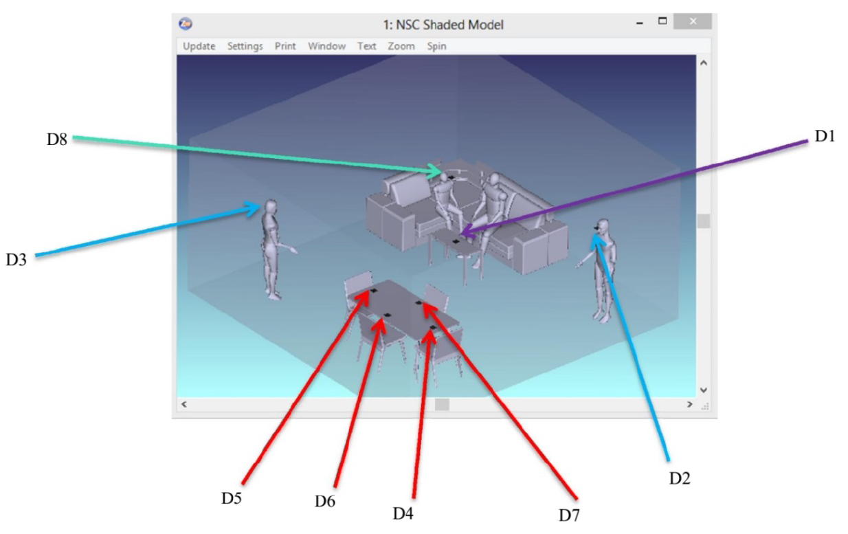
Situation 3: Home Use
May 2018
Image from [1]
8 Locations (D1-D8)

Slide 15
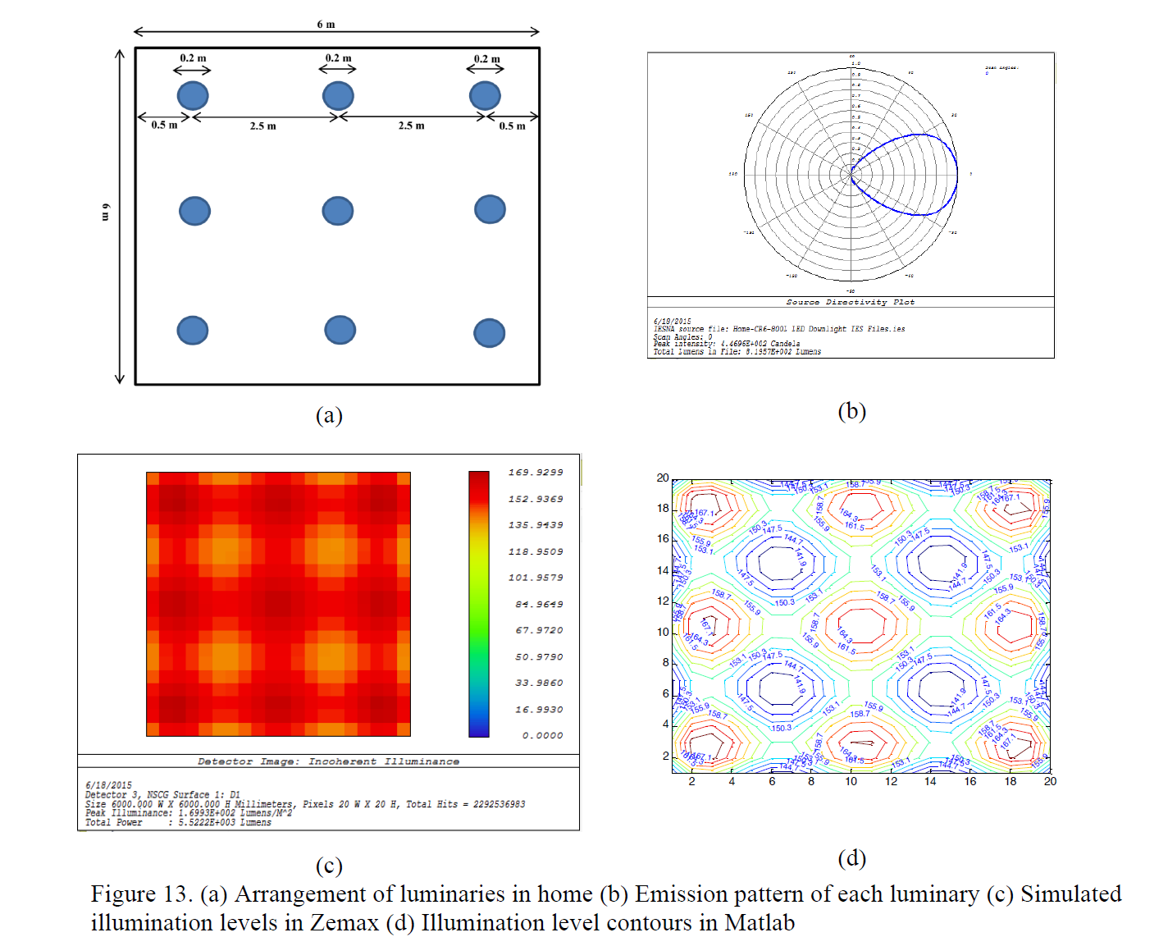
Situation 3: Home Use
May 2018
Image from [1]

Slide 16
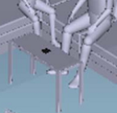
Channel Response – D1
May 2018
D1
Image from [1]
Samples

Slide 17
Channel Response – D1
May 2018

Slide 18
Equalization Process
May 2018
Linear Equalization, no decision directed feedback
21 Coefficient Channel Estimate
Equalization runs after matched filter and decimation
No Noise in training sequence
Placing an upper bound on linear equalizer performance

Slide 19
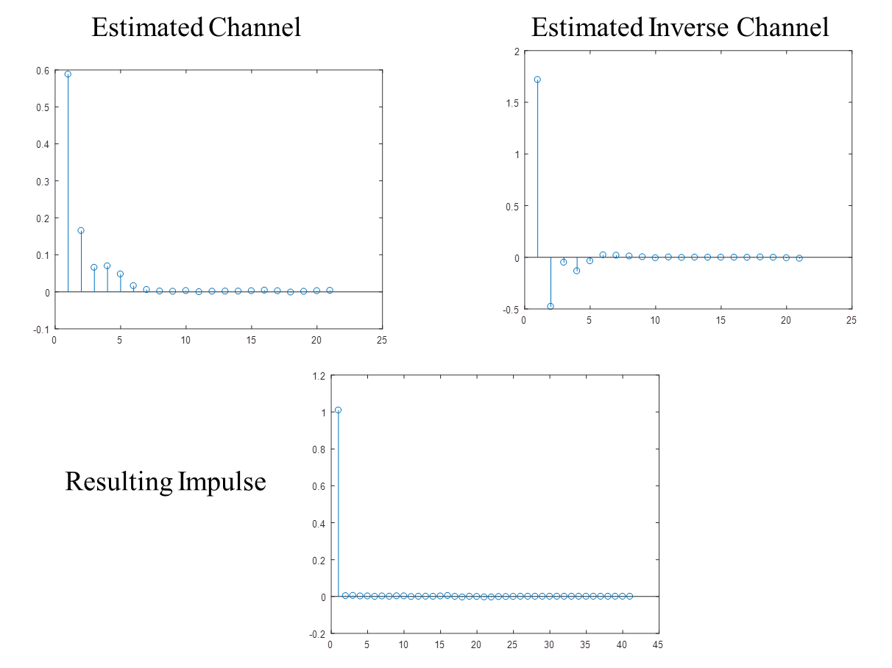
Equalization – D1
May 2018

Slide 20
D1, OSR = 50
May 2018
P_{e}
E_{b}/N₀

Slide 21
D1, OSR = 7
May 2018
P_{e}
E_{b}/N₀

Slide 22
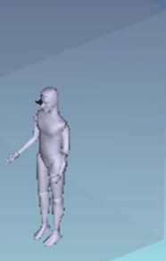
Channel Response – D2
May 2018
D2
Image from [1]
Samples

Slide 23
Channel Response – D2
May 2018

Slide 24
D2, OSR = 7
May 2018
P_{e}
E_{b}/N₀

Slide 25
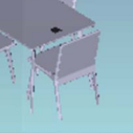
Channel Response – D4
May 2018
D4
Image from [1]
Samples

Slide 26
Channel Response – D4
May 2018

Slide 27
D4, OSR = 7
May 2018
P_{e}
E_{b}/N₀

Slide 28
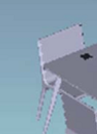
Channel Response – D5
May 2018
D5
Image from [1]
Samples

Slide 29
Channel Response – D5
May 2018

Slide 30
D5, OSR = 7
May 2018
P_{e}
E_{b}/N₀

Slide 31
Results
May 2018
Most data points in the scenario benefit more from spectral efficiency than the cost in PAPR when there is no equalization.
  D2 and D3 are the exceptions
Pulse Shaping Leads to Higher Spectral Efficiency
  Higher Spectral Efficiency demonstrated greater resilience to limited channel bandwidth.
The system in situation 3 clearly benefits from spectral efficiency.

Slide 32
References
May 2018
[1] Uysal, Murat, Tuncer Baykas, Farshad Miramirkhani, Nikola Serafimovskim, and Volker Jungnickel. IEEE P802.15-15-0746-01-007a Technical Report, September 2015.
[2] Uysal, Murat, Farshad Miramirkhani, Omer Narmanlioglu, Tuncer Baykas, and Erdal Panayirci. "IEEE 802.15. 7r1 reference channel models for visible light communications." IEEE Communications Magazine 55, no. 1 (2017): 212-217.

