Slide 1
Project: IEEE P802.15 Working Group for Wireless Personal Area Networks (WPANs)
Submission Title: [Considerations on general MAC frame]
Date Submitted: [May, 2018]
Source: [John Li] Company [Huawei]
Address []
Voice:[86-15801539749], FAX: [+86-10-82882144], E-Mail:[john.liqiang@huawei.com]
Re: []
Abstract: [In this contribution, we discuss how to unify MAC frame format in 802.15.13]
Purpose: [Contribution to IEEE 802.15.13]
Notice: This document has been prepared to assist the IEEE P802.15. It is offered as a basis for discussion and is not binding on the contributing individual(s) or organization(s). The material in this document is subject to change in form and content after further study. The contributor(s) reserve(s) the right to add, amend or withdraw material contained herein.
Release: The contributor acknowledges and accepts that this contribution becomes the property of IEEE and may be made publicly available by P802.15.

Slide 2
Introduction
MAC issues to be resolved
  MAC frame format
    General format
    Format of each frame type
  Security protocol
  Other functionalities such as Coordinated MAC
MAC frame format, what do we have right now
  Frame format from 15.7-2011
  Frame format in Annex H
In this contribution, we try to merge these two MAC frame structure

Slide 3
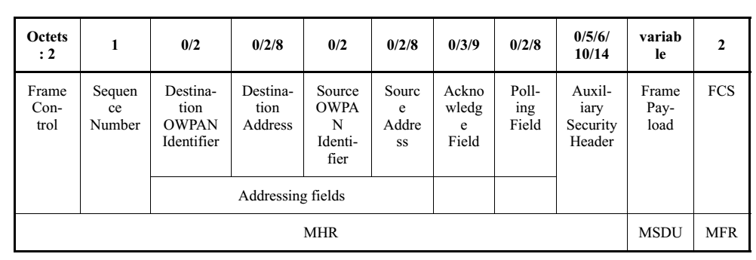
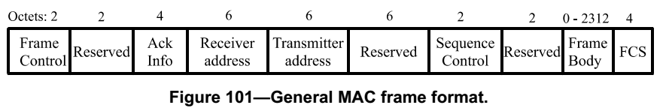
General MAC frames
15.7-2011
Annex H
Proposed general MAC frame format
Frame control
Sequence control
ACK information
Addressing field
Auxiliary Security header
Frame payload
FCS
MHR
MSDU
MFR

Slide 4
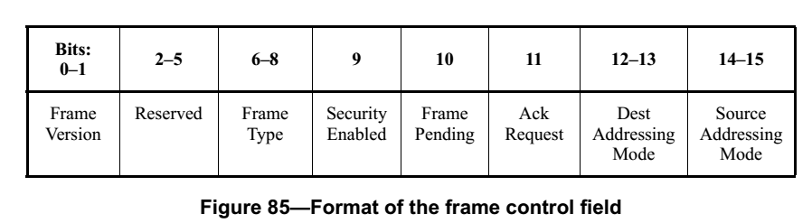
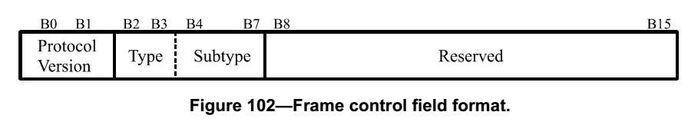
Frame control
15.7-2011
Annex H
Proposed “frame control” field
Frame version
Frame type / subtype
Security enabled
Frame pending
ACK request
reserved
The Security Enabled subfield is 1 bit in length, and it shall be set to one if the frame is protected by the MAC sublayer and shall be set to zero otherwise. The Auxiliary Security Header field of the MHR shall be present only if the Security Enabled subfield is set to one.
The Frame Pending subfield is 1 bit in length and shall be set to one if the device sending the frame has more data for the recipient. This subfield shall be set to zero otherwise
The Acknowledgment Request subfield is 1 bit in length and specifies whether an acknowledgment is required from the recipient device on receipt of a data or MAC command frame.

Slide 5
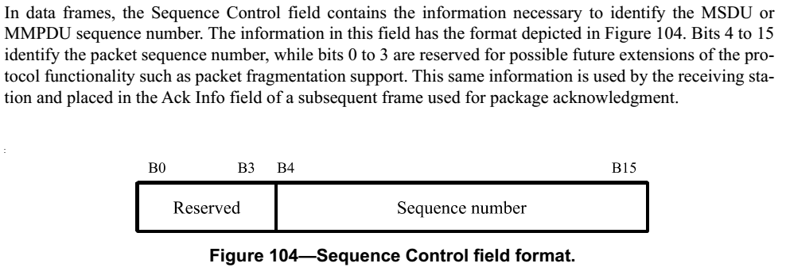
Sequence control
15.7-2011
Annex H
Proposed “sequence control” field
Option 1: One octet
Option 2: Two octet

Slide 6
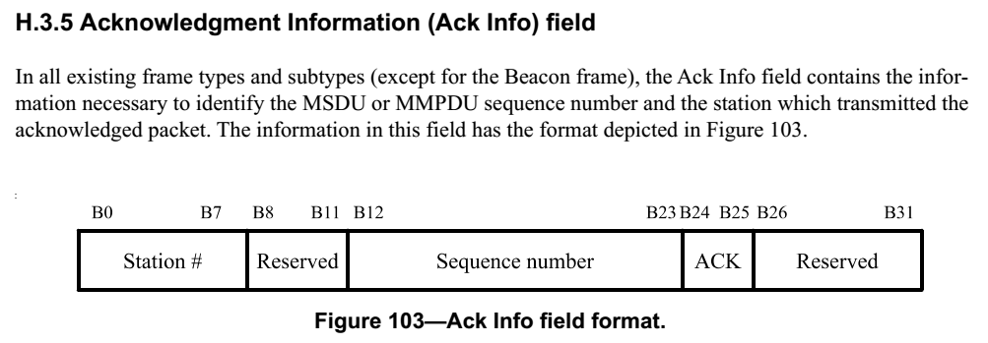
ACK information
Annex H
Proposed “ACK information” field
Device address
Sequence number
ACK
reserved

Slide 7
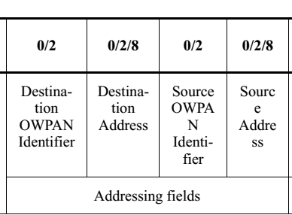
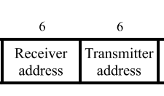
Addressing field
15.7-2011
Annex H
The Receiver Address field is a 48-bit field indicating the network address of the STA for which the transmitted packet is intended.
The Transmitter Address field is a 48-bit field indicating the network address of the STA transmitting the packet.
The Destination OWPAN Identifier field, when present, is 2 octets in length and specifies the unique OWPAN identifier of the intended recipient of the frame.
The Destination Address field, when present, is either 2 octets or 8 octets in length, according to the value specified in the Destination Addressing Mode subfield of the frame control field, see G.1.1.6, and specifies the address of the intended recipient of the frame.
The Source OWPAN Identifier field, when present, is 2 octets in length and specifies the unique OWPAN identifier of the originator of the frame.
The Source Address field, when present, is either 2 octets or 8 octets in length, according to the value specified in the Source Addressing Mode subfield of the frame control field,
Proposed “Addressing field” field
Destination OWPAN ID
Destination address
Source OWPAN ID
Source address

Slide 8
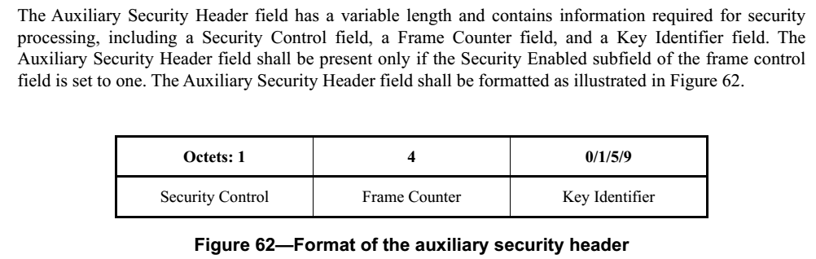
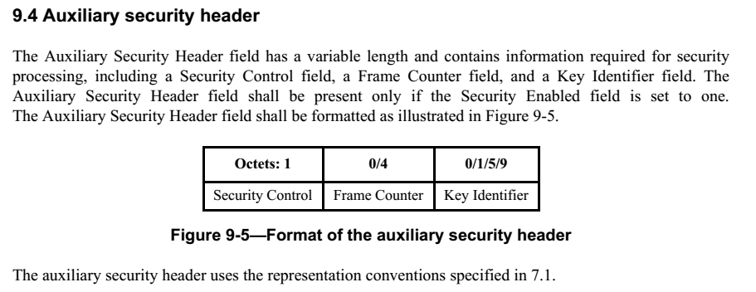
Auxiliary Security header
15.7-2011
15.4-2015

Slide 9
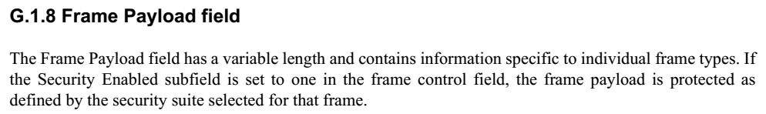
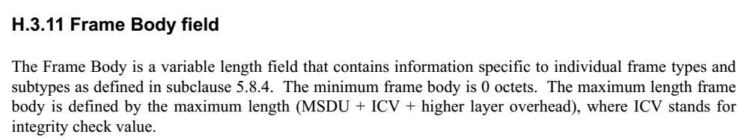
Frame payload
15.7-2011
Annex H
Please explain ICV and higher layer overhead.
Do we need them?
If we do, where to define them?

Slide 10
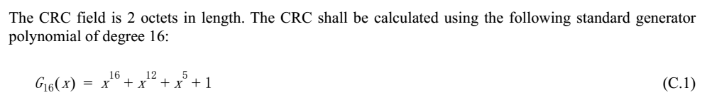
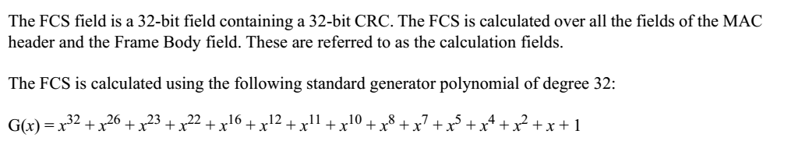
FCS
15.7-2011
Annex H
To be decided: which option to use

Slide 11
To be decided
Can the proposed general MAC frame format be accepted?
Can the proposed frame control format be accepted?
Which sequence control format be accepted?
Can the proposed “ACK information” field be accepted?
Can the proposed “Addressing field” be accepted?
Should we adopt security protocol from 15.4-2015?
Which FCS to be used, four octets or two octets?

