Slide 1
Project: IEEE P802.15 Working Group for Wireless Personal Area Networks (WPANs)
Submission Title: Evaluation of PM PHY Header and Payload
Date Submitted: 26 April 2018
Source: Malte Hinrichs, Volker Jungnickel [Fraunhofer HHI]
Address: Einsteinufer 37, 10587 Berlin, Germany
Voice:[+49-30-31002 284], E-Mail:[malte.hinrichs@hhi.fraunhofer.de]
Re:
Abstract: This document provides the evaluation results on header and payload coding schemes of PM PHY to TG13.
Purpose: Contribution to IEEE 802.15.13
Notice: This document has been prepared to assist the IEEE P802.15. It is offered as a basis for discussion and is not binding on the contributing individual(s) or organization(s). The material in this document is subject to change in form and content after further study. The contributor(s) reserve(s) the right to add, amend or withdraw material contained herein.
Release: The contributor acknowledges and accepts that this contribution becomes the property of IEEE and may be made publicly available by P802.15.

Slide 2
IEEE P802.15.13
Evaluation of PM PHY
Header and Payload coding schemes
Date: 2018-04-27 Place: Warsaw, Poland
Authors:

Slide 3
Channel simulation
Random Data
  Ca. 5M (without 8B10B)/2M (with 8B10B) bits
Encoding
  Reed-Solomon 36,24 (Header), 256,248 (Payload)
  8B10B line coding
  Separate 8B10B line coding for RS parity bits
Channel: AWGN
  SNR 0-15 dB
  Random noise samples added directly to baseband signal
Evaluation
  BER of decoded data stream

Slide 4
Channel simulation
Uncoded
Random bits
+
Error counting
AWGN
RS
Random bits
RS
+
RS⁻¹
Error counting
AWGN
RS + 8B10B
Random bits
RS
8B10B
+
8B10B⁻¹
RS⁻¹
Error counting
AWGN

Slide 5
Channel simulation
8B10B + RS
Random bits
8B10B
RS
+
RS⁻¹
8B10B⁻¹
Error counting
AWGN
8B10B + RS
+ 8B10B parity
Parity
bits
8B10B
8B10B⁻¹
Parity
bits
Random bits
8B10B
RS
+
RS⁻¹
8B10B⁻¹
Error counting
AWGN

Slide 6
BER for AWGN channel
Header coding schemes
OCR: baseband
Number of bits:
Uncoded | 4,999,970
RS 36,24 | 4,999,968
RS 36,24 + 8B10B | 1,999,872
8B10B + RS 36,24 | 1,999,872
8B10B + RS 36,24 + 8B10B parity | 1,998,720
8B10B | 1,999,872

Slide 7
BER for AWGN channel
Header coding schemes
OCR: baseband
Number of bits:
Uncoded | 4,999,970
RS 36,24 | 4,999,968
RS 36,24 + 8B10B | 1,999,872
8B10B + RS 36,24 | 1,999,872
8B10B + RS 36,24 + 8B10B parity | 1,998,720
8B10B | 1,999,872

Slide 8
BER for AWGN channel
Payload coding schemes
OCR: baseband
Number of bits:
Uncoded | 4,999,970
RS 256,248 | 4,999,680
RS 256,248 + 8B10B | 1,986,480
8B10B + RS 256,248 | 1,999,872
8B10B + RS 256,248 + 8B10B parity | 1,999,872
8B10B | 1,999,872

Slide 9
BER for AWGN channel
Payload coding schemes
OCR: baseband
Number of bits:
Uncoded | 4,999,970
RS 256,248 | 4,999,680
RS 256,248 + 8B10B | 1,986,480
8B10B + RS 256,248 | 1,999,872
8B10B + RS 256,248 + 8B10B parity | 1,999,872
8B10B | 1,999,872

Slide 10
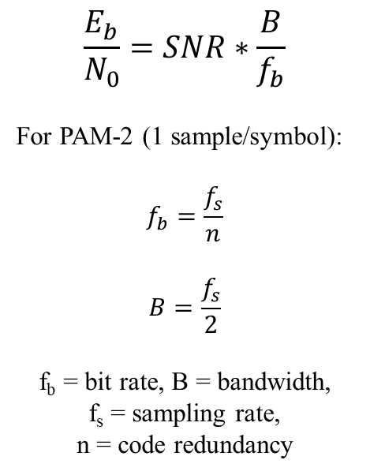
SNR / E_{b}/N₀ relation
$$\frac{E_{b}}{N_{0}}=SNR∗\frac{B}{f_{b}}$$
For PAM-2 (1 sample/symbol):
$$f_{b}=\frac{f_{s}}{n}$$
$$B=\frac{f_{s}}{2}$$
f_{b} = bit rate, B = bandwidth,
f_{s} = sampling rate,
n = code redundancy
Code redundancy n
Uncoded | 1
8B10B | 1,25
RS 36,24 | 1,5
RS 36,24 + 8B10B | 1,875
8B10B + RS 36,24 | 1,875
8B10B + RS 36,24 + 8B10B parity | 2,03125
RS 256,248 | 1,03225806
RS 256,248 + 8B10B | 1,29032258
8B10B + RS 256,248 | 1,29032258
8B10B + RS 256,248 + 8B10B parity | 1,30040323

