Slide 1
Project: IEEE P802.15 Working Group for Wireless Personal Area Networks (WPANs)
Submission Title: Evaluation Results on Payload of PM PHY
Date Submitted: 27 April 2018
Source: Sang-Kyu Lim, Jin-Doo Jeong, Il Soon Jang, Tae-Gyu Kang [ETRI]
Address: 218 Gajeong-ro, Yuseong-gu, Daejeon, 34129, Korea
Voice:[+82-42-860-1573], FAX: [+82-42-860-5218], E-Mail:[sklim@etri.re.kr]
Re:
Abstract: This document provides the evaluation results on payload of Pulsed Modulation PHY to TG13.
Purpose: Contribution to IEEE 802.15.13
Notice: This document has been prepared to assist the IEEE P802.15. It is offered as a basis for discussion and is not binding on the contributing individual(s) or organization(s). The material in this document is subject to change in form and content after further study. The contributor(s) reserve(s) the right to add, amend or withdraw material contained herein.
Release: The contributor acknowledges and accepts that this contribution becomes the property of IEEE and may be made publicly available by P802.15.

Slide 2
Evaluation Results
on Payload of PM PHY
Sang-Kyu Lim, Jin-Doo Jeong, Il Soon Jang, Tae-Gyu Kang [ETRI]

Slide 3
Evaluation Framework of PM PHY
Preamble : Detection probability (for false alarm rate = 0.1%) vs. SNR (cf. doc. 15-18-0106/r0) and required SNR where prob. of misdetection (timing error) < 0.1%
Header : BER vs. SNR for the header incl. 8B10B and RS(36,24) coding assuming random data for the header information
Payload : BER vs. SNR for the payload incl. 8B10B or HCM and RS(255,248) coding assuming random data for the payload
Results are expected for AWGN, D3 in scenario 3 and D7 in scenario 4 (Fig. 25) where LED1-6 are used together from https://mentor.ieee.org/802.15/dcn/15/15-15-0746-01-007a-tg7r1-channel-model-document-for-high-rate-pd-communications.pdf.
CIRs: https://mentor.ieee.org/802.15/dcn/15/15-15-0747-00-007a-tg7r1-cirs-channel-model-document-for-high-rate-pd-communications.zip a companion file.
In case of questions, please, use TG13 email reflector.

Slide 4
RS code for Payload Simulations
Payload : BER vs. SNR for the payload incl. 8B10B or HCM and RS(255,248) coding assuming random data for the payload
However, RS(255,248) couldn’t be applied to the simulations using MatLab because of a syntax error.
So, we replaced RS(255,248) with RS(255,239) for payload simulations, and RS(255,239) has been also applied to G.709 and ETSI-BRAN standards.

Slide 5
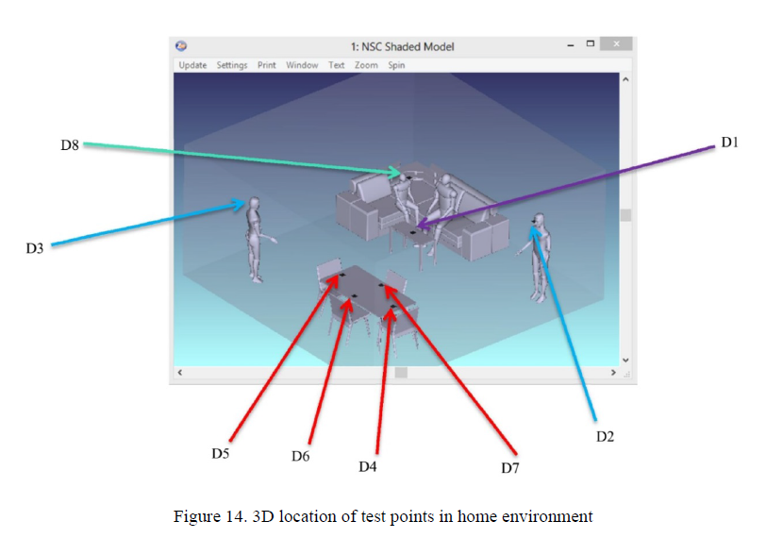
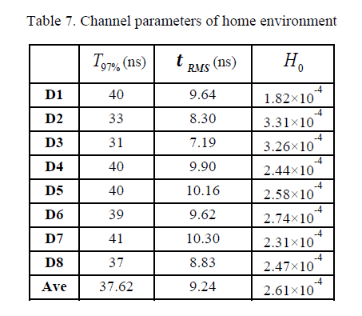
D3 Channel in Scenario 3 (Home Scenario)

Slide 6
D7 Channel in Scenario 4 (Home Scenario)

Slide 7

Simulation Set-up for Payload (1)
(1) Theoretical Model
$P_{e}=$ $Q\left(\sqrt{{E_{b}}/{N_{0}}}\right)$
( for 2-PAM Unipolar Signaling )
(2) AWGN only Model
AWGN
Payload Data
@ OCR = 50 MHz
@ OCR = 25 MHz
@ OCR = 12.5 MHz
@ OCR = 6.25 MHz
@ OCR = 3.125 MHz
8b10b
Modulation
CIR
Channels
Receiver
RS(255,239)
+

Slide 8
Simulation Set-up for Payload (2)
(3) Uncoded Model
AWGN
Payload Data
@ OCR = 50 MHz
@ OCR = 25 MHz
@ OCR = 12.5 MHz
@ OCR = 6.25 MHz
@ OCR = 3.125 MHz
8b10b
Modulation
CIR
Channels
Receiver
RS(255,239)
+
(4) RS Model
AWGN
Payload Data
@ OCR = 50 MHz
@ OCR = 25 MHz
@ OCR = 12.5 MHz
@ OCR = 6.25 MHz
@ OCR = 3.125 MHz
8b10b
Modulation
CIR
Channels
Receiver
RS(255,239)
+

Slide 9
Simulation Set-up for Payload (3)
(5) 8b10b Model
AWGN
Payload Data
@ OCR = 50 MHz
@ OCR = 25 MHz
@ OCR = 12.5 MHz
@ OCR = 6.25 MHz
@ OCR = 3.125 MHz
8b10b
Modulation
CIR
Channels
Receiver
RS(255,239)
+
(6) (RS+8b10b) Model
AWGN
Payload Data
@ OCR = 50 MHz
@ OCR = 25 MHz
@ OCR = 12.5 MHz
@ OCR = 6.25 MHz
@ OCR = 3.125 MHz
8b10b
Modulation
CIR
Channels
Receiver
RS(255,239)
+

Slide 10
Simulation Set-up for Payload (4)
(7) (8b10b+RS) Model
AWGN
Payload Data
@ OCR = 50 MHz
@ OCR = 25 MHz
@ OCR = 12.5 MHz
@ OCR = 6.25 MHz
@ OCR = 3.125 MHz
8b10b
Modulation
CIR
Channels
Receiver
RS(255,239)
+
(8) (8b10b+RS+R-8b10b) Model
* RB = Redundancy Bits
8b10b
for RB
AWGN
Payload Data
@ OCR = 50 MHz
@ OCR = 25 MHz
@ OCR = 12.5 MHz
@ OCR = 6.25 MHz
@ OCR = 3.125 MHz
8b10b
Modulation
CIR
Channels
Receiver
RS(255,239)
+

Slide 11
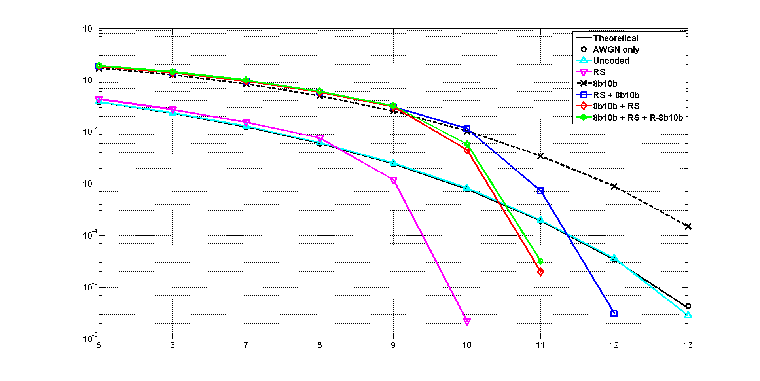
Results for D3 in S3 @ OCR = 3.125 MHz
Number of bits = 7,342,080
BER
SNR (dB)

Slide 12
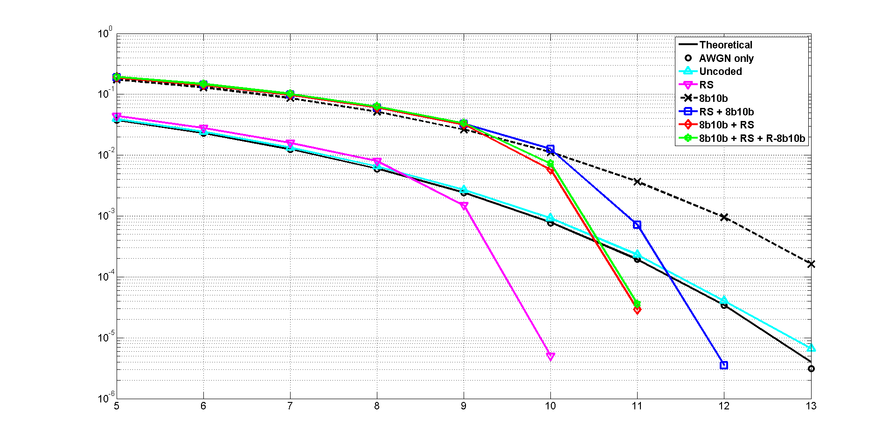
Results for D3 in S3 @ OCR = 6.25 MHz
Number of bits = 7,342,080
BER
SNR (dB)

Slide 13
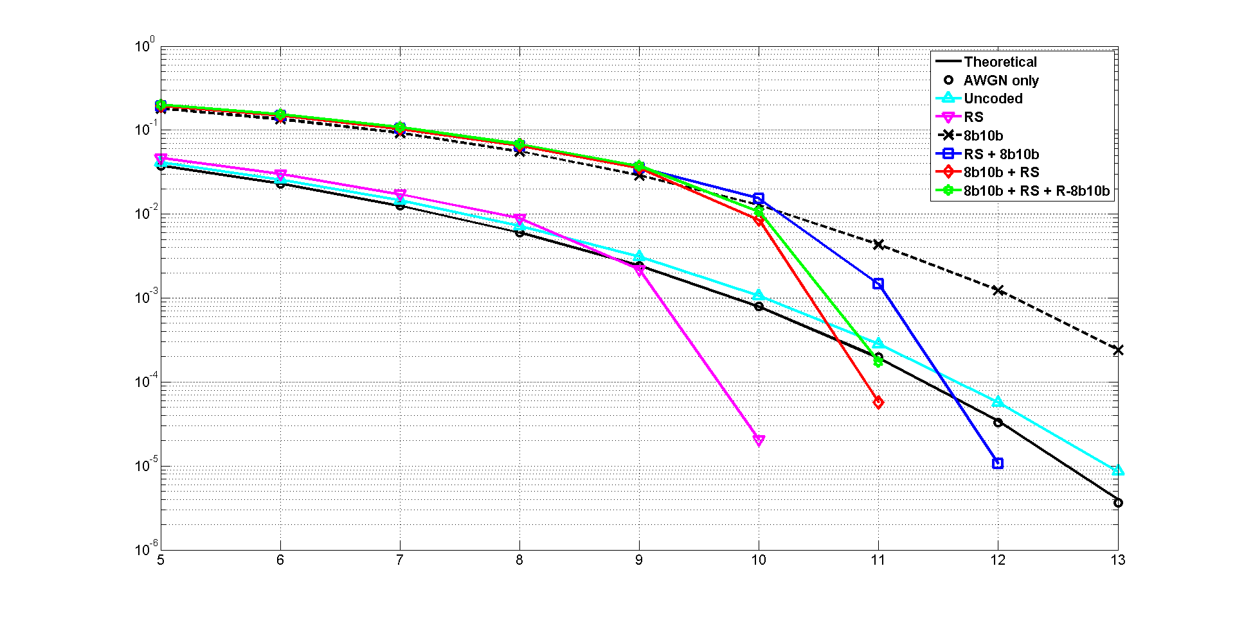
Results for D3 in S3 @ OCR = 12.5 MHz
Number of bits = 7,342,080
BER
SNR (dB)

Slide 14
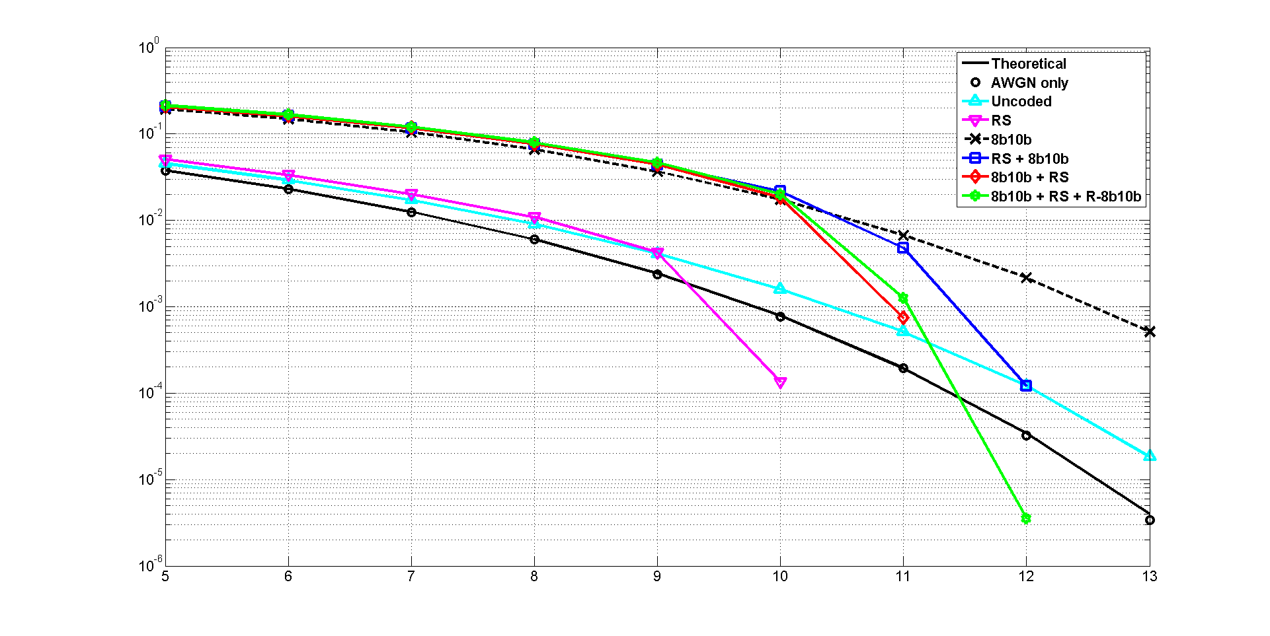
Results for D3 in S3 @ OCR = 25 MHz
Number of bits = 7,342,080
BER
SNR (dB)

Slide 15
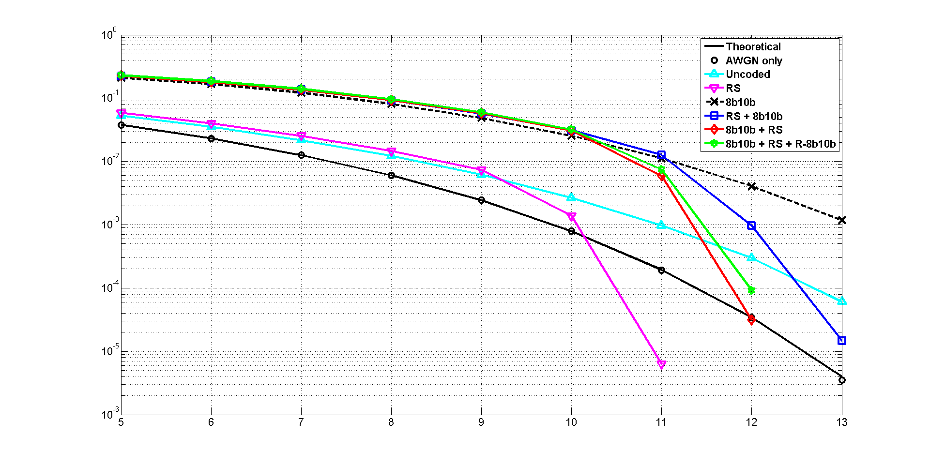
Results for D3 in S3 @ OCR = 50 MHz
Number of bits = 3,671,040
BER
SNR (dB)

Slide 16
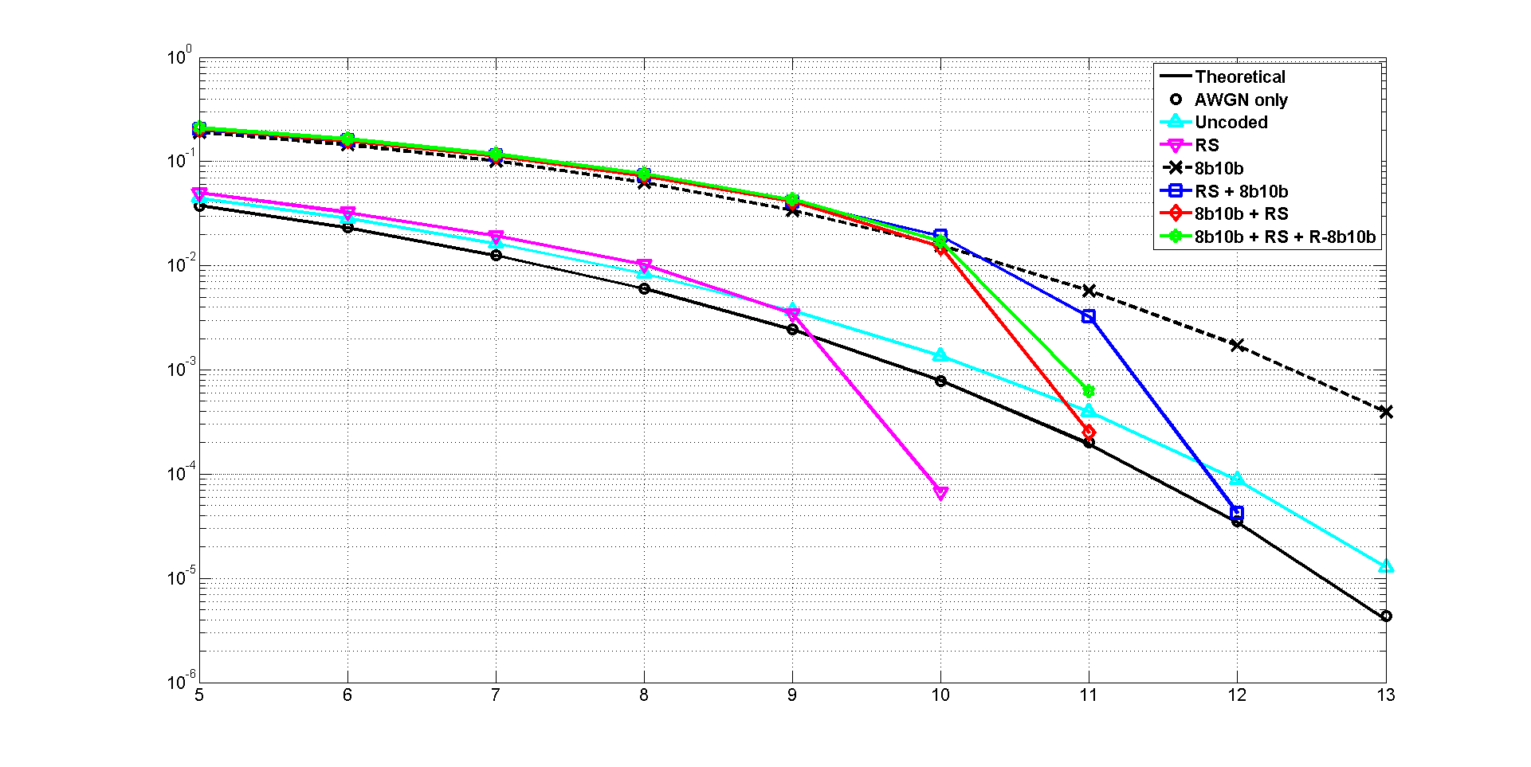
Results for D7 in S4 @ OCR = 3.125 MHz
Number of bits = 7,342,080
BER
SNR (dB)

Slide 17
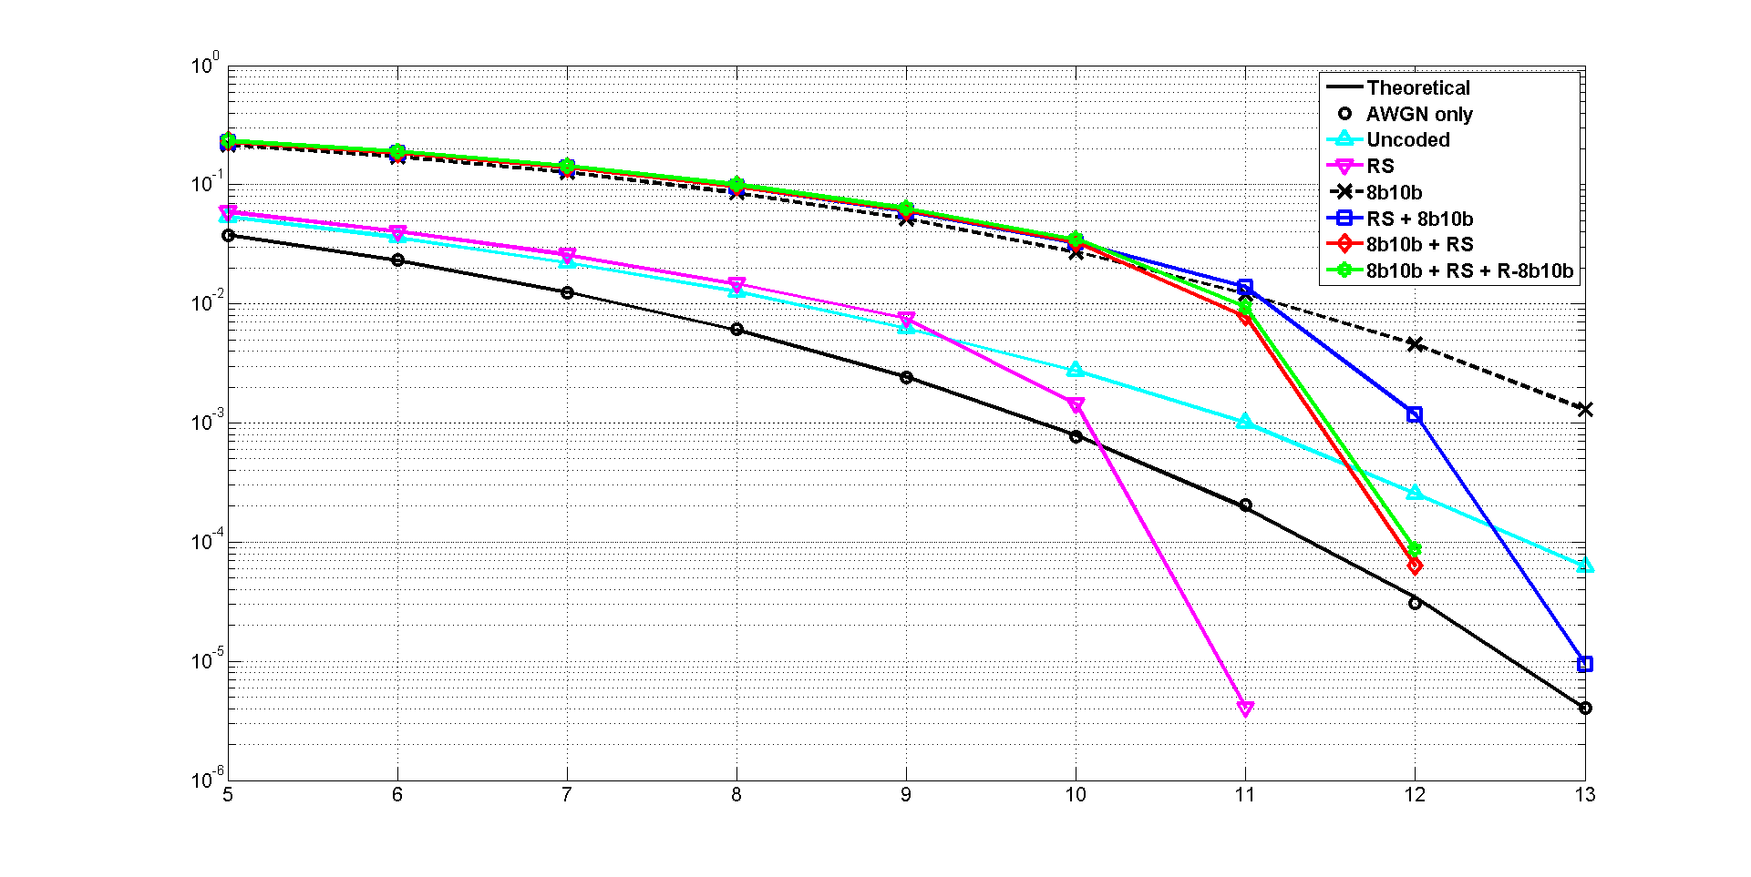
Results for D7 in S4 @ OCR = 6.25 MHz
Number of bits = 2,447,360
BER
SNR (dB)

Slide 18
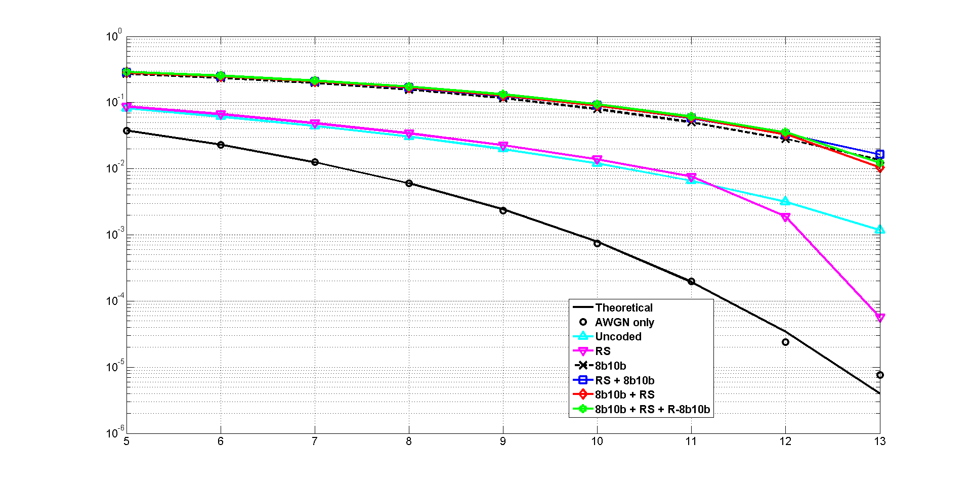
Results for D7 in S4 @ OCR = 12.5 MHz
Number of bits = 917,760
BER
SNR (dB)

Slide 19
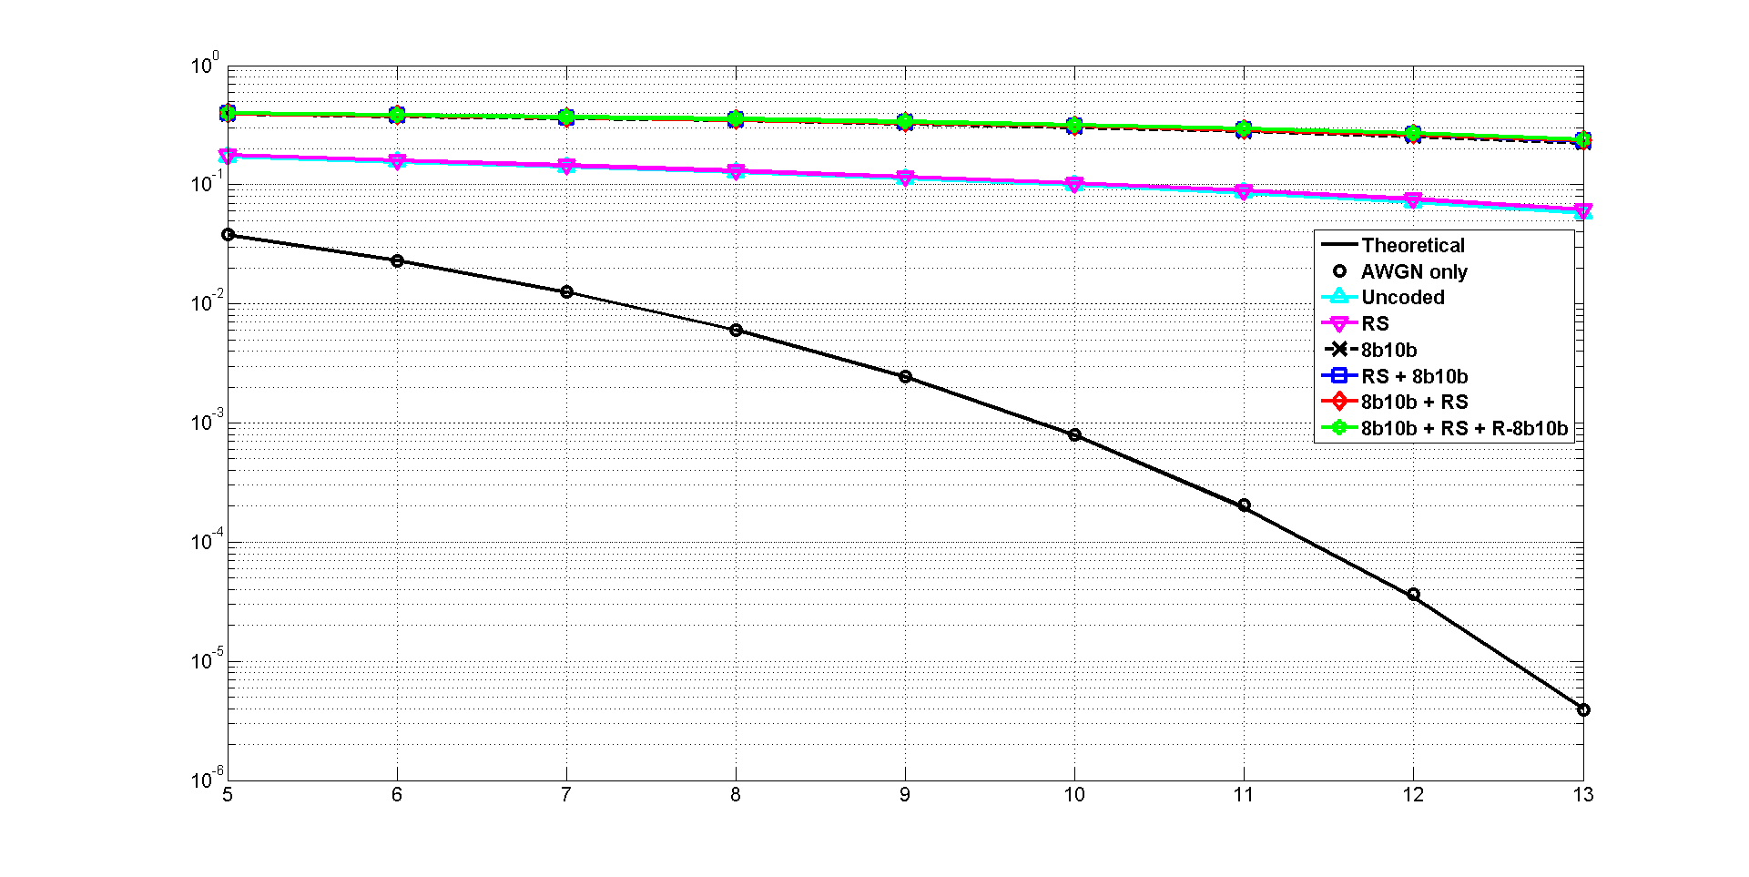
Results for D7 in S4 @ OCR = 25 MHz
Number of bits = 1,529,600
BER
SNR (dB)

Slide 20
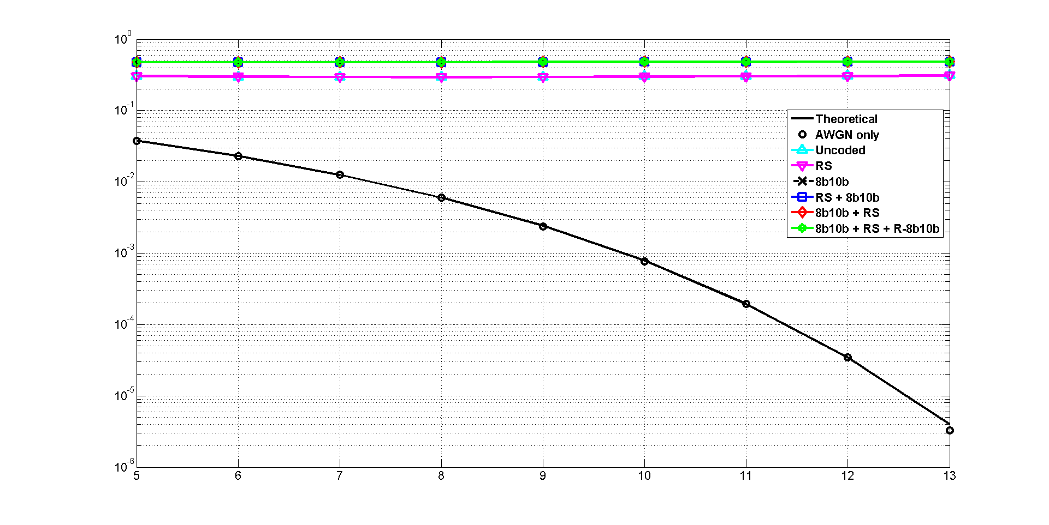
Results for D7 in S4 @ OCR = 50 MHz
Number of bits = 2,447,360
BER
SNR (dB)

Slide 21
Summary
BER vs. SNR characteristics for the header were evaluated under 8 simulation set-up (theoretical, AWGN only, uncoded, RS(255,239), 8b10b, RS(255,239)+8b10b, 8b10b+RS(255,239), 8b10b+RS(255,239)+R_8b10b) conditions.
Compared to the best sampling, the channel effects caused by ISI are shown from when OCR is lower. I think it’s because we used down-sampling through averaging process in this simulation.
The best performance was obtained when we consider only RS code, but we also have to think that 8b10b is used for flicker mitigation.
So, from the flicker mitigation point of view, (8b10b+RS+ R_8b10b) combination is better than (RS+8b10b) in BER performance.

