Slide 1
Project: IEEE P802.15 Working Group for Wireless Personal Area Networks (WPANs)
Submission Title: Evaluation Results on Header of PM PHY
Date Submitted: 25 April 2018
Source: Sang-Kyu Lim, Jin-Doo Jeong, Il Soon Jang, Tae-Gyu Kang [ETRI]
Address: 218 Gajeong-ro, Yuseong-gu, Daejeon, 34129, Korea
Voice:[+82-42-860-1573], FAX: [+82-42-860-5218], E-Mail:[sklim@etri.re.kr]
Re:
Abstract: This document provides the evaluation results on header of Pulsed Modulation PHY to TG13.
Purpose: Contribution to IEEE 802.15.13
Notice: This document has been prepared to assist the IEEE P802.15. It is offered as a basis for discussion and is not binding on the contributing individual(s) or organization(s). The material in this document is subject to change in form and content after further study. The contributor(s) reserve(s) the right to add, amend or withdraw material contained herein.
Release: The contributor acknowledges and accepts that this contribution becomes the property of IEEE and may be made publicly available by P802.15.

Slide 2
Evaluation Results
on Header of PM PHY
Sang-Kyu Lim, Jin-Doo Jeong, Il Soon Jang, Tae-Gyu Kang [ETRI]

Slide 3
Evaluation Framework of PM PHY
Preamble : Detection probability (for false alarm rate = 0.1%) vs. SNR (cf. doc. 15-18-0106/r0) and required SNR where prob. of misdetection (timing error) < 0.1%
Header : BER vs. SNR for the header incl. 8B10B and RS(36,24) coding assuming random data for the header information
Payload : BER vs. SNR for the payload incl. 8B10B or HCM and RS(255,248) coding assuming random data for the payload
Results are expected for AWGN, D3 in scenario 3 and D7 in scenario 4 (Fig. 25) where LED1-6 are used together from https://mentor.ieee.org/802.15/dcn/15/15-15-0746-01-007a-tg7r1-channel-model-document-for-high-rate-pd-communications.pdf.
CIRs: https://mentor.ieee.org/802.15/dcn/15/15-15-0747-00-007a-tg7r1-cirs-channel-model-document-for-high-rate-pd-communications.zip a companion file.
In case of questions, please, use TG13 email reflector.

Slide 4
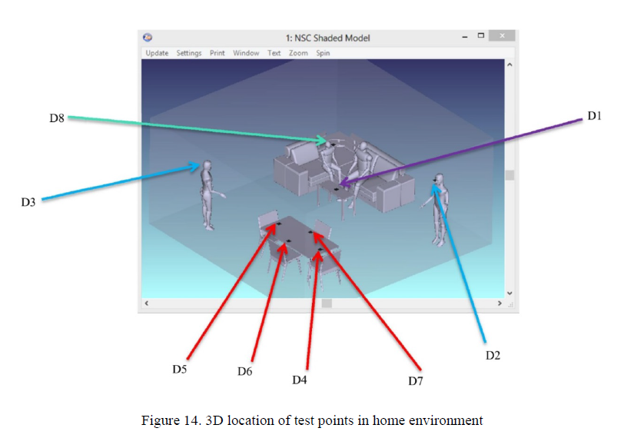
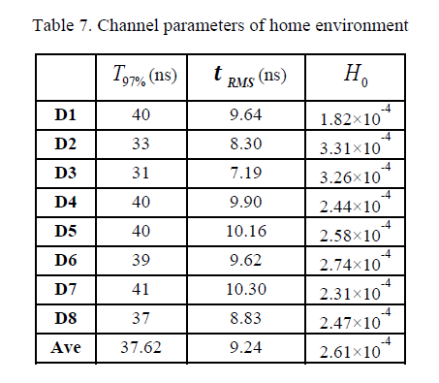
D3 Channel in Scenario 3 (Home Scenario)

Slide 5
D7 Channel in Scenario 4 (Home Scenario)

Slide 6

Simulation Set-up for Header (1)
(1) Theoretical Model
$P_{e}=$ $Q\left(\sqrt{{E_{b}}/{N_{0}}}\right)$
( for 2-PAM Unipolar Signaling )
(2) AWGN only Model
AWGN
Header Data
@ OCR = 50 MHz
@ OCR = 25 MHz
@ OCR = 12.5 MHz
@ OCR = 6.25 MHz
@ OCR = 3.125 MHz
RS(36,24)
8b10b
Modulation
CIR
Channels
Receiver
+

Slide 7
Simulation Set-up for Header (2)
(3) Uncoded Model
AWGN
Header Data
@ OCR = 50 MHz
@ OCR = 25 MHz
@ OCR = 12.5 MHz
@ OCR = 6.25 MHz
@ OCR = 3.125 MHz
RS(36,24)
8b10b
Modulation
CIR
Channels
Receiver
+
(4) RS Model
AWGN
Header Data
@ OCR = 50 MHz
@ OCR = 25 MHz
@ OCR = 12.5 MHz
@ OCR = 6.25 MHz
@ OCR = 3.125 MHz
RS(36,24)
8b10b
Modulation
CIR
Channels
Receiver
+

Slide 8
Simulation Set-up for Header (3)
(5) 8b10b Model
AWGN
Header Data
@ OCR = 50 MHz
@ OCR = 25 MHz
@ OCR = 12.5 MHz
@ OCR = 6.25 MHz
@ OCR = 3.125 MHz
RS(36,24)
8b10b
Modulation
CIR
Channels
Receiver
+
(6) (RS+8b10b) Model
AWGN
Header Data
@ OCR = 50 MHz
@ OCR = 25 MHz
@ OCR = 12.5 MHz
@ OCR = 6.25 MHz
@ OCR = 3.125 MHz
RS(36,24)
8b10b
Modulation
CIR
Channels
Receiver
+

Slide 9
Simulation Set-up for Header (4)
(7) (8b10b+RS) Model
AWGN
Header Data
@ OCR = 50 MHz
@ OCR = 25 MHz
@ OCR = 12.5 MHz
@ OCR = 6.25 MHz
@ OCR = 3.125 MHz
8b10b
RS(36,24)
Modulation
CIR
Channels
Receiver
+
(8) (8b10b+RS+R-8b10b) Model
* RB = Redundancy Bits
8b10b
for RB
AWGN
Header Data
@ OCR = 50 MHz
@ OCR = 25 MHz
@ OCR = 12.5 MHz
@ OCR = 6.25 MHz
@ OCR = 3.125 MHz
8b10b
RS(36,24)
Modulation
CIR
Channels
Receiver
+

Slide 10
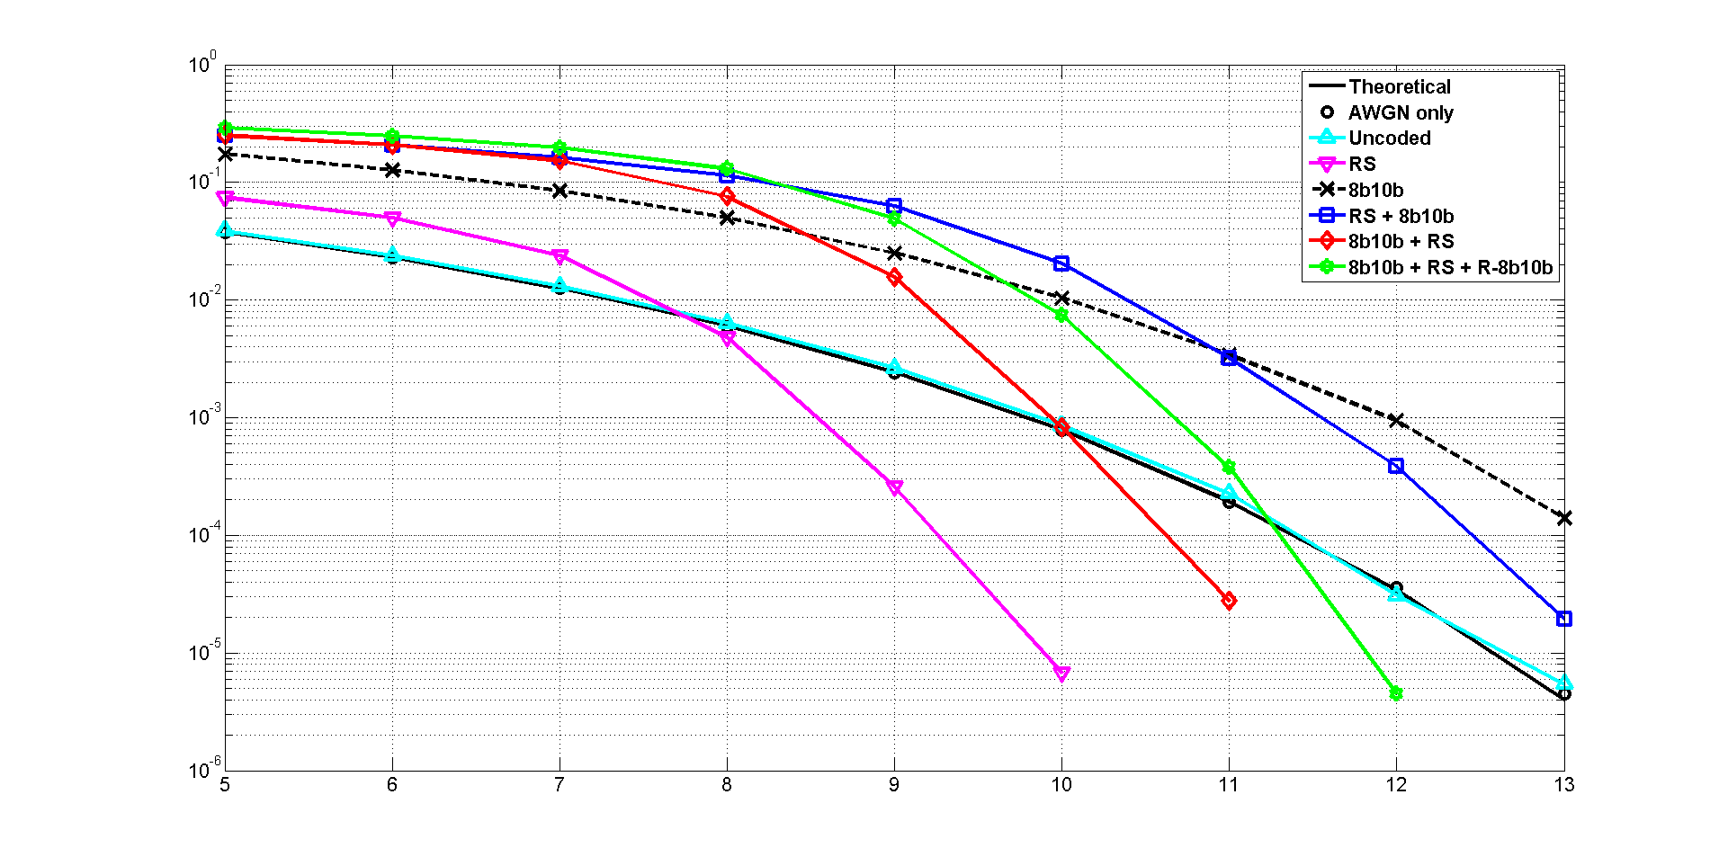
Results for D3 in S3 @ OCR = 3.125 MHz
Number of bits = 2,447,360
BER
SNR (dB)

Slide 11
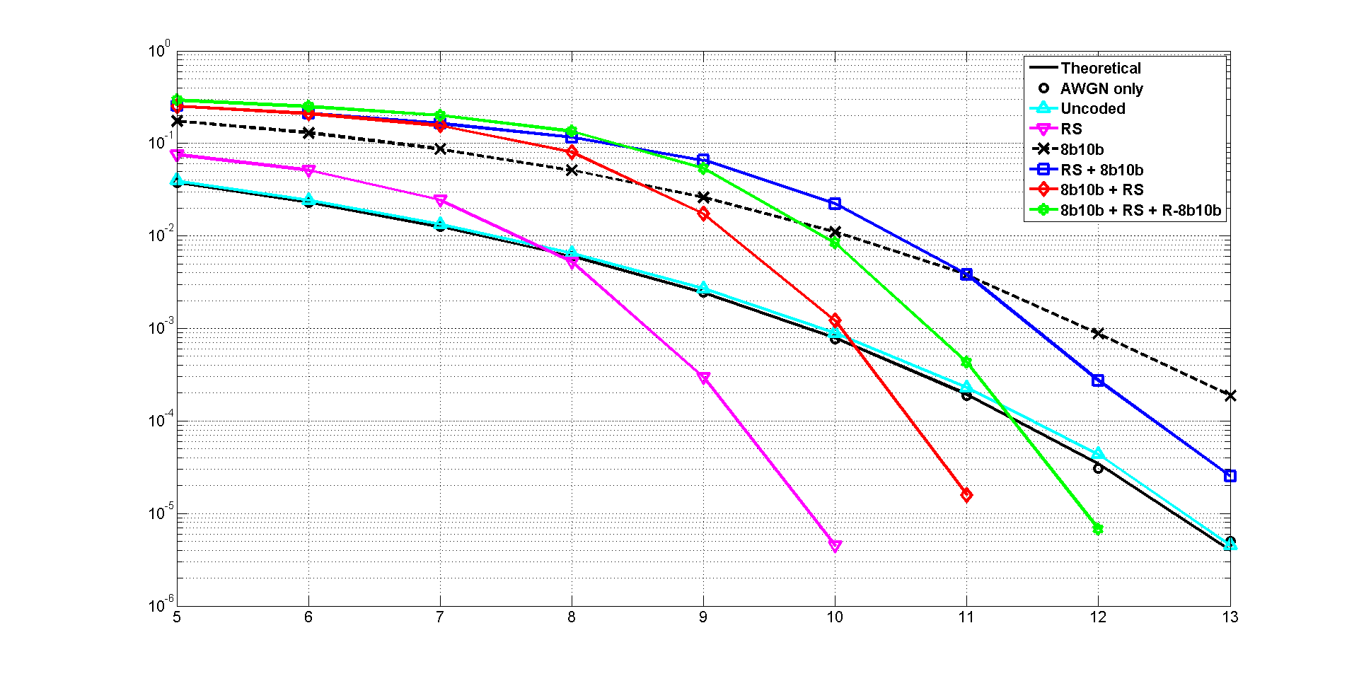
Results for D3 in S3 @ OCR = 6.25 MHz
Number of bits = 2,447,360
BER
SNR (dB)

Slide 12
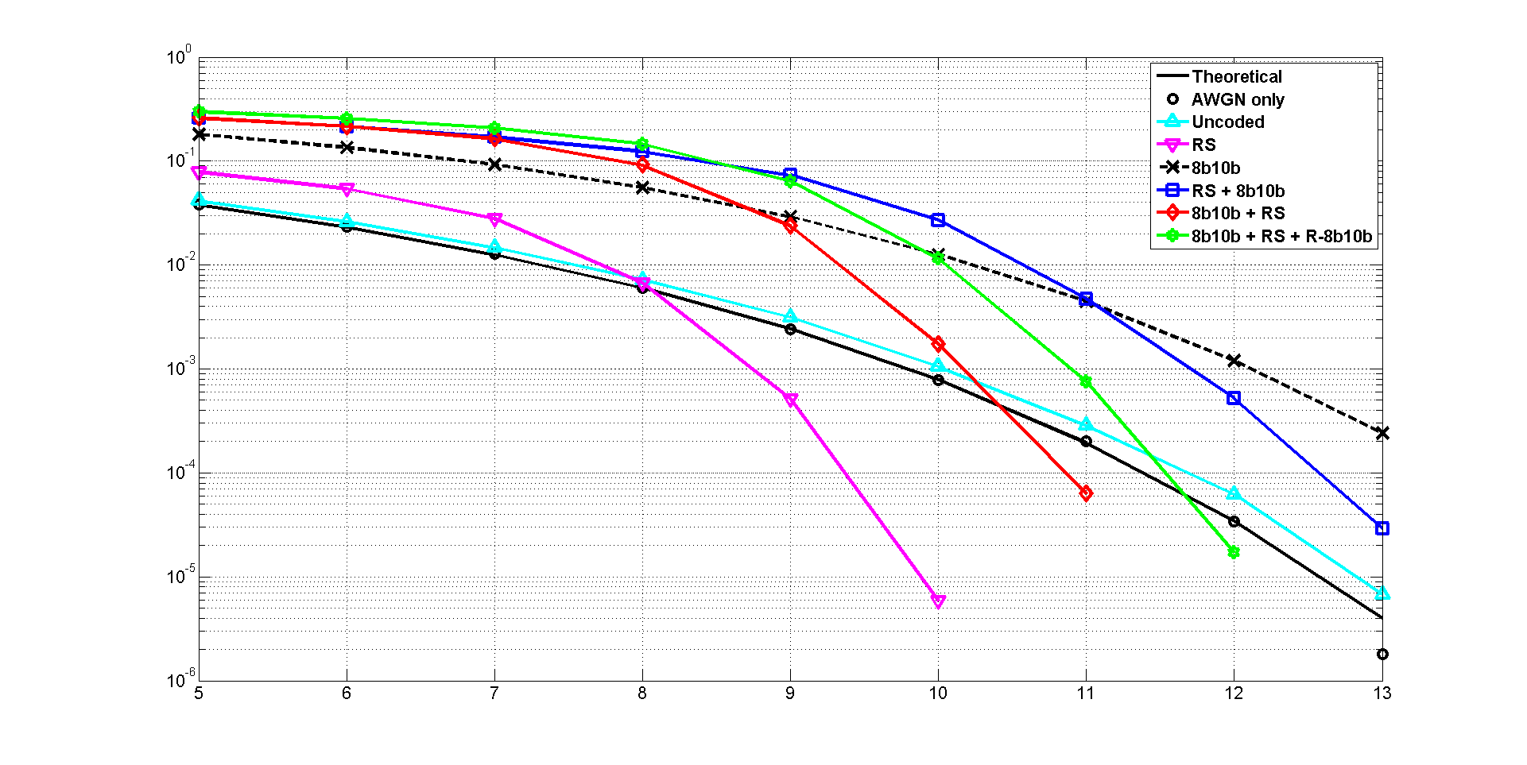
Results for D3 in S3 @ OCR = 12.5 MHz
Number of bits = 2,447,360
BER
SNR (dB)

Slide 13
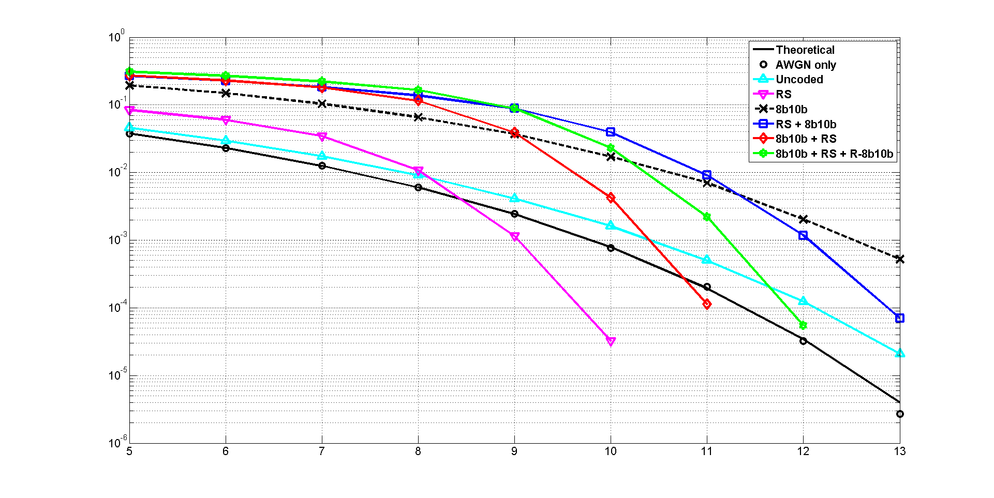
Results for D3 in S3 @ OCR = 25 MHz
Number of bits = 2,447,360
BER
SNR (dB)

Slide 14
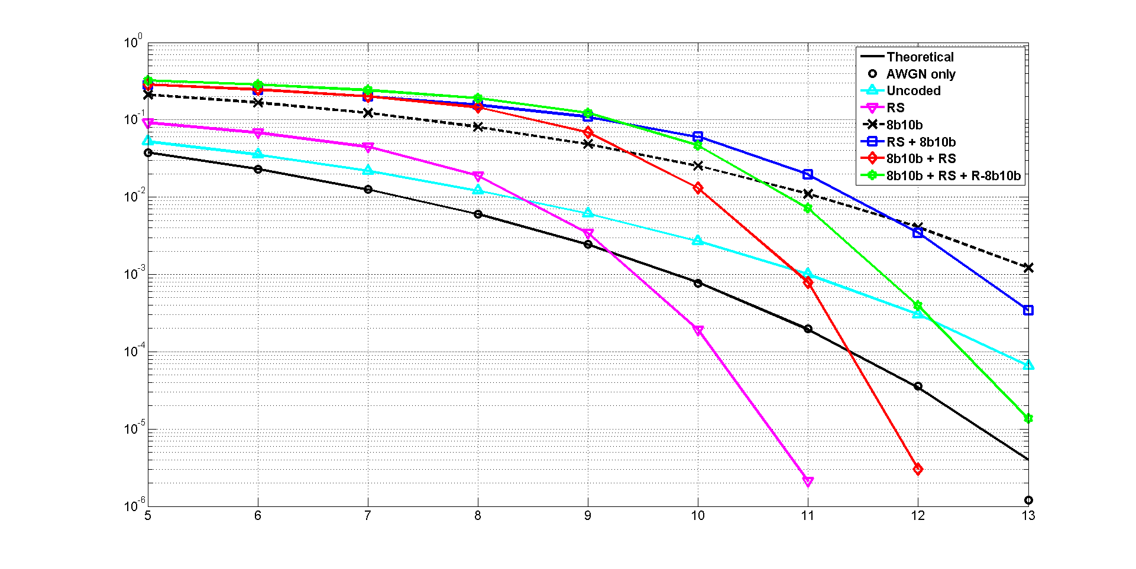
Results for D3 in S3 @ OCR = 50 MHz
Number of bits = 3,317,760
BER
SNR (dB)

Slide 15
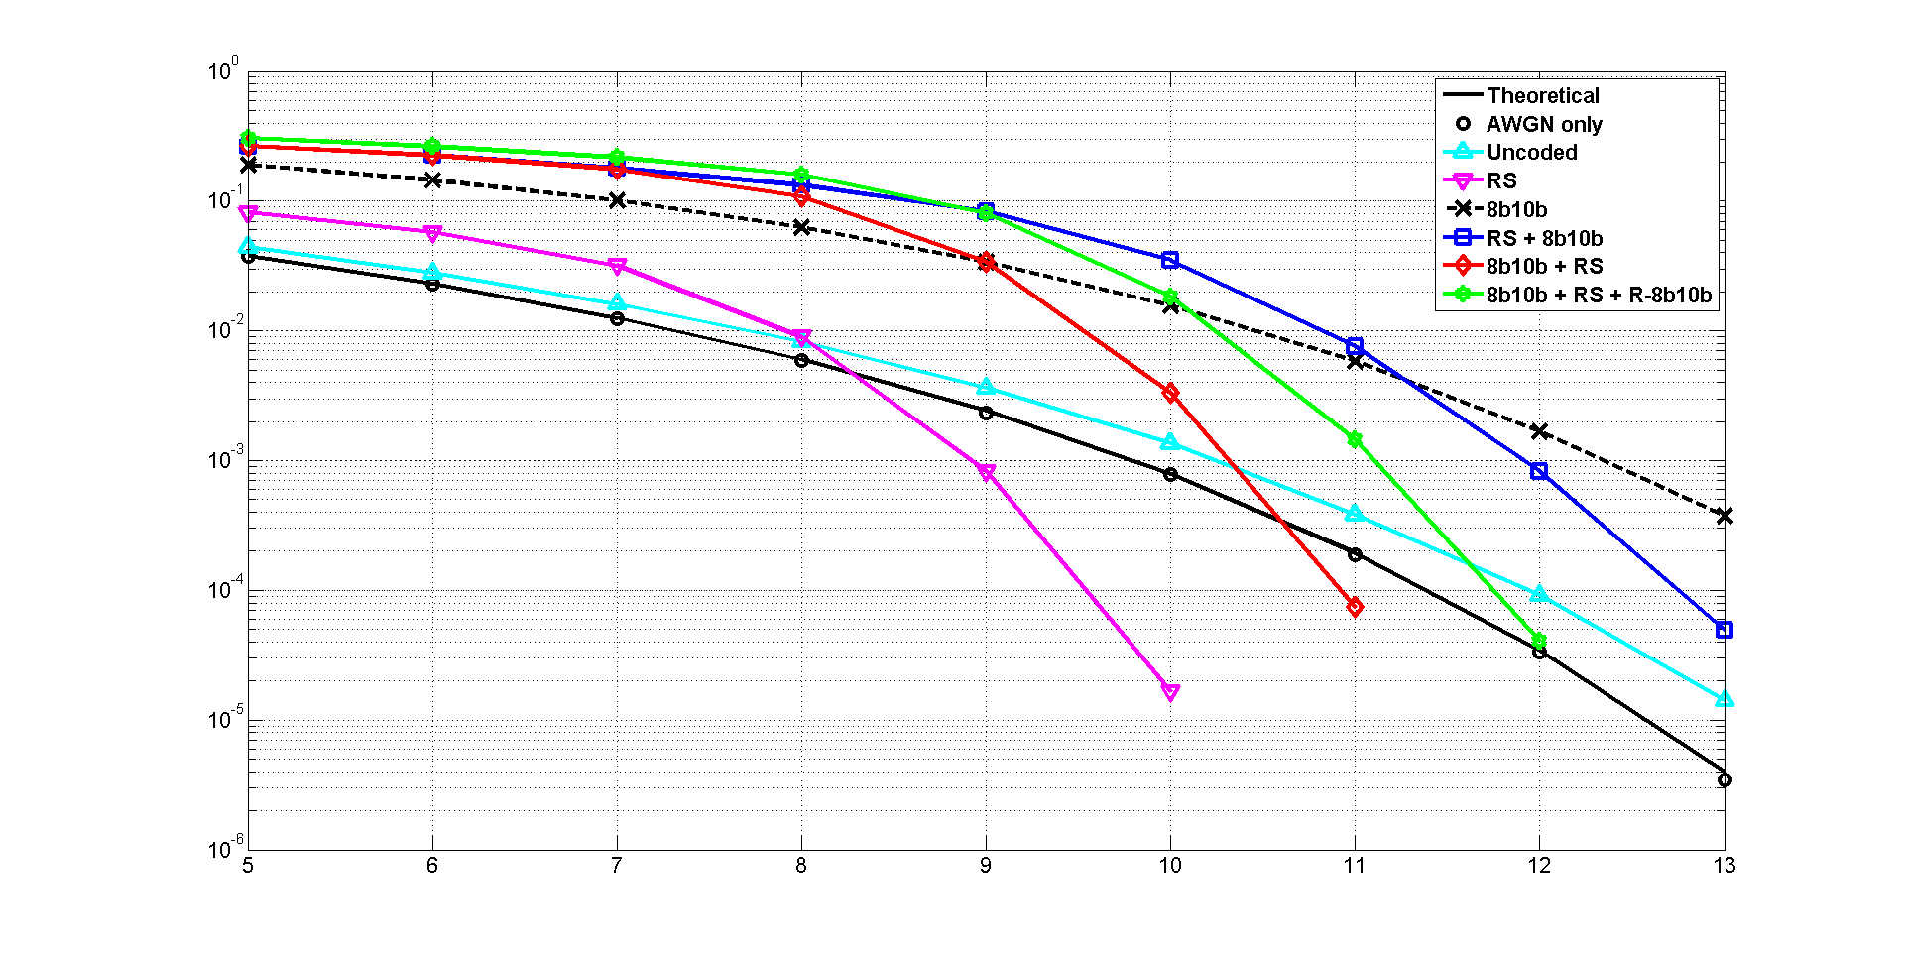
Results for D7 in S4 @ OCR = 3.125 MHz
Number of bits = 7,342,080
BER
SNR (dB)

Slide 16
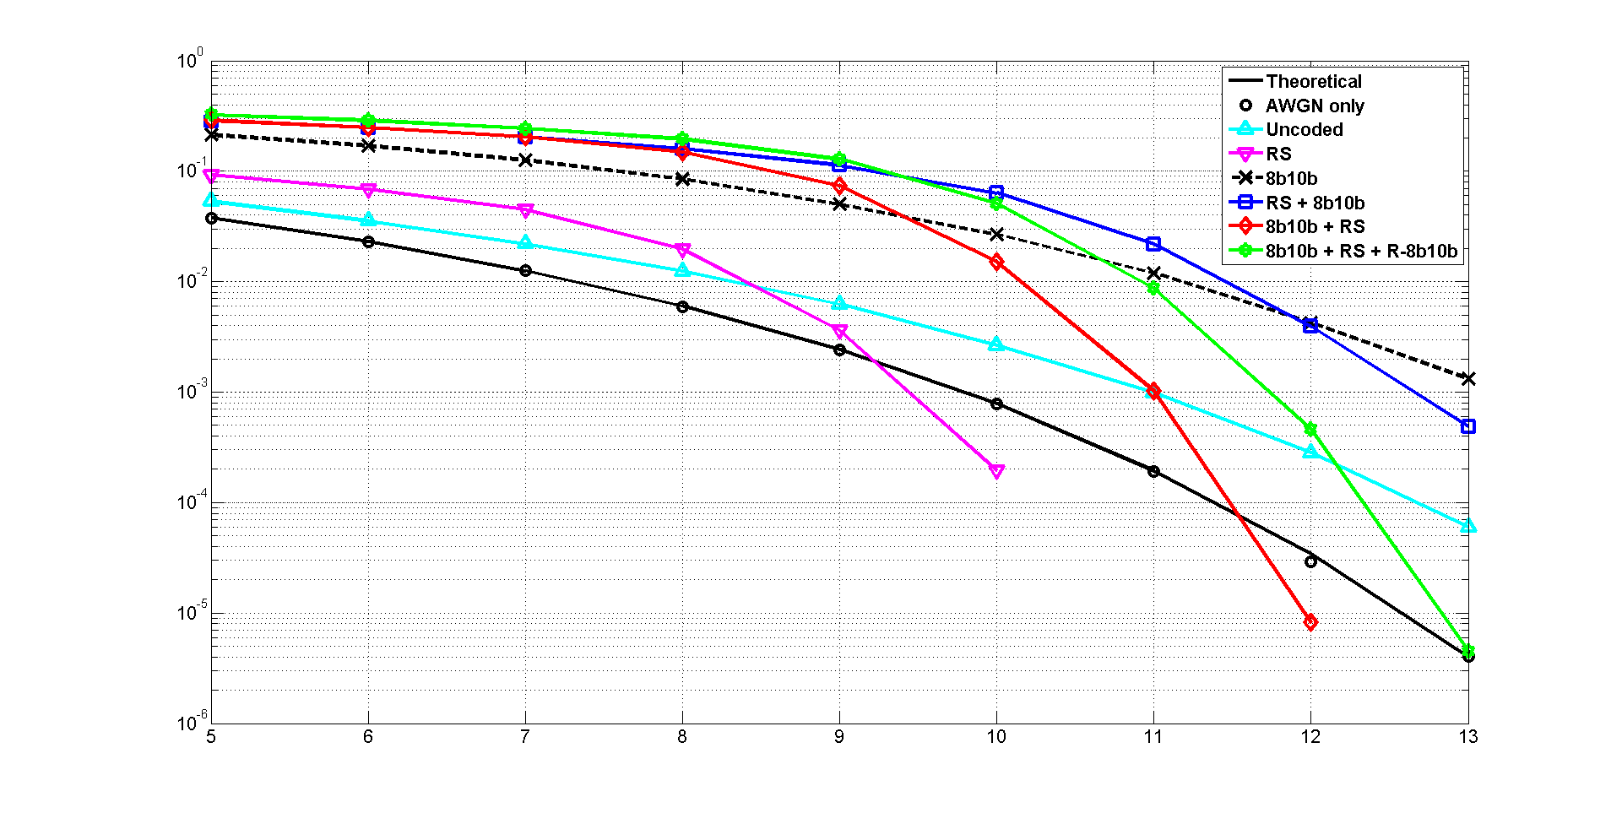
Results for D7 in S4 @ OCR = 6.25 MHz
Number of bits = 2,447,360
BER
SNR (dB)

Slide 17
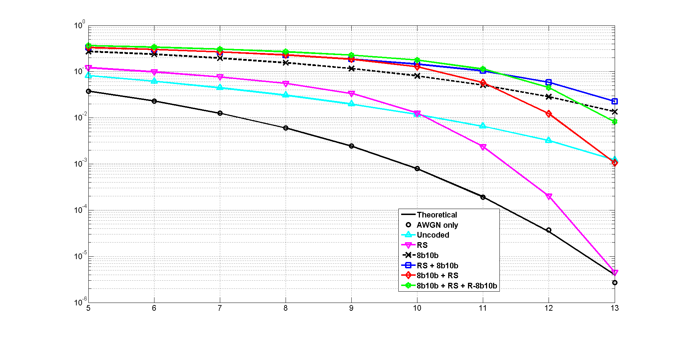
Results for D7 in S4 @ OCR = 12.5 MHz
Number of bits = 1,105,920
BER
SNR (dB)

Slide 18
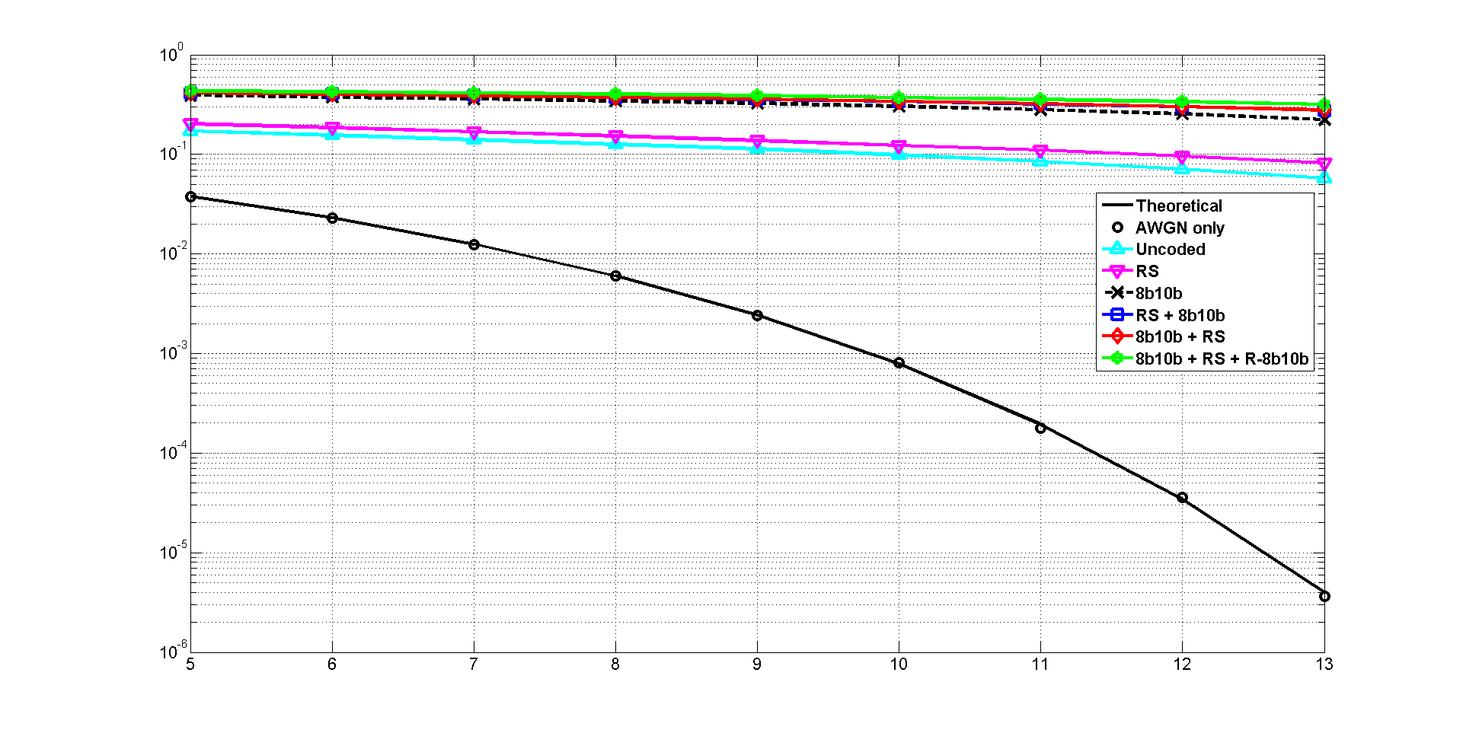
Results for D7 in S4 @ OCR = 25 MHz
Number of bits = 1,382,400
BER
SNR (dB)

Slide 19
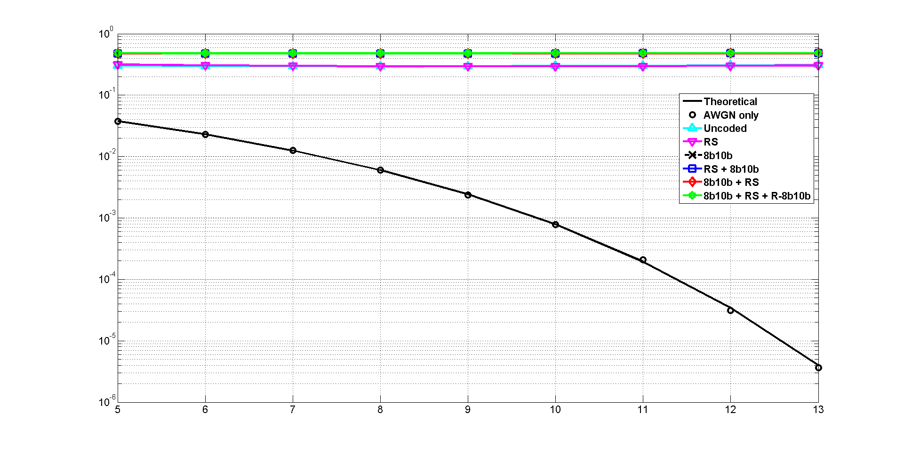
Results for D7 in S4 @ OCR = 50 MHz
Number of bits = 2,764,800
BER
SNR (dB)

