Slide 1
Project: IEEE P802.15 Working Group for Wireless Personal Area Networks (WPANs)
Submission Title: Proposals for LB-OFDM PHY
Date Submitted: 4 June 2018
Source: Nikola Serafimovski, Chong Han, Stephan Berner, Mostafa Afgani (pureLiFi)
Address: 9 Haymarket Terrace, Edinburgh, UK, EH12 5EZ
Mobile:[+44-7503016565], E-Mail:[chong.han@purelifi.com]
Re:
Abstract: Proposals for LB-OFDM PHY
Purpose: Contribution to IEEE 802.15.13
Notice: This document has been prepared to assist the IEEE P802.15. It is offered as a basis for discussion and is not binding on the contributing individual(s) or organization(s). The material in this document is subject to change in form and content after further study. The contributor(s) reserve(s) the right to add, amend or withdraw material contained herein.
Release: The contributor acknowledges and accepts that this contribution becomes the property of IEEE and may be made publicly available by P802.15.

Slide 2
Proposal for LB-OFDM PHY
Nikola Serafimovski (pureLiFi), Chong Han (pureLiFi), Stephan Berner (pureLiFi), Mostafa Afgani (pureLiFi)

Slide 3
PPDU Format
Preamble
Channel estimation
PHY
header
HCS
Optional fields
Payload
2 OFDM symbols
2 OFDM symbols
variable
SHR
PHR
Payload
Notes:
PHY header: 2 OFDM symbols after applying Hermitian symmetry.

Slide 4
Synchronization Header (SHR) (1)
Preamble
Channel estimation
2 OFDM symbols
2 OFDM symbols
PHY Preamble field consists of PN sequence training (used for AGC convergence, timing acquisition, and coarse frequency acquisition in the receiver).
Channel estimation field consists of two repetitions of a “Hermitian symmetric long training sequence” (used for channel estimation and fine frequency acquisition in the receiver), preceded by a guard interval (GI).
The SHR is a time domain sequence and does not have any channel coding or line coding.

Slide 5
Synchronization Header (SHR) (2)
Generation of PN sequence training
  Select two 20-bit PN sequences:
    pn_seq_0 = 20'b01001011000001110111;
    pn_seq_1 = 20'b01101100111101010000;
  Upsample the above sequences by 8
  Pulse shape with the following pulse {-479, 416, -10, -409, 67, -409, -10, 416}
  Flip the sequence got by the last step to get two sequences for each original PN sequences
Notes:
which is on segment of the original IEEE Std 802.11 short sequence

Slide 6
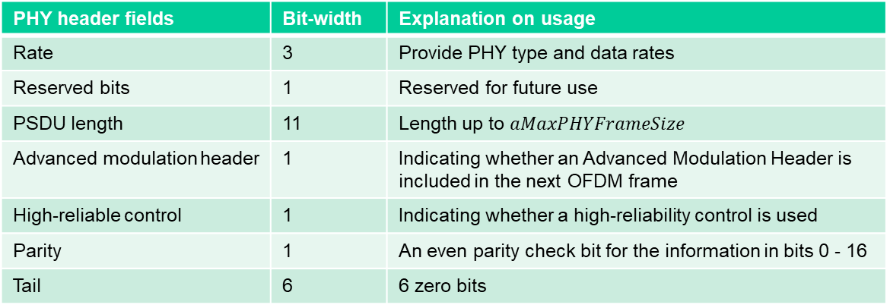
PHY Header (1)
Basic PHY Header:
Rate
Reserved
PSDU length
Advanced modulation header
High-reliability control
Parity
Tail
3 bits
1 bit
11 bits
1 bit
1 bit
1 bit
6 bits
PHY header fields | Bit-width | Explanation on usage
Rate | 3 | Provide PHY type and data rates
Reserved bits | 1 | Reserved for future use
PSDU length | 11 | Length up to $aMaxPHYFrameSize$
Advanced modulation header | 1 | Indicating whether an Advanced Modulation Header is included in the next OFDM frame
High-reliable control | 1 | Indicating whether a high-reliability control is used
Parity | 1 | An even parity check bit for the information in bits 0 - 16
Tail | 6 | 6 zero bits

Slide 7
PHY Header (2)
Advanced Modulation Header (optional):
Adaptive
CQI
eU
STR
SC-FDMA
DFT
Relaying enabled
Relaying mode
MIMO enabled
MIMO RS
Res
Parity
Tail
1 bit
1 bit
1 bit
1 bit
1 bit
5 bits
1 bit
2 bits
1 bit
1 bit
2 bits
1 bit
6 bits
Field | Bit | Explanation on usage | Field | Bit | Explanation on usage
Adaptive | 1 | Whether carriers are to be allocated dynamically | Relaying mode | 2 | Specify the mode of relaying operation to be performed
CQI | 1 | Indicate if CQIs should be calculated in the PHY for the current transmission frame | MIMO enabled | 1 | Indicate if a MIMO mode is enabled for the current PHY frame
eU-OFDM | 1 | Indicate if DATA is encoded using eU-OFDM | MIMO reference symbol | 1 | Indicate format of the reference symbols used for CQI estimation
STR | 1 | Indicate the number of eU-OFDM streams superimposed in the signal encoding procedure | Reserved bits | 2 | Reserved for future use
SC-FDMA | 1 | Indicate if DATA field is encoded using SC-FDMA | Parity | 1 | An even parity check bit for the information in bits 0 - 16.
DFT | 5 | DFT size used in the SC-FDMA pre-coding procedure | Tail | 6 | 6 zero bits
Relaying enabled | 1 | Indicate if relaying should be performed for the current PHY frame

Slide 8
PHY Header (3)
The Header contains all information necessary for demodulating the subsequent frame payload.
It is always encoded in 1/2 FEC rate BPSK modulation using DCO-OFDM.

Slide 9
HCS
HCS field does not apply in LB-OFDM PHY.

Slide 10
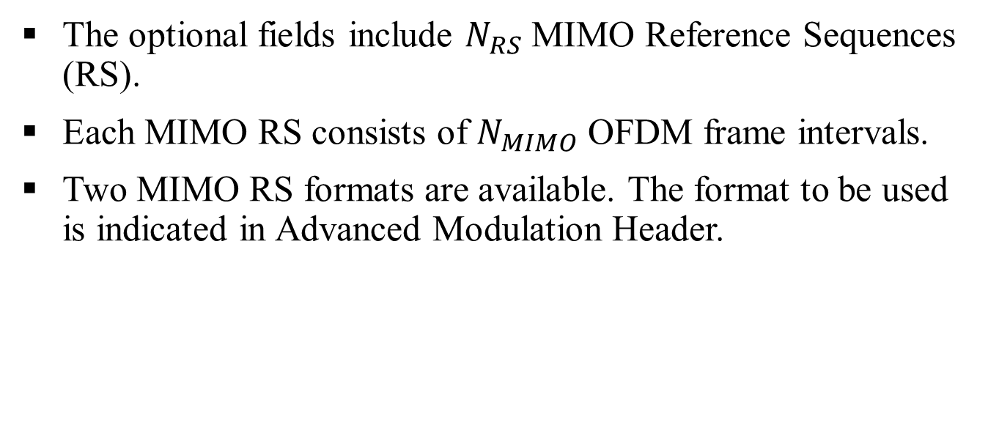
Optional fields (1)
The optional fields include $N_{RS}$ MIMO Reference Sequences (RS).
Each MIMO RS consists of $N_{MIMO}$ OFDM frame intervals.
Two MIMO RS formats are available. The format to be used is indicated in Advanced Modulation Header.

Slide 11
Optional fields (2)
MIMO Reference Symbols Format I
  For each MIMO transmitter, only one OFDM frame interval is set to the desired channel estimation sequence (CES). All other intervals are set to zero.
  The CES transmission intervals never coincide for any two transmitters. Hence, the MIMO RSs for the different transmitters are orthogonal to each other.

Slide 12
Optional fields (3)
MIMO Reference Symbols Format II
  For each MIMO transmitter, Every frame interval is set to the desired CES.
  The CESs for each transmitter are modified by adjusting the polarity of the individual CES according to a pre-determined set of Walsh sequences (available at K.3.2.2 in P802.15.13D2). The value of '1' in the Walsh sequence corresponds to an unmodified CES sequence while a value of '-1' corresponds to a CES with reverse polarity.
Notes:
The CES sequences in white are left unmodified, while the CES sequences in gray are multiplied by -1.

Slide 13
Payload (1)
High reliability control
Service
Length of pkt
PSDU
Tail
Pad
48 bits
16 bits
32 bits
Up to aMaxPHYFrameSize
6 bits
variable
Payload is transmitted at one of the supported data rates.
High-reliability MAC header: Robust transmission of the polling and acknowledgement information ensures avoiding a lot of unnecessary retransmissions. Furthermore, when this information is encoded separately from the rest of the payload, errors in the payload (especially for long payloads) which cause the packet to be discarded (and retransmitted) do not affect the polling and acknowledgement mechanism. The MAC header is encoded using the lowest data-rate (most robust) modulation format 1/2 FEC rate BPSK separately from the data payload.
SERVICE bits: the first 0-6 bits are set to 0s to synchronize the descrambler in the receiver. The remaining 9 bits (7–15) shall be reserved for future use.
Length of pkt: indicates the length of this packet/data.

Slide 14
Payload (2)
High-reliability control:
Protocol version
Polled STA
Next STA to poll
STA to ackn-owledge
Buffer status reporting
Sequence number
Payload ACK
Beacon ACK
CRC
Reserved
Tail
2 bits
5 bits
5 bits
5 bits
1 bit
12 bits
1 bit
1 bit
8 bits
2 bits
6 bits
Protocol version: The two bits indicate the MAC protocol version. If an incompatible MAC frame version is encountered in this frame, the PHY will drop the rest of the packet and signal an incompatible MAC protocol version to the MAC layer management entity
Polled STA: the STA to be polled (by AP only)
Next STA to poll: next STA to be polled (by AP only)
STA to acknowledge: indicates which STA is to be acknowledged by this packet
Tail: 6 bits of ‘0’s
Buffer status reporting: indicates the current STA has more data waiting for transmission (by STAs only)
Sequence number: sequence number of the packet to ACK
Payload ACK: indicates that this is to acknowledge a payload
Beacon ACK: indicates that this is to acknowledge a beacon
CRC: 8 bits CRC for pervious sub-fields
Reserved: reserved for future use
Notes:
Robust transmission of the polling and acknowledgement information ensures avoiding a lot of unnecessary retransmissions. Furthermore, when this information is encoded separately from the rest of the payload, errors in the payload (especially for long payloads) which cause the packet to be discarded (and retransmitted) do not influence the polling and acknowledgement mechanism.

Slide 15
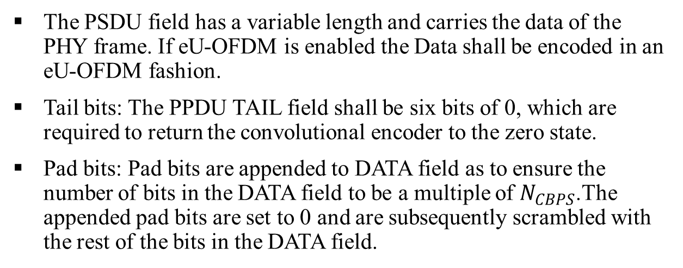
Payload (3)
High reliability control
Service
Length of pkt
PSDU
Tail
Pad
48 bits
16 bits
32 bits
Up to aMaxPHYFrameSize
6 bits
variable
The PSDU field has a variable length and carries the data of the PHY frame. If eU-OFDM is enabled the Data shall be encoded in an eU-OFDM fashion.
Tail bits: The PPDU TAIL field shall be six bits of 0, which are required to return the convolutional encoder to the zero state.
Pad bits: Pad bits are appended to DATA field as to ensure the number of bits in the DATA field to be a multiple of $N_{CBPS}$.The appended pad bits are set to 0 and are subsequently scrambled with the rest of the bits in the DATA field.

Slide 16
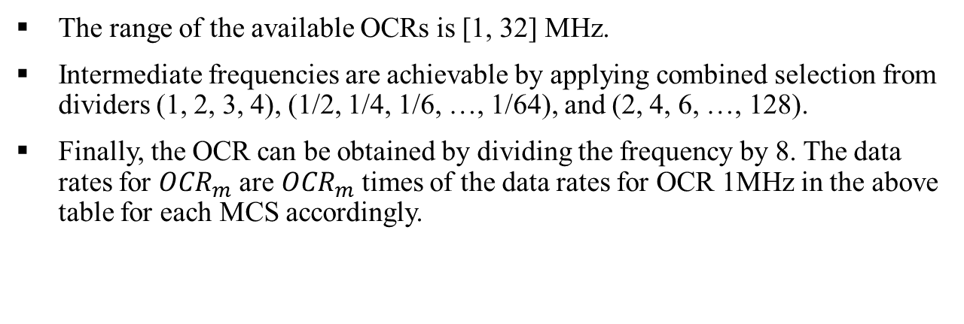
Data Rates
R0-R2 | Modulation | FEC rate | Date rate (Mbps) (OCR 1 MHz) | Date rate (Mbps) (OCR 16 MHz) | Date rate (Mbps) (OCR 20 MHz) | Date rate (Mbps) (OCR 32 MHz)
001 | BPSK | Inner CC(1/2) | 0.3 | 4.8 | 6 | 9.6
000 |  | Inner CC(3/4) | 0.45 | 7.2 | 9 | 14.4
010 | QPSK | Inner CC(1/2) | 0.6 | 9.6 | 12 | 19.2
011 |  | Inner CC(3/4) | 0.9 | 14.4 | 18 | 28.8
100 | 16-QAM | Inner CC(1/2) | 1.2 | 19.2 | 24 | 38.4
101 |  | Inner CC(3/4) | 1.8 | 28.8 | 36 | 57.6
110 | 64-QAM | Inner CC(2/3) | 2.4 | 38.4 | 48 | 76.8
111 |  | Inner CC(3/4) | 2.7 | 43.2 | 54 | 86.4
The range of the available OCRs is [1, 32] MHz.
Intermediate frequencies are achievable by applying combined selection from dividers (1, 2, 3, 4), (1/2, 1/4, 1/6, …, 1/64), and (2, 4, 6, …, 128).
Finally, the OCR can be obtained by dividing the frequency by 8. The data rates for ${OCR}_{m}$are ${OCR}_{m}$times of the data rates for OCR 1MHz in the above table for each MCS accordingly.

Slide 17
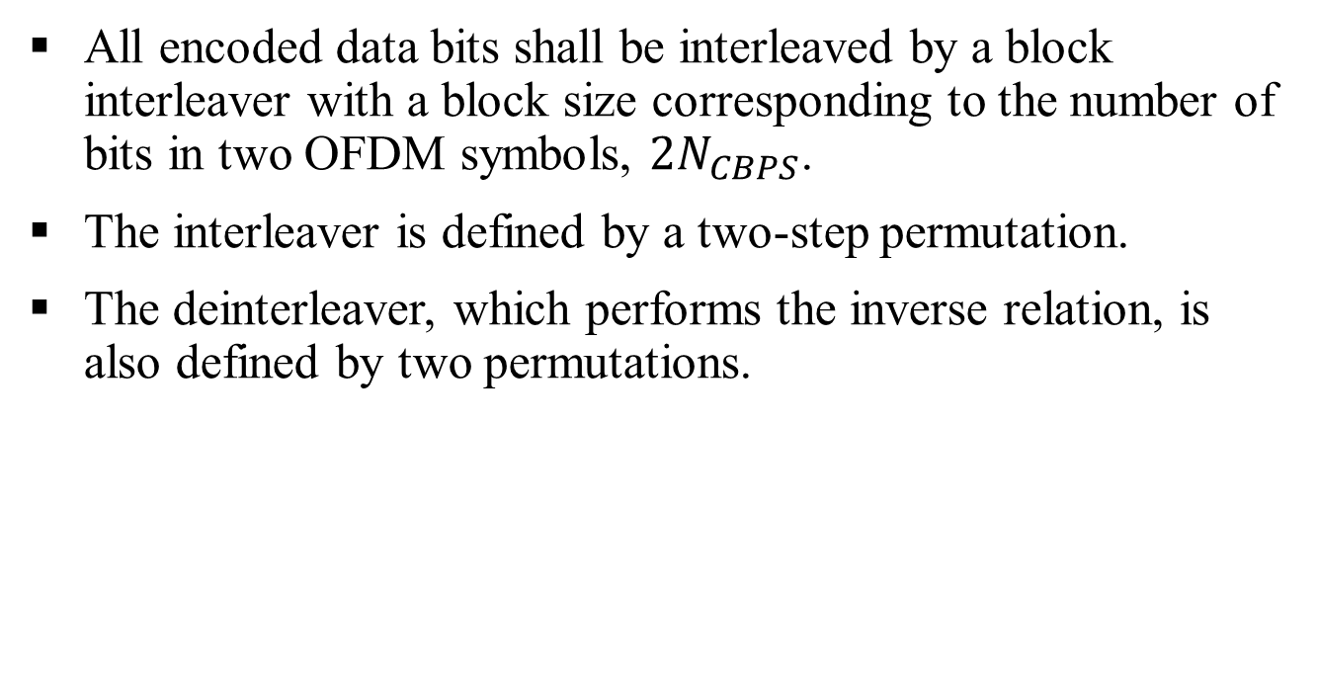
Interleaver/Deinterleaver
All encoded data bits shall be interleaved by a block interleaver with a block size corresponding to the number of bits in two OFDM symbols, $2N_{CBPS}$.
The interleaver is defined by a two-step permutation.
The deinterleaver, which performs the inverse relation, is also defined by two permutations.

Slide 18
Relaying (1)
Amplify and forward
  The PPDU shall be buffered at the receiving node and upon successful demodulation of the advanced modulation header and identification of the amplify and forward specification.
  The PPDU shall be retransmitted without any further processing at the PHY layer.
  In FD relaying mode, the relay STA shall simultaneously receive the information on the downlink and shall transmit it on the uplink.
  In HD relaying mode, the relay STA shall store the data packets in order to retransmit them to the STA during its designated transmission period.
  The relay STA can erase the stored packet after it receives the ACK.
  The method is proprietary.
  In both configurations, the PHY header shall be demodulated before a decision for relaying can be made.

Slide 19
Relaying (2)
Decode and forward
  The PPDU shall be completely demodulated and upon successful identification of the decoded and forward specification.
  The PPDU shall be re-modulated and re-transmitted.
  The relay STA can erase the stored packet after it receives the ACK.
  The method is proprietary.

