Slide 1
Project: IEEE P802.15 Working Group for Wireless Personal Area Networks (WPANs)
Submission Title: Evaluation Results on Preamble of PM PHY
Date Submitted: 24 April 2018
Source: Sang-Kyu Lim, Il Soon Jang, Jin-Doo Jeong, Tae-Gyu Kang [ETRI]
Address: 218 Gajeong-ro, Yuseong-gu, Daejeon, 34129, Korea
Voice:[+82-42-860-1573], FAX: [+82-42-860-5218], E-Mail:[sklim@etri.re.kr]
Re:
Abstract: This document provides the evaluation results on preamble of PM PHY to TG13.
Purpose: Contribution to IEEE 802.15.13
Notice: This document has been prepared to assist the IEEE P802.15. It is offered as a basis for discussion and is not binding on the contributing individual(s) or organization(s). The material in this document is subject to change in form and content after further study. The contributor(s) reserve(s) the right to add, amend or withdraw material contained herein.
Release: The contributor acknowledges and accepts that this contribution becomes the property of IEEE and may be made publicly available by P802.15.

Slide 2
Evaluation Results
on Preamble of PM PHY
Sang-Kyu Lim, Il Soon Jang, Jin-Doo Jeong, Tae-Gyu Kang [ETRI]

Slide 3
Evaluation Framework of PM PHY
Preamble : Detection probability (for false alarm rate = 0.1%) vs. SNR (cf. doc. 15-18-0106/r0) and required SNR where prob. of misdetection (timing error) < 0.1%
Header : BER vs. SNR for the header incl. 8B10B and RS(36,24) coding assuming random data for the header information
Payload : BER vs. SNR for the payload incl. 8B10B or HCM and RS(255,248) coding assuming random data for the payload
Results are expected for AWGN, D3 in scenario 3 and D7 in scenario 4 (Fig. 25) where LED1-6 are used together from https://mentor.ieee.org/802.15/dcn/15/15-15-0746-01-007a-tg7r1-channel-model-document-for-high-rate-pd-communications.pdf.
CIRs: https://mentor.ieee.org/802.15/dcn/15/15-15-0747-00-007a-tg7r1-cirs-channel-model-document-for-high-rate-pd-communications.zip a companion file.
In case of questions, please, use TG13 email reflector.

Slide 4
Background on New TDPs for Preamble
Before
After
(6 TDPs from the 15-bits Gold Sequences)
(6 TDPs selected from the 31-bits Gold Sequences)
P1
0 0 0 0 0 1 1 0 1 1 1 1 0 1 1
P1
1 0 1 1 1 0 1 1 1 0 0 1 0 1 0 0 1 0 0 0 1 0 1 0 0 1 0 1 1 0 1
P2
1 1 0 0 1 1 1 0 0 0 0 0 0 0 1
P2
1 1 0 0 1 0 1 0 1 1 0 0 1 1 1 0 1 0 0 1 0 0 1 1 0 1 1 0 0 1 0
P3
0 0 0 1 1 0 0 0 0 1 0 0 0 1 0
P3
1 0 1 0 0 0 1 0 1 0 1 0 1 0 1 0 0 1 1 0 1 0 0 0 1 1 1 0 1 1 1
P4
1 1 1 0 1 1 0 1 1 1 0 1 0 1 0
P4
1 1 1 0 0 0 0 1 1 0 0 0 1 1 0 1 1 0 1 1 0 1 0 0 1 0 1 1 1 0 0
P5
1 1 0 1 0 0 0 0 1 0 1 1 0 0 0
P5
1 0 0 1 1 1 0 0 0 1 0 0 1 0 0 0 1 1 0 1 1 1 0 0 1 1 0 1 1 1 0
P6
0 1 0 1 1 1 1 1 1 1 1 0 1 0 0
P6
1 0 1 0 1 1 1 0 0 0 1 1 0 1 0 1 0 0 0 1 1 0 0 1 1 0 1 1 0 1 0
TDP
~ TDP
TDP
~ TDP
TDP
~ TDP
60 bits
62 bits
TDPs selected from 15-bits Gold Sequences for preamble have been changed to TDPs selected from 31-bits Gold Sequences in order to resolve the comment that there were more than 5 consecutive ones or zeros in the Gold sequences.
As the results, the new 6 TDPs with less than 4 consecutive ones or zeros are proposed and the cross correlation characteristics between them selected from 31-bits Gold Sequences have been much improved.

Slide 5
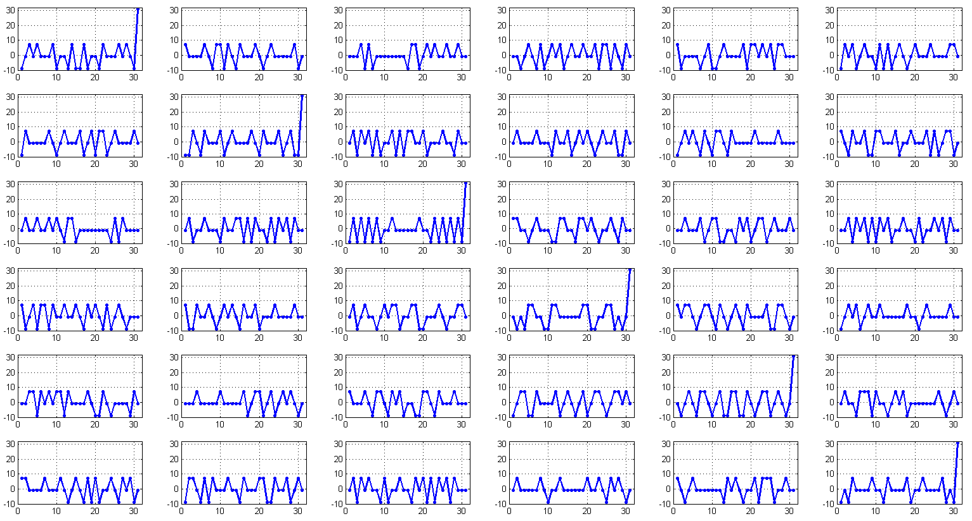
Auto & Cross correlations between New TDPs

Slide 6
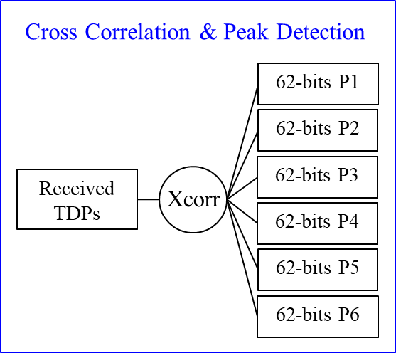
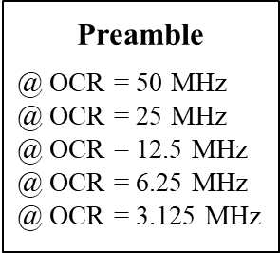
Simulation Set-up for Preamble (1)
(6 TDPs selected from the 31-bits Gold Sequences)
P1
1 0 1 1 1 0 1 1 1 0 0 1 0 1 0 0 1 0 0 0 1 0 1 0 0 1 0 1 1 0 1
P2
1 1 0 0 1 0 1 0 1 1 0 0 1 1 1 0 1 0 0 1 0 0 1 1 0 1 1 0 0 1 0
P3
1 0 1 0 0 0 1 0 1 0 1 0 1 0 1 0 0 1 1 0 1 0 0 0 1 1 1 0 1 1 1
P4
1 1 1 0 0 0 0 1 1 0 0 0 1 1 0 1 1 0 1 1 0 1 0 0 1 0 1 1 1 0 0
P5
1 0 0 1 1 1 0 0 0 1 0 0 1 0 0 0 1 1 0 1 1 1 0 0 1 1 0 1 1 1 0
P6
1 0 1 0 1 1 1 0 0 0 1 1 0 1 0 1 0 0 0 1 1 0 0 1 1 0 1 1 0 1 0
(1) AWGN only Model
AWGN
62 bits / 50,000 times
Modulation
CIR
Channels
Preamble
Detector
=
TDP
~ TDP
+
Detection
Probability
@ 0.1% FA

Slide 7
Simulation Set-up for Preamble (2)
(2) CIR Channel Model
AWGN
62 bits / 50,000 times
Modulation
CIR
Channels
Preamble
Detector
=
TDP
~ TDP
+
Detection
Probability
@ 0.1% FA

Slide 8
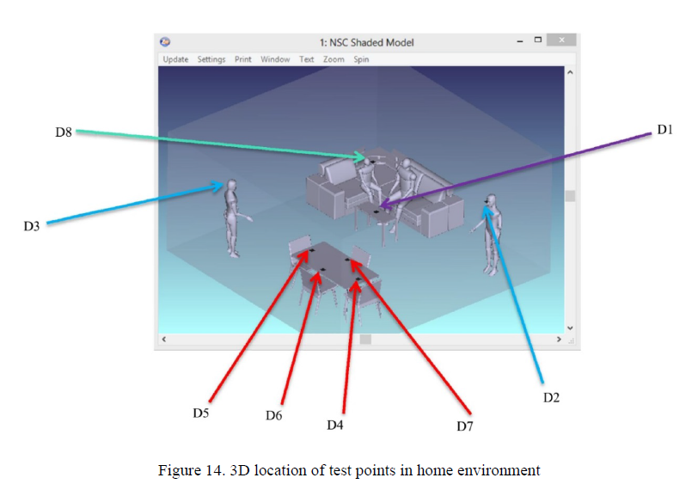
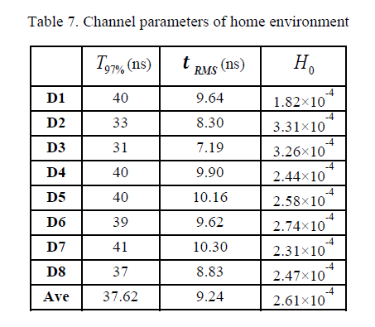
D3 in Scenario 3 (Home)

Slide 9
D7 in Scenario 4 (Manufacturing Cell)

Slide 10
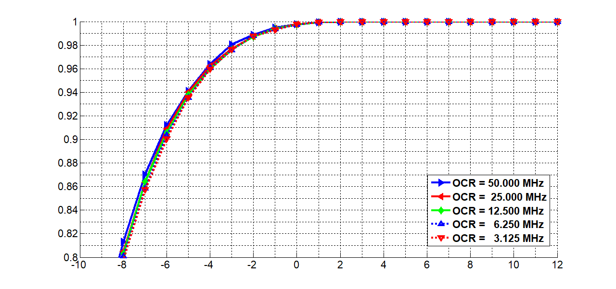
Results for P1 TDP @ AWGN only
False Alarm = 0.1 %
Detection Probability
SNR (dB)

Slide 11
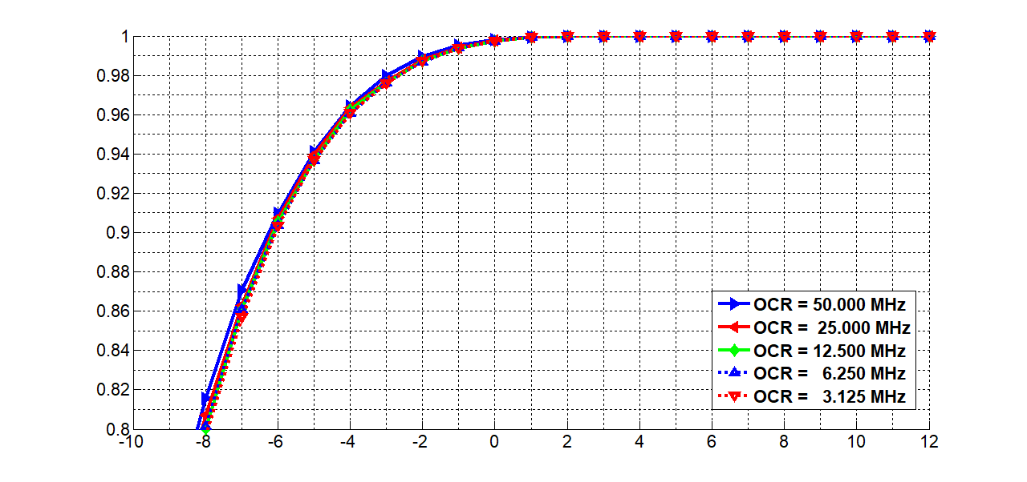
Results for P2 TDP @ AWGN only
False Alarm = 0.1 %
Detection Probability
SNR (dB)

Slide 12
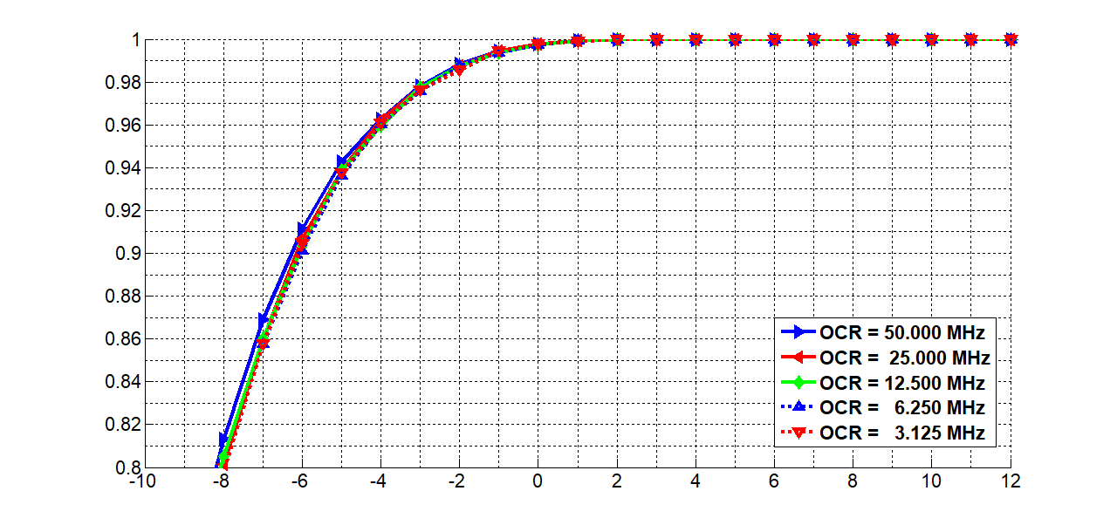
Results for P3 TDP @ AWGN only
False Alarm = 0.1 %
Detection Probability
SNR (dB)

Slide 13
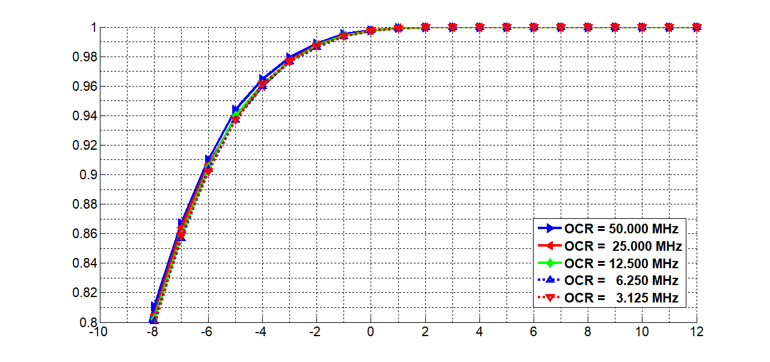
Results for P4 TDP @ AWGN only
False Alarm = 0.1 %
Detection Probability
SNR (dB)

Slide 14
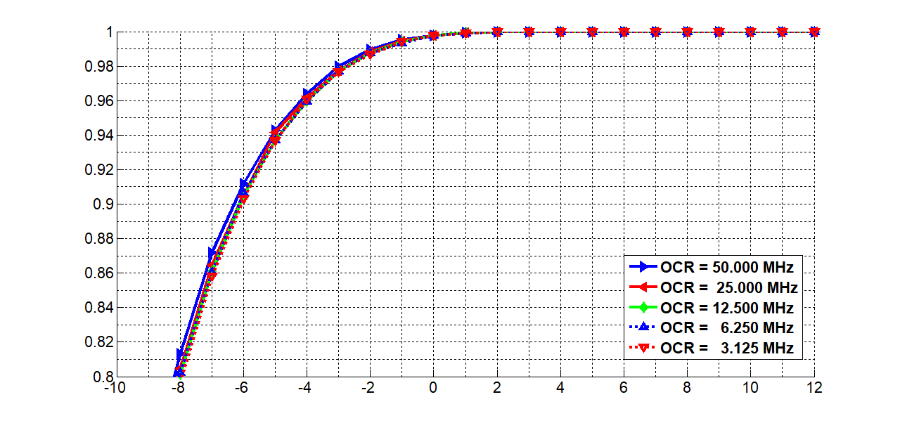
Results for P5 TDP @ AWGN only
False Alarm = 0.1 %
Detection Probability
SNR (dB)

Slide 15
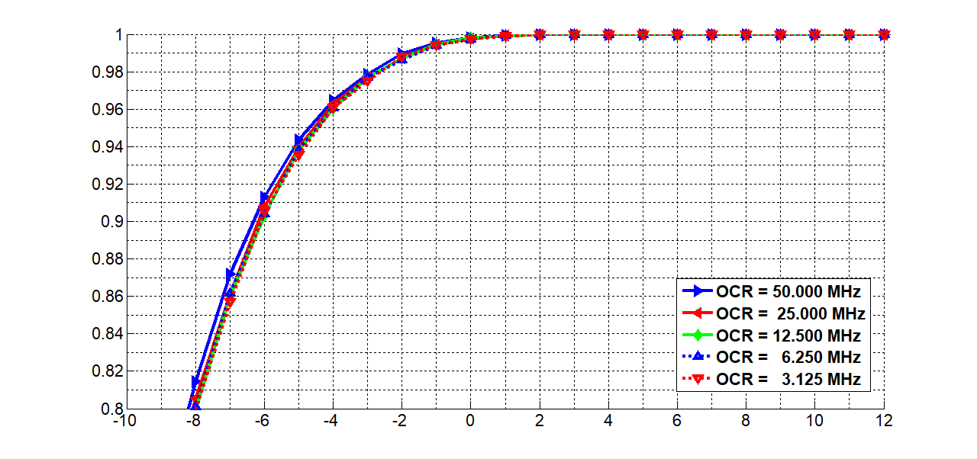
Results for P6 TDP @ AWGN only
False Alarm = 0.1 %
Detection Probability
SNR (dB)

Slide 16
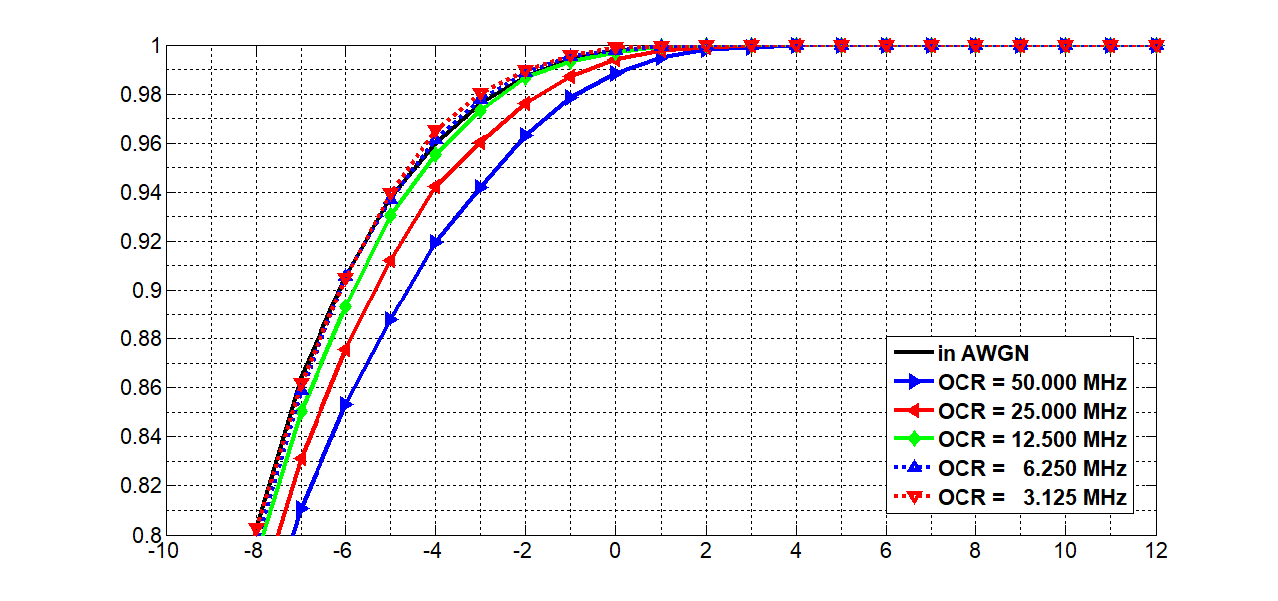
Results for P1 TDP @ D3 in S3
False Alarm = 0.1 %
Detection Probability
SNR (dB)

Slide 17
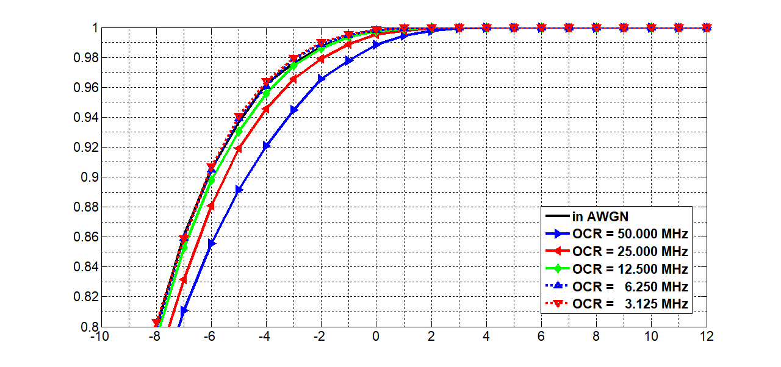
Results for P2 TDP @ D3 in S3
False Alarm = 0.1 %
Detection Probability
SNR (dB)

Slide 18

Results for P3 TDP @ D3 in S3
False Alarm = 0.1 %
Detection Probability
SNR (dB)

Slide 19
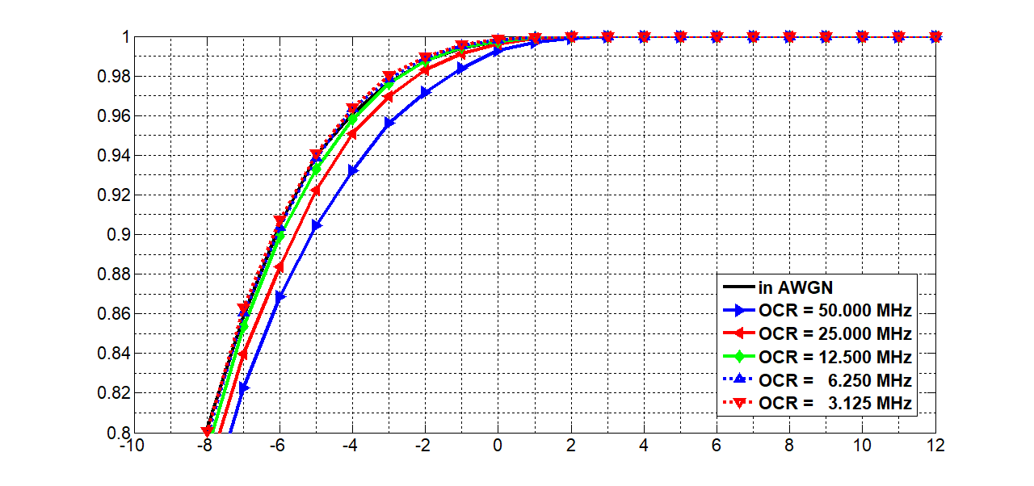
Results for P4 TDP @ D3 in S3
False Alarm = 0.1 %
Detection Probability
SNR (dB)

Slide 20
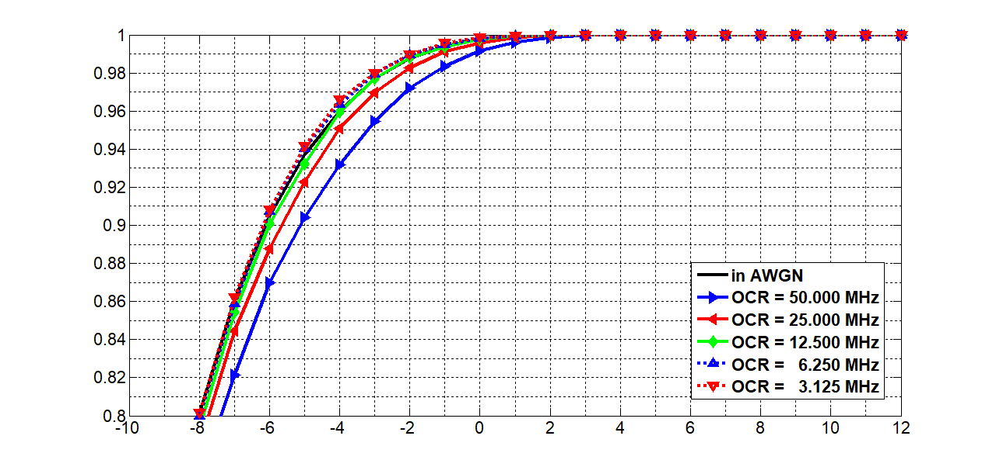
Results for P5 TDP @ D3 in S3
False Alarm = 0.1 %
Detection Probability
SNR (dB)

Slide 21

Results for P6 TDP @ D3 in S3
False Alarm = 0.1 %
Detection Probability
SNR (dB)

Slide 22
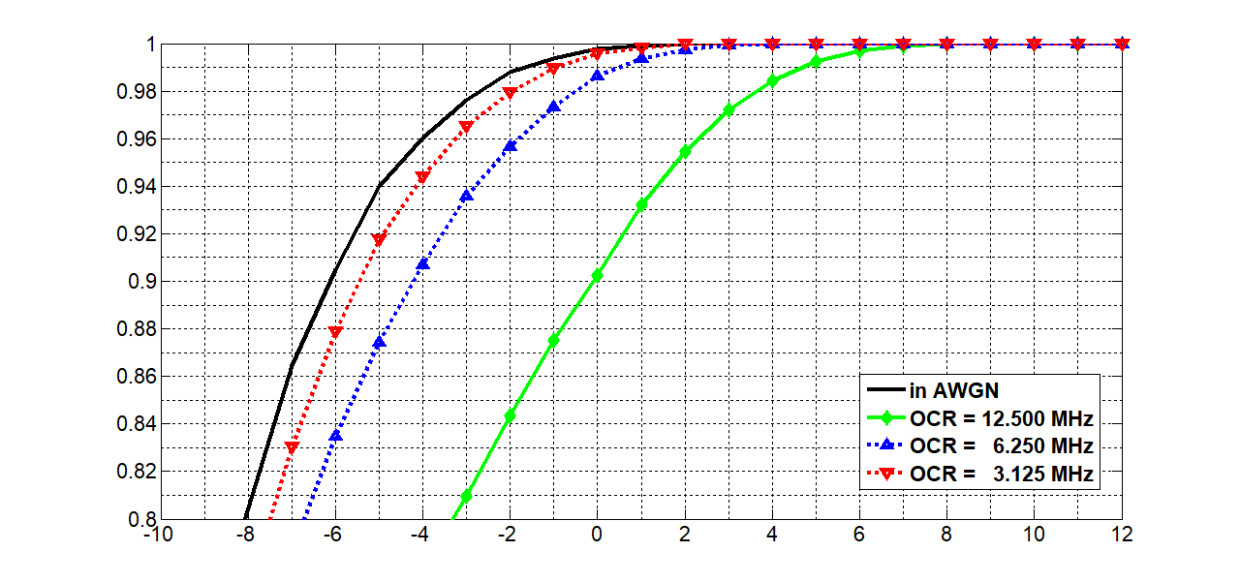
Results for P1 TDP @ D7 in S4
False Alarm = 0.1 %
Detection Probability
SNR (dB)

Slide 23
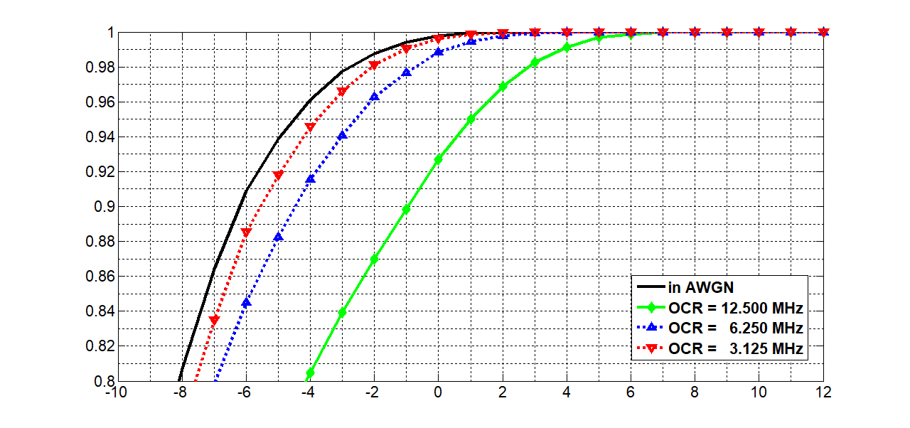
Results for P2 TDP @ D7 in S4
False Alarm = 0.1 %
Detection Probability
SNR (dB)

Slide 24
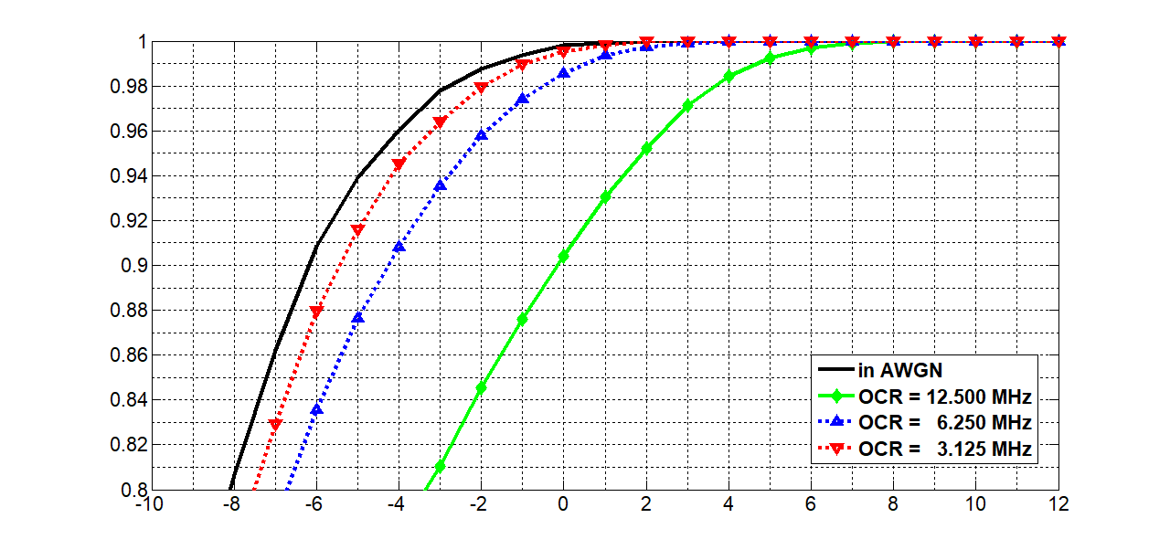
Results for P3 TDP @ D7 in S4
False Alarm = 0.1 %
Detection Probability
SNR (dB)

Slide 25
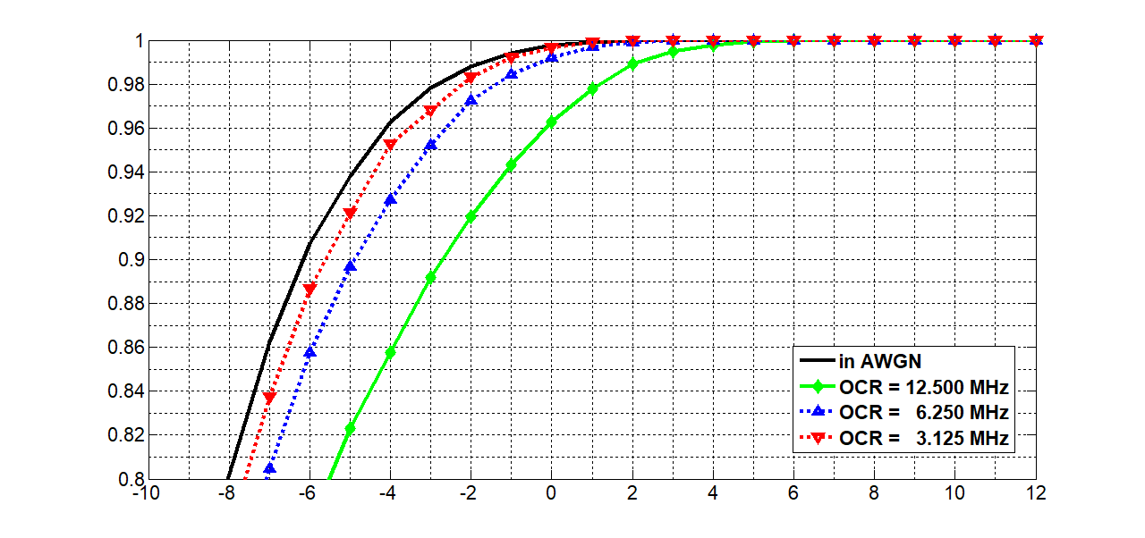
Results for P4 TDP @ D7 in S4
False Alarm = 0.1 %
Detection Probability
SNR (dB)

Slide 26
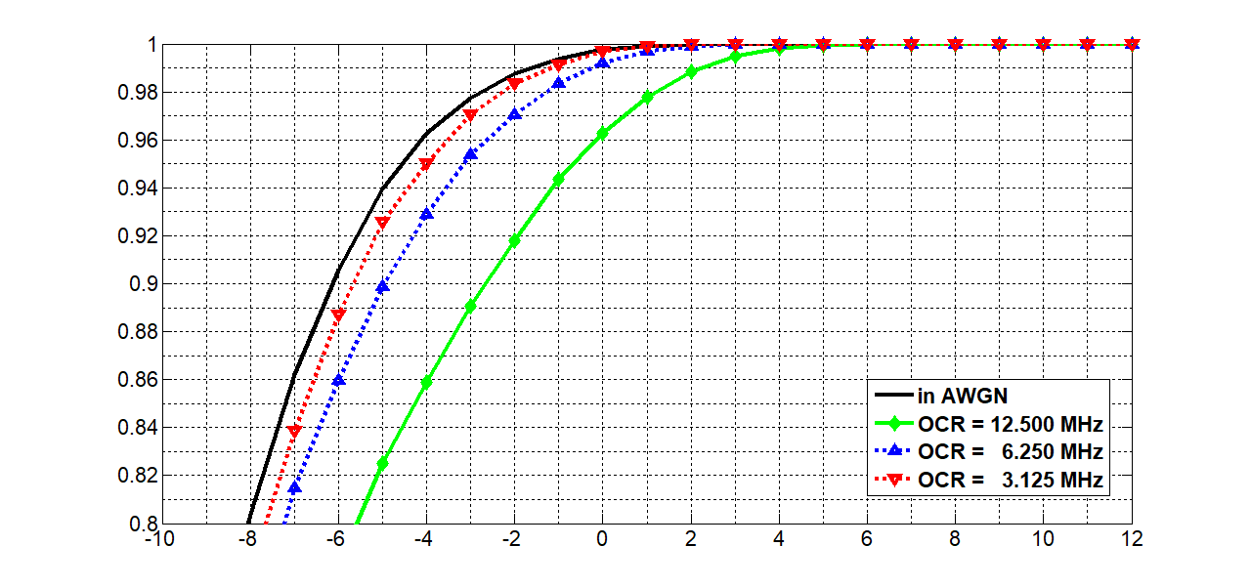
Results for P5 TDP @ D7 in S4
False Alarm = 0.1 %
Detection Probability
SNR (dB)

Slide 27
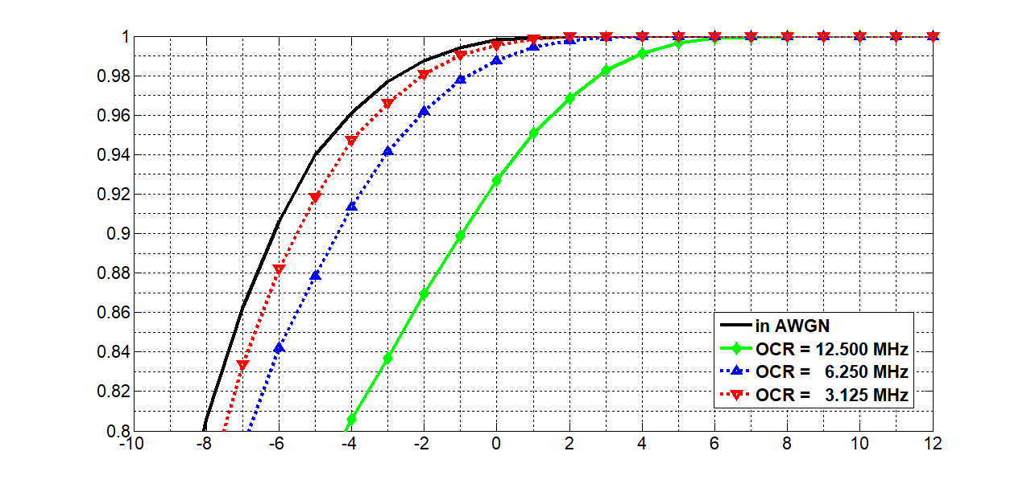
Results for P6 TDP @ D7 in S4
False Alarm = 0.1 %
Detection Probability
SNR (dB)

Slide 28
Summary
The new 6 TDPs showing almost the same cross-correlation characteristics with less than 4 consecutive ones or zeros were selected for preamble from 31-bits Gold Sequences.
As the optical clock rate change, the performance of the preamble patterns has been evaluated under AWGN only, D3 in S3, and D7 in S4 channels.
The detection threshold was determined to the level that FA(False Alarm) is < 0.1%, which was already fixed last meeting.
If we use down-sampling that the signal is sampled on the point close to the center of the bit, i.e. if we consider the best case, then there will be no variation in performance below OCR≈100MHz in D3/S3 and OCR ≈ 25MHz in D7/S4.
However, the channel effects caused by ISI are shown from when OCR is lower rate, compared to the best sampling. I think it’s because we used down-sampling through averaging process in this simulation.

