Slide 1
Project: IEEE P802.15 Working Group for Wireless Personal Area Networks (WPANs)
Submission Title: [IG DEP Superframe controlling scheme based on IEEE 802.15.6 for dependable WBAN]
Date Submitted: [6 March 2018]
Source: [Tomohiro Fukuya1, Ryuji Kohno1,2,3] [1;Yokohama National University, 2;Centre for Wireless Communications(CWC), University of Oulu, 3;University of Oulu Research Institute Japan CWC-Nippon]
Address [1; 79-5 Tokiwadai, Hodogaya-ku, Yokohama, Japan 240-8501
2; Linnanmaa, P.O. Box 4500, FIN-90570 Oulu, Finland FI-90014
3; Yokohama Mitsui Bldg. 15F, 1-1-2 Takashima, Nishi-ku,Yokohama, Japan 220-0011]
Voice:[1; +81-45-339-4115, 2:+358-8-553-2849], FAX: [+81-45-338-1157],
Email:[1: kohno@ynu.ac.jp, 2: Ryuji.Kohno@oulu.fi, 3: ryuji.kohno@cwc-nippon.co.jp] Re: []
Re: []
Abstract: [As a dependable MAC protocol for wireless body area network(WBAN), a scheme of controlling superframe is introduced.]
Purpose: [information]
Notice: This document has been prepared to assist the IEEE P802.15. It is offered as a basis for discussion and is not binding on the contributing individual(s) or organization(s). The material in this document is subject to change in form and content after further study. The contributor(s) reserve(s) the right to add, amend or withdraw material contained herein.
Release: The contributor acknowledges and accepts that this contribution becomes the property of IEEE and may be made publicly available by P802.15.

Slide 2
Superframe controlling scheme based on IEEE 802.15.6 for dependable wireless body area network (WBAN)
Tomohiro Fukuya*, Ryuji Kohno*†
＊Graduate School of Engineering Yokohama National University
† University of Oulu Research Institute Japan – CWC-Nippon, Co. Ltd.

Slide 3
Issues in contention base protocol
There is a possibility of frame collision in contention base protocol because each node sends their frames randomly.
Especially, in Slotted ALOHA, when some nodes transmit frames at the same transmission slot, WBANs’ performance become worse.
  Combine CDMA with Slotted ALOHA :
  Spread Slotted ALOHA(SSA)
  Modified SSA for WBAN QoS management.
User1
User2
Slot N-1
Slot N
Slot N+1
Fig. collision problem in Slotted ALOHA

Slide 4
DS-UWB for QoS management
IR-UWB is adopted in IEEE 802.15.6 as PHY layer.
Focus on the DS-UWB which is a signal obtained by multiplying the IR-UWB signal by the PN sequence.
  The longer spread sequence is, the higher outputs of autocorrelation peak value is. Therefore, improve the performance of received SNR.
[ 1 1 -1 -1 1 -1 1]
UWB pulse
(1 Symbol)
Spread sequence
DS-UWB (1 Symbol)
Fig. DS-UWB
Otherwise, if the chip rate of UWB pulse is fixed, throughput performance becomes worse with long sequence length.
  There is a trade-off between spreading code length and throughput of information bit.

Slide 5
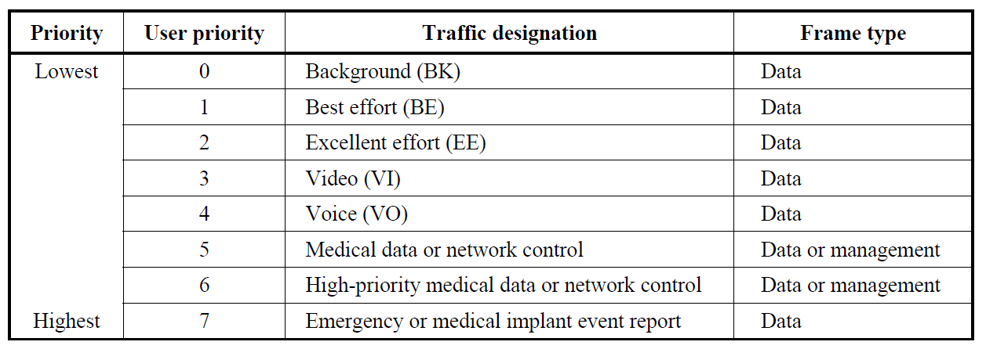
Spread sequence assignment for WBAN
Based on user priority mapping in IEEE 802.15.6, we classified spreading code lengths into three categories for the simplicity.
Video and voice traffic demand high data rate :
  Assign the short spread sequence
Medical traffic demands dependability :
  Assign the long spread sequence
$$N_{Category 2}<N_{Category 1}<N_{Category 3}$$
Table. User priority mapping for spread sequence assignment
Category 1
Category 2
Category 3

Slide 6
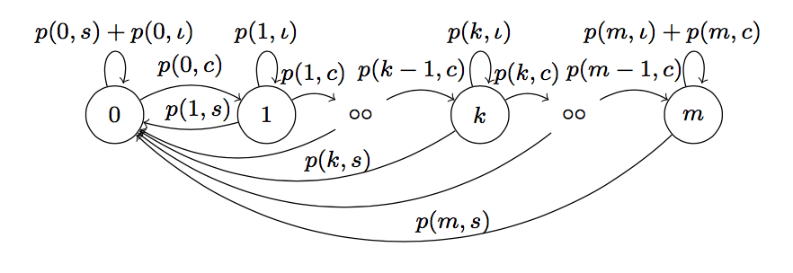
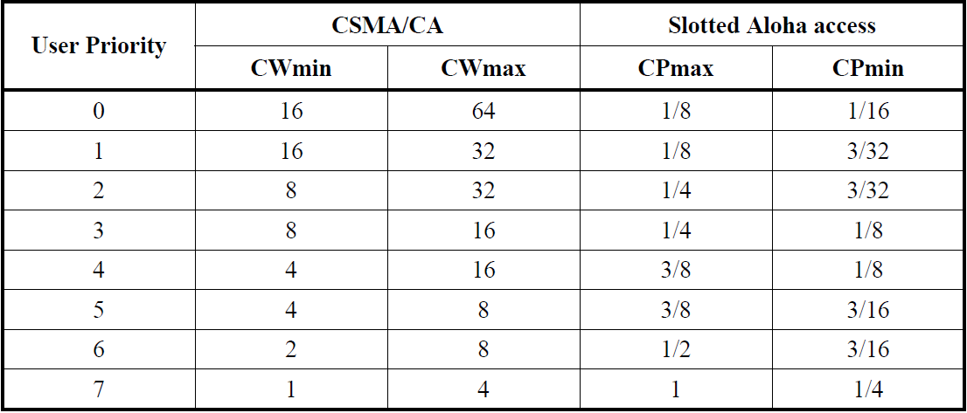

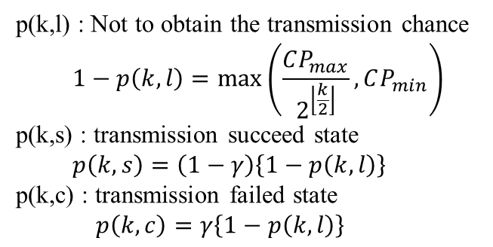
Theoretical analysis of proposal scheme
Table. Contention probability in IEEE 802.15.6
Fig. Markov chain model in [1]
p(k,l) : Not to obtain the transmission chance
  $$1−p\left(k,l\right)=\max\left(\frac{CP_{max}}{2^{\left\lfloor \frac{k}{2}\right\rfloor }}, CP_{min}\right)$$
p(k,s) : transmission succeed state
  $$p\left(k,s\right)=\left(1−γ\right)\left\{1−p\left(k,l\right)\right\}$$
p(k,c) : transmission failed state
  $$p\left(k,c\right)=γ\left\{1−p\left(k,l\right)\right\}$$
$γ$: transmission failed
[1]:Mohammad C. et al., “Saturation Throughput Analysis of IEEE 802.15.6 Slotted Aloha in Heterogeneous Conditions”, IEEE Wireless Commun. Lett. 2014.

Slide 7
Theoretical analysis of proposal scheme
Table. Contention probability in IEEE 802.15.6
Fig. Markov chain model
p(k,l) : Not to obtain the transmission chance
  $$1−p\left(k,l\right)=\max\left(\frac{CP_{max}}{2^{\left\lfloor \frac{k}{2}\right\rfloor }}, CP_{min}\right)$$
p(k,s) : transmission succeed state
  $$p\left(k,s\right)=\left(1−γ\right)\left\{1−p\left(k,l\right)\right\}$$
p(k,c) : transmission failed state
  $$p\left(k,c\right)=γ\left\{1−p\left(k,l\right)\right\}$$
$γ$: transmission failed

Slide 8

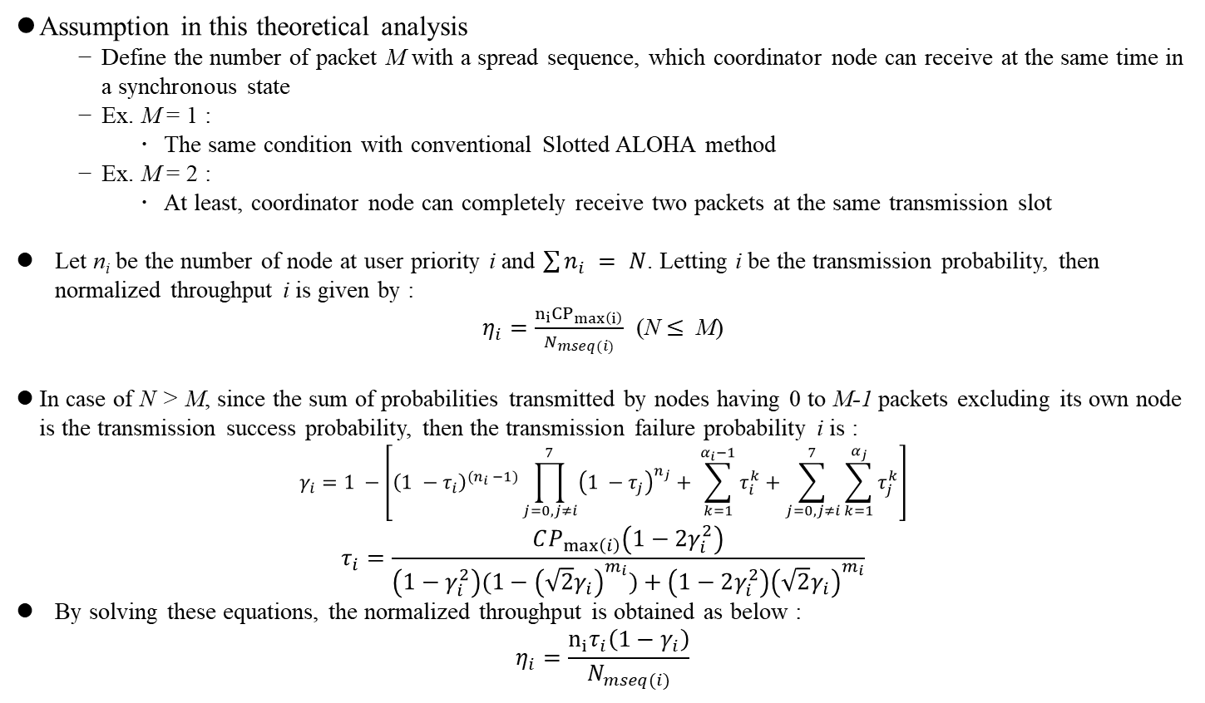
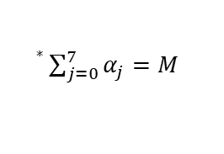
Cont’d
Assumption in this theoretical analysis
  Define the number of packet M with a spread sequence, which coordinator node can receive at the same time in a synchronous state
  Ex. M = 1 :
    The same condition with conventional Slotted ALOHA method
  Ex. M = 2 :
    At least, coordinator node can completely receive two packets at the same transmission slot
Let n_{i} be the number of node at user priority i and $\sum{n_{i}} = N$. Letting i be the transmission probability, then normalized throughput i is given by :
$η_{i}=\frac{n_{i}{CP}_{\max\left(i\right)}}{N_{mseq(i)}}$ (N $≤$ M)
In case of N > M, since the sum of probabilities transmitted by nodes having 0 to M-1 packets excluding its own node is the transmission success probability, then the transmission failure probability i is :
$$γ_{i}=1 −\left[{\left(1 −τ_{i}\right)}^{{(n}_{i} −1)}\prod_{j=0, j≠i}^{7}{{\left(1 −τ_{j}\right)}^{n_{j}}}+ \sum_{k=1}^{α_{i}−1}{τ_{i}^{k}}+\sum_{j=0,j≠i}^{7}{\sum_{k=1}^{α_{j}}{τ_{j}^{k}}}\right]$$
$$τ_{i}=\frac{CP_{\max\left(i\right)}\left(1−2γ_{i}^{2}\right)}{\left(1−γ_{i}^{2}\right)(1−{\left(\sqrt{2}γ_{i}\right)}^{m_{i}})+\left(1−2γ_{i}^{2}\right){\left(\sqrt{2}γ_{i}\right)}^{m_{i}}}$$
By solving these equations, the normalized throughput is obtained as below :
$$η_{i}=\frac{n_{i}τ_{i}\left(1−γ_{i}\right)}{N_{mseq(i)}}$$
${}^{∗}\sum_{j=0}^{7}{α_{j}=M}$
$N_{mseq(i)}$ is the length of spread sequence

Slide 9
Simulation condition
Using only RAP superframe model and compare the performance between IEEE 802.15.6 Slotted ALOHA and proposal Spread Slotted ALOHA.
For the simplicity, offered load in each node is the same.
Throughput is defined as the number of bits which coordinator node completely received.
Table. Simulation parameters
Data rate | 7.8 Mbps
Spread sequence | M-sequence
Spread sequence length | 1, 7, 15
Simulation time | 30 sec
Channel model | AWGN
SNR | 0 dB
Modulation system | BPSK
Packet length | 1050 bit
ALOHA slot length | 1.07 msec
The number of node | 1（coordinator）
 | 7（sensor）
User Priority | 0 - 6
Table. Contention probability in IEEE 802.15.6

Slide 10
Results of mean latency performance
Advantage :
  In proposal scheme, if some nodes transmit at the same transmission slot, coordinator node can demodulate. So, the number of retransmission which cased by the error decreases. Therefore, proposal scheme can improve mean latency performance.
(a) Slotted ALOHA（IEEE 802.15.6）
(b)Spread Slotted Aloha（proposal scheme）
Fig. Mean latency performance in each method

Slide 11
Results of throughput performance
Drawback :
  Although the proposed method can receive multiple packets by code division multiplexing, high throughput can not be obtained because the amount of information that can be transmitted in one packet decreases by directly spreading the transmission signal.
  The UP₆ traffic has a code length of 16 and the UP₀ traffic uses a code length of 8, so that the payload in one packet is 1/16, 1/8, as compared with the conventional method.
1
(a) Slotted ALOHA（IEEE 802.15.6）
(b)Spread Slotted Aloha（proposal scheme）
Fig. Throughput performance in each method

Slide 12
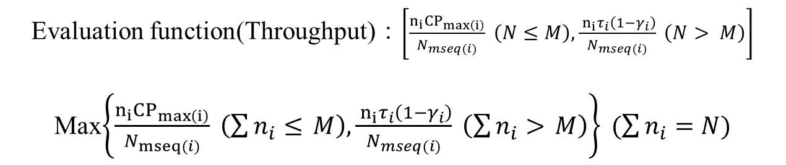
Adaptive algorithm in order to improve throughput
The amount of traffic in the network is detected beforehand, and the code length allocated to the above three groups is changed according to the amount of traffic.
  If the amount of traffic in the network is small, it is unnecessary to spread the signal.
  If the amount of traffic is large, it is necessary to spread with a code length that is somewhat long.
Evaluation function(Throughput)：$\left[\frac{n_{i}{CP}_{\max\left(i\right)}}{N_{mseq(i)}} \left(N≤M\right),\frac{{ n}_{i}τ_{i}\left(1−γ_{i}\right)}{N_{mseq(i)}} \left(N> M\right)\right]$
Max$\left\{\frac{n_{i}{CP}_{\max\left(i\right)}}{N_{mseq(i)}} \left(\sum{n_{i}≤} M\right),\frac{{ n}_{i}τ_{i}\left(1−γ_{i}\right)}{N_{mseq(i)}} \left(\sum{n_{i}>} M\right)\right\} (\sum{n_{i}=N})$
Detection of traffic volume plays an important role in Code length allocation algorithm.
The detection of the traffic volume takes a overestimation. There is a More data field in the MAC header of the standard. It means that node has at least one packet to transmit except current transmission.
  Apply it to the theoretical formula N of throughput.

Slide 13
Simulation condition
Using only RAP superframe model and compare the performance between IEEE 802.15.6 Slotted ALOHA and proposal Spread Slotted ALOHA.
For the simplicity, offered load in each node and received power are the same.
Throughput is defined as the number of bits which coordinator node completely received.
Table. Simulation parameters
Data rate | 7.8 Mbps
Spread sequence | M-sequence
Spread sequence length | 1, 7, 15 (M=1, 2, 3)
Simulation time | 10 sec
Channel model | AWGN
SNR | 0 dB
Modulation system | BPSK
Packet length | 1050 bit
ALOHA slot length | 1.07 msec
The number of node | 1（coordinator）
 | 7（sensor nodes）
User Priority | 0 - 6
Table. Spread sequence length for adaptive algorithm
Spread sequence length
Category 1
[1,7]
Category 2
[1]
Category 3
[7,15]
:default

Slide 14
Results of mean latency performance
(a) Spread Slotted ALOHA（proposal scheme）
(b)Spread Slotted Aloha（proposal scheme w/ adaptive algorithm）
Fig. Mean latency performance in each method

Slide 15
Results of throughput performance
From these figures, it can be seen that throughput is greatly improved in the proposed method of adaptively allocating sequence length, and its usefulness has been shown.
(a) Spread Slotted ALOHA（proposal scheme）
(b)Spread Slotted Aloha（proposal scheme w/ adaptive algorithm）
Fig. Mean latency performance in each method

