Slide 1
Project: IEEE P802.15 Interest Group for Wireless Personal Area Networks (WPANs)
Submission Title: Hybrid OCC-PD communication system
Date Submitted: March 2018
Source: Trang Nguyen, Minh Duc Thieu and Yeong Min Jang [Kookmin University].
Contact: +82-2-910-5068 E-Mail: yjang@kookmin.ac.kr
Re:
Abstract: Summarize a Hybrid OCC-PD communication system
Purpose: To introduce an reference architecture of a Hybrid OCC-PD communication system for researchers.
Notice: This document has been prepared to assist the IEEE P802.15. It is offered as a basis for discussion and is not binding on the contributing individual(s) or organization(s). The material in this document is subject to change in form and content after further study. The contributor(s) reserve(s) the right to add, amend or withdraw material contained herein.
Release: The contributor acknowledges and accepts that this contribution becomes the property of IEEE and may be made publicly available by P802.15.

Slide 2
Hybrid OCC-PD Communication Systems

Slide 3
Introduction
Several studies have investigated hybrid OCC and Photodiode (PD) systems that are able to realize new types of image sensors with PD cells (i.e., communication cells) integrated between the image pixels (i.e., image cells) [1].
Inheriting the achievement of PD communications from existing VLC standards such as IEEE 802.15.7-2011 std., along with the achievement of high-rate PD communication sub-committee (LiFi sub-committee) in the ongoing IEEE 802.15.7 revision TG7m [1].

Slide 4
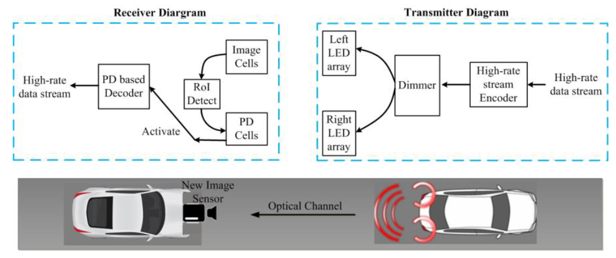
Hybrid OCC and PD reference architecture
There are variations between the related works on hybrid OCC and PD systems realizing a new type of image sensor comprising PD cells integrated between image pixels [5].
Reference architecture for Hybrid OCC/PD communication system
based on RoI signaling technique

Slide 5
Hybrid OCC and PD reference architecture
The image output form the image cells is used to detect the light source; then a communication link is set up and the PD cells are actived.
This technique also requires the detection of RoI. When RoI signaling is missing, Computer Vision based RoI detection will be performed instead.
Typical modulation schemes such as OOK and VPPM standardized by IEEE 802.15.7-2011 standard are useful.
Some advanced modulation and coding schemes such as OFDM series, will give new opportunities for hybrid OCC-PD system

Slide 6
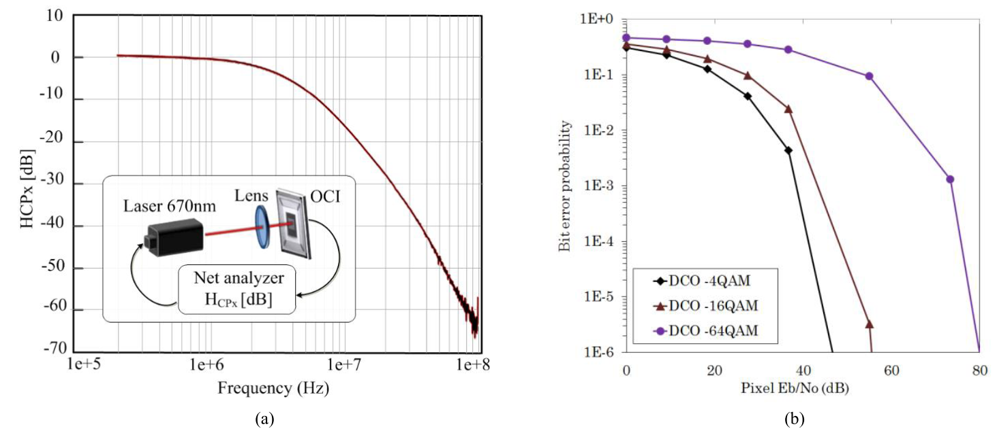
Hybrid OCC and PD reference architecture
Experiment results
Operation and performance of Hybrid OCC/PD systems. (a) Measurement of frequency response characteristics (redrawn from [2]). (b) Simulation result of bit error rate against pixel Eb/No for PD communication in hybrid system (re-simulated from [3])

Slide 7
Hybrid OCC and PD reference architecture
Experiment results
Assume that the RoI is successfully detected, and communication pixel (CPx) is PD-activated according to the detected RoI from image cells.
After this link setup step, the performance of high-rate link is based on the performance of PD and its circuit (such as an equalizer). The frequency response allowed the occupied bandwidth up to 10MHz with the equalizer considered.
The bit-error rate as a function of the Eb=No performance of direct current-biased OFDM (DCO–OFMD) using quadrature amplitude modulation (QAM) symbol mapping.
It shows that 10−6 BER shall require the signal strength above 40dB (up to 80 dB).

Slide 8
References
[1] T. Nguyen et al,. “Current Status and Performance Analysis of OCC Technologies for 5G Networks”, IEEE Access, vol. 5, April 2017, pp. 4574-4594.
[2] I. Takai, S. Ito, K. Yasutomi, K. Kagawa, M. Andoh, and S. Kawahito, ‘‘LED and CMOS image sensor based optical wireless communication system for automotive applications,’’ IEEE Photon. J., vol. 5, no. 5, Oct. 2013, Art. no. 6801418.
[3] Y. Goto et al., ‘‘BER characteristic of optical-OFDM using OCI,’’ in Proc. IEEE Asia Pacific Conf. Circuits Syst. (APCCAS), Ishigaki, Japan, Nov. 2014, pp. 328–331

