Slide 1
Project: IEEE P802.15 Interest Group for Wireless Personal Area Networks (WPANs)
Submission Title: Summary of some high speed OCC systems
Date Submitted: March 2018
Source: Trang Nguyen, Minh Duc Thieu and Yeong Min Jang [Kookmin University].
Contact: +82-2-910-5068 E-Mail: yjang@kookmin.ac.kr
Re:
Abstract: Summarize some basic high speed OCC systems developed by some groups of researchers.
Purpose: To introduce some high speed OCC systems which can be used as reference architectures for researchers.
Notice: This document has been prepared to assist the IEEE P802.15. It is offered as a basis for discussion and is not binding on the contributing individual(s) or organization(s). The material in this document is subject to change in form and content after further study. The contributor(s) reserve(s) the right to add, amend or withdraw material contained herein.
Release: The contributor acknowledges and accepts that this contribution becomes the property of IEEE and may be made publicly available by P802.15.

Slide 2
Summary of some high speed OCC systems

Slide 3
Introduction
OCC technologies are classified into a set of five major types which address how the systems work and which LED Tx and camera Rx is applicable [1]:
Nyquist sampling based flicker modulations
High frame-rate Nyquist sampling
Region of Interest (RoI) signaling
Hybrid OCC and PD communication
Roling shutter based OCC
The classification covered the entire research trend on OCC and current standardization of OCC TG7m.

Slide 4
Introduction (2)
Because of the requirement of flicker mitigation, high-speed cameras were used in the high frame-rate Nyquist sampling. Therefore, it is best-applied in traffic light signals.
Under-sampled RoI signaling systems were designed being suitable for car-to-car communication, namely the killer app of OCC. The low-rate stream and high-rate data stream of RoI are simultaneously transmitted, making it a complete technology that is readily incorporated into cars.
The hybrid OCC and PD systems can support the required 5G data rate up to Gbps level using the advanced OFDM modulation series. Cameras are expected to be the receiver for automotive OWC systems. Cameras have already been used for safety and comfort applications in the automotive field. Therefore, using the camera as the optical signal receiver is reasonable and straightforward.

Slide 5
Introduction (3)
Various potentials and advantages of the camera-based OCC system have already been reported.
However, only a few reports have implemented the camera-based OCC system in a real automotive system and conducted experiments under real driving and outdoor lighting conditions until now.
To achieve a useful camera-based OCC system for automotive applications, barriers must be overcome: one is data rate improvement and another is accurate and quick LED detection.

Slide 6
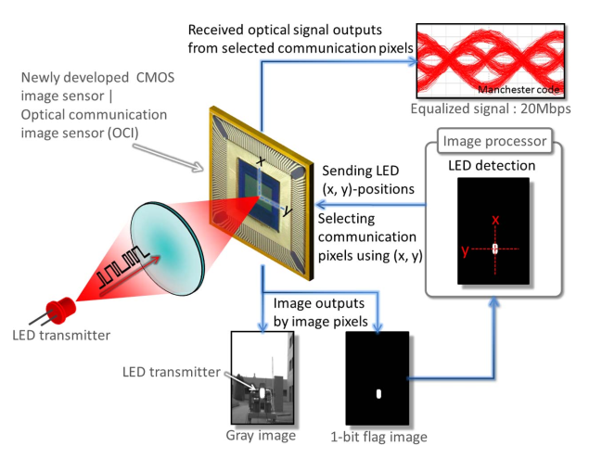
Summary of some high speed OCC systems (1)
Isamu Takai and his partners proposed an optical Vehicle-to-Vehicle communication system. Their work is published in IEEE Photonics Journal in 2013 (Reference document [2]).
On their paper, they focused on designing a new CMOS image sensor OCI to obtain higher transmission rates (Mbps-class).
Illustration of the optical communication
system using new image sensor

Slide 7
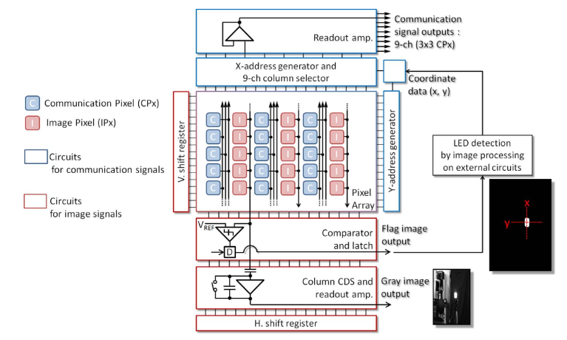
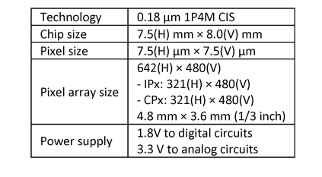
Summary of some high speed OCC systems (1)
New Optical Communication Image Sensor (OCI)
They developed an OCI using complementary metal-oxide-semiconductor (CMOS) technology that can integrate multiple functions
Specifications of the OCI Chip
Block diagram of the OCI Chip

Slide 8
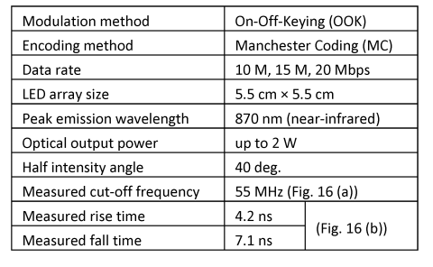
Summary of some high speed OCC systems (1)
The transmitter system
Sample IS-OWC system.
(a) LED transmitter. (b) Camera receiver
Specifications of LED transmitter
LED transmitter System block diagram

Slide 9
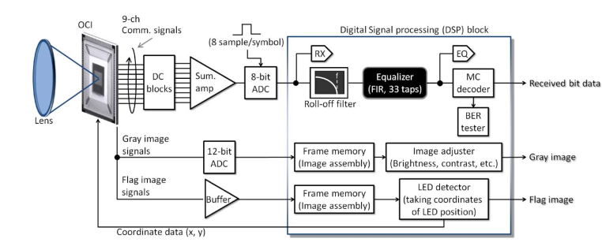
Summary of some high speed OCC systems (1)
The receiver system
System block diagram of the camera receiver

Slide 10
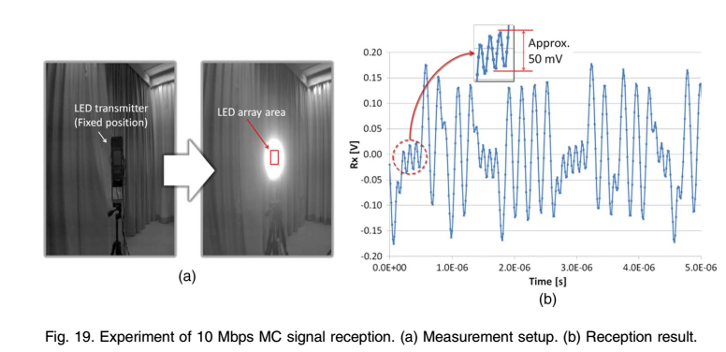
Summary of some high speed OCC systems (1)
Experiment results
Experiment of 10Mbps MC signal reception. (a) Measurement setup. (b) Reception result

Slide 11
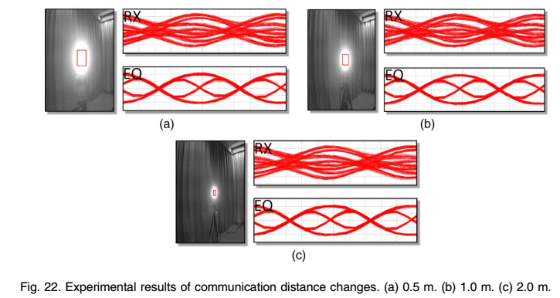
Summary of some high speed OCC systems (1)
Experiment results
Experiment result of communication distance changes.
(a) 0.5m. (b) 1.0m. (c) 2.0m

Slide 12
Summary of some high speed OCC systems (1)
Experiment results
Experiment result of long communication distances.
(a) At 10m and indoor. (b) At 20m and outdoor

Slide 13
Summary of some high speed OCC systems (1)
Experiment results
Measurement results of the BER

Slide 14
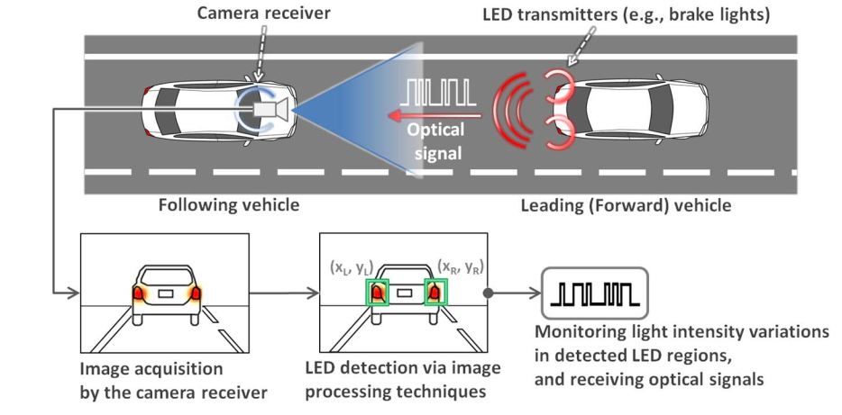
Summary of some high speed OCC systems (2)
Isamu Takai and his partners continued to introduce his new optical Vehicle-to-Vehicle communication system. His work is published in IEEE Photonics Journal in 2014 (Reference document [3]).
Illustration of the optical V2V communication system

Slide 15
Summary of some high speed OCC systems (2)
A leading vehicle (LV) has LED transmitters that use vehicle LED light sources such as tail lights, brake lights, and head lights.
A following vehicle (FV) has the camera receiver. The LV collects its own various internal data (such as speed) and sends these data to the FV by optical signals.
At the same time, the camera receiver on the FV captures the images and looks for the LED regions in the captured images via image processing techniques.
The LED regions are enclosed by green rectangles. Subsequently, the receiver system monitors the light intensity variations in the detected LED regions and receives the optical signals.

Slide 16
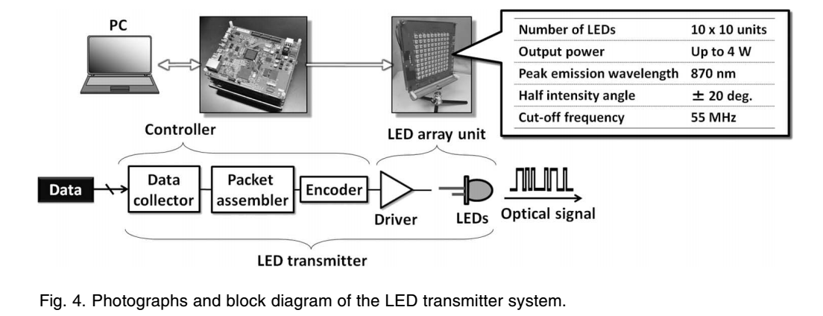
Summary of some high speed OCC systems (2)
The transmitter system
Photographs and block diagram of the LED transmitter system

Slide 17
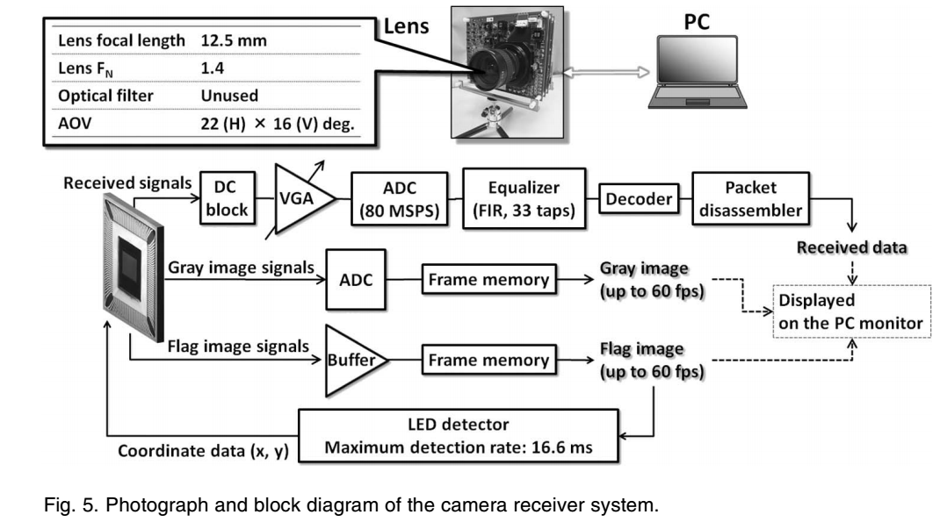
Summary of some high speed OCC systems (2)
The receiver system
Photograph and block diagram of the camera receiver system

Slide 18
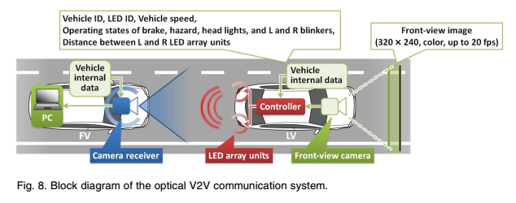
Summary of some high speed OCC systems (2)
The receiver system

Slide 19
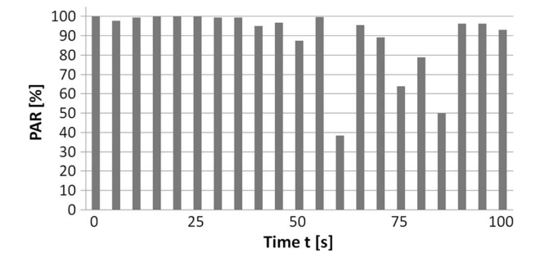
Summary of some high speed OCC systems (2)
Experiment results
Measurement results of PAR (Packet Arrival Rate)
PAR measurement result per 5 seconds

Slide 20
Summary of some high speed OCC systems (2)
Experiment results
To confirm the image reception performance of this system, the reception-frame-rate of the front-view image is measured, as shown in the table below.
Measurement results of reception-frame-rate of front-view images

Slide 21
Summary of some high speed OCC systems (3)
Another V2V communication system has been proposed by Yuki Goto, Isamu Takai and their partners in 2016 (Reference document [4]).
Illustration of the optical V2V communication system

Slide 22
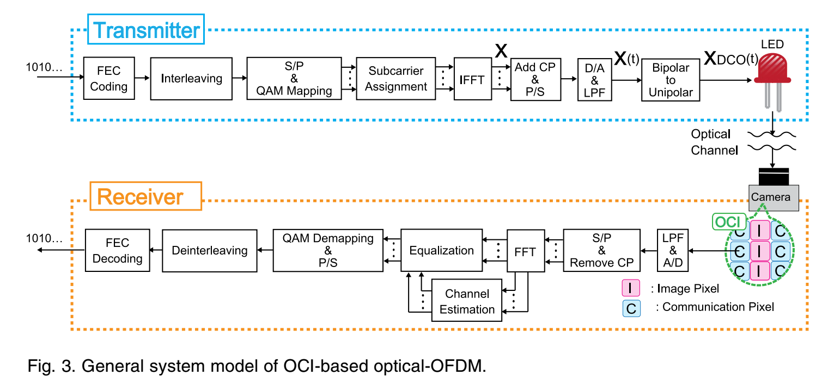
Summary of some high speed OCC systems (3)
General system model
General system model of OCI-based optical-OFDM

Slide 23
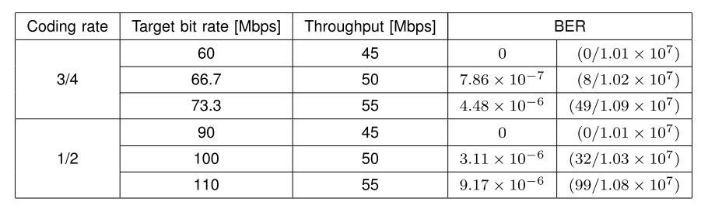
Summary of some high speed OCC systems (3)
Experiment results
The data-transmission experiment demonstrated that the OCI-based DCO-OFDM system achieves a data rate of 45 Mbps without bit errors and 55 Mbps with a BER < 10⁻⁵
BER measurement results

Slide 24
References
[1] T. Nguyen et al., “Current Status and Performance Analysis of Optical Camera Communication Technologies for 5G Networks”, IEEE Access, vol. 5, March 2017, pp. 4574-4594.
[2] I. Takai et al., “LED and CMOS Image Sensor Based Optical Wireless Communication System for Automotive Aplications”, IEEE Photon. J., vol. 5, no. 5, October 2013, Art. no. 6801418.
[3] Y. Goto et al., “A New Automotive VLC System Using Optical Communication Image Sensor”, IEEE Photon. J., vol. 8, no. 3, June 2016, Art. no. 6802716.
[4] I. Takai et al., “Optical Vehicle-to-Vehicle Communication System Using LED Transmitter and Camera Receiver”, IEEE Photon. J., vol. 6, no. 5, Oct. 2014, Art. no. 7902513.

