Slide 1
Project: IEEE P802.15 Working Group for Wireless Personal Area Networks (WPANs)
Submission Title: Summary of PHY proposals
Date Submitted: March 6, 2018
Source: John Li
Company: Huawei
Address: No.156 Beiqing road, Beijing
Voice: +86 158 0153 9749
e-mail: john.Liqiang@hisilicon.com
Re:
Abstract: This document summarize the PHY proposals and provide list of issues to be resolved
Purpose: Guidelines for PHY development
Notice: This document has been prepared to assist the IEEE P802.15. It is offered as a basis for discussion and is not binding on the contributing individual(s) or organization(s). The material in this document is subject to change in form and content after further study. The contributor(s) reserve(s) the right to add, amend or withdraw material contained herein.
Release: The contributor acknowledges and accepts that this contribution becomes the property of IEEE and may be made publicly available by P802.15.

Slide 2
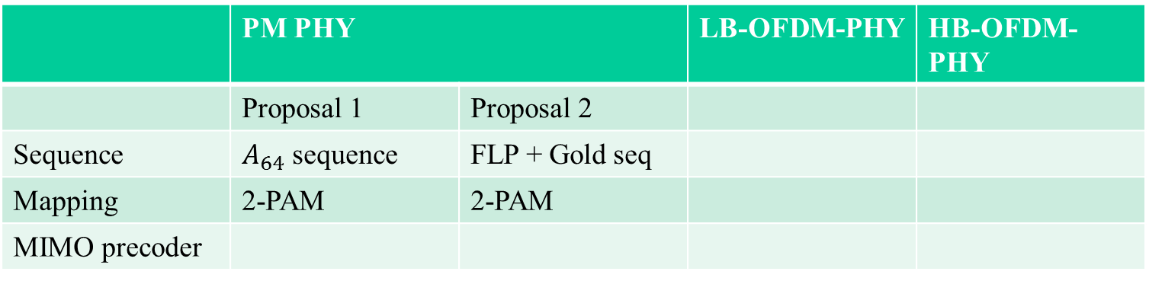
Preamble design
 | PM PHY |  | LB-OFDM-PHY | HB-OFDM-PHY
 | Proposal 1 | Proposal 2
Sequence | $A_{64}$ sequence | FLP + Gold seq
Mapping | 2-PAM | 2-PAM
MIMO precoder

Slide 3
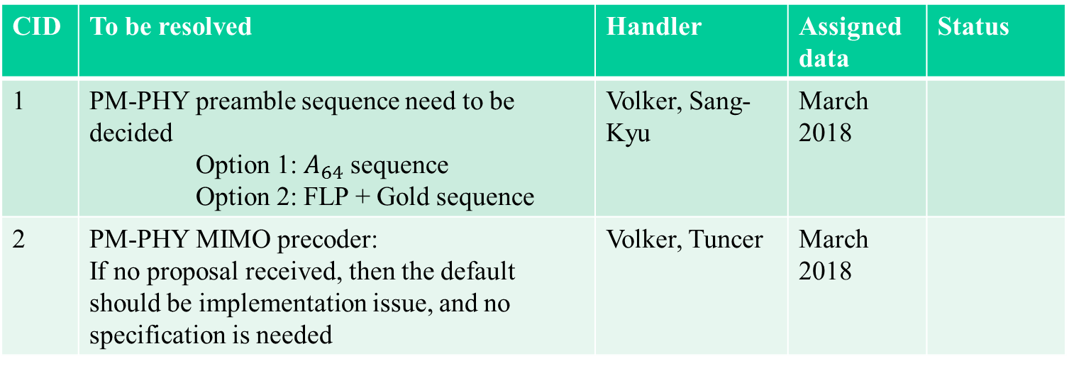
Preamble design: to be resolved
CID | To be resolved | Handler | Assigned data | Status
1 | PM-PHY preamble sequence need to be decided Option 1: $A_{64}$ sequence Option 2: FLP + Gold sequence | Volker, Sang-Kyu | March 2018
2 | PM-PHY MIMO precoder: If no proposal received, then the default should be implementation issue, and no specification is needed | Volker, Tuncer | March 2018

