Slide 1
Project: IEEE P802.15 Working Group for Wireless Personal Area Networks (WPANs)
Submission Title: Water Vehicle Emergency Warning Signal Application using LiFi/CAMCOM Technology
Date Submitted: March 2018
Source: Jaesang Cha (SNUST), Minwoo Lee (SNUST), Jeong Gon Kim (Korea Polytechnic Univ.), Hyeongho Lee (Netvision Telecom Inc., Korea), Mariappan Vinayagam (SNUST)
Address: Contact Information: +82-2-970-6431, FAX: +82-2-970-6123, E-Mail: chajs@seoultech.ac.kr
Re:
Abstract: This documents introduce the V2V LiFi/CamCom Link design consideration for VAT. This proposed LiFi/CamCom for water vehicle used for emergency warning signal. This VAT to operate on the application services like ITS, ADAS, IoT/IoL, etc. on road condition. Also this can be used for LEDIT, Digital Signage with connected information services etc.
Purpose: To provided concept models of Light Communication based LiFi/CamCom solution for Vehicular Assistant Technology (VAT) Interest Group
Notice: This document has been prepared to assist the IEEE P802.15. It is offered as a basis for discussion and is not binding on the contributing individual(s) or organization(s). The material in this document is subject to change in form and content after further study. The contributor(s) reserve(s) the right to add, amend or withdraw material contained herein.
Release: The contributor acknowledges and accepts that this contribution becomes the property of IEEE and may be made publicly available by P802.15.
Slide 1

Slide 2
Contents
Needs for Water Vehicle Emergency Warning Signal
LiFi/CamCom Technology for Water Vehicle
Conclusion
Slide 2

Slide 3
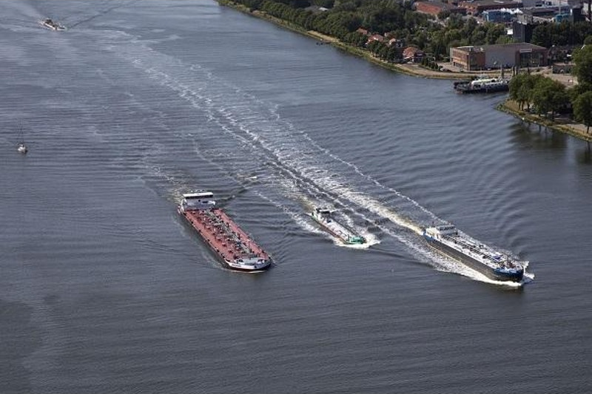
Needs for Water Vehicle Emergency Warning Signal
Emergency Warning
  Casualties to large navigational buoys, primary lights or lightships.
  Changes in depth of water
  Dangerous wrecks or obstruction to navigation
  Floating dangers-like containers, drifting buoys, icebergs
  Newly established aids to navigation
  Gunnery or fire exercise areas and underwater activities in certain areas
  Vessels aground in approaching port areas
  Any changes or development of new buoyage system
  Gale warnings
Basic Concept
  Uses the Lighting System and the PD/Camera connected on water vehicle to enable LiFi/CamCom technology for communication between water vehicles
  < Water Vehicles In Use Scenario >
GOOGLE
Slide 3

Slide 4
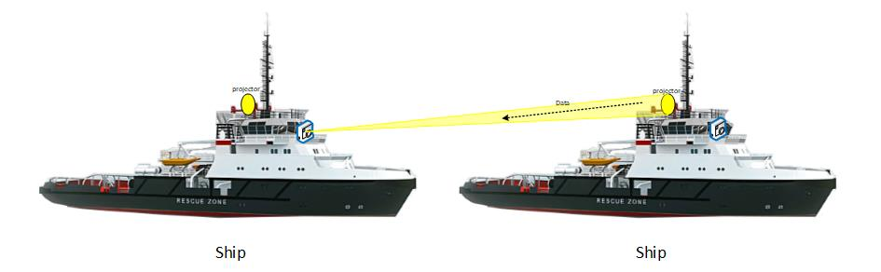
LiFi/CAMCOM Technology for Water Vehicle
Light Based LiFi/CamCom Link on Water Vehicles
  Tx : Water Vehicle Lights
  Rx : PD / CCTV Camera
  Day-Night Communication Mode
  Modulations :
    OOK, VPPM, Offset-VPWM, Multilevel PPM, Inverted PPM, Subcarrier PPM, DSSS SIK etc.
  Data Rate : 1K ~ 1Mb/s
  Supported LoS (Line of Sight)
  Available Distance : more than 500m with lens
  < Water Vehicle LiFi CamCom Link >
Uses the LiFi/CamCom Technology to communicate between water vehicles for emergency condition information broadcasting, Water vehicle specific secured informations, etc.
Helps to protect the water vehicles from emergency situation locks and saves human / goods, etc.
Use the existing lighting infrasture and on vehicle cameras for LiFi/CamCom Link
Slide 4

Slide 5
Conclusion
Proposed the Water Vehicle Emergency Warning Signaling method using LiFi/CAMCOM Technology
Uses the existing infrastructure to built the system and does not required any additional infrastructure needs to be Installed
Provides warning signals to nearby water vehicles casualties to large navigational buoys, primary lights or lightships, Changes in depth of water, Dangerous wrecks or obstruction to navigation, floating dangers-like containers, drifting buoys, icebergs, etc.
Reduce the travelers/goods risk and avoids confusions on the way of sailing.
Slide 5

