Slide 1
Project: IEEE P802.15 Working Group for Wireless Personal Area Networks (WPANs)
Submission Title: LiFi/CAMCOM Technology based Aircraft carrier Optical Landing System Solution
Date Submitted: March 2018
Source: Jaesang Cha(SNUST), Minwoo Lee(SNUST), Soo Young Chang(CSUS), Jeong Gon Kim (Korea Polytechnic Univ.), Hyeongho Lee(Netvision Telecom Inc., Korea), Mariappan Vinayagam(SNUST)
Address: Contact Information: +82-2-970-6431, FAX: +82-2-970-6123, E-Mail: chajs@seoultech.ac.kr
Re:
Abstract: This documents introduce the V2V LiFi/CamCom Link design consideration for VAT. This proposed LiFi/CamCom technology for aircraft carrier optical landing system solution. This VAT to operate on the application services like ITS, ADAS, IoT/IoL, etc. on road condition. Also this can be used for LEDIT, Digital Signage with connected information services etc.
Purpose: To provided concept models of Light Communication based LiFi/CamCom solution for Vehicular Assistant Technology (VAT) Interest Group
Notice: This document has been prepared to assist the IEEE P802.15. It is offered as a basis for discussion and is not binding on the contributing individual(s) or organization(s). The material in this document is subject to change in form and content after further study. The contributor(s) reserve(s) the right to add, amend or withdraw material contained herein.
Release: The contributor acknowledges and accepts that this contribution becomes the property of IEEE and may be made publicly available by P802.15.
Slide 1

Slide 2
Contents
Needs for Aircraft carrier Optical Landing System Solution
LiFi/CamCom Technology for Optical Landing System
Conclusion
Slide 2

Slide 3
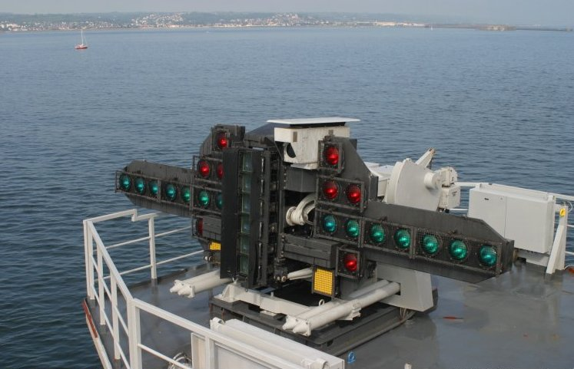
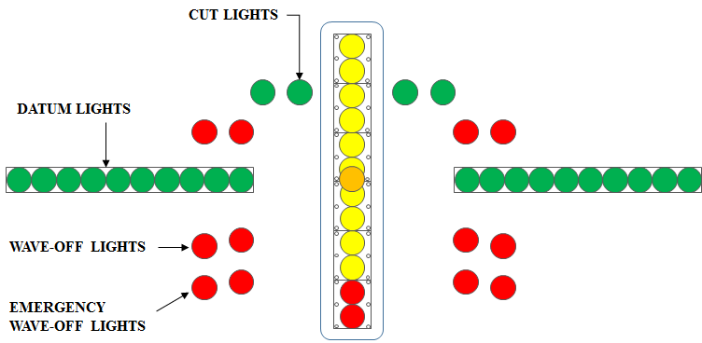
Needs for Aircraft carrier Optical Landing System
Needs
Presently very complex light based signaling used for Optical Landing System Light (OLS) for aircraft landing
Need to use lens to focus on OLS to detect the type of signal lighting
Difficult to detect the landing signal status from long
Need to easy and long distance coverage method for OLS
Basic Concept
Uses the OLS Lighting System or Simple Lighting Model and the PD/head mounted Camera connected on aircraft to enable LiFi/CamCom technology for communication between aircraft and aircraft carriers
Simple and Effective to Install the LiFi/CamCom System
More user friendly for OLS operators and pilots for Landing
Increase the distance coverage to take decision on Landing
< Fresnel Lens Optical Landing System >
WIKIPEDIA
< Lens Optical Landing System Lights >
Slide 3

Slide 4
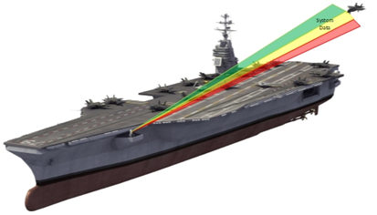
LiFi/CamCom Technology for Optical Landing System
Light Based LiFi/CamCom Link for OLS
Tx : OLS Lights
Rx : PD / Head Mounted Camera
Day-Night Communication Mode
Modulations :
OOK, VPPM, Offset-VPWM, Multilevel PPM, Inverted PPM, Subcarrier PPM, DSSS SIK etc.
Data Rate : 1K ~ 1Mb/s
Supported LoS (Line of Sight)
Available Distance : more than 500m with lens
< Aircraft carrier Optical Landing System (OLS) LiFi CamCom Link >
Uses the LiFi/CamCom Technology to communicate between Aircraft and Aircraft Carrier for OLS
Simplifies and automate the OLS Signaling Method
Use the existing lighting infrasture and PD/ Head mounted Camera for LiFi/CamCom Link
Add Capability for OLS Signaling recognition from long distance on aircraft
Slide 4

Slide 5
Conclusion
Proposed the LiFi/CAMCOM Technology based Aircraft carrier Optical Landing System Solution
Uses the existing OLS lighting infrastructure to built the system and does not required any additional infrastructure needs to be installed
Provides easy way signaling for aircraft landing and increase the distance coverage to recognize the OLS lighting signals.
Simplifies and automate the OLS Lighting Signal method
Slide 5

