Slide 1
Project: IEEE P802.15 Working Group for Wireless Personal Area Networks (WPANs)
Submission Title: Location based Bus Guidance Information Using IoT/IoL Technology
Date Submitted: March 2018
Source: Jaesang Cha (SNUST), Daehyun Kim (Namuga Co., Ltd), Jaekwon Shin, Jintae Kim (Fivetek Co., Ltd), Sangwoon Lee (Namseoul Univ.), Minwoo Lee (SNUST), Mariappan Vinayagam (SNUST)
Address: Contact Information: +82-2-970-6431, FAX: +82-2-970-6123, E-Mail: chajs@seoultech.ac.kr
Re:
Abstract: This documents introduce the V2I IoT/IoL Link design consideration for VAT. This proposed location based bus guidance information system based on IoT/IoL solution used for Travelers at bus stops. This VAT to operate on the application services like ITS, ADAS, etc. on road condition. Also this can be used for LEDIT, Digital Signage with connected information services etc.
Purpose: To Provided Concept models of Light Communication based IoT/IoL solution for Vehicular Assistant Technology (VAT) Interest Group
Notice: This document has been prepared to assist the IEEE P802.15. It is offered as a basis for discussion and is not binding on the contributing individual(s) or organization(s). The material in this document is subject to change in form and content after further study. The contributor(s) reserve(s) the right to add, amend or withdraw material contained herein.
Release: The contributor acknowledges and accepts that this contribution becomes the property of IEEE and may be made publicly available by P802.15.
Slide 1

Slide 2
Contents
Needs for Location Based Bus Guidance Information
IoT/IoL Based Bus Guidance Information
Conclusion
Slide 2

Slide 3

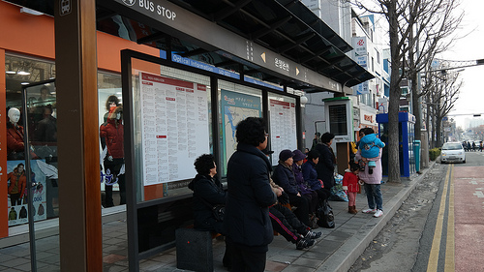
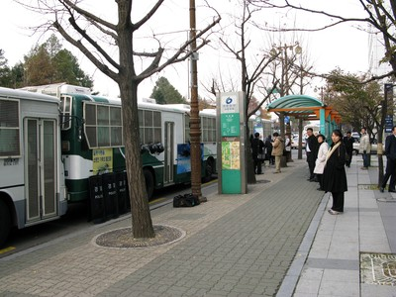
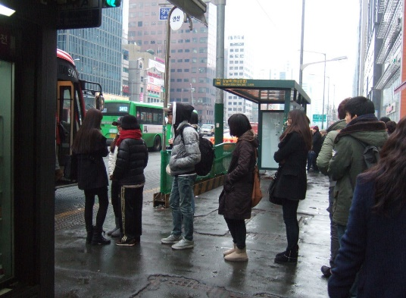
Needs for Location Based Bus Guidance Information
Needs
  Present ITS for Bus information system provides real-time bus service information like Bus No, Time, etc. for bus users to save their valuable time based on GPS.
  If there are too many bus passengers, it will cause confusion because the exact number can not be grasped with route Information.
  Need to adapt IoT/IoL based technologies to obtain relevant information on the bus platform.
Basic Concept
  Uses the bus mirror or front lights as OWC Transmitter and the camera connected on bus stop as receiver to decode the data
  Possible to provide the exact number of passenger and relevant routing information
  Technology easy to apply to growing infrastructure without adding additional infrastructure
  < Bus Stop Infrastructure >
GOOGLE
Slide 3

Slide 4
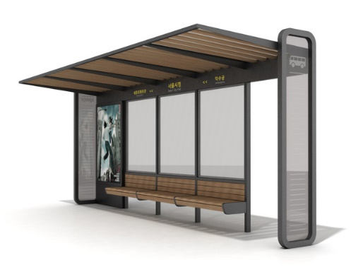


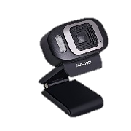
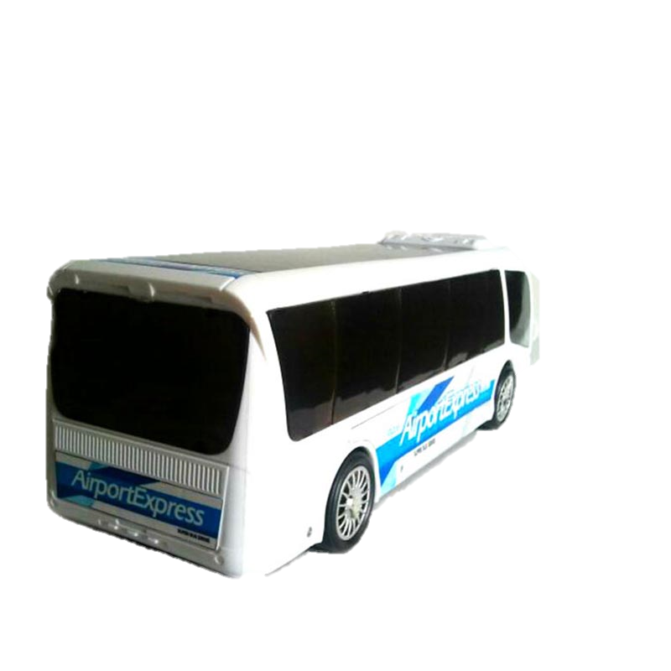
IoT/IoL Based Bus Guidance Information
Light Based IoT/IoL Link
  Tx : Bus Transparent Signage / Front Lights
  Rx : Bus Stop CCTV Camera
  Day-Night Communication Mode
  Modulations : VTASC, SS2DC, QR-Code, Color Code, OOK, VPPM, Offset-VPWM, etc.
  Data Rate : 1K ~ 1Mb/s
  Supported LoS (Line of Sight)
  Available Distance : 2m ~ 20m
  < Lighting based IoT/IoL Link >
Uses the OWC Technology to do display exact Bus No, Bus Route Details, Traffic Informations etc. through ITS infrastructure and reduce the travelers inconvenience and confusion
Use the Bus Transparent Signage / Front Lights and Bus Stop CCTV for IoT/IoL Link
Slide 4

Slide 5
Conclusion
Proposed the Location based Bus Guidance Information Using IoT/IoL Technology
Uses the existing infrastructure to built the system and does not required any additional infrastructure needs to be Installed
Provide bus no, bus route info, Traffic Informations etc. through ITS infrastructure and reduce the travelers inconvenience and confusion
Slide 5

