Slide 1
Project: IEEE P802.15 Working Group for Wireless Personal Area Networks (WPANs)
Submission Title: IoT/IoL Connectivity Enabled Road Marker for Driver Assistive Highway ITS Service
Date Submitted: March 2018
Source: Jaesang Cha(SNUST), Soo Young Chang(CSUS), Sangwoon Lee (Namseoul Univ.), Minwoo Lee(SNUST), Mariappan Vinayagam(SNUST)
Address: Contact Information: +82-2-970-6431, FAX: +82-2-970-6123, E-Mail: chajs@seoultech.ac.kr
Re:
Abstract: This documents introduce the V2I IoT/IoL Link design consideration for VAT. This proposed IoT/IoL connected Highway road marker based OWC system used to provide driver assistive ITS service information for highway drivers. This VAT to operate on the application services like ITS, ADAS, etc. on road condition. Also this can be used for LEDIT, Digital Signage with connected information services etc.
Purpose: To Provided Concept models of Light Communication based IoT/IoL solution for Vehicular Assistant Technology (VAT) Interest Group
Notice: This document has been prepared to assist the IEEE P802.15. It is offered as a basis for discussion and is not binding on the contributing individual(s) or organization(s). The material in this document is subject to change in form and content after further study. The contributor(s) reserve(s) the right to add, amend or withdraw material contained herein.
Release: The contributor acknowledges and accepts that this contribution becomes the property of IEEE and may be made publicly available by P802.15.
Slide 1

Slide 2
Contents
Needs for Road Marker Based OWC System
IoT/IoL Connected Road Marker for OWC
Conclusion
Slide 2

Slide 3
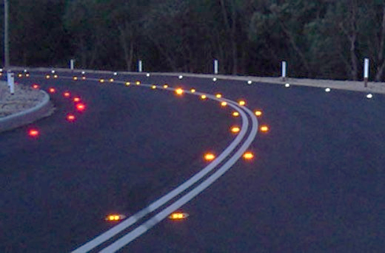
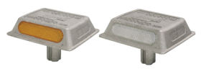
Needs for Road Marker Based OWC System
Needs
  Environmental climate conditional changes like Foggy, Raining, Snowing, Windy conditions affects performance robustness of Vehicle Connectivity.
  Needs Easy way to get connected with ITS data for safety Driving.
  Need to adapt IoT/IoL based technologies to obtain travelers relevant information on the highway.
Basic Concept
  Uses the highway road marker as a IoT/IoL connected OWC Transmitter and the camera connected on vehicle as a receiver to decode the data
  Possible for Vehicle to get traffic information, and following or forwarding vehicles informations like speed, passenger, vehicle state, and so on…
  Help for Automatic control available
  Utilize the installed road signs, recognition rate can be improved since its connected each other nearby.
GOOGLE
  < Highway Road Marker >
Slide 3

Slide 4

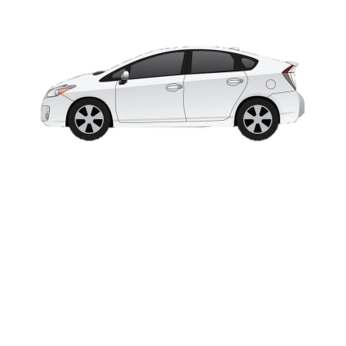
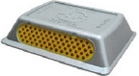

IoT/IoL Connected Road Marker for OWC
Light Based Highway IoT/IoL Link
  Tx : Highway Road Marker
  Rx : Vehicle Camera
  Day-Night Communication Mode
  Modulations : OOK, VPPM, Offset-VPWM, etc.
  Data Rate : 1K ~ 1Mb/s
  Supported LoS (Line of Sight)
  Available Distance : 1m ~ 10m
  Rx. Camera
  Tx. Road Marker
0 0 1 0 0 1 0 1 1 …
  < Road Maker Optical IoT/IoL OWC Link >
Uses the OWC Technology to do get Traffic Informations, On-Road Forward and Following Vehicles Information, First AID Centers, Nearest Food court, and Nearest Fuel Bank, etc. through ITS infrastructure and reduce the vehicle drivers inconvenience and confusions
Enable precise automatic drive control
Use the Road Markers and Vehicle Built-In Cameras for IoT/IoL Link
Slide 4

Slide 5
Conclusion
Proposed the Road Maker OWC Based IoT/IoL Solution
Since the road signs already have a lot of infrastructures, it is easy to apply the technology and it can be applied variously.
Uses the existing infrastructure to built the system and does not required any additional infrastructure needs to be Installed
Expected that it will be possible to provide interactive service with driver such as traffic situation, accurate traffic volume measurement due to technology development, and it is expected to have a huge ripple effect in the future vehicle assistive technologies.
Slide 5

