Slide 1
Project: IEEE P802.15 Working Group for Wireless Personal Area Networks (WPANs)
Submission Title: Transparent Signage based CamCom Solution for Drive Thru Ordering Services
Date Submitted: March 2018
Source: Jaesang Cha (SNUST), Younkwan Kim (The Catholic University of Korea), Hyoungkyu Song(Sejong Univ.), Mariappan Vinayagam (SNUST)
Address: Contact Information: +82-2-970-6431, FAX: +82-2-970-6123, E-Mail: chajs@seoultech.ac.kr
Re:
Abstract: This documents introduce the V2I CamCom Link design consideration for VAT. This proposed transparent signage based CamCom solution used for Drive-Through ordering service on drive. This VAT to operate on the application services like ITS, ADAS, etc. on road condition. Also this can be used for IoT/IoL, LEDIT, Digital Signage with connected information services etc.
Purpose: To Provided Concept models of Transparent Signage based CamCom solution for Vehicular Assistant Technology (VAT) Interest Group
Notice: This document has been prepared to assist the IEEE P802.15. It is offered as a basis for discussion and is not binding on the contributing individual(s) or organization(s). The material in this document is subject to change in form and content after further study. The contributor(s) reserve(s) the right to add, amend or withdraw material contained herein.
Release: The contributor acknowledges and accepts that this contribution becomes the property of IEEE and may be made publicly available by P802.15.
Slide 1

Slide 2
Contents
Needs for Drive-Thru Ordering Using CamCom Solutions
Transparent Signage Based CamCom Link
Conclusion
Slide 2

Slide 3
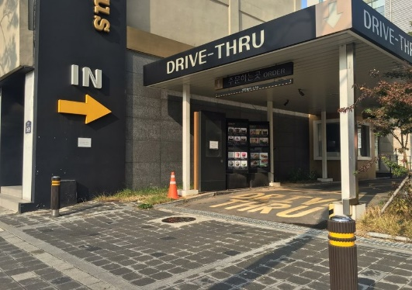
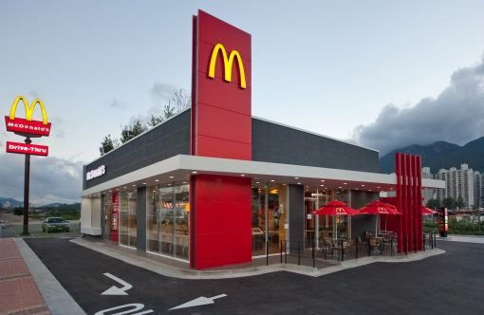
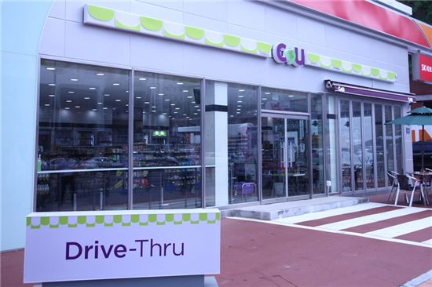
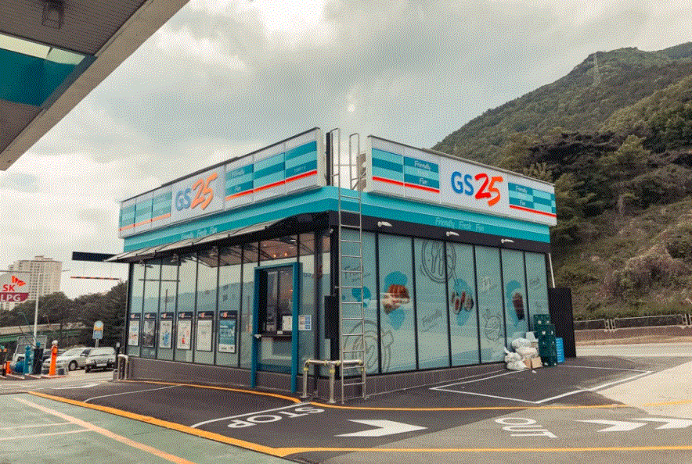
Needs for Drive-Thru Ordering Using CamCom Solutions
Needs
  Many use Drive-Thru due to time, emergency, and on the way traffic conditions, etc.
  There is an increasing number of facilities that provide drive-thru around
  It is important to introduce a simple and fast ordering and payment system.
Basic Concept
  Provides a simple ordering and payment system for purchasing goods without additional interaction with Drive-Thru Service Person.
  Uses the Existing Drive-Thru Signage / Vehicle Signage System and On-Vehicle Camera / Drive-Thru CCTV Infrastructure
  Technology easy to apply to growing infrastructure without adding additional infrastructure
  < Example of application of drive thru >
GOOGLE
Slide 3

Slide 4
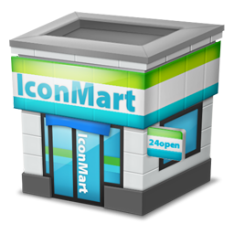
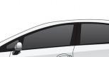





Transparent Signage Based CamCom Link
  CamCom Link
Transparent Signage based CamCom Link
  Tx : Drive-Through Signage / Car HUD Transparent Signage
  Rx : Drive-Through CCTV Camera / Car Built-In CMOS Camera Sensor
  Day-Night Communication Mode
  Modulations : VTASC, SS2DC, QR-Code, Color Code
  Data Rate : 1K ~ 1Mb/s
  Supported LoS (Line of Sight)
  Available Distance : 2m ~ 20m
  CamCom Link
  < Drive Thru Solution using CamCom Link >
Uses the CamCom Technology to do automatic order and payment in Drive-Thru.
Use the Drive-Through Signage / Car HUD Transparent Signage and Drive-Through CCTV Camera / Car Built-In CMOS Camera Sensor for CamCom Link
Slide 4

Slide 5
Conclusion
Proposed the Drive-Through Ordering Services Using Transparent Signage Based CamCom Solution
The existing Drive-Thru Signage, Car HUD Signage and Drive-Thru CCTV, Built-In Car Camera used to develop the Ordering Service Solution.
Reduce the inconvenience of manual payment and to provide smoothness of use
Slide 5

