Slide 1
Project: IEEE P802.15 Working Group for Wireless Personal Area Networks (WPANs)
Submission Title: HUD Transparent Signage based Image Sensor Communication for Special Service Vehicles
Date Submitted: March 2018
Source: Jaesang Cha (SNUST), Soo Young Chang (CSUS), Younkwan Kim (The Catholic University of Korea), Hyoungkyu Song (Sejong Univ.) , Mariappan Vinayagam (SNUST)
Address: Contact Information: +82-2-970-6431, FAX: +82-2-970-6123, E-Mail: chajs@seoultech.ac.kr
Re:
Abstract: This documents introduce the V2I Image Sensor Communication Link design consideration for VAT. This proposed HUD transparent signage based Image Sensor Communication solution used for automatic traffic signal control when special service vehicles in the use. This VAT to operate on the application services like ITS, ADAS, etc. on road condition. Also this can be used for IoT/IoL, LEDIT, Digital Signage with connected information services etc.
Purpose: To Provided Concept models of HUD Transparent Signage based Image Sensor Communication for Vehicular Assistant Technology (VAT) Interest Group
Notice: This document has been prepared to assist the IEEE P802.15. It is offered as a basis for discussion and is not binding on the contributing individual(s) or organization(s). The material in this document is subject to change in form and content after further study. The contributor(s) reserve(s) the right to add, amend or withdraw material contained herein.
Release: The contributor acknowledges and accepts that this contribution becomes the property of IEEE and may be made publicly available by P802.15.
Slide 1

Slide 2
Contents
Needs for Automatic Traffic Signal Control for Special Service Vehicles
HUD Transparent Signage Based Image Sensor Communication
Conclusion
Slide 2

Slide 3
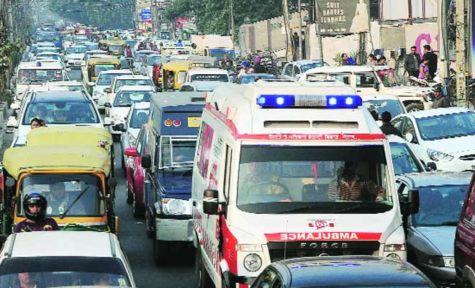
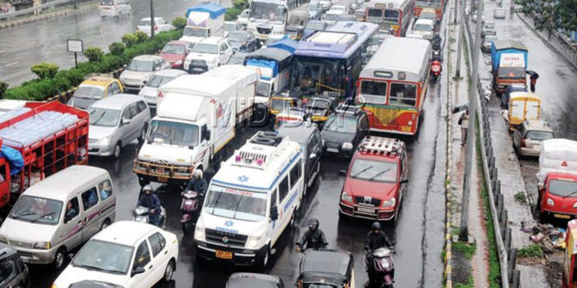
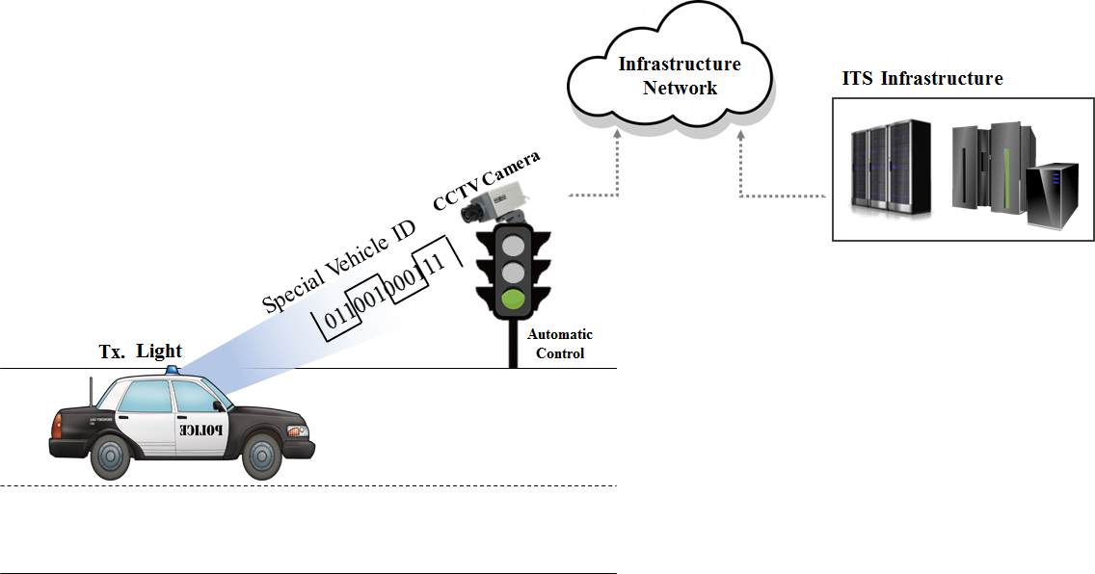
Needs for Automatic Traffic Signal Control
Needs
Frequent occurrence of Traffic and vehicle accidental conditions may not create to the way to move the Special Service Vehicles (Fire Truck, Ambulance, and Polices )
Need to be in emergency situation spot as quick as possible for AIDs
Basic Concept
Vehicles Transmit the ID information using Front Mirror HUD Transparent Signage
Traffic Light Connected Camera decode the vehicles ID information and connected to the ITS Infrastructure
ITS server has the registered Special Service Vehicles Information and approve the automatic traffic signal control till Special Service Vehicles move on to the signals
< Ambulance in Traffic Conditions >
GOOGLE
< Basic Concept>
Slide 3

Slide 4
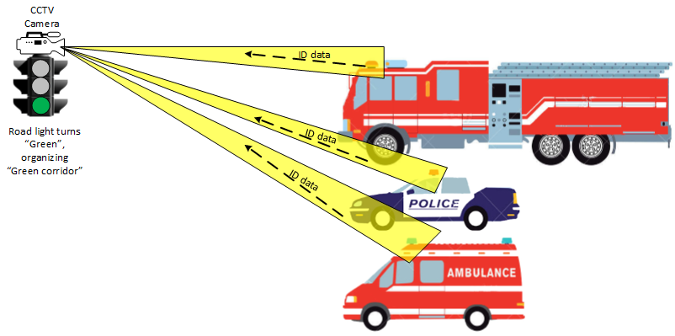
HUD Transparent Signage Based ISC
HUD Transparent Signage based ISC Link
Tx : HUD Transparent Signage
Rx : Traffic Signal Connected CMOS Image Sensor on Traffic
Day-Night Communication Mode
Modulations : VTASC, SS2DC, QR-Code, Color Code
Data Rate : 1K ~ 1Mb/s
Supported LoS(Line of Sight)
Available Distance : 5m ~ 100m
< HUD Transparent Signage based V2I Image Sensor Communication (ISC) Link Model >
Uses the ISC Technology to Identify special service Vehicle, to organize authorized access to closed sites in case of emergency.
Use the road traffic control camera systems, to recognize and define position of current special service vehicle.
Slide 4

Slide 5
Conclusion
Proposed the Automatic Traffic Signal Control Using HUD Transparent Signage Based Image Sensor Communication For Special Service Vehicles
The existing CCTV based Traffic signal can be utilized to make cost effective and easy to apply the technology in a wide range.
All types special services vehicles could be recognized and defined by position on road and control path way with ITS connected infrastructure
Special services vehicles ID information can be used as unique defining system in case of centralized road control system existing
Slide 5

