Slide 1
Project: IEEE P802.15 Working Group for Wireless Personal Area Networks (WPANs)
Submission Title: [HRP UWB PHY enhancements]
Date Submitted: [10th May 2018]
Source: [Billy Verso] Company [Decawave Ltd.]
Address [Peter Street, Dublin 8, Ireland]
Voice:[+353.87.233.7323], E-Mail:[billy.verso (at) decawave.com]
Re: [Proposed enhancements to the HRP UWB PHY]
Abstract: [contribute a proposal to the enhanced impulse radio group w.r.t. the HRP UWB PHY ]
Purpose: []
Notice: This document has been prepared to assist the IEEE P802.15. It is offered as a basis for discussion and is not binding on the contributing individual(s) or organization(s). The material in this document is subject to change in form and content after further study. The contributor(s) reserve(s) the right to add, amend or withdraw material contained herein.
Release: The contributor acknowledges and accepts that this contribution becomes the property of IEEE and may be made publicly available by P802.15.

Slide 2
The aim of this presentation:
Outline a set of enhancements to the HRP UWB PHY which will result in:
Improved ranging timestamp integrity and robustness
Reduced on-air transmission times:
  This will increase channel capacity and reduce power consumption
Also, outline MAC enhancements to reduce the number of messages to complete a two-way ranging time-of-flight (TOF) measurement:
Shortens the time to complete a TOF measurement:
  Also increases channel capacity and reduces power consumption

Slide 3
Timestamp integrity and robustness:
The HRP UWB PHY synchronisation sequence is made up of repeated symbols consisting of (ternary) Ipatov sequences with the property of perfect periodic auto-correlation. Accumulation of this correlation yields a channel impulse response (CIR) from which the first arriving ray (RX timestamp) can be determined.
The problem:
Accidental or intentional interference from other transmitters of the same sequence, or repeated energy bursts at the preamble symbol rate, can give rise to artefacts in the CIR giving erroneous RX timestamp results.

Slide 4
Timestamp integrity and robustness:
The solution:
Include a cryptographically generated pulse sequence in the transmitted PHY frame and have the receiver generate its own version of this sequence to cross correlate and accumulate to produce a CIR to get RX timestamp.
Since only valid transmitters and receivers know the key to generate this ciphered sequence it is secure against both accidental interference and intentional malicious attack neither of which will correlate correctly with the ciphered sequence.

Slide 5
Timestamp integrity and robustness:
Two modes to set where the ciphered sequence is placed in the frame
Mode 1 – After the SFD before PHR
  Deterministic position without needing to adjust for varying data frames length.
  Cipher CIR processing to get the RX timestamp can begin earlier
Mode 2 – After the data
  Allows interworking with receivers expecting normal HRP UWB frame format
  Data can be received without cipher alignment and used to regain alignment

Slide 6
Cipher sequence structure:
With the cipher sequence generated cryptographically it will only be correctly received (correctly correlated in the receiver) when both TX and RX parties know the keys and cryptographic scheme.
The receiver can validate the sequence by measuring the strength of the correlation across the whole sequence
To promote interworking between vendors the cryptographic scheme will be defined in the amendment
  The proposed scheme is based on AES-128 in counter mode
  This has a 128-bit key and a 128-bit nonce (generated via an LFSR)
  The resultant sequence of 1’s and 0’s define the pulse polarity for the cipher sequence

Slide 7
Cipher sequence CSPRNG:
First of two options:

Slide 8
Cipher sequence CSPRNG:
Second of two options:

Slide 9
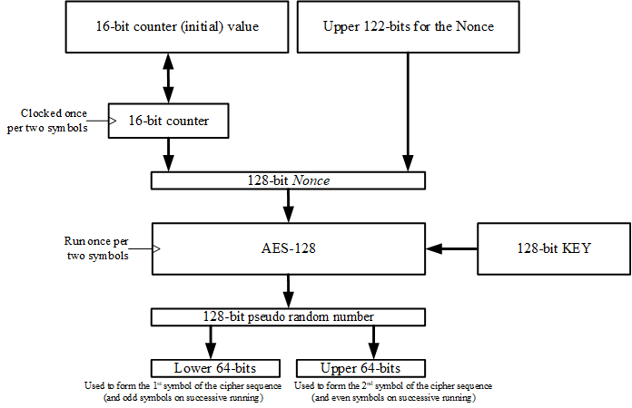
Cipher sequence CSPRNG:
Third option:

Slide 10
Cipher sequence LFSR:
128-bit LFSR:
64-bit LFSR:

Slide 11
Cipher sequence structure:
For 64 MHz PRF, the 64 bits of CSPRNG output are used to define 64 pulse polarities
  i.e. 1 gives a positive polarity pulse, 0 gives negative polarity pulse
These are spread by the delta function δ_{L} of length L = 4 to create 256 chips at the peak PRF of 499.2 MHz, and the symbol is completed with 256 zero chips.
The symbol time T_{csymb} is ~1.0256 µs (mean PRF 62.4 MHz).
Cipher sequence length 32 symbols up to 2048, steps of 8.
In mode 2 a gap of 512 chips is inserted between the end of data and the start of the first cipher sequence symbol

Slide 12
Reduced on-air transmission times:
The frame duration is a critical parameter
  Shorter frames save power since the radio can be turned off sooner
  Send the PHR at the data rate for 6.81 Mb/s and 27 Mb/s frames
    Two-way ranging applications typically use fixed data rate and frame formats
Compress the preamble and SFD transmission phases
  Reduce the spreading factor in the preamble sequences
    The high peak PRF of the HRP UWB PHY affords this possibility
  Use Ipatov codes with greater proportion of non-zero elements
    Increases symbol energy to compensate for shorter symbols
Compress the PHR and data symbols for 27 Mb/s data rate
  remove the burst time hopping and reduce the guard period duration
  Use just BPSK to encode the data, (i.e. no BPM)
  Use 8 pulses per burst instead of 2
    Increases multipath immunity for this 27 Mb/s data mode modulation

Slide 13
Compressed 27 Mb/s modulation mode
Using existing convolutional encoder (16.3.3.2), use output g₀ to select 1 of 2 pulse sequences, and g₁ to invert or not.
  This convolution code has maximum free distance (coding gain) and comes from Proakis, it is rate 1/8.
And scramble v^{(n)} using the existing scrambler (16.3.2), giving 8 chips per burst and 8 chips guard interval.
This modulation is 6 dB better than current HRP UWB PHY 27 Mb/s,
  Same range as 6.8Mb/s in AWGN channel
  Just 1 dB worse than 6.8 Mb/s in heavy multipath environments
  Existing HRP UWB PHY Viterbi decoder can be reused, altering only the input metrics

Slide 14
Operating range

Slide 15
Compressed preamble and SFD
Using length 31 Ipatov sequence with 25 pulses and 6 zeros
Spread by the delta function δ_{L} of length 4, (or for very high compression L = 1).
SFD [-1 -1 -1 -1 +1 -1 0 0] spread by the preamble symbol

Slide 16
Compressed cipher sequence
Reduce cipher sequence duration by removing most of the gaps (of 256 zero chips)
Compressed cipher symbols then have no gaps, just the spread sequence of 256 chips however 2 gaps are inserted for every 64 of these gapless cipher symbols.
  Gaps of 256 zero chips are inserted before and after the 1st symbol, after the 64th and 65th symbol, after the 128th and 129th symbol, etc. The resultant PRF is 124.8 MHz peak and 121 MHz mean.

Slide 17
Compressed PHR
Reduce PHR duration by sending it at the data rate for 6.81 Mb/s and 27 Mb/s frames.
We can make a new PHR.
  pre-4z PHY won’t be able to receive the PHR
  Don’t need data rate bits, or SYNC length specifier
  Can modify PHR to allow longer data frames at these higher rates to increase the utility of the standard.
Proposal:
  10 bit length gives 1023 max frame length.
  GS bits to specify mode 2 data to cipher sequence gap.

Slide 18
MAC changes to support the previous items:
New PIB attributes providing the API for the new features:

Slide 19
MAC enhancements for TOF measurement:
The current MAC provides ranging counters in the MCPS-DATA primitives
  This does not promote standardised TOF interworking
  It leaves the messaging for TOF measurement to the upper layers
  In general it is necessary to communicate response times or round-trip delay times between the parties to complete the TOF calculation
The addition of Information Elements (IEs) by amendment 4e provides a mechanism to standardise ranging messages
This also provides an opportunity improve the utility of the MAC such that it would be possible for a TOF estimate to be completed with just two messages, one TX and one RX
  See next sheet

Slide 20
Ranging mechanism: SS-TWR
For single-sided two-way ranging between two devices, A and B, we need a transmitted message from A and a response from B
  The response could be an ACK generated by the MAC or a data frame sent under upper layer control.
For device A to calculate the estimated time of flight, T_{prop}, device B needs to communicate its reply time, T_{reply}, to device A.
  This could be done in a subsequent frame, but as a further enhancement we should include the option for the MAC to be able to pre-compute, T_{reply}, and include it in an IE embedded in the reply message,

Slide 21
Specifying the IEs for TOF measurement:
This may seem like a lot of work, but it is not, since a model for this already exists….
All the necessary IE and mechanisms (and the text) for what is needed have already been developed and included in the recently published IEEE 802.15.8-2017 standard
The proposal here is to copy the relevant text relating to ranging and IE’s from that standard
The only change needed is re-numbering the IEs
  The 802.15.8 IEs for ranging will need to be merged into the 802.15.4 IE table which should be a small task

Slide 22
THE END

