Slide 1
Project: IEEE P802.15 Working Group for Wireless Personal Area Networks (WPANs)
Submission Title: [Secure RF Ranging]
Date Submitted: [5 March, 2018]
Source: [Frank Leong] Company [NXP Semiconductors]
Address [High Tech Campus 60, 5656 AG, The Netherlands]
Voice:[+31 6 133 60727], E-Mail:[Frank.Leong (at) nxp.com]
Re: [Input to the Interest Group]
Abstract: [Presentation, enhancements to 802.15.4 for secure ranging, ranging integrity]
Purpose: []
Notice: This document has been prepared to assist the IEEE P802.15. It is offered as a basis for discussion and is not binding on the contributing individual(s) or organization(s). The material in this document is subject to change in form and content after further study. The contributor(s) reserve(s) the right to add, amend or withdraw material contained herein.
Release: The contributor acknowledges and accepts that this contribution becomes the property of IEEE and may be made publicly available by P802.15.

Slide 2
Secure RF Ranging

Slide 3
Secure Ranging – Motivation
Growing market interest in secure RF ranging based on ToF
Secure RF ranging on the PHY layer requires many short pulses per measurement
UWB as specified in IEEE 802.15.4 PHYs may be suitable as starting point

Slide 4
Secure Ranging – Overview
Modulation for ranging should be based on short “active” bit/chip durations (target <~3 m, eq. 10 ns)
  Implies large signal bandwidth
  OOK/PAM would be a candidate
  N-PSK would be a candidate
  N-FSK would be a candidate
  PPM/BPM would not be suitable
IEEE UWB PHYs useful as basis for secure ranging
  Prefer a single solution to be used for both HRP and LRP
Need an extension
  This presentation outlines our thoughts

Slide 5
Secure Ranging – Essential Requirement
Modulation based on short “active” bit/chip durations
  Protect against Early Detect, Late Commit (EDLC) attacks
  Protect against preamble attacks
  Limit distance decrease to <~3 m
Modulated data must not be predictable to an attacker
  Suitable CSPRNG must be used
  Avoid Forward Error Correction (FEC), prefer error-tolerance
Our proposal, use a standardized method:
  DRBG according to NIST SP 800-90A Rev. 1 (2015) §10.2.1
    Builds on AES128: proven in the field, fast, ubiquitous
CSPRNG: Cryptographically Secure Pseudo Random Number Generator
DRBG: Deterministic Random Bit Generator

Slide 6
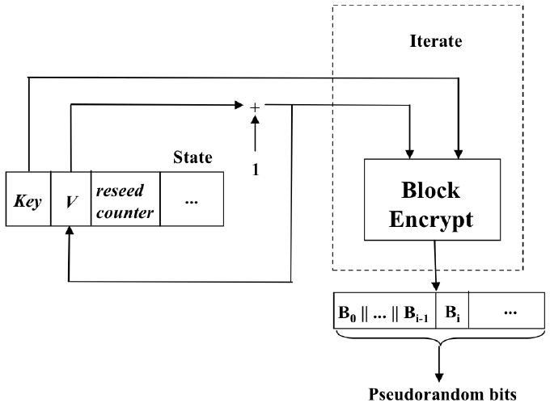
DRBG – Principle of Operation

Slide 7
Summary
Recognize a need for enhancing the 802.15.4 UWB PHYs to support secure ranging
in both HRP and LRP
Support the Interest Group in this area
Presented an approach for bit generation
Looking forward to working towards an interoperable 802.15.4 solution for
secure ranging

