Slide 1
Project: IEEE P802.15 Working Group for Wireless Personal Area Networks (WPANs)
Submission Title: Initial Evaluation Results on PM PHY proposed from ETRI
Date Submitted: 05 March 2018
Source: Sang-Kyu Lim, Il Soon Jang, Jin-Doo Jeong, Tae-Gyu Kang [ETRI]
Address: 218 Gajeong-ro, Yuseong-gu, Daejeon, 34129, Korea
Voice:[+82-42-860-1573], FAX: [+82-42-860-5218], E-Mail:[sklim@etri.re.kr]
Re:
Abstract: Initial Evaluation Results on Pulsed Modulation PHY
Purpose: Contribution to IEEE 802.15.13
Notice: This document has been prepared to assist the IEEE P802.15. It is offered as a basis for discussion and is not binding on the contributing individual(s) or organization(s). The material in this document is subject to change in form and content after further study. The contributor(s) reserve(s) the right to add, amend or withdraw material contained herein.
Release: The contributor acknowledges and accepts that this contribution becomes the property of IEEE and may be made publicly available by P802.15.

Slide 2
Initial Evaluation Results on PM PHY
Proposed from ETRI
Sang-Kyu Lim, Il Soon Jang, Jin-Doo Jeong, Tae-Gyu Kang [ETRI]

Slide 3
Motivations
According to the results of November meeting last year (15-17-0661-01-0013 and 15-17-0662-00-0013), the proposal on PM PHY from ETRI (15-18-0002-00-0013) was submitted to the committee of TG13.
According to the results of January meeting this year (15-18-0067-01-0013), TG13 requests full or partial evaluation results for PM-PHY using the simplified or TG7r1 channel models.
So, this contribution is to show the initial evaluation results for the preamble proposed from ETRI.

Slide 4
Preamble (1) – (15-18-0002-00-0013)
FLP (101010…..)
TDP
~ TDP
TDP
~ TDP
64 to 16,384 bits
60 bits
(TDP assignments for various topologies)
P1
Peer-to-Peer
P2
Star
P3
Broadcast
P4
Coordinated
P5
Relay functionality
P6
Heterogeneous RF-OWC functionality
* FLP : Fast Locking Pattern
* TDP : Topology Dependent Pattern

Slide 5
Preamble (2) - (15-18-0002-00-0013)
We propose 15-bit Gold code as a TDP pattern because Gold codes are used in CDMA and satellite systems.
If we use Gold codes, we can get 6 sequences with good auto correlation and cross correlation properties to distinguish different topologies.
The Gold codes have DC balancing but since they are odd, they are off by one (e.g. 8 zeros and 7 ones for 15-bit Cold code).
If exact DC balance is needed, the code can be inverted and repeated.
In another aspect we need to discuss about whether TDP patterns to distinguish different topologies are necessary or not.

Slide 6
Preamble (3) - (15-18-0002-00-0013)
We propose that the preamble is transmitted using OOK modulation (2-level PAM).
The preamble shall be sent at a clock rate chosen by the TX and supported by the RX.
The preamble is a time domain sequence and does not have any channel coding or line coding.
The FLP is fixed to start as a “1010…” pattern i.e., it ends with a ‘0’.

Slide 7
Preamble (4)
The different TDP patterns are to minimize interference between different topologies and having wrong devices connect to network.
If there is no TDP pattern, all devices would connect to network and then MAC will reject it - this can cause significant contention between intended topology and non-intended topology.
If we use TDP pattern, devices with wrong TDP will not be able to attach to network.

Slide 8
Data Rates - (15-18-0002-00-0013)
Modulation | Level | FEC RS(n,k) | Line Code | HCM | Optical Clock Rates (MHz) | Data Rates (Mbps)
PAM | 2 | (255,248) | 8B10B | (1,1) | 50 (200/2²) | 38.9
 |  |  |  |  | 25 (200/2³) | 19.45
 |  | (36,24) |  |  | 12.5 (200/2⁴) | 6.67
 |  |  |  |  | 6.25 (200/2⁵) | 3.33
 |  |  |  |  | 3.125 (200/2⁶) | 1.67

Slide 9
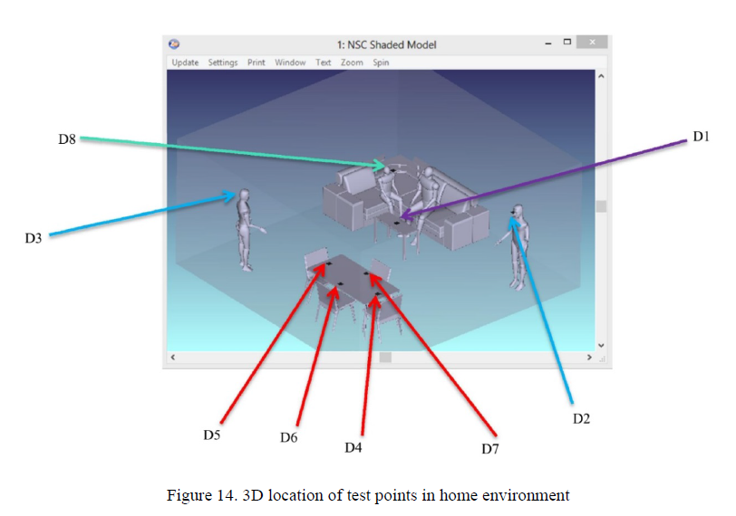
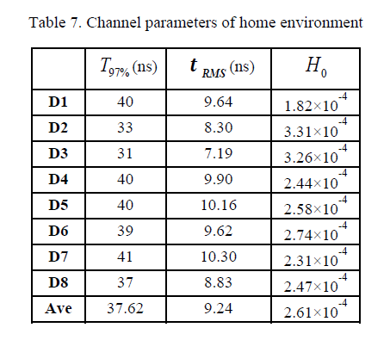
Simulation Process (1)
There are 4 scenarios in TG7r1 channel model document (15-15-0746-01-007a-tg7r1) and we select the Scenario 3 (Home Scenario) as the first step.

Slide 10
Simulation Process (2)
6 sequences among the 15-bit Gold Sequences (17 sequences) were selected for TDP patterns through the analysis of the peak cross-correlation values. (Ref. John G. Proakis, Digital Communications, 4th Edition, 2001)
(6 TDP patterns from the 15-bit Gold Sequences)
P1
0 0 0 0 0 1 1 0 1 1 1 1 0 1 1
P2
1 1 0 0 1 1 1 0 0 0 0 0 0 0 1
P3
0 0 0 1 1 0 0 0 0 1 0 0 0 1 0
P4
1 1 1 0 1 1 0 1 1 1 0 1 0 1 0
P5
1 1 0 1 0 0 0 0 1 0 1 1 0 0 0
P6
0 1 0 1 1 1 1 1 1 1 1 0 1 0 0
P1
~ P1
P1
~ P1
D1, D3, D4, D8 Channels
of Scenario 3
(Home Scenario)
Preamble Detection
(Detection Probability & False Alarm)
60 bits
AWGN

Slide 11
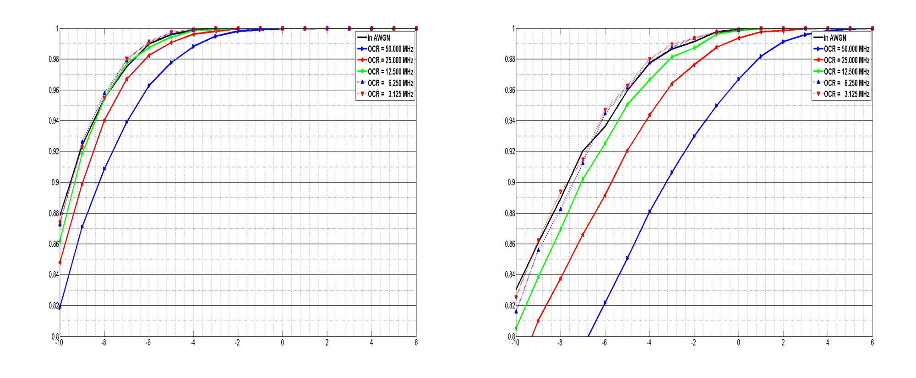
Simulation Results for D1 in Scenario 3
False Alarm = 1 %
False Alarm = 0.1 %
Detection Probability
Detection Probability
Eb/No (dB)
Eb/No (dB)

Slide 12
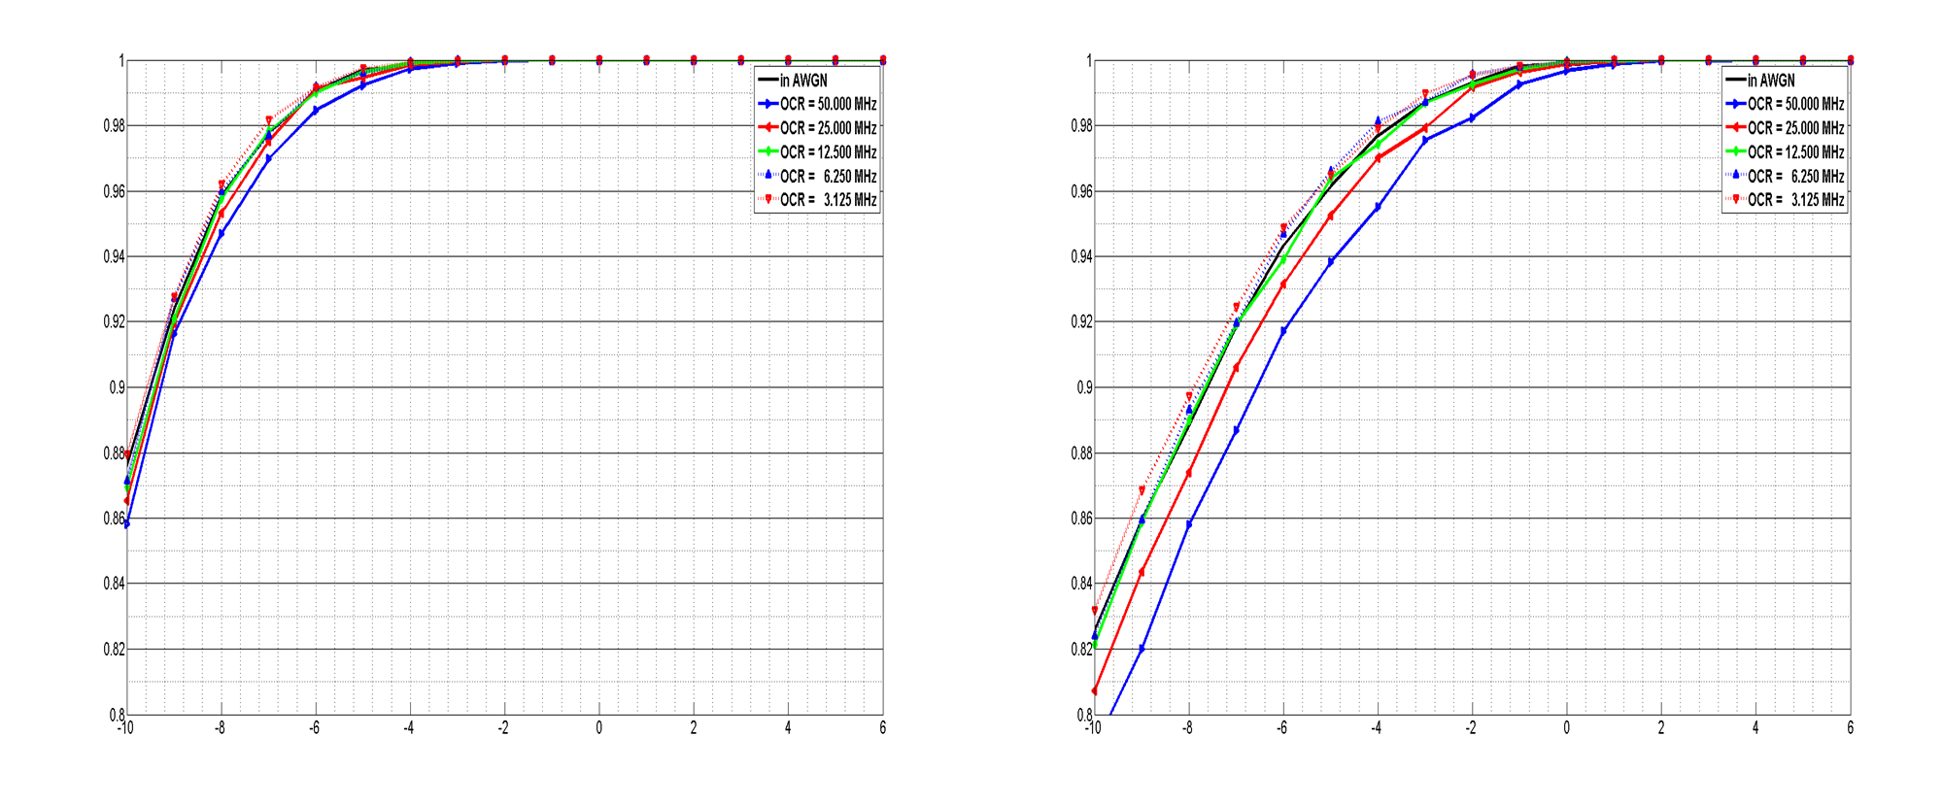
Simulation Results for D3 in Scenario 3
False Alarm = 1 %
False Alarm = 0.1 %
Detection Probability
Detection Probability
Eb/No (dB)
Eb/No (dB)

Slide 13
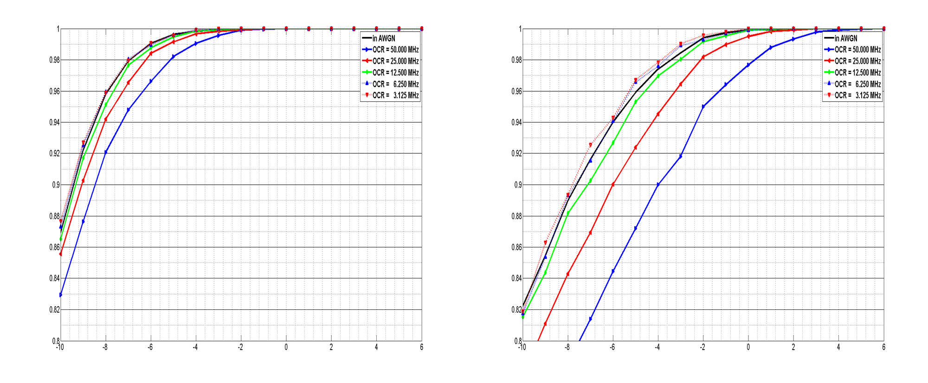
Simulation Results for D4 in Scenario 3
False Alarm = 1 %
False Alarm = 0.1 %
Detection Probability
Detection Probability
Eb/No (dB)
Eb/No (dB)

Slide 14
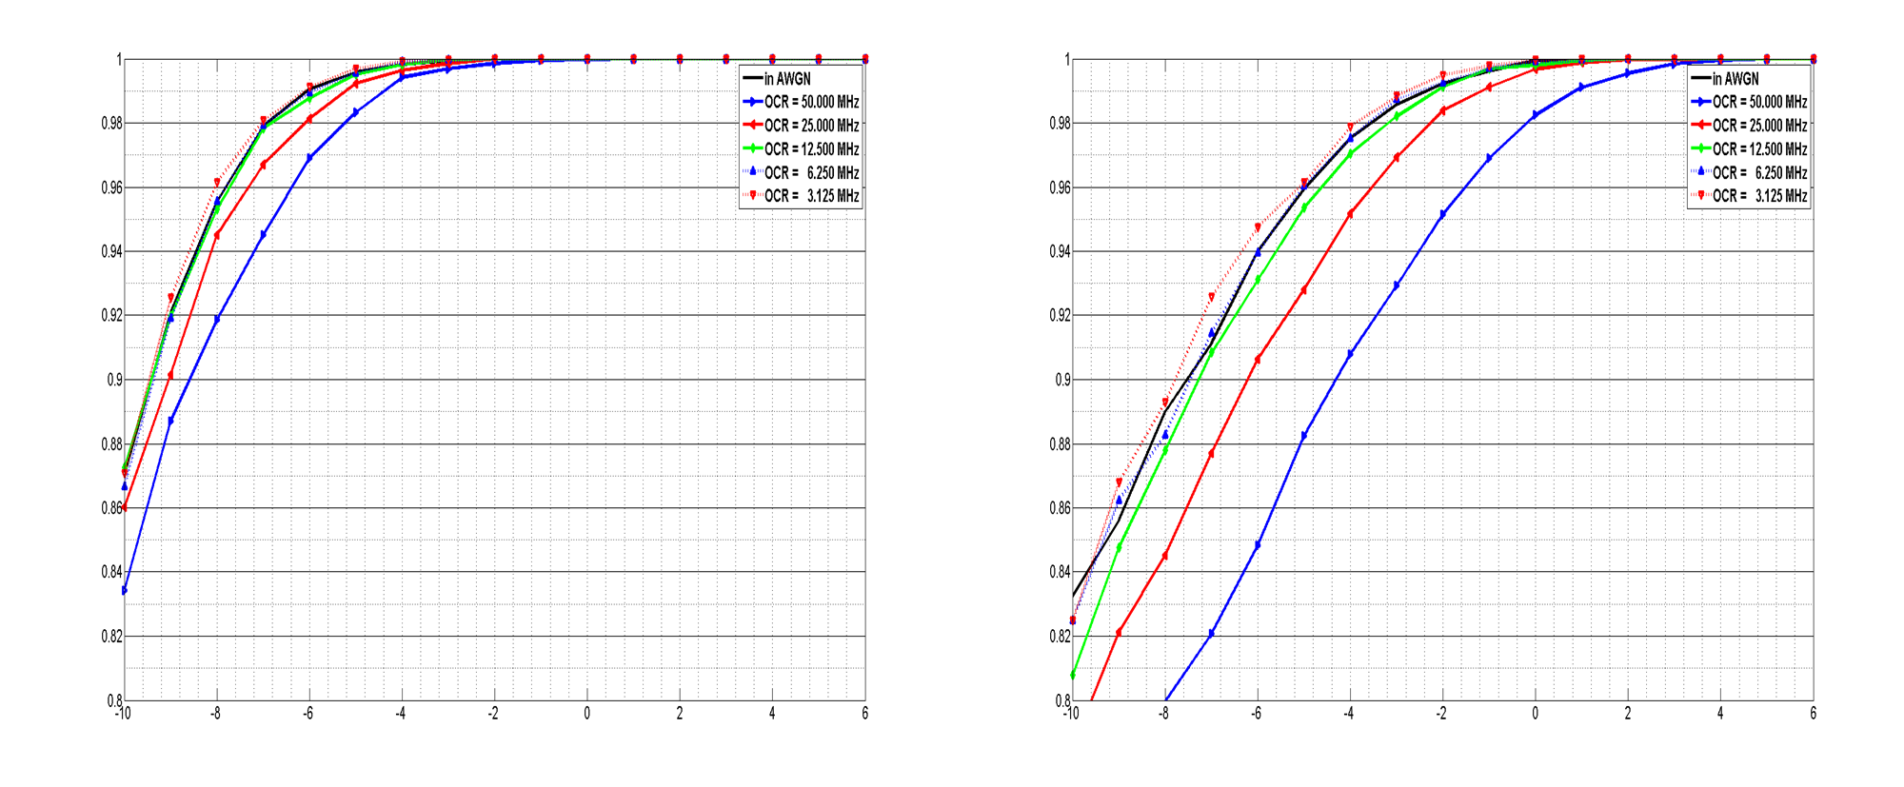
Simulation Results for D8 in Scenario 3
False Alarm = 1 %
False Alarm = 0.1 %
Detection Probability
Detection Probability
Eb/No (dB)
Eb/No (dB)

Slide 15
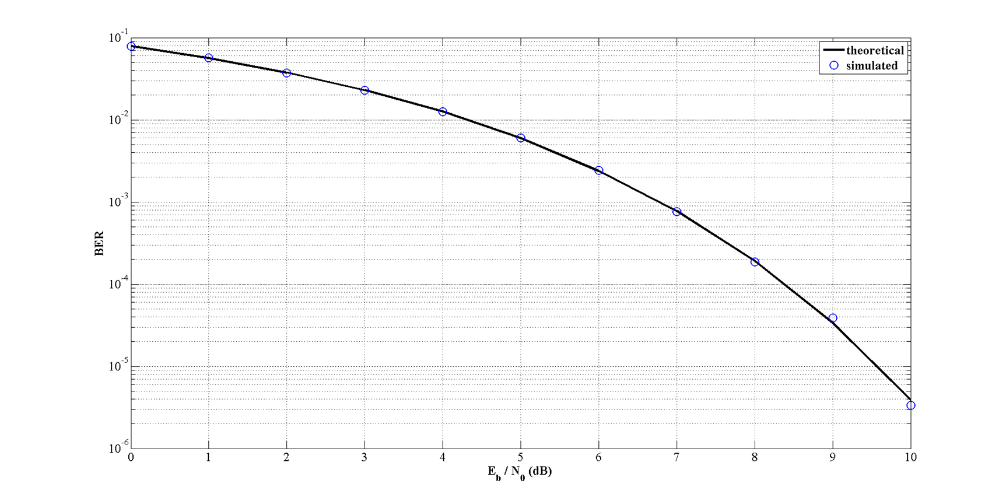
Evaluation of 2-PAM Receiver Modeling

Slide 16
Conclusions
The performance of the preamble pattern proposed from ETRI was evaluated under Scenario 3 (Home Scenario) in TG7r1 channel models.
The preamble detection probabilities for the fixed false alarm (1% and 0.1%) were simulated.
2-PAM receiver modeling as the first step to simulate the BER performance after 2-PAM transmission under Scenario 3 was verified.
So, as the next step, we plan to evaluate the BER performance after 2-PAM transmission under Scenario 3.

