Slide 1
Project: IEEE P802.15 Working Group for Wireless Personal Area Networks (WPANs)
Submission Title: Deep Leaning Method for OWC
Date Submitted: January 2018
Source: Jaesang Cha, Deokgun Woo, Seonhee Lee, Seongjin Choi (SNUST), Sooyoung Chang (CSUS), Mariappan Vinayagam (SNUST)
Address: Contact Information: +82-2-970-6431, FAX: +82-2-970-6123, E-Mail: chajs@seoultech.ac.kr
Re:
Abstract: This documents introduce the advanced machine learning method called for Deep Learning for OWC. The proposed deep learning for OWC helps to detect the ROI of Light or Signage or display source region to apply light communication. This VAT to operate on the application services like ITS, ADAS, etc. on road condition, Bio-Plant / Manufacturing Industry Safety AIDS using Sign boards / Lighting / Display based infrastructure. Also this can be used for IoT/IoL, LEDIT, Digital Signage with Advertisement Information etc.
Purpose: To Provided Concept models of See-Through Display based Vehicle CamCom for Vehicular Assistant Technology (VAT) Interest Group
Notice: This document has been prepared to assist the IEEE P802.15. It is offered as a basis for discussion and is not binding on the contributing individual(s) or organization(s). The material in this document is subject to change in form and content after further study. The contributor(s) reserve(s) the right to add, amend or withdraw material contained herein.
Release: The contributor acknowledges and accepts that this contribution becomes the property of IEEE and may be made publicly available by P802.15.
Slide 1

Slide 2
Contents
Needs for Deep Learning
Deep Learning
Deep Leaning on OWC
Conclusion
Slide 2

Slide 3
Needs for Deep Learning
Traditional OWC needs hand-crafted feature representation (Uses Computer Vision) method and leaning method (Machine Learning) to decoded the data from light sources using Image Sensor
Traditional Computer Vision (CV) with Machine Leaning on Object Detection and Recognition has limitations
  Processing hand-crafted feature extraction and features learning is intensive operations, needs time, high computation and memory resources.
  Performance of Feature Leaning is not resistive in the dynamic changing environment
  Lighting Condition (Illumination) variation and dynamic environment changes complicates the design of robust algorithms because
  Environmental climate conditional changes like Foggy, Raining, Snowing, Windy conditions affects performance robustness
Need Adaptive Method to work with robust perception as human brain does for VAT OWC
  Deep Leaning
Slide 3

Slide 4
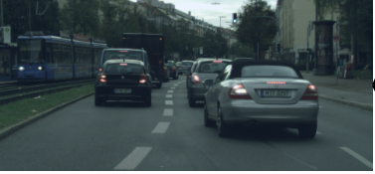
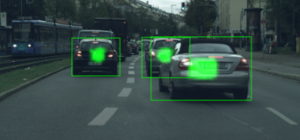
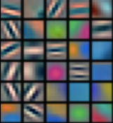
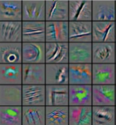
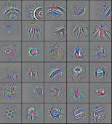
Deep Learning
Deep Learning
  Deep Learning is a type of learning mechanism
  A powerful class of machine learning model
  Modern reincarnation of artificial neural networks
  Collection of simple, trainable mathematical functions
  Deep learning seeks to learn rich hierarchical representations (i.e. features) automatically through multiple stage of feature learning process.
  Learning Hierarchical Representations is Biologically Inspired
Low-level features
Mid-level features
High-level features
Trainable classifier
Slide 4

Slide 5
Deep Learning on OWC
Deep Learning Methods
  Deep Neural Networks (DNNs)
  Convolutional Neural Networks (CNNs)
  Recurrent Neural Networks (RNNs)
OWC Needed Imaging Operations
  Effective RoI detection on dynamic environment with varying light conditions like traffics, rainy , foggy, snowing, windy, etc
  Object recognition Classifications to classify pedestrian , vehicles, street lights, sign boards, on-road signange, etc
  OWC Data Decoding
Deep Learning for OWC
  Convolutional Neural Networks (CNNs) perform well for OWC
  Convolutional Neural Networks (CNNs) has been designed specifically for Object recognition and classifications
Slide 5

Slide 6
Deep Learning on OWC…
How CNN Works
  Each image used in learning is divided into compact topological portions, each of which will be processed by filters to search for particular patterns
  Formally, each image is represented as a three-dimensional matrix of pixels (width, height, and color), and every sub-portion is put on convolution with the filter set
  In other words, scrolling each filter along the image computes the inner product of the same filter and input
  This procedure produces a set of feature maps (activation maps) for the various filters
  By superimposing the various feature maps of the same portion of the image, we get an output volume
Slide 6

Slide 7
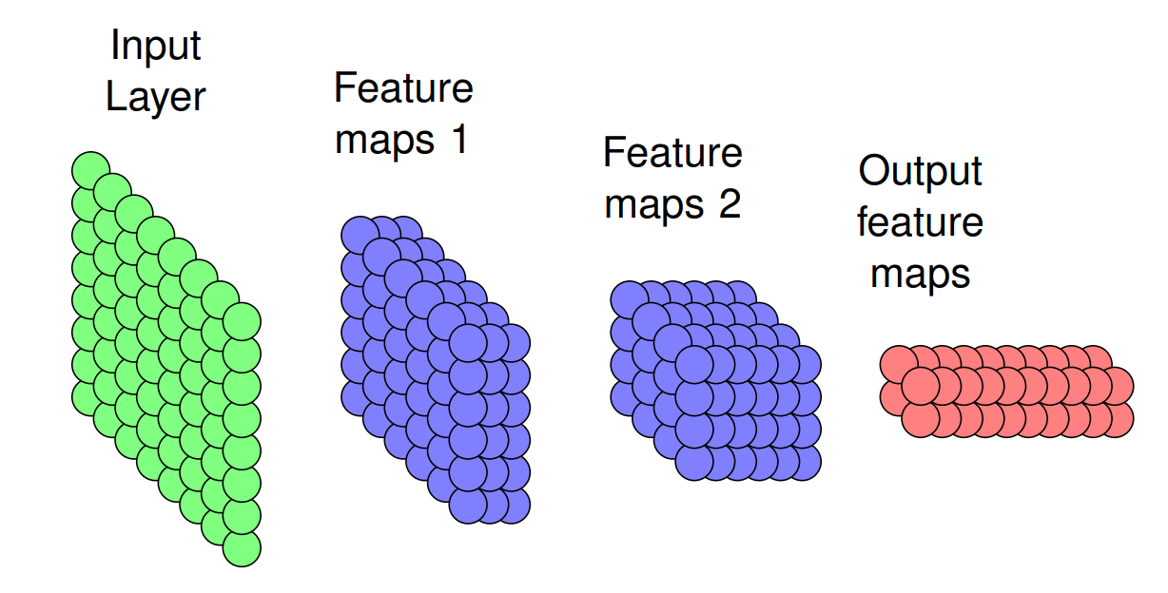
Deep Learning on OWC…
CNN Architecture
  A CNN is a list of layers that transform the input data into an output class/prediction.
  There are a few distinct types of layers:
    Convolutional layer
    Non-linear layer
    Pooling layer
    Normalization (Optional)
Slide 7

Slide 8
Conclusion
Introduced the Deep Learning Method for VAT OWC
Deep leaning improves the performance n the dynamic changing environment and varying Lighting Condition (Illumination)
Works well in environmental climate conditional changes like Foggy, Raining, Snowing, Windy conditions affects performance robustness
Slide 8

