Slide 1
Project: IEEE P802.15 Working Group for Wireless Personal Area Networks (WPANs)
Submission Title: Highway Tollgates 3D Signage Based CamCom Solution
Date Submitted: January 2018
Source: Jaesang Cha (SNUST), Hyoungkyu Song (Sejong Univ.), Sooyoung Chang (CSUS) , Mariappan Vinayagam (SNUST)
Address: Contact Information: +82-2-970-6431, FAX: +82-2-970-6123, E-Mail: chajs@seoultech.ac.kr
Re:
Abstract: This documents introduce the V2I CAMCOM Link design consideration for VAT. The proposed Highway tollgates 3D signange based V2X CamCom Link for VAT to operate on the application services like ITS, ADAS, LBS, etc. on road condition, Manufacturing / Bio-Plant / Nuclear Power Plans Industry Safety AIDS using Lighting / Display based infrastructure. Also this can be used for IoT/IoL, LEDIT, Digital Signage with Advertisement Information etc.
Purpose: To Provided Concept models of See-Through Display based Vehicle CamCom for Vehicular Assistant Technology (VAT) Interest Group
Notice: This document has been prepared to assist the IEEE P802.15. It is offered as a basis for discussion and is not binding on the contributing individual(s) or organization(s). The material in this document is subject to change in form and content after further study. The contributor(s) reserve(s) the right to add, amend or withdraw material contained herein.
Release: The contributor acknowledges and accepts that this contribution becomes the property of IEEE and may be made publicly available by P802.15.
Slide 1

Slide 2
Contents
Needs for Tollgates 3D Signage based CamCom
Highway Tollgates 3D Signage based CamCom solution
Conclusion
Slide 2

Slide 3
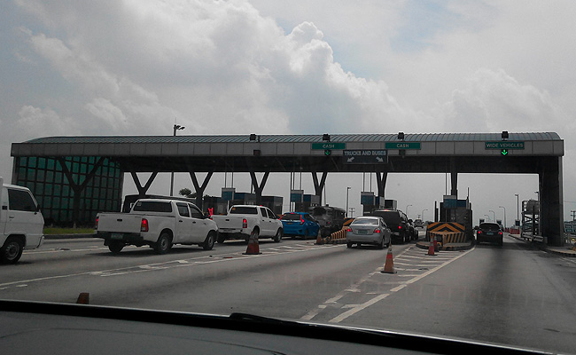
Needs for Tollgates 3D Signage based CamCom
Needs
To much traffic Congestion in the toll gate on Peak Hours, Rain / Snow / Fog / Festival Days
Requires easily solution to control automatic tollgate control and requires simple method for data transmission while driving
Advantages
Traffic information collection available
Applicable to use in various transportation fields
Possible to Vehicle get information (speed, passenger, vehicle state, and so on…) Automatic control available
< Tollgate Congestion >
Slide 3

Slide 4
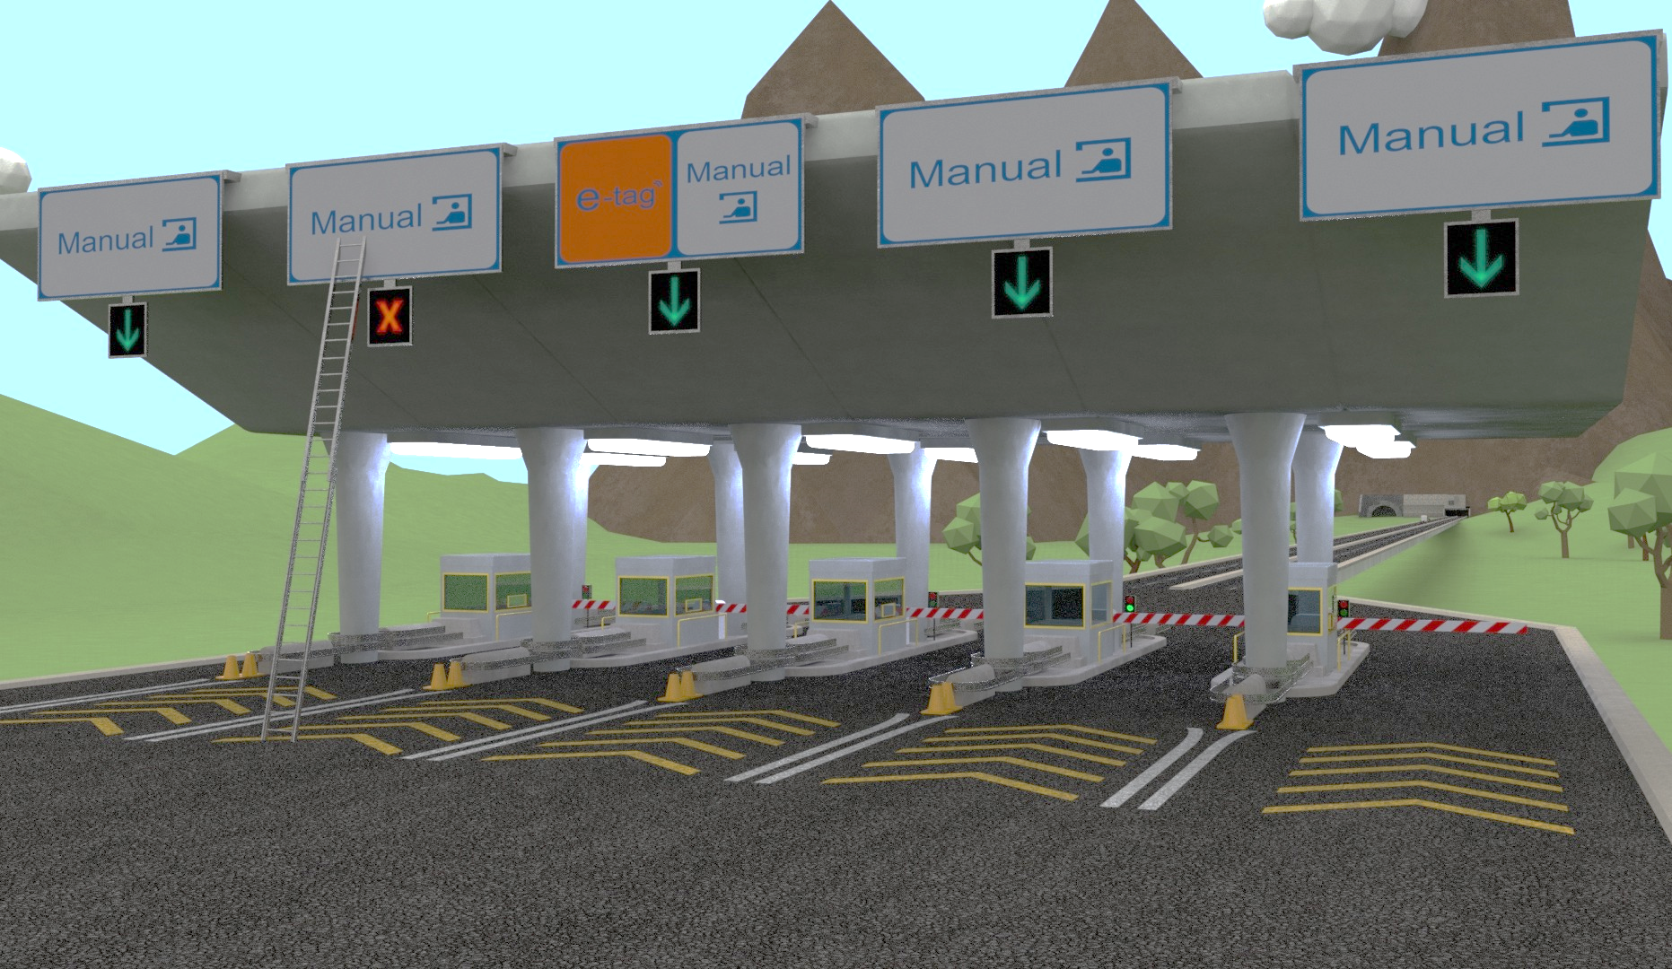
Highway Tollgates 3D Signage Based CamCom Solution
Vehicle Camera and Highway Tollgates 3D Signage based CamCom Link
Tx : 3D Signage
Rx : CMOS Image Sensor in Camera
Day-Night Communication Mode
Data Rate : 1K ~ 1Mb/s
Supported LoS(Line of Sight)
Available Distance : 1m ~ 15m
Highway Tollgates 3D Signage
Gate Open/Close
3D Signage
Vehicle Camera
< Highway Tollgates 3D Signage based CamCom >
Slide 4

Slide 5
Conclusion
Proposed the Highway Tollgates 3D Signage based CamCom solution
Use the existing tollgate infrastructures (Tollgate Signage) can be utilized, making it easy to apply the technology in a wide range.
Proposed system significantly alleviates traffic congestion and provides a simple way to a variety of 3D signage based services.
Slide 5

