Slide 1
Project: IEEE P802.15 Working Group for Wireless Personal Area Networks (WPANs)
Submission Title: [IG LPWA Agenda November 2017 Plenary]
Date Submitted: [6 November, 2017]
Source: [Matthew Gillmore] Company [Itron]
Address[2111 N Molter Rd, Liberty Lake, WA 99019]
Voice[] E-Mail:[matthew.gillmore@itron.com]
Re: []
Abstract: [Contains the agenda of the IG FANE]
Purpose: [Agenda for January 201 IG FANE]
Notice: This document has been prepared to assist the IEEE P802.15. It is offered as a basis for discussion and is not binding on the contributing individual(s) or organization(s). The material in this document is subject to change in form and content after further study. The contributor(s) reserve(s) the right to add, amend or withdraw material contained herein.
Release: The contributor acknowledges and accepts that this contribution becomes the property of IEEE and may be made publicly available by P802.15.

Slide 2
Instructions for the WG Chair
The IEEE-SA strongly recommends that at each WG meeting the chair or a designee:
Show slides #1 through #4 of this presentation
Advise the WG attendees that:
IEEE’s patent policy is described in Clause 6 of the IEEE-SA Standards Board Bylaws;
Early identification of patent claims which may be essential for the use of standards under development is strongly encouraged;
There may be Essential Patent Claims of which IEEE is not aware. Additionally, neither IEEE, the WG, nor the WG Chair can ensure the accuracy or completeness of any assurance or whether any such assurance is, in fact, of a Patent Claim that is essential for the use of the standard under development.
Instruct the WG Secretary to record in the minutes of the relevant WG meeting:
That the foregoing information was provided and that slides 1 through 4 (and this slide 0, if applicable) were shown;
That the chair or designee provided an opportunity for participants to identify patent claim(s)/patent application claim(s) and/or the holder of patent claim(s)/patent application claim(s) of which the participant is personally aware and that may be essential for the use of that standard
Any responses that were given, specifically the patent claim(s)/patent application claim(s) and/or the holder of the patent claim(s)/patent application claim(s) that were identified (if any) and by whom.
The WG Chair shall ensure that a request is made to any identified holders of potential essential patent claim(s) to complete and submit a Letter of Assurance.
It is recommended that the WG Chair review the guidance in IEEE-SA Standards Board Operations Manual 6.3.5 and in FAQs 14 and 15 on inclusion of potential Essential Patent Claims by incorporation or by reference.
Note: WG includes Working Groups, Task Groups, and other standards-developing committees with a PAR approved by the IEEE-SA Standards Board.
(Optional to be shown)

Slide 3
Participants have a duty to inform the IEEE
Participants shall inform the IEEE (or cause the IEEE to be informed) of the identity of each holder of any potential Essential Patent Claims of which they are personally aware if the claims are owned or controlled by the participant or the entity the participant is from, employed by, or otherwise represents
Participants should inform the IEEE (or cause the IEEE to be informed) of the identity of any other holders of potential Essential Patent Claims
Early identification of holders of potential Essential Patent Claims is encouraged
Slide #1

Slide 4
Ways to inform IEEE
Cause an LOA to be submitted to the IEEE-SA (patcom@ieee.org); or
Provide the chair of this group with the identity of the holder(s) of any and all such claims as soon as possible; or
Speak up now and respond to this Call for Potentially Essential Patents
If anyone in this meeting is personally aware of the holder of any patent claims that are potentially essential to implementation of the proposed standard(s) under consideration by this group and that are not already the subject of an Accepted Letter of Assurance, please respond at this time by providing relevant information to the WG Chair
Slide #2

Slide 5
Other guidelines for IEEE WG meetings
All IEEE-SA standards meetings shall be conducted in compliance with all applicable laws, including antitrust and competition laws.
Don’t discuss the interpretation, validity, or essentiality of patents/patent claims.
Don’t discuss specific license rates, terms, or conditions.
Relative costs of different technical approaches that include relative costs of patent licensing terms may be discussed in standards development meetings.
Technical considerations remain the primary focus
Don’t discuss or engage in the fixing of product prices, allocation of customers, or division of sales markets.
Don’t discuss the status or substance of ongoing or threatened litigation.
Don’t be silent if inappropriate topics are discussed … do formally object.
---------------------------------------------------------------
For more details, see IEEE-SA Standards Board Operations Manual, clause 5.3.10 and Antitrust and Competition Policy: What You Need to Know at http://standards.ieee.org/develop/policies/antitrust.pdf
Slide #3

Slide 6
Patent-related information
The patent policy and the procedures used to execute that policy are documented in the:
IEEE-SA Standards Board Bylaws (http://standards.ieee.org/develop/policies/bylaws/sect6-7.html#6)
IEEE-SA Standards Board Operations Manual (http://standards.ieee.org/develop/policies/opman/sect6.html#6.3)
Material about the patent policy is available at
http://standards.ieee.org/about/sasb/patcom/materials.html
If you have questions, contact the IEEE-SA Standards Board Patent Committee Administrator at patcom@ieee.org
Slide #4

Slide 7
802.15 IG FANE Agenda January 2018 Plenary
Matthew Gillmore Itron

Slide 8
IG OFDM Schedule for the Week
 | Monday | Tuesday | Wednesday | Thursday
AM 1 |  | IG FANE |  | IG FANE
AM 2 |  | IG FANE
PM 1
PM 2

Slide 9
Main Agenda Items for the Week
Tuesday AM1
Time line review
Refinement of scope/proposal
Tuesday AM2
PAR review
CSD review
Thursday AM1
IG Report Conclusion
SG/TG call for chairs

Slide 10
Timeline
Sept 2017 Interim (Waikoloa)
Initial WNG presentation
November 2017 Plenary (Orlando)
Develop IG report and draft PAR and CSD
January 2018
Get SG/TG approval
March 2018
Develop amendment
Submit for ballot
May 2018
Comment resolution
Resubmission for ballot

Slide 11
Scope/Proposal for FANE
Requirements derived from utility use cases
51-17-0523.00
Utilities want higher speeds
Utilities want lower latency
Utilities want longer range
Utilities want to use existing hardware
Utilities want less equipment

Slide 12
Requirements
Utilities are asking for higher data rates
Require lower latency in mesh networks to support latency sensitive applications
<10ms per hop required in some applications
Applications with higher data volumes e.g. OTA updates.
Higher capacity of nodes in mesh networks
Expanding trade-off space for balancing bandwidth, interference footprint, delivery reliability.
Performance: Higher Rates & Adaptive RF link optimization
Mix of performance needs
Minimize Latency, effective use of spectrum, backward compatibility
Ability to adjust to changing RF conditions

Slide 13
Ways to improve
Points to increases in data rates
Modest increases – still low Mb/sec
Modest bandwidth usage/channel width
Flexible channelization
Just Right balancing point
OFDM 800 kbps, 1.2 Mbps, 2.4 Mbps
Compliment to lower rate (bandwidth) OFDM, OQPSK and FSK
Builds on what is working now

Slide 14
Longer Range Enhancements
SUN-OQPSK rate modes 0-3 at 100 k/chips per second works
However, channel plan is not defined for most market regions including North America

Slide 15
Proposed PAR Scope
Create a TG to assess adding additional SUN-OFDM MCS modes
Clarify SUN-OQPSK channel plans for new markets (e.g. North America, etc)

Slide 16
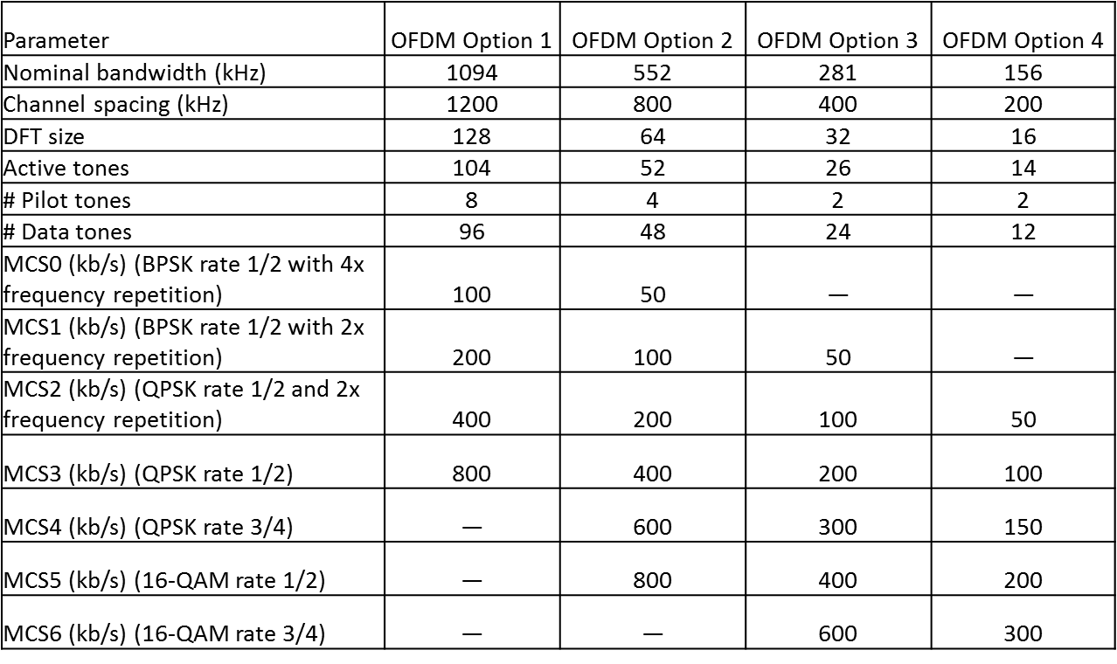
SUN-OFDM Modes Existing

Slide 17
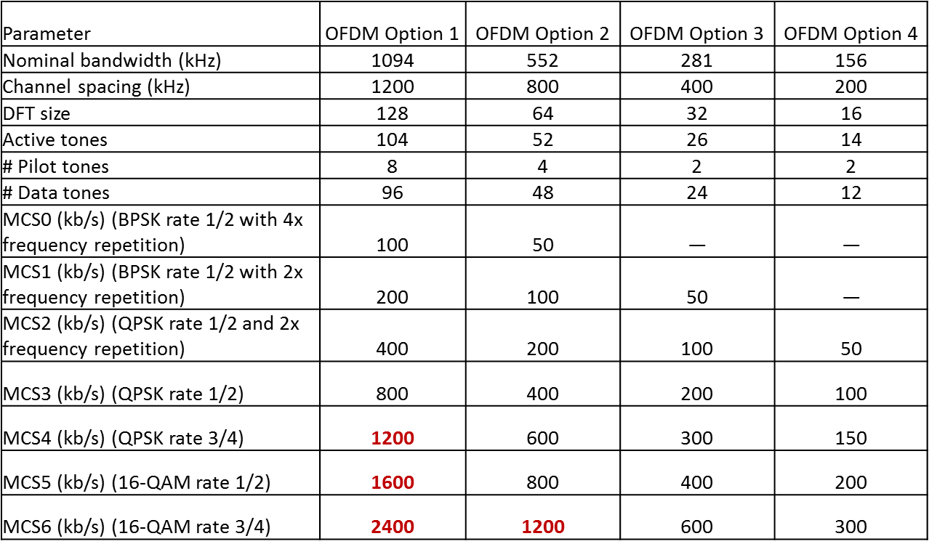
SUN-OFDM Modes Proposed

Slide 18
Extension Justification
Multiple SUN-OFDM implementations commercially available
Existing implementations support MCS5 and MCS6 for all options already
Using modulation, coding, channelization already defined.

Slide 19
SUN-OQPSK Channel Plans
Clarify where SUN-OQPSK can be used in 200khz channel spacing in all markets

Slide 20
SUN-OQPSK Example Clarifications
902 – 928 (U.S. ISM) Note (1) | SUN-FSK mode #1 | 0.2 | 129 | 902.2
 | SUN-FSK mode #2 & #3 | 0.4 | 64 | 902.4
 | SUN-OFDM Option 4 | 0.2 | 129 | 902.2
 | SUN-OFDM Option 3 | 0.4 | 64 | 902.4
 | SUN-OFDM Option 2 | 0.8 | 31 | 902.8
 | SUN-OQPSK 100 kchip/s | 0.2 | 129 | 902.2

