Slide 1
Project: IEEE P802.15 Working Group for Wireless Personal Area Networks (WPANs)
Submission Title: LRP UWB PHY minor enhancements Overview and Rationales
Date Submitted: January 2018
Source: David Barras, 3db Access AG
Contact:
E-Mail: David.Barras @ 3db-Access.com
Re: Enhanced Low Rate Interest Group
Abstract: Presentation, potential enhancements to the 802.15.4 LR-UWB PHY to improve ranging integrety
Purpose: Technical contribution.
Notice: This document has been prepared to assist the IEEE P802.15. It is offered as a basis for discussion and is not binding on the contributing individual(s) or organization(s). The material in this document is subject to change in form and content after further study. The contributor(s) reserve(s) the right to add, amend or withdraw material contained herein.
Release: The contributor acknowledges and accepts that this contribution becomes the property of IEEE and may be made publicly available by P802.15.
Slide 1
Slide 1
Notes:
Jul 12, 2010
Page 1

Slide 2
LRP UWB PHY minor enhancements Overview and Rationales
David Barras – 3db Access AG

Slide 3
Motivations
Enable a new class of devices that will be used for secure access based on ranging
These new devices shall features ultra-low power consumption:
typical markets: automotive, house+building access, payment, automatic logging,…
small devices such as keys, tags, wristwatches,… with long battery life.
Ensure interoperability for a secure access function between manufacturers
to trigger interest of “big” players
Notes:
Boris: Qqs typos

Slide 4
Why LRP UWB PHY ?
This standard has been identified as the closest to enable
“secure access” : 1 pulse per bit
“ultra-low power” : coherent and/or non-coherent, OOK-based implementation
Acceptance of the technology
Low cost of ownership (e.g., small size)
Low power
Low complexity
Provably secure

Slide 5
LRP UWB PHY Enhancements for Access
Add the two-way time-of-flight definition by fixed processing time t_{p}
round-trip time (RTT) crucial for security, otherwise no challenge-response protocol security is possible !
Initiator
Responder
t_{s}
Nv
t_{p}
Np
t_{r}
Secure distance measurement = (t_{r}-t_{s}-t_{p})*c/2

Slide 6
LRP UWB PHY Enhancements for Access
Make the “base mode” (1 pulse per bit) the only mandatory for access applications
multiple pulses per bit kills the security feature
no need of “extended” or “long range” modes as the access application is only operated in close proximity (1-2m)
additional not used modes will increases the silicon area → higher costs

Slide 7
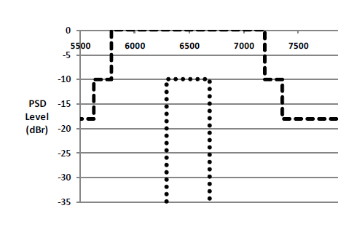
LRP UWB PHY Enhancements for Access
Improve the PHY by using dual-OOK
ease the sync (avoid long stream of “0”)
improve interference robustness and diversity
Exemple with Band 0 :
Band 0a
1 1 1 1… 1 0 0 1 1
Band 0b
Adds data points for 0’s

Slide 8
Proposal for changes
19.1 Overview
add: “The LRP PHY also optionally supports a distance measurement using Round-Trip Time function”
x.xx Round Trip Time function
add: Fixed turnaround time of 16 symbols (16us in Base mode)
In that case the device is notified as a RDEV in the upper layer (no change)
19.8 LRP UWB receiver specification
add: A receiver featuring the RTT function shall support base mode. Extended and long-range modes are optional.
Modulation
to be further discussed

