Slide 1
Project: IEEE P802.15 Working Group for Wireless Personal Area Networks (WPANs)
Submission Title: Unobtrusive Interactive VAT using Vehicle See-Through-HUD based CamCom Link
Date Submitted: November 2017
Source: Jaesang Cha, Younkwan Kim (The Catholic University of Korea), Mariappan Vinayagam(SNUST)
Address: Contact Information: +82-2-970-6431, FAX: +82-2-970-6123, E-Mail: chajs@seoultech.ac.kr
Re:
Abstract: This documents introduce the Vehicle See-Through-HUD based CamCom application for Vehicular Assistant Technology (VAT). This is proposed VAT uses Image Sensor Communication to operate on the application services like ADAS, ITS, See-Through-Display Signage, HUD-Signage, IoT/IoL/IoS, LED IT, Smart Signage with Advertisement Information etc.
Purpose: To Provided Concept models of See-Through Display based Vehicle CamCom for Vehicular Assistant Technology (VAT) Interest Group
Notice: This document has been prepared to assist the IEEE P802.15. It is offered as a basis for discussion and is not binding on the contributing individual(s) or organization(s). The material in this document is subject to change in form and content after further study. The contributor(s) reserve(s) the right to add, amend or withdraw material contained herein.
Release: The contributor acknowledges and accepts that this contribution becomes the property of IEEE and may be made publicly available by P802.15.
Slide 1

Slide 2
Contents
Elements Related to Attentional Disturbances on Drive
Unobtrusive Interactive VAT using Vehicle See-Through-HUD
Conclusion

Slide 3
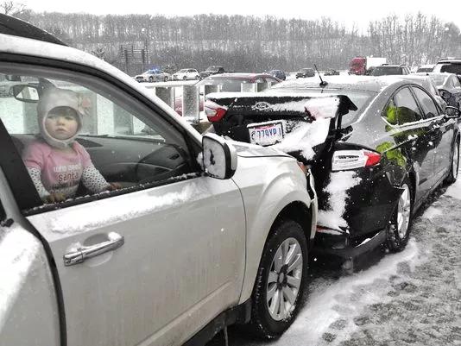
Elements Related to Attentional Disturbances on Drive
Inattention
  Low Level of Attention (e.g. leisure journey)
  Thoughts, Concerns
  Over-Familiarity with the road/monotony
  Over-Familiarity with the maneuver
Attention Competition
  Searching for a direction
  Identification of s potential risk in another part of the situation ( e.g. a car / human / animals coming from the other side)
Distraction
  External Stimulus (e.g. phone, conversation with a passenger, etc )
  Secondary task ( e.g. tuning the radio, picking up an object, etc)
Google
Leads to
  Accidents
  Causes Life

Slide 4
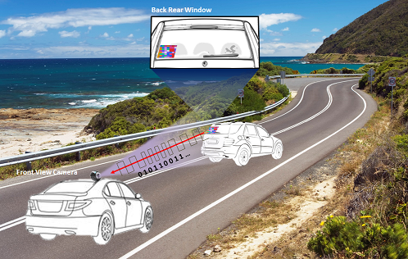
Unobtrusive Interactive VAT using Vehicle See-Through-HUD
Vehicle See-Through Rear Window HUD – CamCom Link
Vehicle See – Through – HUD - Rear Window based CamCom application
  Uses Vehicle See-Through-HUD-Rear Window as a Transmitter
  Front View Camera as a CAMCOM Link Receiver
  Uses Visible or Invisible mode of data transmission
  Display Tx Transmits
    Vehicle Speed, Location to Travel, and Vehicle Specific Informations
    Location and Route Informations
    Real-Time Traffic Informations
    Digital Advertisement
Advantages
  Unobtrusive Driving Instruction displayed on See-Through-HUD- Front Window
  Safety Travelers Informative Assistance
  Real-Time Driving Information Sharing
  Guides to easy ITS Integration and Connectivity
  Access to Mobile Network Connectivity Infrastructure

Slide 5
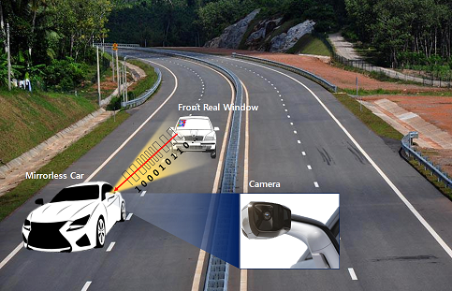
Unobtrusive Interactive VAT using Vehicle See-Through-HUD
Vehicle See-Through Front Window HUD – CamCom Link
Vehicle See – Through – HUD – Front Window based CamCom application
  Uses Vehicle See-Through-HUD-Front Window as a Transmitter
  Back View / Mirrorless Cars Mirror Camera as a CAMCOM Link Receiver
  Uses Visible or Invisible mode of data transmission
  Display Tx Transmits
    Vehicle Speed, Location to Travel, and Vehicle Specific Informations
    Location and Route Informations
    Real-Time Traffic Informations
    Digital Advertisement
Advantages
  Unobtrusive Driving Instruction displayed on See-Through-HUD- Front Window
  Safety Travelers Informative Assistance
  Real-Time Driving Information Sharing
  Guides to easy ITS Integration and Connectivity
  Access to Mobile Network Connectivity Infrastructure

Slide 6
Conclusion
Proposed the Vehicle See-Through-HUD based VAT CamCom Link use case model
Explore the Interactive and Unobtrusive driving assistive use of See-Through-HUD to CamCom Technology
CamCom provides optical wireless communication from Mobile Infrastructure-to-Vehicle, broadcasting many traveling related information, hence suitable for traveler safety applications.

