Slide 1
Project: IEEE P802.15 Working Group for Wireless Personal Area Networks (WPANs)
Submission Title: Unobtrusive Interactive VAT using Vehicle See-Through-HUD based CamCom Link
Date Submitted: November 2017
Source: Jaesang Cha, Younkwan Kim (The Catholic University of Korea), Mariappan Vinayagam(SNUST)
Address: Contact Information: +82-2-970-6431, FAX: +82-2-970-6123, E-Mail: chajs@seoultech.ac.kr
Re:
Abstract: This documents introduce the Vehicle See-Through-HUD based CamCom application for Vehicular Assistant Technology (VAT). This is proposed VAT uses Image Sensor Communication to operate on the application services like ADAS, ITS, See-Through-Display Signage, HUD-Signage, IoT/IoL/IoS, LED IT, Smart Signage with Advertisement Information etc.
Purpose: To Provided Concept models of See-Through Display based Vehicle CamCom for Vehicular Assistant Technology (VAT) Interest Group
Notice: This document has been prepared to assist the IEEE P802.15. It is offered as a basis for discussion and is not binding on the contributing individual(s) or organization(s). The material in this document is subject to change in form and content after further study. The contributor(s) reserve(s) the right to add, amend or withdraw material contained herein.
Release: The contributor acknowledges and accepts that this contribution becomes the property of IEEE and may be made publicly available by P802.15.
Slide 1

Slide 2
Contents
Elements Related to Attentional Disturbances on Drive
Unobtrusive Interactive VAT using Vehicle See-Through-HUD
Conclusion

Slide 3
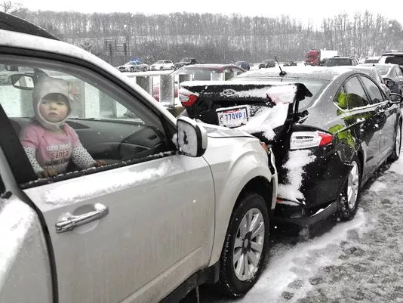
Elements Related to Attentional Disturbances on Drive
Inattention
Low Level of Attention (e.g. leisure journey)
Thoughts, Concerns
Over-Familiarity with the road/monotony
Over-Familiarity with the maneuver
Attention Competition
Searching for a direction
Identification of s potential risk in another part of the situation ( e.g. a car / human / animals coming from the other side)
Distraction
External Stimulus (e.g. phone, conversation with a passenger, etc )
Secondary task ( e.g. tuning the radio, picking up an object, etc)
Google
Leads to
Accidents
Causes Life

Slide 4
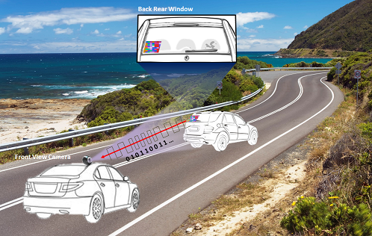
Unobtrusive Interactive VAT using Vehicle See-Through-HUD
Vehicle See-Through Rear Window HUD – CamCom Link
Vehicle See – Through – HUD - Rear Window based CamCom application
Uses Vehicle See-Through-HUD-Rear Window as a Transmitter
Front View Camera as a CAMCOM Link Receiver
Uses Visible or Invisible mode of data transmission
Display Tx Transmits
Vehicle Speed, Location to Travel, and Vehicle Specific Informations
Location and Route Informations
Real-Time Traffic Informations
Digital Advertisement
Advantages
Unobtrusive Driving Instruction displayed on See-Through-HUD- Front Window
Safety Travelers Informative Assistance
Real-Time Driving Information Sharing
Guides to easy ITS Integration and Connectivity
Access to Mobile Network Connectivity Infrastructure

Slide 5
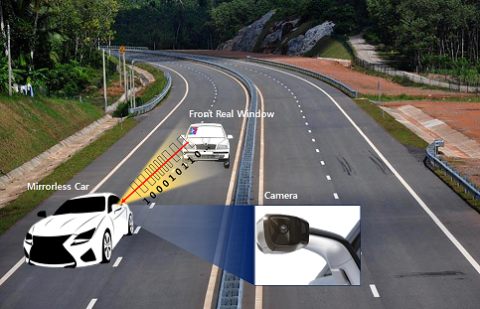
Unobtrusive Interactive VAT using Vehicle See-Through-HUD
Vehicle See-Through Front Window HUD – CamCom Link
Vehicle See – Through – HUD – Front Window based CamCom application
Uses Vehicle See-Through-HUD-Front Window as a Transmitter
Back View / Mirrorless Cars Mirror Camera as a CAMCOM Link Receiver
Uses Visible or Invisible mode of data transmission
Display Tx Transmits
Vehicle Speed, Location to Travel, and Vehicle Specific Informations
Location and Route Informations
Real-Time Traffic Informations
Digital Advertisement
Advantages
Unobtrusive Driving Instruction displayed on See-Through-HUD- Front Window
Safety Travelers Informative Assistance
Real-Time Driving Information Sharing
Guides to easy ITS Integration and Connectivity
Access to Mobile Network Connectivity Infrastructure

Slide 6
Conclusion
Proposed the Vehicle See-Through-HUD based VAT CamCom Link use case model
Explore the Interactive and Unobtrusive driving assistive use of See-Through-HUD to CamCom Technology
CamCom provides optical wireless communication from Mobile Infrastructure-to-Vehicle, broadcasting many traveling related information, hence suitable for traveler safety applications.

