Slide 1
Project: IEEE P802.15 Working Group for Wireless Personal Area Networks (WPANs)
Submission Title: Facility IoT Connected Lighting System Design Parameters Considerations for VAT V2I CAMCOM
Date Submitted: November 2017
Source: Jaesang Cha (SNUST), Mariappan Vinayagam (SNUST), Minsoo Kim (SRENG Co., Ltd.), Younkwan Kim (The Catholic University of Korea), Jaekwon Shin, Jintae Kim (Fivetek Co., Ltd.)
Address: Contact Information: +82-2-970-6431, FAX: +82-2-970-6123, E-Mail: chajs@seoultech.ac.kr
Re:
Abstract: This documents introduce the V2I CAMCOM Link design consideration for VAT. The proposed Lighting infrastructure system model design parameters consideration for VAT to operate on the application services like ITS, ADAS, etc on road condition, Bio-Plant / Manufacturing Industry Safety AIDS using Lighting / Display based infrastructure. Also this can be used for IoT/IoL, LEDIT, Digital Signage with Advertisement Information etc..
Purpose: To Provided Concept models of Vehicle CamCom for VAT Interest Group
Notice: This document has been prepared to assist the IEEE P802.15. It is offered as a basis for discussion and is not binding on the contributing individual(s) or organization(s). The material in this document is subject to change in form and content after further study. The contributor(s) reserve(s) the right to add, amend or withdraw material contained herein.
Release: The contributor acknowledges and accepts that this contribution becomes the property of IEEE and may be made publicly available by P802.15.
Slide 1

Slide 2
Contents
VAT V2I CAMCOM Link
Infrastructure Lighting System Design Parameters Considerations
Conclusion

Slide 3
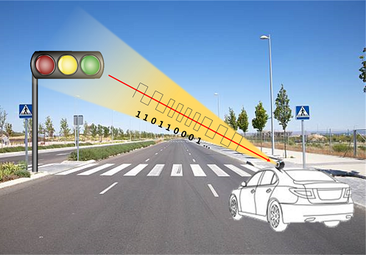
VAT V2I CAMCOM Link
Image Sensor based V2I CAMCOM Link
  Tx – LED / Display ; Rx - CMOS Image Sensor
  Data Rate : 10 Mb/s
  Day-Night Communication Mode
  ADAS , Industrial Automation, Industrial Emergency Alert / AIDS

Slide 4
Infrastructure Lighting System Design Parameters Considerations for VAT V2I CamCom Link (1)
V2X Noise Sources
  CamCom system in VAT is largely affected by natural and artificial lights (noise and interference) such as Sunlight, ambient lights, road/street lights etc.
Issues Needs to be address in Infrastructure Lighting System design
  Minimizing the effect of external noise
    Artificial or Natural
  Ambient lights effect
  Interference minimization

Slide 5
Infrastructure Lighting System Design Parameters Considerations for VAT V2I CamCom Link (2)
CamCom Link Design Requires
  Long Range Communication
  Line-of-Sight (LoS)
  Limiting Communication range and many more…
  Integration with Infrastructure
    RF/OWC Integration

Slide 6
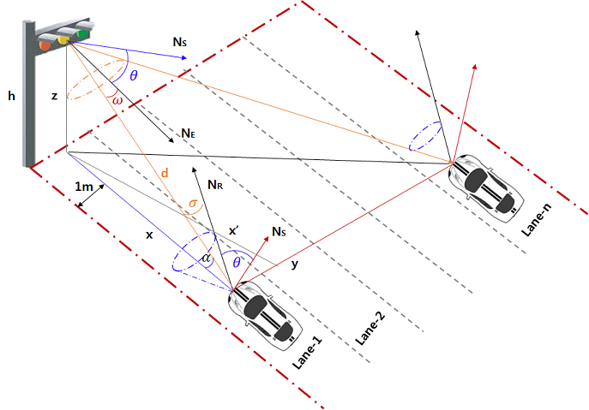
Infrastructure Lighting System Design Parameters Considerations for VAT V2I CamCom Link (3)
Analysis Results for Line-of-sight (LOS) case for the given two lanes road based on Lambertian Model from a single LED light source are presented and published in: “Design and Analysis of the Basic Parameters for Traffic Information Transmission Using VLC”, Proceeding of IEEE Int.Conf. WirelessVitae 09, May 2009, Denmark.

Slide 7

Infrastructure Lighting System Design Parameters Considerations for VAT V2I CamCom Link (4)
Important Design Parameters
  Height of Traffic Light “h”
  Height of Traffic Light from the receiver “z”
  Lane / Path Width
  Horizontal distance (m) from traffic light to the vehicle / Object in lane / path 1 “x”
  Distance (m) from the base of traffic/ sign light to the receiver on vehicle/object in different lane / path “y’”
  Direct distance (m) from emitter to the detector on lane / path 1 “d”
  Direct distance (m) from emitter to the detector on lane / path 2 “d’”
  Half power semi-angle of emitter “ϕ_{1/2}” (degree)
  Orientation of Emitter “ϕ” (degree)
  Angle of irradiation “φ” (degree)
  Orientation of Receiver “θ” (degree)
  Angle of incidence “σ” (degree)
  Width of the vehicle / Object
System Design Model
  Line-of-sight (LOS) case for the given two lanes road based on System Model

Slide 8
Conclusion
Supported by existing infrastructures, a low cost CamCom can find wide range of applications, offers ubiquitous and seamless connectivity
CamCom provide OWC from infrastructure-to-vehicle and vehicle-to vehicle, broadcasting many safety related information, hence suitable for road safety applications.

