Slide 1
Project: IEEE P802.15 Working Group for Wireless Personal Area Networks (WPANs)
Submission Title: Potential Enhancements To Low Rate UWB RFID PHY
Date Submitted: November 2017
Source: Tim Harrington, Pro-ID Consulting
Contact:
Voice: +1 408-353-3675 E-Mail: Timothy.Harrington@verizon.net
Re: Wireless Next Generation
Abstract: Wireless Next Generation presentation for potential enhancement to 802.15.4 RFID.
Purpose: Present a good idea to the WG
Notice: This document has been prepared to assist the IEEE P802.15. It is offered as a basis for discussion and is not binding on the contributing individual(s) or organization(s). The material in this document is subject to change in form and content after further study. The contributor(s) reserve(s) the right to add, amend or withdraw material contained herein.
Release: The contributor acknowledges and accepts that this contribution becomes the property of IEEE and may be made publicly available by P802.15.
Slide 1
Slide 1
Notes:
Jul 12, 2010
Page 1

Slide 2
Potential Enhancements to Low Rate UWB RFID PHY

Slide 3
Why Consider Enhancements
Allow 2-way ranging for mobile devices with small coin cell batteries for extended periods
Applies to single pulse-per-bit and non-coherent multi-pulse-per-bit UWB implementations (802.15.4f)
  Utilizes reduced power consumption capabilities of non-coherent receiver
Enables ranging with OOK PHY
Example Automotive Wireless Key Example:
  Single Pulse-to-bit improves resistance to relay attacks

Slide 4
2-Way Ranging for OOK
Low power receiver can apply intelligent power saving protocols already implemented in 802.15.4
Initiator
Responder
ts
Nv
tp
Np
tr
Secure distance measurement = (tr-ts-tp)*c/2

Slide 5
Very Low Power Receiver
Allows 2-Way Ranging
Property | Example Coherent | Dual Band OOK | Comment
RX energy consumption | 267 uJ | 18 uJ | > 15x better
TX energy consumption | 165 uJ | 9 uJ | > 18x better
Coherent Example: 110kb/s, 12 bytes, 6.5 GHz;
Dual Band OOK Proposal 250 kb/s, 12 bytes, 6.5 GHz
NOTE: Both in ranging mode with similar distance range of approx. 100 m

Slide 6
Very Fast Distance Measurement
Round-trip Time Time-of-flight (RTT ToF) distance measurement could takes as low as 500 us
  This means that a point-to-point distance measurement system can achieve a refresh rate of more than 1000 Hz! → true “real-time” tracking with low latency
Performance | Single measurement
Duration [us] | 300
Energy [uJ] | 20 (typ.)
Path loss [dB] | ≥ 89 dB

Slide 7
Dual Band OOK
Standard single pulse OOK
Band 1
No data points for 0’s
1 1 1 1… 1 0 0 1 1
Dual band single pulse OOK
Band 1
1 1 1 1… 1 0 0 1 1
Adds data points for 0’s
Band 2

Slide 8
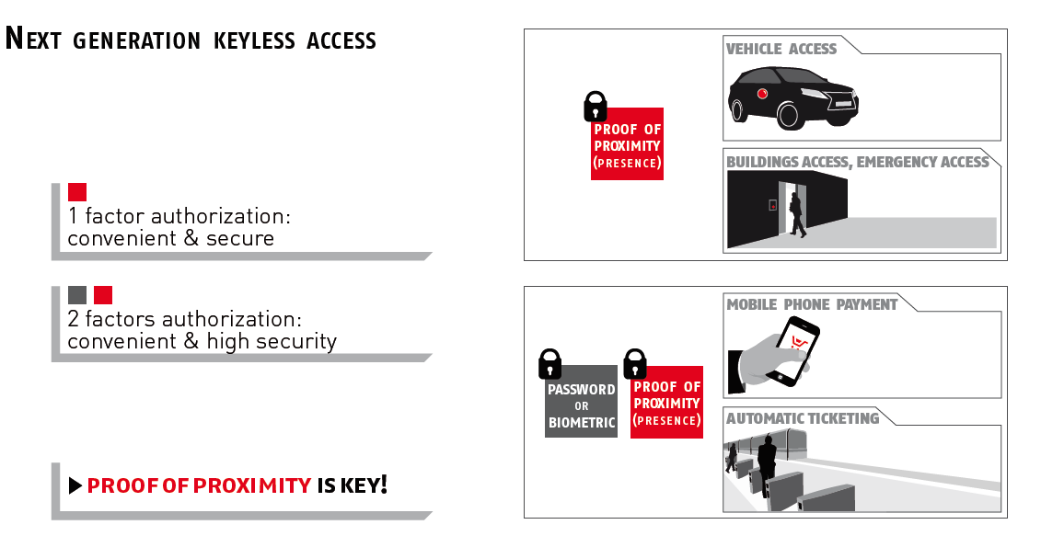

Example applications
Keyless access control
Localization/Positioning

Slide 9
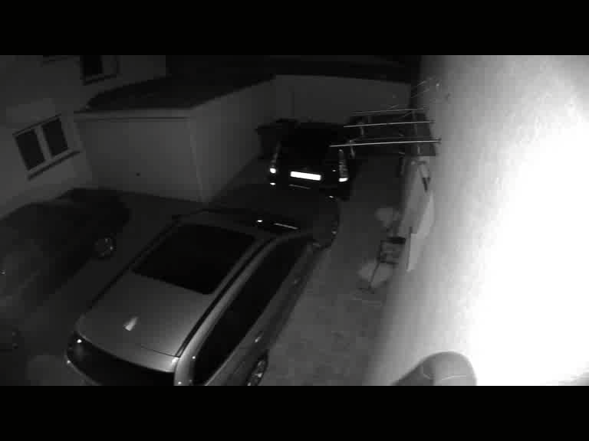
Wireless Automotive Relay Attack
While owner is sleeping, Attackers steal car with keyless entry

Slide 10
Example: Automotive Key Security
Single pulse per bit UWB meets power and security requirements
  Distance bounding with 2-way ID is required
Valid Operator
Hacking Attack
Preamble
Nv = [1 0 1 1 …]
Preamble
Nv = [1 0 1 1 …]
Key
Vehicle
Key
Vehicle
…
…
…
…
Np = [1 0 0 1 …]
Preamble
RTT
Np = [1 0 0 1 …]
Preamble
RTT
…
…
…
X
V
…
Attack scenario:
To shorten the distance the attacker starts preamble earlier
He needs to guess the Np bits in advance
Attack probability is 2^length(Nv) i.e., If Nv/Np = 20 bits = 1/1Million
The distance measurement is secure

Slide 11
Ranging Enables
Distance Bounding
Conclusions
  Round trip time (RTT) is crucial for security, otherwise no ranging type (bounding) security is possible!
  Round trip (RTT) distance bounding is not secure with message and ACK (acknowledgement). Transceiver ID is required
  Distance bounding needs a challenge (Nv) and response (Np)
    Both Nv and Np has to be fresh and unknown to the attacker

Slide 12
Why Consider Enhancements
2-way ranging for very small devices
  Single pulse-per-bit utilizes minimum power capabilities of non-coherent receiver
Dual stream OOK provides ranging in presence of interference
Single Pulse-to-bit provides resistance to distance relay attacks

