Slide 1
doc.: IEEE 15-17-0630-00-0vat
Project: IEEE P802.15 Working Group for Wireless Personal Area Networks (WPANs)
Submission Title: Consideration Issues for VAT IG PAR
Date Submitted: November 2017
Source: Yeong Min Jang [Kookmin University].
Contact: +82-2-910-5068 E-Mail: yjang@kookmin.ac.kr
Re:
Abstract: This document contains the output of the Vehicular Assistant Technology (VAT) Interest Group, intended to describe the use cases, requirements, and technical feasibility of Optical Wireless Communications in 802.15.
Purpose: Press release announcing confirmation of VAT IG
Notice: This document has been prepared to assist the IEEE P802.15. It is offered as a basis for discussion and is not binding on the contributing individual(s) or organization(s). The material in this document is subject to change in form and content after further study. The contributor(s) reserve(s) the right to add, amend or withdraw material contained herein.
Release: The contributor acknowledges and accepts that this contribution becomes the property of IEEE and may be made publicly available by P802.15.
Submission

Slide 2
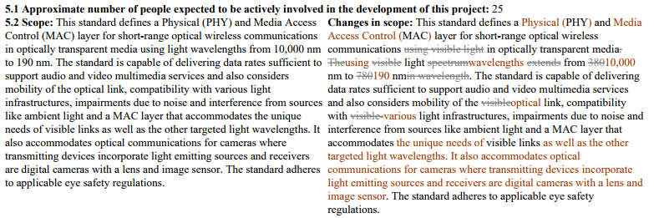
IEEE P802.15 VAT IG Group
doc.: IEEE 15-17-0630-00-0vat
802.15.13
Camera and image sensor based
Visual Light, Near IR with Laser technology
Data rate at 100 Mbps
Distance at 100m
802.15.7m

Slide 3
IEEE P802.15 VAT IG Group
doc.: IEEE 15-17-0630-00-0vat
802.15.13
Safety issues for VAT.
Vehicle to Vehicle and Vehicle to Infrastructure ITS system based Camera communication technique.
Data rate and communication range is restricted with ITS requirement.
802.15.7m

