Slide 1
Project: IEEE P802.15 Working Group for Wireless Personal Area Networks (WPANs)
Submission Title: [Final Report of the IG LPWA]
Date Submitted: [5 November, 2017]
Source: [Joerg ROBERT] Company [Friedrich-Alexander University Erlangen-Nuernberg]
Address [Am Wolfsmantel 33, 91058 Erlangen, Germany]
Voice:[+49 9131 8525373], FAX: [+49 9131 8525102], E-Mail:[joerg.robert@fau.de]
Re: []
Abstract: [This document presents the results of the final report of the IG LPWA]
Purpose: [Presentation within IEEE 802.15 SC WNG]
Notice: This document has been prepared to assist the IEEE P802.15. It is offered as a basis for discussion and is not binding on the contributing individual(s) or organization(s). The material in this document is subject to change in form and content after further study. The contributor(s) reserve(s) the right to add, amend or withdraw material contained herein.
Release: The contributor acknowledges and accepts that this contribution becomes the property of IEEE and may be made publicly available by P802.15.

Slide 2
Final Report of the IG LPWA
Joerg Robert (FAU Erlangen-Nuernberg)

Slide 3
Motivation
Low Power Wide Area Networks (LPWANs) have recently gained significant interest
A list of proprietary systems and standards is already available on the market
The question before the start of the Interest Group Low Power Wide Area (IG LPWA) therefore was:
Are there any LPWAN use-cases that are not perfectly covered by an existing IEEE standard?
Complete report is available in 15-17/528r1

Slide 4
Table of Contents
What are LPWANs?
Market Potential
Payload Bit-Rates and Challenges
LPWAN Use-Cases
Parameters Affecting the LPWAN Performance
LPWAN Evaluation
Recommendation to WG 802.15

Slide 5
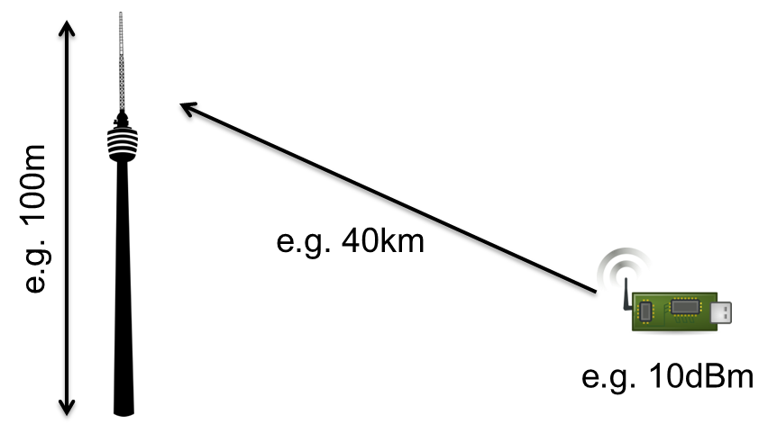
What are Low Power Wide Area Networks (LPWANs)?
Low cost, low complexity and ultra-low power sensor nodes
Battery lifetimes of 10 years with tiny batteries
Ultra long-range transmission over several km with 10mW and very low reception level <-140dBm, highly exposed BS antennas
Use of license exempt frequency bands (e.g. close to 900 MHz)
➔ Interesting approach to provide cost-efficient IoT connectivity

Slide 6
LPWAN Market Requirements/Potential
Interoperability
  One system supports all use-cases
System availability over decades
  Use-cases related to infrastructure require operation and hardware availability over decades
Network coverage
  Users may have to operate private networks, as public networks may not cover rural areas
Full control of the network and data
  Users do not want to rely on public networks
Market potential for open standard LPWAN solution
Open question: Already covered by existing IEEE standards?

Slide 7
Maximum Payload Bit-Rates
The successful transmission of a payload bit requires a certain energy wrt. the noise level → E_{b}/N₀
A reception level of P_{RX}=-140dBm allows a max. payload bit-rate of 3622 bit/s (network cell capacity may be higher)
LPWAN only support very low payload bit-rates

Slide 8
Technical Challenges of LPWANs
The ultra-low payload bit-rates cause different technical challenges, e.g.:
Frequency offset:
Frequency offset of the oscillator is higher than the signal bandwidth
Hidden node problem:
Listen before talk does not work, coordination of the network potentially too power demanding
Frequency regulation:
Limited transmit power and length, limited duty cycle
Interference:
Interference caused by other users in license exempt frequency bands (e.g. RFID, IEEE 802.11ah, ...) in addition to long transmit durations (> 1s)

Slide 9
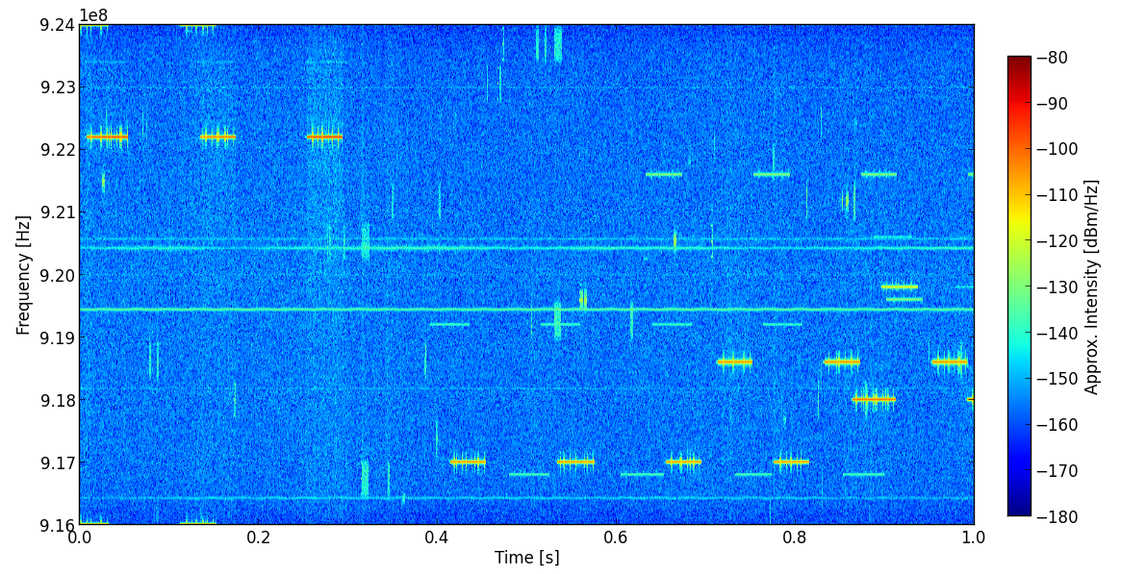
Example: Interference in Orlando
RFID
Interference measured on 5 November, 2017, inside hotel room
Significant interference due to RFID
Significantly higher channel loads can be expected in case of outdoor-measurements
Shown interference may already reduce LPWAN performance significantly

Slide 10
Table of Contents
What are LPWANs?
Market Potential
Payload Bit-Rates and Challenges
LPWAN Use-Cases
Parameters Affecting the LPWAN Performance
LPWAN Evaluation
Recommendation to WG 802.15

Slide 11
Potential Use-Cases ( I / II )
Defined 24 potential LPWAN use-cases in 7 different domains:
  Agriculture and Environmental
  Consumer/Medical
  Industrial
  Infrastructure
  Logistics
  Smart Building
  Smart City
Use-case list not complete, but covers all relevant technical scenarios that were required for the evaluation process
Full use-case list is presented in 15-16/770r5

Slide 12
Potential Use-Cases ( II / II )
Example Industrial Plant Monitoring
Parameter | Value
Channel Model | Outdoor Urban
Interference Model | None
Active Interfering Users | Medium
Communication Mode | Uplink/Broadcast Downlink
Data Period | Occasionally 1/hour
Data Length (Uplink) | <=16bytes
Availability | High
Latency | <10s
LP-WAN Localization Precision | <10m
Typical Power Supply | Energy Harvesting
Frequency Regulation | NA
Cell Radius | <50km
Data Security | Layer-3

Slide 13
Parameters Affecting the LPWAN Performance
Frequency Regulation
Propagation Models
Interference Models
Traffic Models
→ Detailed analyses within IG LPWA

Slide 14
Frequency Regulation
Worldwide frequency regulation wrt. LPWAN is not consistent
FCC (US):
  Maximum transmit duration of 0.4s
  For transmission exceeding 0.4s mandatory use of frequency hopping
  High transmit power of one Watt plus antenna gain
  ...
ETSI (Europe):
  Strict limitations of duty cycle, e.g. 1% and 0.1% (especially critical for LPWAN base-stations)
  Significantly lower transmit powers compared to FCC
  ...

Slide 15
Propagation Models
Definition of propagation models for outdoor rural / urban and indoor scenarios
Re-use of existing IEEE 802.11ah channel models with focus on narrow-band signals
Definition of noise figures for base-stations and sensor nodes

Slide 16
Interference and Traffic Models
Defined interference and traffic models based on assumptions of the population density
Traffic model can be used for PHY and MAC simulations
PHY model allows analysis for interference on LPWAN transmissions

Slide 17
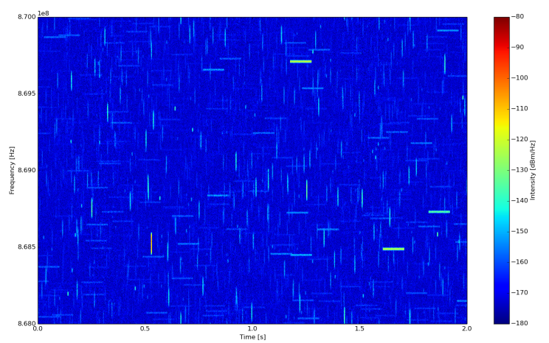
Example of Interference Model Playground

Slide 18
Table of Contents
What are LPWANs?
Market Potential
Payload Bit-Rates and Challenges
LPWAN Use-Cases
Parameters Affecting the LPWAN Performance
LPWAN Evaluation
Recommendation to WG 802.15

Slide 19
IG LPWA Evaluation Procedure
Suitability
  Analysis the general suitability of a candidate technology or IEEE standard
Qualitative Evaluation
  Analysis pros and cons, and dependency on other technologies
Quantitative Evaluation
  Exact performance (only for selected technologies)
Parameters affecting the LPWAN performance were used to evaluate the defined use-cases

Slide 20
Results of the “Suitability and Qualitative Analyses”
IEEE 802.15.4 and IEEE 802.11ah perfectly cover all use-cases that can be realized with medium to high payload bit-rates
IEEE 802.15.4 additionally perfectly covers all use-cases with very low payload bit-rates in licensed frequency bands
Potential improvements are only possible for very low payload bit-rates due to
  0.4s FCC limitation
  Interference in license exempt frequency bands

Slide 21
Remaining LPWAN Use-Cases
Domain | Use-Case
Agriculture and Environmental
Consumer/Medical | Pet Tracking
Industrial
Infrastructure | Smart Grid - Fault Monitoring, Smart Grid – LPWAN Extension, Automated Meter Reading, Structural Health Monitoring
Logistics
Smart Building
Smart City | Smart Parking, Vending Machines – general, Waste Management
All use-cases require long-range and low payload bit-rates
Typical channel access is ALOHA and typical traffic is focusing on uplink

Slide 22
Qualitative Analyses of Remaining
Use-Cases
Simulations focusing on low payload bit-rates in interfered channels
Comparison of different encoding schemes
  Uncoded without frequency hopping
  Uncoded with frequency hopping (16 hops)
  FEC Coded without frequency hopping
  FEC Coded with frequency hopping (16 hops)
FEC code based on Reed Solomon Code that is able to correct 16 out of 64 transmitted bytes (convolutional code may obtain better results)
Use of Minimum Shift Keying that is offered by all chipsets supporting IEEE 802.15.4

Slide 23
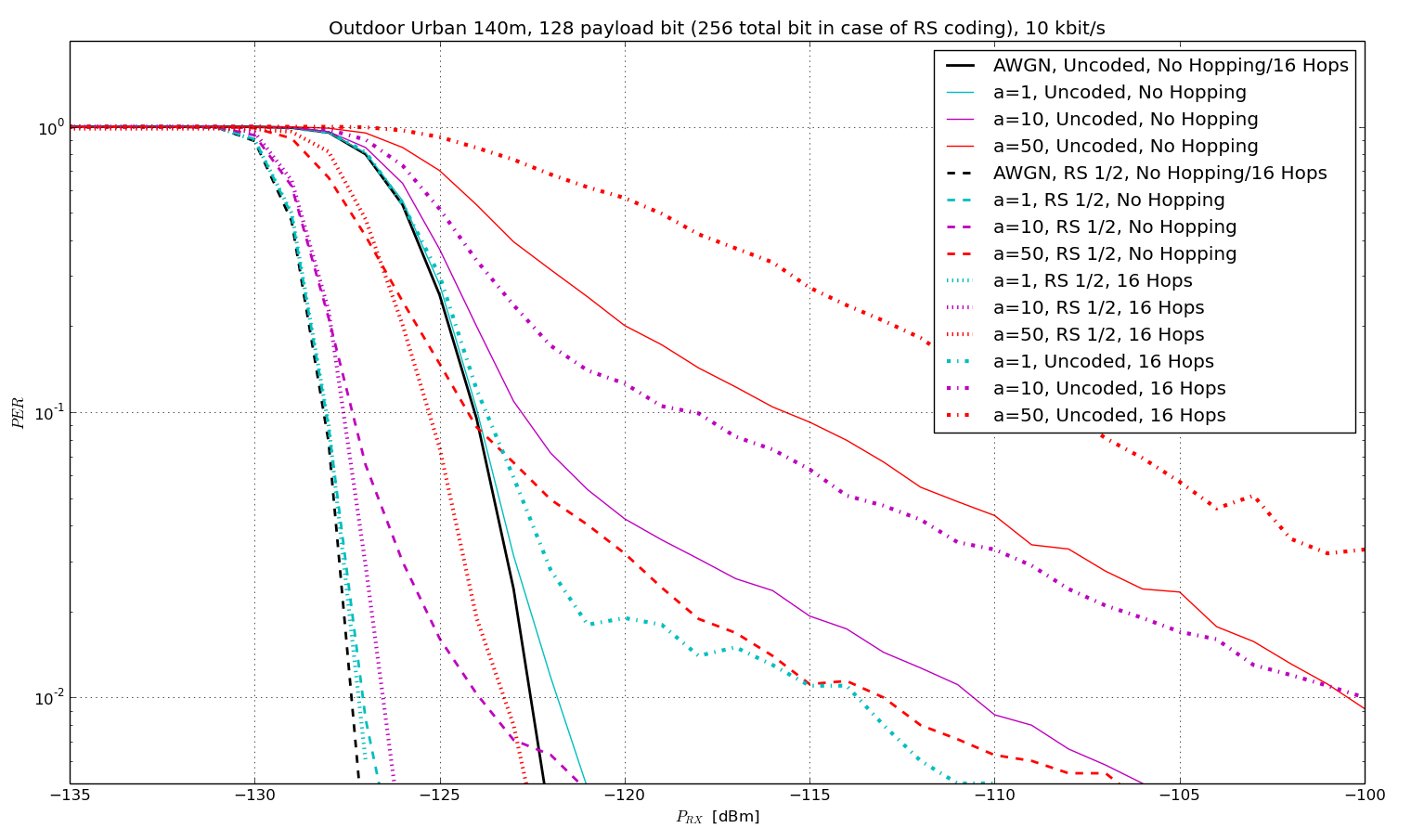
Example Simulation Results
23dB
Frequency hopping with coding offers significant gain and additionally satisfies 0.4s FCC requirement

Slide 24
Table of Contents
What are LPWANs?
Market Potential
Payload Bit-Rates and Challenges
LPWAN Use-Cases
Parameters Affecting the LPWAN Performance
LPWAN Evaluation
Recommendation to WG 802.15

Slide 25
IEEE 802.15.4 Optimization Potential for Improved LPWAN Functionality
IEEE 802.15.4 is able to almost reach the theoretical bounds for medium to high payload bit-rates → no relevant gain possible
BUT: For low payload bit-rates in interfered channels a significant gain is possible using frequency hopping and powerful coding
Simulation results indicate a gain of more than 20dB
Gain may allow 5 times bigger cell radii without increasing the transmit power

Slide 26
What is Missing to Achieve Gain?
IEEE 802.15.4 already offers all building blocks
  Powerful Forward Error Correction (FEC) based on convolutional codes
  Fragmentation with Frequency Hopping
Significant improvements of the IEEE 802.15.4 performance for low payload bit-rates in highly interfered channels can be achieved with minor changes
Improvements only require optimizing the order of the processing blocks in the TX and RX
Improvements may be realized by software using existing silicon
Possibility to achieve significantly improved performance using software-updates of already shipped devices

Slide 27
Recommendation for Future WG Activities
Create SG LPWA in order to amend IEEE 802.15.4 for low payload bit-rates in interfered channels
High performance gains can be expected with PAR and CSD focusing on
  Optimized PHY/MAC by modifying the position of the FEC encoder in the encoding chain
  Low bit-rates, no addition of new modulation schemes
  Solutions that do not require new silicon, but may be realized by software only

Slide 28
Special Thanks to All Contributors for the Fruitful Discussions in the
IG LPWA!

Slide 29
Thank You for Your Attendance!
Any Questions?

Slide 30
Strawpoll
Do you agree on creating a new SG LPWA to create a PAR and CSD focusing on an IEEE 802.15.4 amendment for ultra-low payload bit-rates in license exempt frequency bands?
Y / N / A:

