Slide 1
doc.: IEEE 802.15-15- 0611 -00-007a
Project: IEEE P802.15 Working Group for Wireless Personal Area Networks (WPANs)
Submission Title: Summary of PHY/MAC service specification in 802.15.7-2011 std.
Date Submitted: November 2017
Source: Trang Nguyen, Yeong Min Jang [Kookmin University]
Contact: +82-2-910-5068 E-Mail: yjang@kookmin.ac.kr
Re:
Abstract: A brief summary about PLME for discussion
Purpose: to have an open discussion on SNUST schemes (PHY/MAC attributes)
Notice: This document has been prepared to assist the IEEE P802.15. It is offered as a basis for discussion and is not binding on the contributing individual(s) or organization(s). The material in this document is subject to change in form and content after further study. The contributor(s) reserve(s) the right to add, amend or withdraw material contained herein.
Release: The contributor acknowledges and accepts that this contribution becomes the property of IEEE and may be made publicly available by P802.15.
Submission

Slide 2
doc.: IEEE 802.15-15- 0611 -00-007a
Content
PHY service specifications
PHY management service
PHY PIB attributes
Open discussion on Positioning issue
The use of distance measurement in VTASC system
MAC sublayer service
Submission

Slide 3
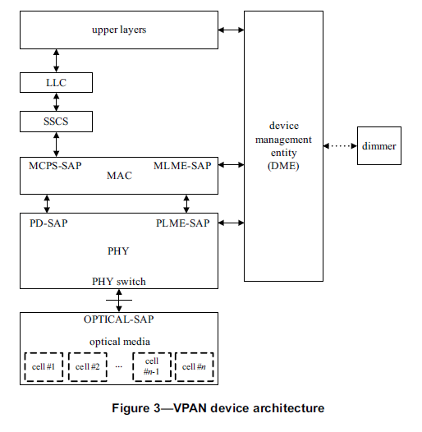
doc.: IEEE 802.15-15- 0611 -00-007a
Device architecture
Discussion issues:
1-The manner to use, GET, and REQUEST values of PHY PIB attributes
2- In case that a positioning application (that is not in the scope of this standard) is applied, how to manage that service.
Submission

Slide 4
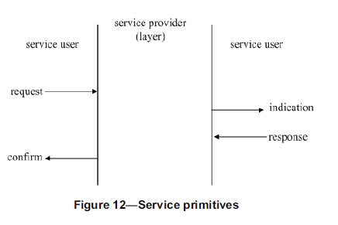
doc.: IEEE 802.15-15- 0611 -00-007a
Concept of primitives
The services of a layer are the capabilities it offers to the next higher layer or sublayer by building its functions on the services of the next lower layer.
Submission

Slide 5
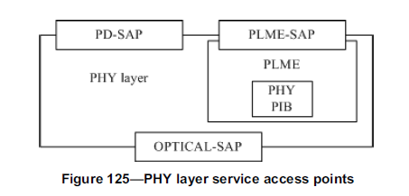
doc.: IEEE 802.15-15- 0611 -00-007a
Section 9. PHY service specification
9.1 Overview
The PHY provides an interface between the MAC sublayer and the physical optical channel. The PHY conceptually includes a management entity called the PLME. This entity provides the layer management service interfaces through which layer management functions may be invoked.
The PLME is also responsible for maintaining a database of managed objects pertaining to the PHY. This database is referred to as the PHY PAN information base (PIB).
not specified
Submission

Slide 6
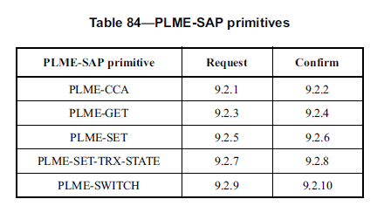
doc.: IEEE 802.15-15- 0611 -00-007a
9.2 PHY management service
The PLME-SAP allows the transport of management commands between the MLME or the DME and the PLME.
Submission

Slide 7
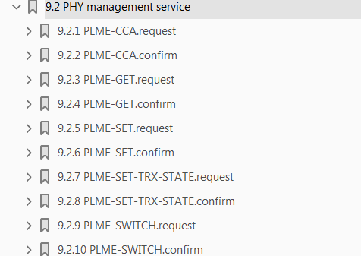
doc.: IEEE 802.15-15- 0611 -00-007a
9.2 PHY management service
PHY PIB attributes
Read/write
a) Transceiver disabled (TRX_OFF)
b) Transmitter enabled (TX_ON)
c) Receiver enabled (RX_ON)
1-phyVTASCTxCameraEnable
2- phyIDETxCameraEnable
These attributes are in a wrong place!
Submission

Slide 8
doc.: IEEE 802.15-15- 0611 -00-007a
9.3 PHY data service
The PD-SAP supports the transport of MPDUs between a local MAC sublayer and a local PHY layer entity.
PD-DATA.request (
psduLength,
psdu,
bandplanID
)
Submission

Slide 9
doc.: IEEE 802.15-15- 0611 -00-007a
9.5.2 PHY PIB attributes
The PHY PIB comprises the attributes required to manage the PHY of a device. Each of these attributes can be read or written using the PLME-GET.request and PLME-SET.request primitives, respectively. The attributes contained in the PHY PIB are presented in Table 100.
Submission

Slide 10
doc.: IEEE 802.15-15- 0611 -00-007a
6. MAC sublayer service specification
Submission

Slide 11
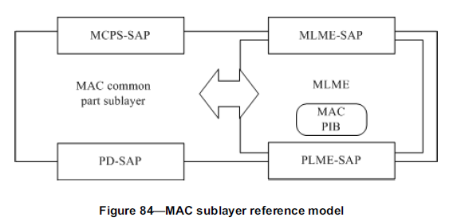
doc.: IEEE 802.15-15- 0611 -00-007a
6. MAC sublayer service specification
The MAC sublayer provides an interface between the SSCS, DME and the PHY. The MAC sublayer conceptually includes a management entity called the MLME.
Submission

Slide 12
doc.: IEEE 802.15-15- 0611 -00-007a
Open discussion
1-phyVTACScalRegion1DistanceRange
2-phyVTACScalRegion2DistanceRange
3-phyVTACScalRegion3DistanceRange
4-phyVTACScalRegion4DistanceRange
The distance measurement is implemented by the other application. So how does that value cross through MAC sublayer service?
Submission

