Slide 1
Project: IEEE P802.15 Working Group for Wireless Personal Area Networks (WPANs)
Submission Title: ETRI’s comment on CVD frame in D1 draft of IEEE 802.15.13
Date Submitted: 06 November 2017
Source: Sang-Kyu Lim and Wan-Ki Park [ETRI]
Address:
Voice:[+82-42-860-1573], FAX: [+82-42-860-5218], E-Mail:[sklim@etri.re.kr]
Re:
Abstract:
Purpose: Contribution to IEEE 802.15.13
Notice: This document has been prepared to assist the IEEE P802.15. It is offered as a basis for discussion and is not binding on the contributing individual(s) or organization(s). The material in this document is subject to change in form and content after further study. The contributor(s) reserve(s) the right to add, amend or withdraw material contained herein.
Release: The contributor acknowledges and accepts that this contribution becomes the property of IEEE and may be made publicly available by P802.15.

Slide 2
ETRI’s Comment on CVD frame
in D1 draft of IEEE 802.15.13
Sang-Kyu Lim and Wan-Ki Park
ETRI

Slide 3
Motivation
Color visibility dimming (CVD) frame is a frame used for color, visibility and dimming support.
TG13 has discussed the functionality issues, which are color function, visibility, and dimming supported by CVD frame, through the comment resolution in September meeting.
TG13 need to make a clear conclusion on CVD frame because the results of September meeting and D0 comment resolution create some confusion.

Slide 4
Comment Resolution against D0
(15-17-0479-03-0013-combined-comments-against-d0)

Slide 5
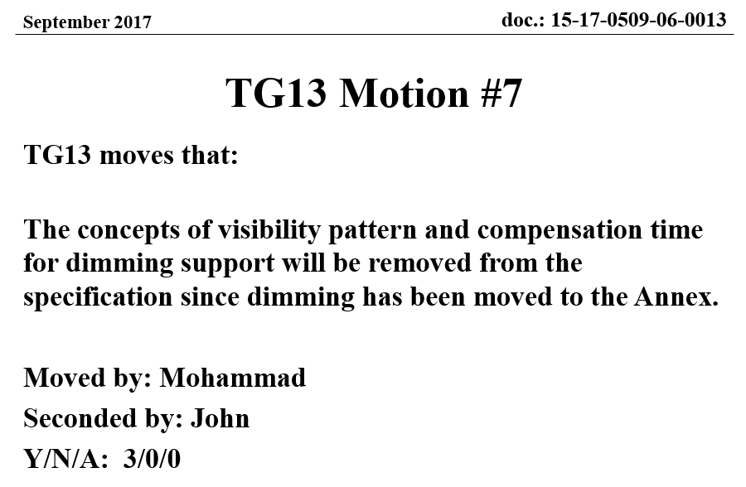
September Meeting Results
(15-17-0509-06-0013-tg13-meeting-slides-for-kona)
So, the color function support has moved into Annex G in D1.

Slide 6
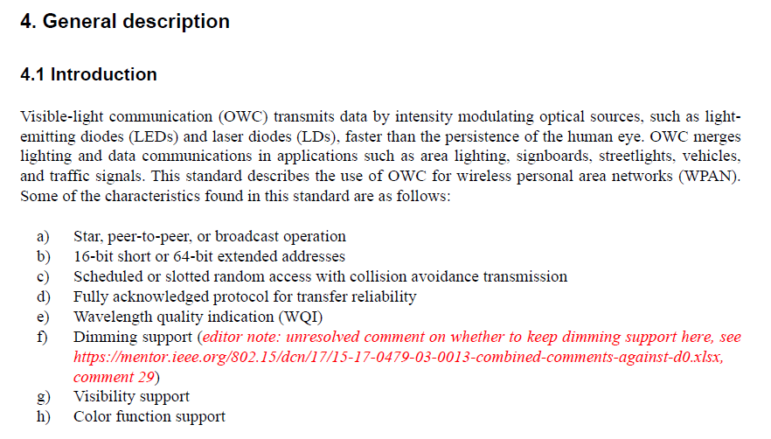
CVD Issues in D1 (#1)
(pdf) page #6

Slide 7
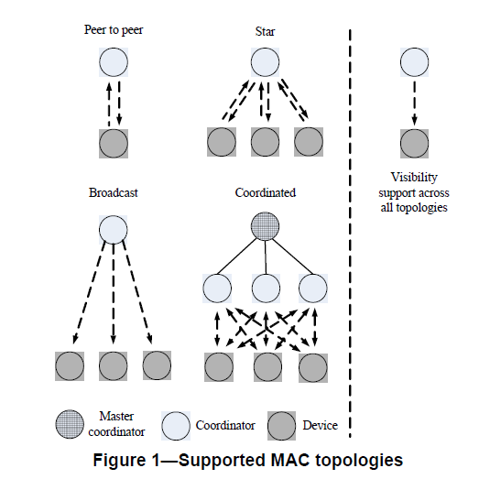
CVD Issues in D1 (#2)
(pdf) page #7

Slide 8
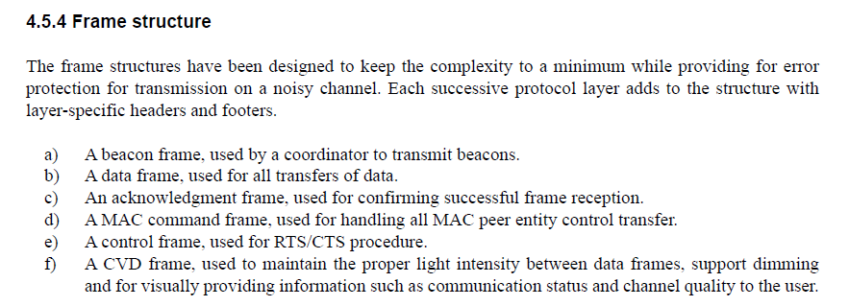
CVD Issues in D1 (#3)
(pdf) page #20

Slide 9
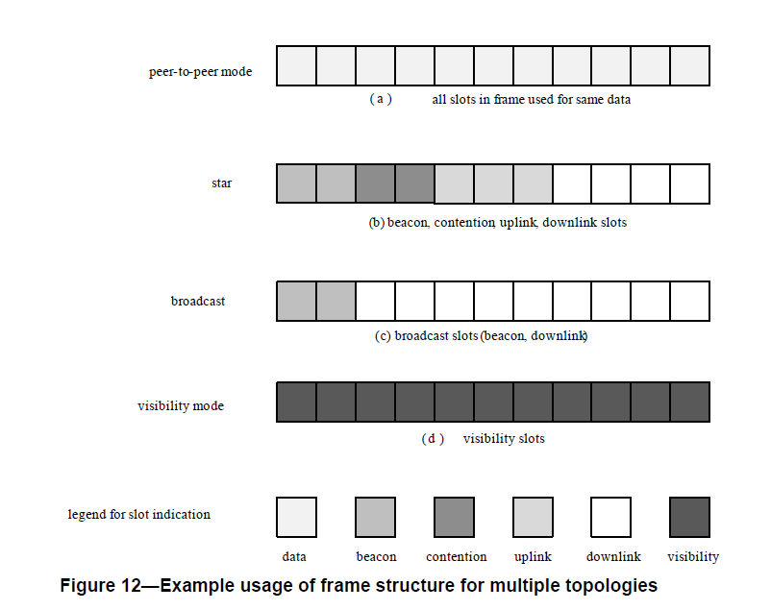
CVD Issues in D1 (#4)
(pdf) page #26

Slide 10
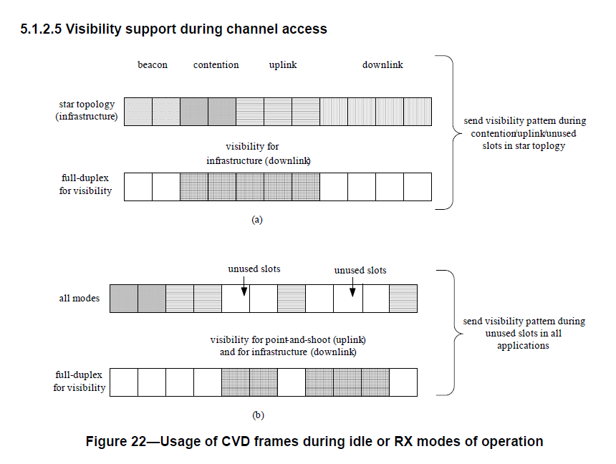
CVD Issues in D1 (#5)
(pdf) page #38

Slide 11
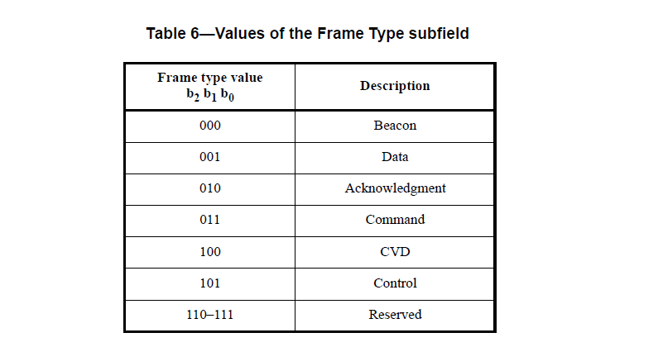
CVD Issues in D1 (#6)
(pdf) page #83

Slide 12
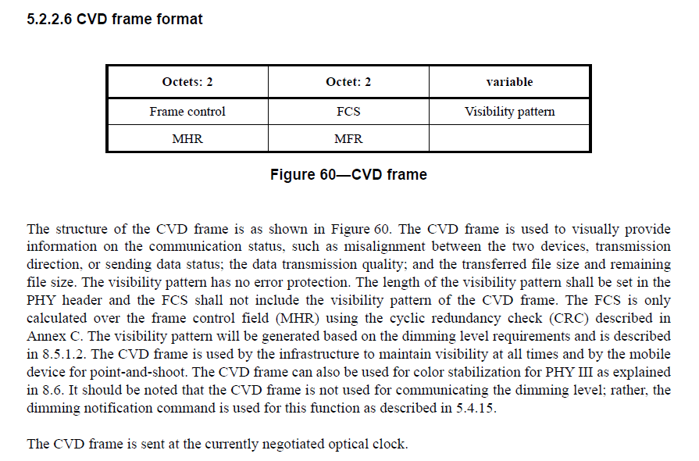
CVD Issues in D1 (#7)
(pdf) page #96

Slide 13
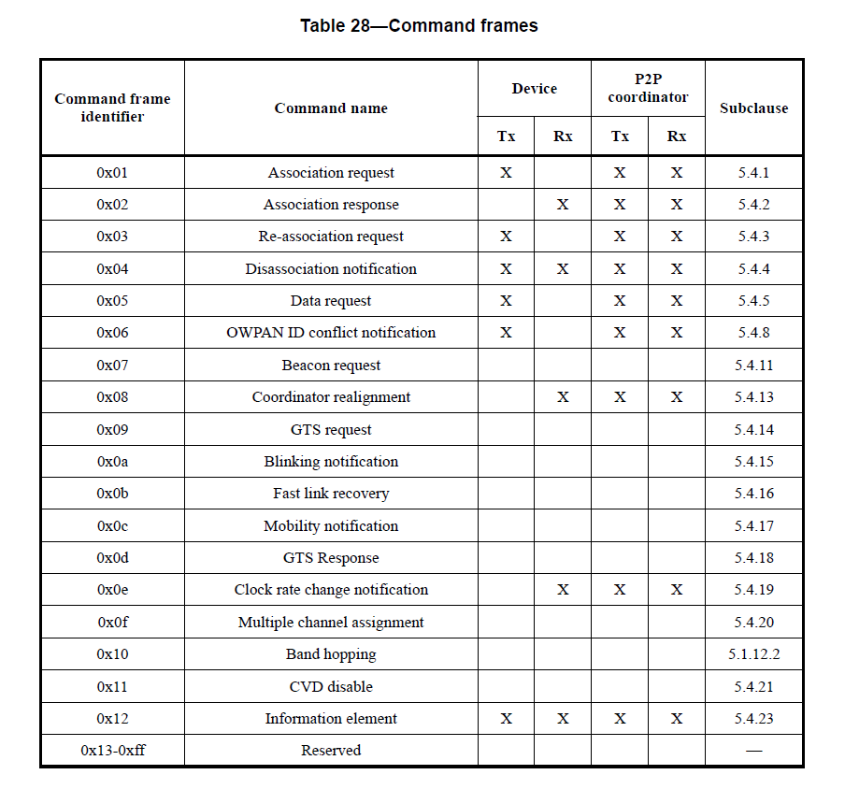
CVD Issues in D1 (#8)
(pdf) page #116

Slide 14
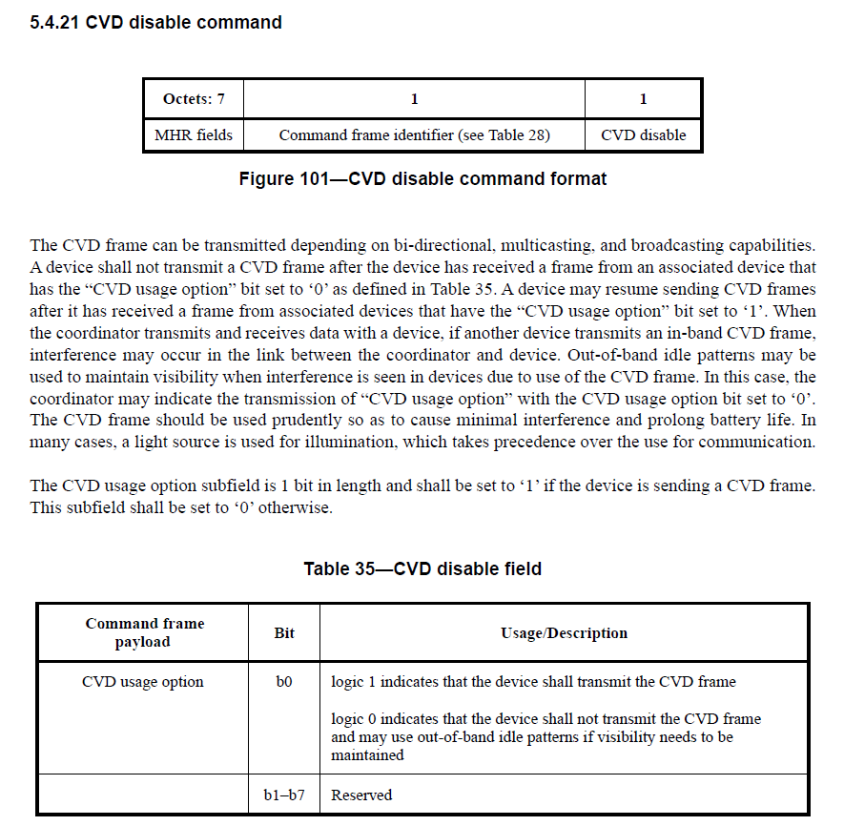
CVD Issues in D1 (#9)
(pdf) page #132

Slide 15
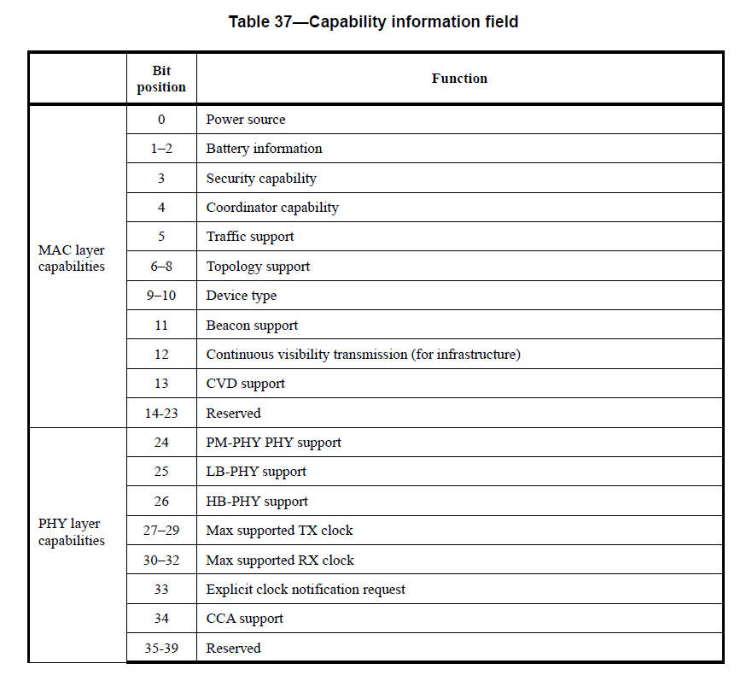
CVD Issues in D1 (#10)
(pdf) page #135

