Slide 1
Project: IEEE P802.15 Working Group for Wireless Personal Area Networks (WPANs)
Submission Title: [Smart Grid with LPWAN Extension]
Date Submitted: [5 November, 2017]
Source: [Joerg ROBERT] Company [Friedrich-Alexander University Erlangen-Nuernberg]
Address [Am Wolfsmantel 33, 91058 Erlangen, Germany]
Voice:[+49 9131 8525373], FAX: [+49 9131 8525102], E-Mail:[joerg.robert@fau.de]
Re: []
Abstract: [Simulation Results for Use-Case “Smart Grid with LPWAN Extension”]
Purpose: [Presentation in IG LPWA]
Notice: This document has been prepared to assist the IEEE P802.15. It is offered as a basis for discussion and is not binding on the contributing individual(s) or organization(s). The material in this document is subject to change in form and content after further study. The contributor(s) reserve(s) the right to add, amend or withdraw material contained herein.
Release: The contributor acknowledges and accepts that this contribution becomes the property of IEEE and may be made publicly available by P802.15.

Slide 2
Simulation Results for Use-Case “Smart Grid with LPWAN Extension”
Joerg Robert (FAU Erlangen-Nuernberg)

Slide 3
Motivation
Use-case to extend 802.15.4g with LPWAN connectivity discussed in Waikoloa
Only remote users are connected via LPWAN
Question on potential gain of optimized PHY in case of low bit-rates in 900 MHz band

Slide 4
Assumed Parameters
Interference class “Dense”, Outdoor channel model
64 payload bytes per packet
MSK modulation
Reed Solomon code with rate ½ for coded packets
Different configurations
  Uncoded 50kBit/s → 10ms
  Coded 50kBit/s → 20ms
  Uncoded 10kBit/s → 50ms
  Coded 10kBit/s → 100ms
Variable number of hops for coded case

Slide 5
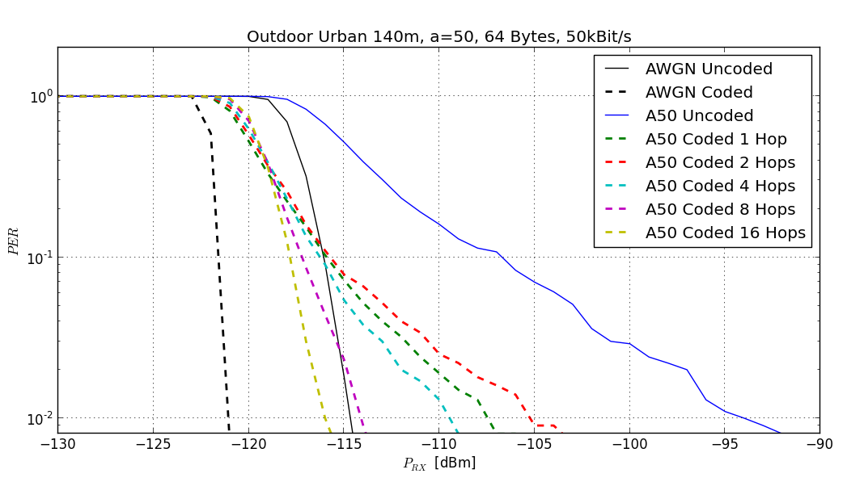
50 kBit/s Simulation Results
20dB

Slide 6
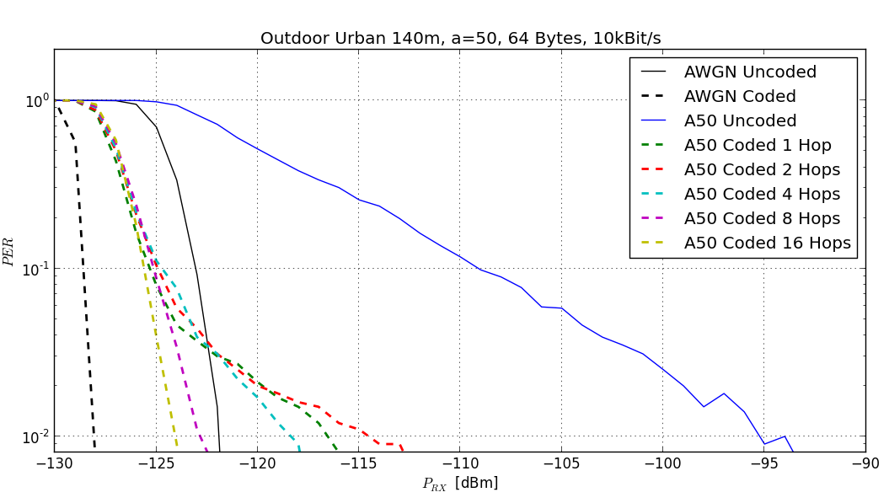
10 kBit/s Simulation Results
25dB

Slide 7
Simulation Result Summary
Reduction of bit-rate from 50kBit/s to 10kBit/s does not provide significant gain without coding
Coding with hopping offers good robustness
Already 8 hops offer significant level of robustness
However: To obtain reliable results for the US additional spectrum measurements are required...

Slide 8
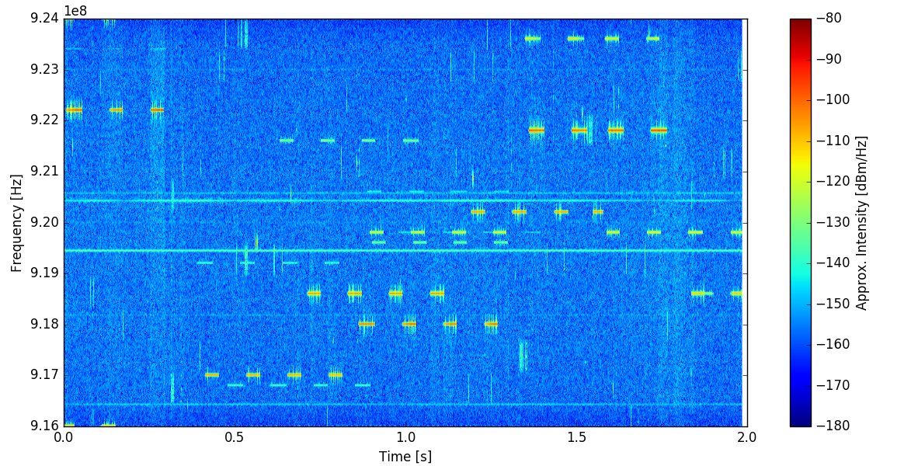
Orlando sub-GHZ ISM Spectrum Use
Measured on 5 November, 2017, in hotel room
Higher interference levels can be expected for outdoor meas.

Slide 9
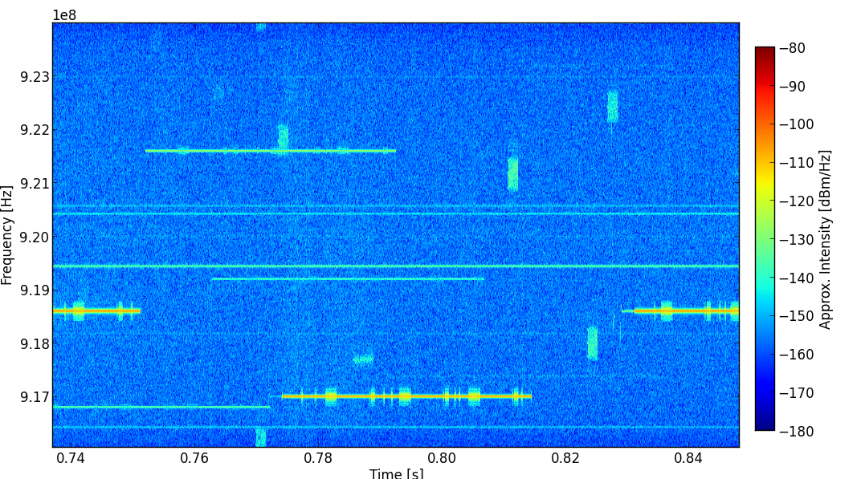
Orlando 100ms Zoom
Window length corresponds to FEC coded (1/2 rate) 64 byte packet with 10kBit/s
→ Significant gain due to frequency hopping can be expected

Slide 10
Summary
Reducing the bit-rate does not lead to additional robustness
Additional link margin can be achieved by reducing the bit-rate in addition to coding and frequency hopping
Additional measurements will be performed to analyze the spectrum usage in the US

Slide 11
Thank You for Your Interest!
Any Questions?

