Slide 1
On PHY specification writing style
Date: 2017-11-01
Authors:

Slide 2
Abstract
Draft 1 of 802.15.13 was released in October 2017
Current three PHY specifications are written in different styles
It is proposed to unify the writing style of the three PHYs

Slide 3

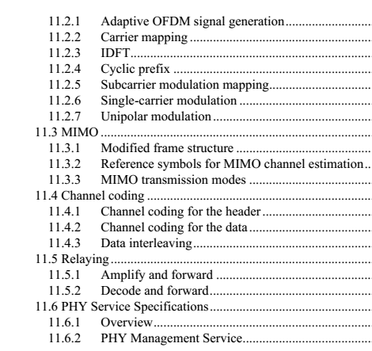
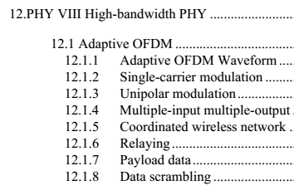
Current situation
Current three PHY are written in different styles
10 Pulsed Modulation PHY
10.1 Transmitter Structure
10.2 Forward Error Correction Encoder
10.3 Line Encoder
10.4.1 PAM Mapper
10.4.3 HCM Mapper

Slide 4
Proposed way forward
Proposal 1: three PHYs should have unified writing style.
Proposal 2: TG13 discuss and decide on the skeleton for each PHY.

Slide 5
Example
1. XXX-PHY
  1.1 PPDU format
  1.2 Transmission
    1.2.1 Preamble
    1.2.2 Header
      1.2.2.1 General
      1.2.2.2 Generation of HCS bits
      1.2.2.3 Header encoding and modulation
    1.2.3 PHY payload
      1.2.3.1 General
      1.2.3.2 Scrambler
      1.2.3.3 Encoding
      1.2.3.4 Modulation mapping
      1.2.3.5 Pilot sequence
      1.2.3.6 OFDM modulation
    1.2.4 Visibility pattern

Slide 6
Proposed way forward
If the skeleton for each PHY is agreed upon
  The skeleton is inserted in the draft as a new section
  Example:
  10 PM-PHY (skeleton)
  10.1 PPDU format
  10.2 Transmission
  10.2.1 Preamble
  10.2.2 Header
  11 PM-PHY (existing text)
  10.1
  text
  10.2
  text
  Participants are encouraged to move the contents in the old section into the new section, following the new structure, if the text can be directly reused. Or the participant can generate new text for the new section. This can be done via comment resolution.
  The old section is deleted eventually after all the contents are moved out.

