Slide 1
Project: IEEE P802.15 Working Group for Wireless Personal Area Networks (WPANs)
Submission Title: [On unifying PPDU formats]
Date Submitted: [July, 2017]
Source: [John Li] Company [Huawei]
Address []
Voice:[86-15801539749], FAX: [+86-10-82882144], E-Mail:[john.liqiang@huawei.com]
Re: []
Abstract: [In this contribution, we propose to unify the PPDU formats in 802.15.13.]
Purpose: [Contribution to IEEE 802.15.13]
Notice: This document has been prepared to assist the IEEE P802.15. It is offered as a basis for discussion and is not binding on the contributing individual(s) or organization(s). The material in this document is subject to change in form and content after further study. The contributor(s) reserve(s) the right to add, amend or withdraw material contained herein.
Release: The contributor acknowledges and accepts that this contribution becomes the property of IEEE and may be made publicly available by P802.15.

Slide 2
On unifying PPDU formats
John Li
Huawei

Slide 3
PHY types
Three PHYs are maintained in 15.13 D0. Due to historical issues they are numbered as:
  PHY II: single carrier
  PHY VII: low bandwidth OFDM
  PHY VIII: high bandwidth OFDM
Proposal1: in future drafts, simply refer these PHYs as, pulsed modulation PHY (PM-PHY), low bandwidth OFDM PHY (LB-PHY) and high bandwidth OFDM PHY (HB-PHY), respectively

Slide 4
Clock rate
The clock rate is not unified, which means implementer need to install different oscillators on chip
PM-PHY [1]
Supported clock rate
  200 MHz, 100 MHz, 50 MHz, 25 MHz, 12.5 MHz, 6.25 MHz, 3.125 MHz, 1.5625MHz
Modulation | Level | FEC RS(n,k) | Line code | HCM | Optical Clock Rates/MHz | Data Rate/Mbps
PAM | 2 | (550, 524) (255, 248) (160, 128) (36,24) | 8B10B | (1,1) | 200/2^{N} with N=0…7 | t.b.d.
 |  |  | Binary PPM
 | 2 |  | 1B1B | (7,8)
 | 4 |  |  | (15,16)

Slide 5
Clock rate
The clock rate is not unified, which means implementer need to install different oscillators on chip

Slide 6
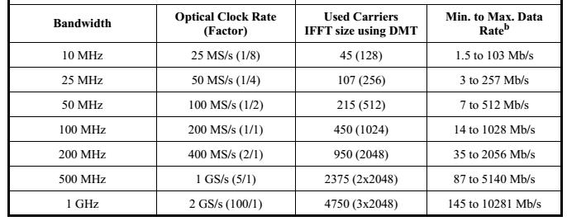
Clock rate

Slide 7
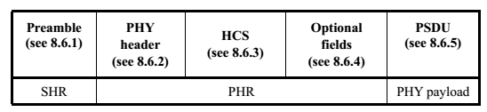
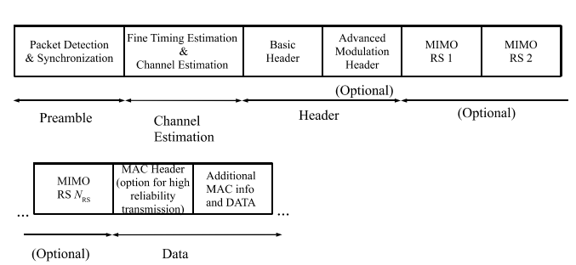
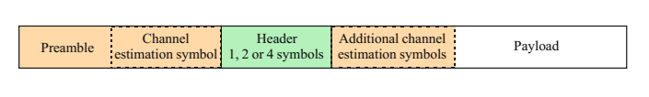
Current PPDU formats
PPDU of SC-PHY
PPDU of LB-OFDM-PHY
PPDU of HB-OFDM-PHY

Slide 8
Unifying PPDU formats for different PHYs
Unified PPDU format will
  greatly reduce the complexity on implementation
  Make the specification consistent and organized
Proposal2: the following unified PPDU format are proposed for all three PHYs. Advanced modulation header and MIMO channel estimation are classified as “optional fields”
Preamble
Channel estimation
PHY header
HCS
Optional fields
PSDU
SHR
PHR
PHY payload

Slide 9
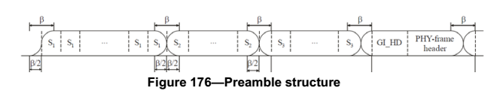
Use preamble/channel estimation to identify PHY type
A coordinator and a device may support multiple PHYs. A device/coordinator needs to know which PHY is used for a received packet.
For current drafts, the preambles of different PHYs are not with unified structure. So the device may need to blind detect the preamble three times to know which PHY is used. To simplify the implementation it is proposed that:
Proposal3: unified SHR (preamble and channel estimation) structure is used across all supported PHYs, with the same clock rate, same sequence structure. So that a device can identify which PHY is used for the packet from detecting the SHR. The details of the design are for further study
Preamble of LB-OFDM-PHY
Preamble of HB-OFDM-PHY

Slide 10
Proposals
Proposal1: in future drafts, simply refer these PHYs as, pulsed modulation PHY (PM-PHY), low bandwidth OFDM PHY (LB-PHY) and high bandwidth OFDM PHY (HB-PHY), respectively
Proposal2: the following unified PPDU format are proposed for all three PHYs. Advanced modulation header and MIMO channel estimation are classified as “optional fields”
Proposal3: unified SHR (preamble and channel estimation) structure is used across all supported PHYs, with the same clock rate, same sequence structure. So that a device can identify which PHY is used for the packet from detecting the SHR. The details of the design are for further study
Preamble
Channel estimation
PHY header
HCS
Optional fields
PSDU
SHR
PHR
PHY payload

Slide 11
Motion
TG15.13 moves that:
In future drafts, simply refer PHYs as, pulsed modulation PHY (PM-PHY), low bandwidth OFDM PHY (LB-PHY) and high bandwidth OFDM PHY (HB-PHY), respectively.
Moved by: John
Seconded by: Volker
Y/N/A: 3/0/0

Slide 12
Reference
Volker Jungnickel, Mohammad Noshad, Tae-Gyu Kang (ETRI), Sang-Kyu Lim, Jonas Hilt (HHI), “Text input into D1 concerning Pulsed Modulation PHY”, available at https://mentor.ieee.org/802.15/dcn/17/15-17-0454-05-0013-text-input-into-d1-concerning-pulsed-modulation-phy.docx
Nikola Serafimovski, “pureLiFi 802.15.7r1 proposal for High Speed PD OWC communications”, available at https://mentor.ieee.org/802.15/dcn/16/15-16-0004-00-007a-purelifi-phy-mac-proposal.pptx

Slide 13
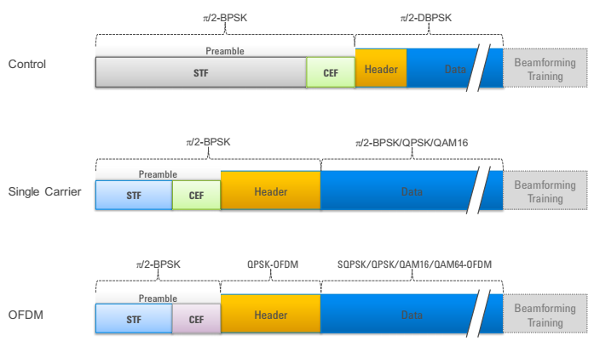
Annex: preamble design of 802.11ad
Three PHYs are defined for 802.11ad, i.e. control PHY, single carrier PHY and OFDM PHY. All of them share the same frame structure

Slide 14
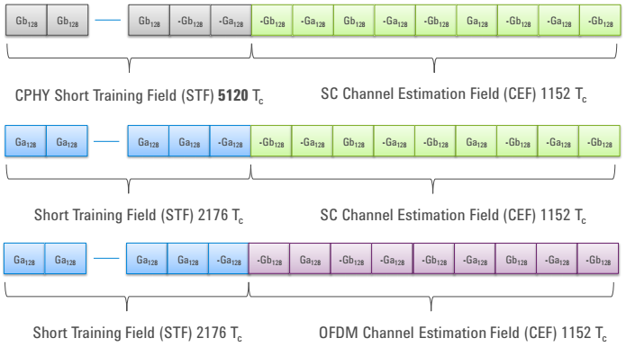
Annex: preamble design of 802.11ad
Preamble and channel estimation sequences are used to identify which PHY is used for a packet
Source: http://www.keysight.com/upload/cmc_upload/All/22May2014Webcast.pdf?&cc=DE&lc=ger

